Slide 2
Backing Up Workstations: How to Protect Yourself on the Cheap
When do we take a Full Computer Backup?
How do we do this?
How do we make this easy and consistent?
You want how many terabytes?

Slide 3
Why Do a Full Computer Backup?
You never know when a rebuild, replacement or upgrade can fail
Users tend to save files in locations other than in their user profile
Faculty/staff tend to be more comfortable in doing a rebuild or replacement of their computer if they know you have a full backup

Slide 4
Why Use the Disk2VHD program?
Captures full hard drive backup into one file (.vhdx)
Vhdx files can be mounted locally for easy retrieval
Only Copies Used Hard Drive Space
Can Be Automated via Script
Can be used in SCCM as an Application and Part of Task Sequences
NOTE: DOES NOT Work on BitLocker Enabled Drives

Slide 5
Backup Automation Scenarios
Three scenarios we use Disk2VHD scripts to backup devices:
Using an SCCM Device Collection
During an SCCM Rebuild Task Sequence
During an SCCM Upgrade Task Sequence

Slide 6
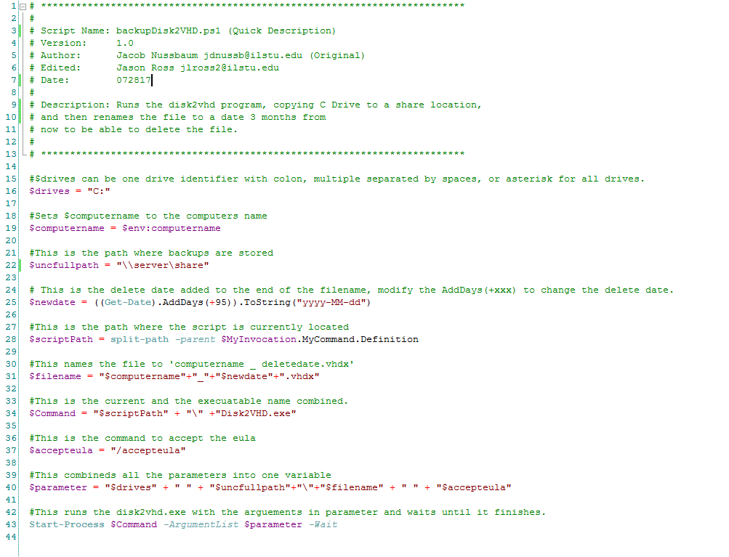
Disk2VHD Script
PowerShell.exe -NoProfile
-ExecutionPolicy Bypass -Command "& '%~dpn0.ps1'"

Slide 7
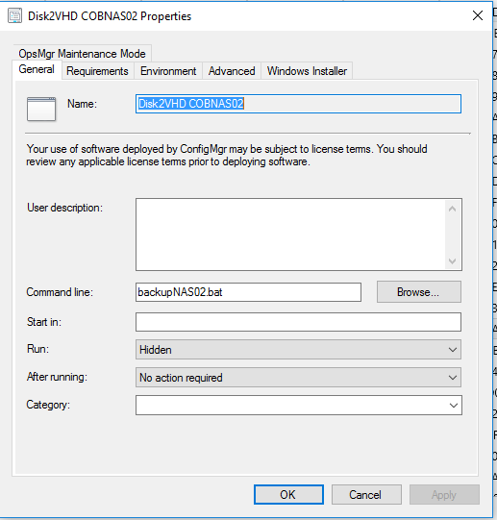
Disk2VHD SCCM Device Collection

Slide 8
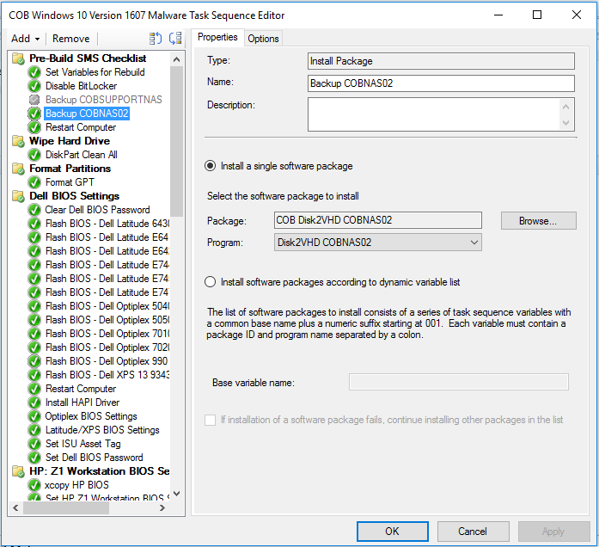
Disk2VHD SCCM Rebuild Task Sequence

Slide 9
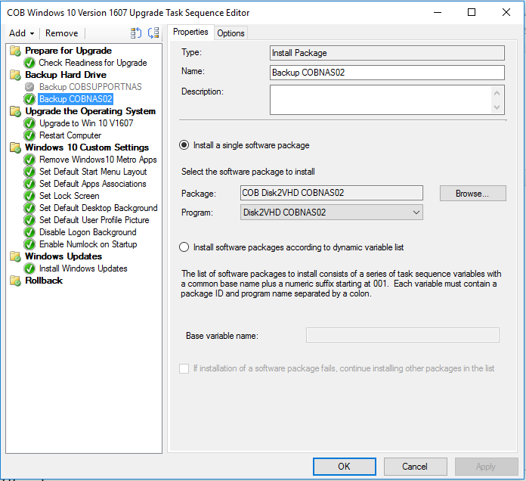
Disk2VHD SCCM Upgrade Task Sequence

Slide 10
You need how many Terabytes?

Slide 11
Storage Challenge
Very Large Files 50< GB per computer
Large aggregate requirement 16 TB
Rarely if ever accessed
Highly Transient, Kept for only 90 Days
Storage must be reliable but cost effective

Slide 12
Storage Considerations
Use USB Hard disks or High capacity flash drives
Simple, cheap, self contained, usefull for one off
Not redundant, not that useful for automation
Use a general purpose file server
Redundant drives, constant location, great for automation
Usually expensive, extra capacity used due to typical backups
Use dedicated NAS
Redundant drives, contestant location, great for automation
Cost effective, right size performance

Slide 13
What we use
QNAP NAS
Well reviewed
Hot swappable drives
Adequate performance
Drives are server grade
5400 RPM 6 TB
Cost effective and adequate performance
RAID
Protects against single drive failure
24 TB Usable Capacity

Slide 14
Q&A
Any Questions?

