Slide 2
Modernize Your Operations
Gain efficiency by automating with Ansible

Slide 3
Brief touch on DevOps and its benefits
Introduction of Ansible
Components of an Ansible Playbook
Other tools involved (git, rundeck/tower)
The process revolving around a team
Demo’s

Slide 4
DevOps? What is it?
Ben Rockwood states in his “Bottoms Up!” talk, DevOps is a “World View” involving the following 3 major components
Collaboration of People
Convergence of Process
Creation/Exploitation of Tools

Slide 5
Benefits of DevOps
Reduces “Tribal Knowledge”
Consistency
Repeatability
Speed
Reclaim your time and focus
Empowering non-IT staff

Slide 6
Misconceptions of DevOps
Not fit for IT Education
Only for start ups or private sector
Only needed for mass scale of single apps
Not needed if you only need to do something once

Slide 7
Tools?
Ansible
Git (ISU’s gitlab @ code.at.illinoisstate.edu)
Rundeck (possibly Ansible tower in the future)
SSH (for passwordless authentication)

Slide 8
Ansible Introduction
Agentless Config Management over SSH
Python based (but you don’t need to know it)
YAML syntax for just about everything
Designed to be very simple
Idempotence

Slide 9
Ansible Playbook Components
Inventories (static or dynamic host groups)
Variables (different values for different envs)
Vault (a mechanism for encrypting secrets)
Tasks (pre tasks, tasks, and post tasks)
Roles (grouping of reusable tasks)
Handlers (provides orchestration of events)

Slide 10
Ansible Playbook: Directory Structure
group_vars
all
vars.yml
vault.yml
dev_webservers
vars.yml
vault.yml
prod_webservers
vars.yml
vault.yml
roles
tasks
main.yml
files
templates
handlers
site.yml
dev_inventory
prod_inventory
ansible.cfg

Slide 11
Ansible Playbook: Inventories
Inventories contain the systems that are managed: They are Static or Dynamic
[dev_webservers]
atweb01a-d.at.illinoisstate.edu
atweb01b-d.at.illinoisstate.edu
atweb01c-d.at.illinoisstate.edu

Slide 12
Ansible Playbook: Variables
Separate the config from the build
Make playbooks and roles reusable for different systems and environments
Can also set variables in real time using the “set_fact” module within a task
Link to docs on variables

Slide 13
Ansible Playbook: Vault
Encrypts sensitive artifacts with AES 256 encryption as the default (shared-secret)
Safe to store in private GIT repositories
Managed with the ansible-vault cmd
- Mostly used for variables within vault.yml

Slide 14
Ansible Playbook: Tasks
Tasks do the work via ansible modules
Can be conditional
There are many modules that are delivered with ansible to perform just about any operational task.
Link to Ansible’s Module Index

Slide 15
Ansible Playbook: Roles
A grouping of tasks that is separate from the main playbook
Reusable across playbooks, systems, and environments
Ansible-Galaxy is a mechanism where users can share roles with the community

Slide 16
Ansible Playbook: Handlers
Basic event system that allows for responding to change
Most common usage involves restarting a service after a config file changes
Link to handler docs

Slide 17
Ansible for Windows
Combined with WinRM and Powershell
Agentless design is maintained
List of ansible modules for windows
Documentation for Ansible on Windows

Slide 18
GIT
Responsible for version control and tracking all system changes
Due to the distributed design of git, always be sure to keep local repos on your workstation in sync with the remote repos stored in gitlab

Slide 19
Rundeck
Web Based Interface to Execute Ansible Playbooks
Role Based Access Control (via ldap groups) for different deployments
Gives people a “button” to push
Tracks execution and deployment history and results

Slide 20
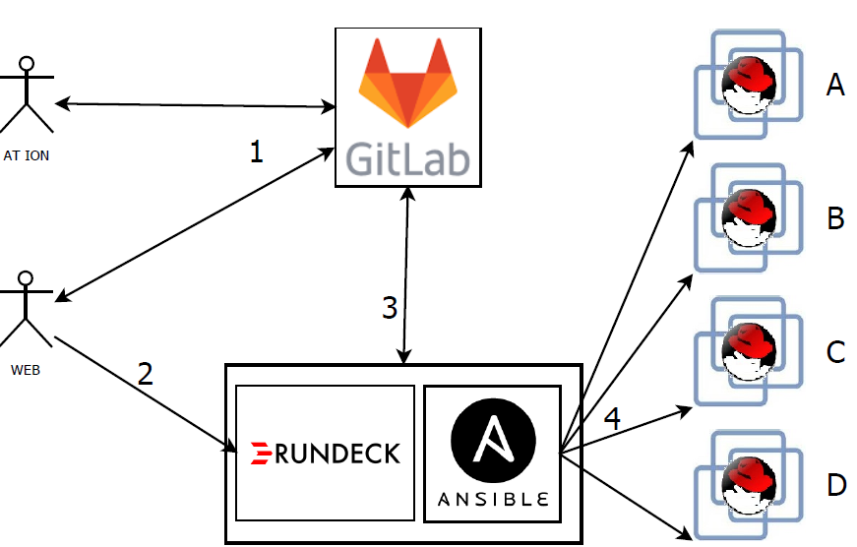
The Process

Slide 21
Demos
Red Hat 7 OS provisioning
Our new automated Central Web Infrastructure
Central Login Skin deployment
A few other operational handoffs

Slide 22
Questions

