Slide 1
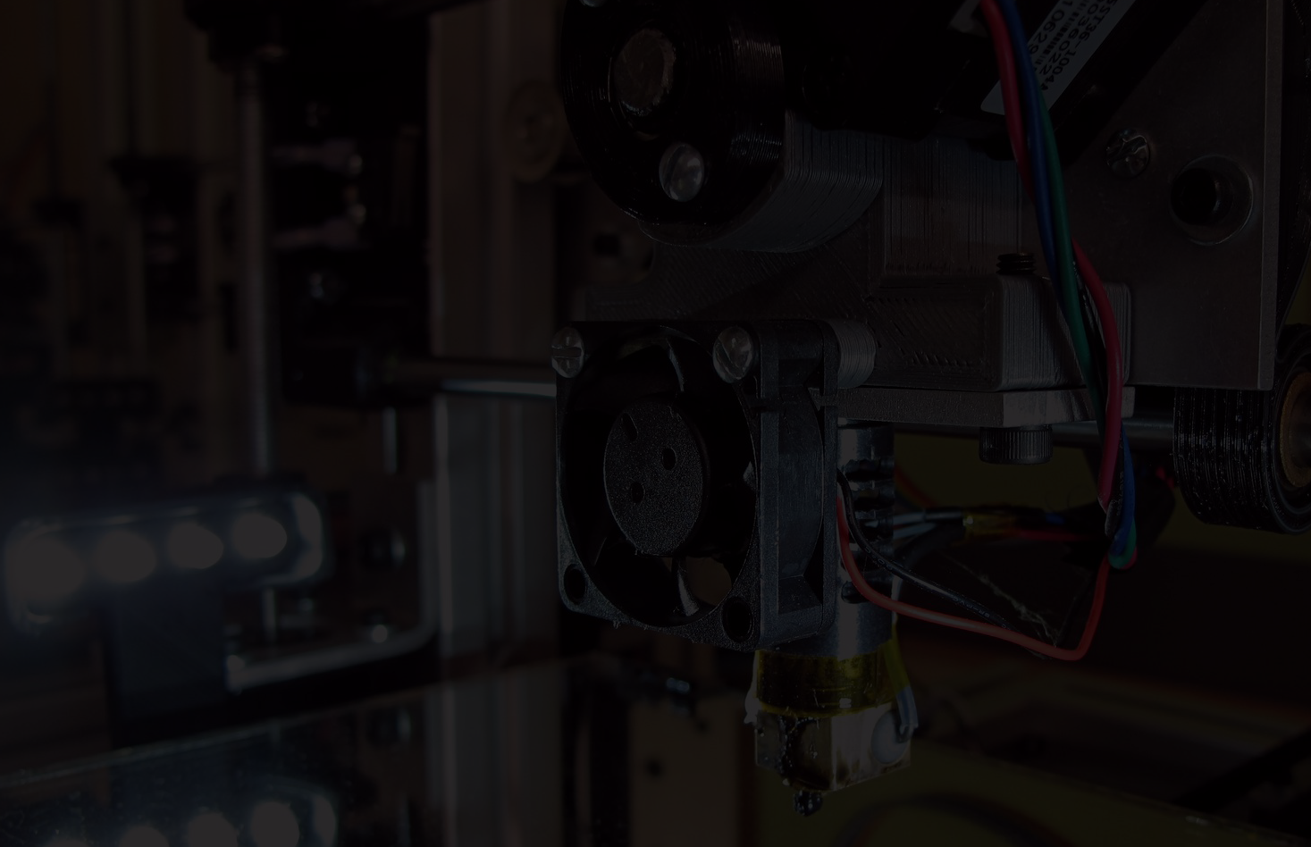
3D Printing Support
Local & Shared Elements
GW

Slide 2
3D printing lab examples: College of business

Slide 3
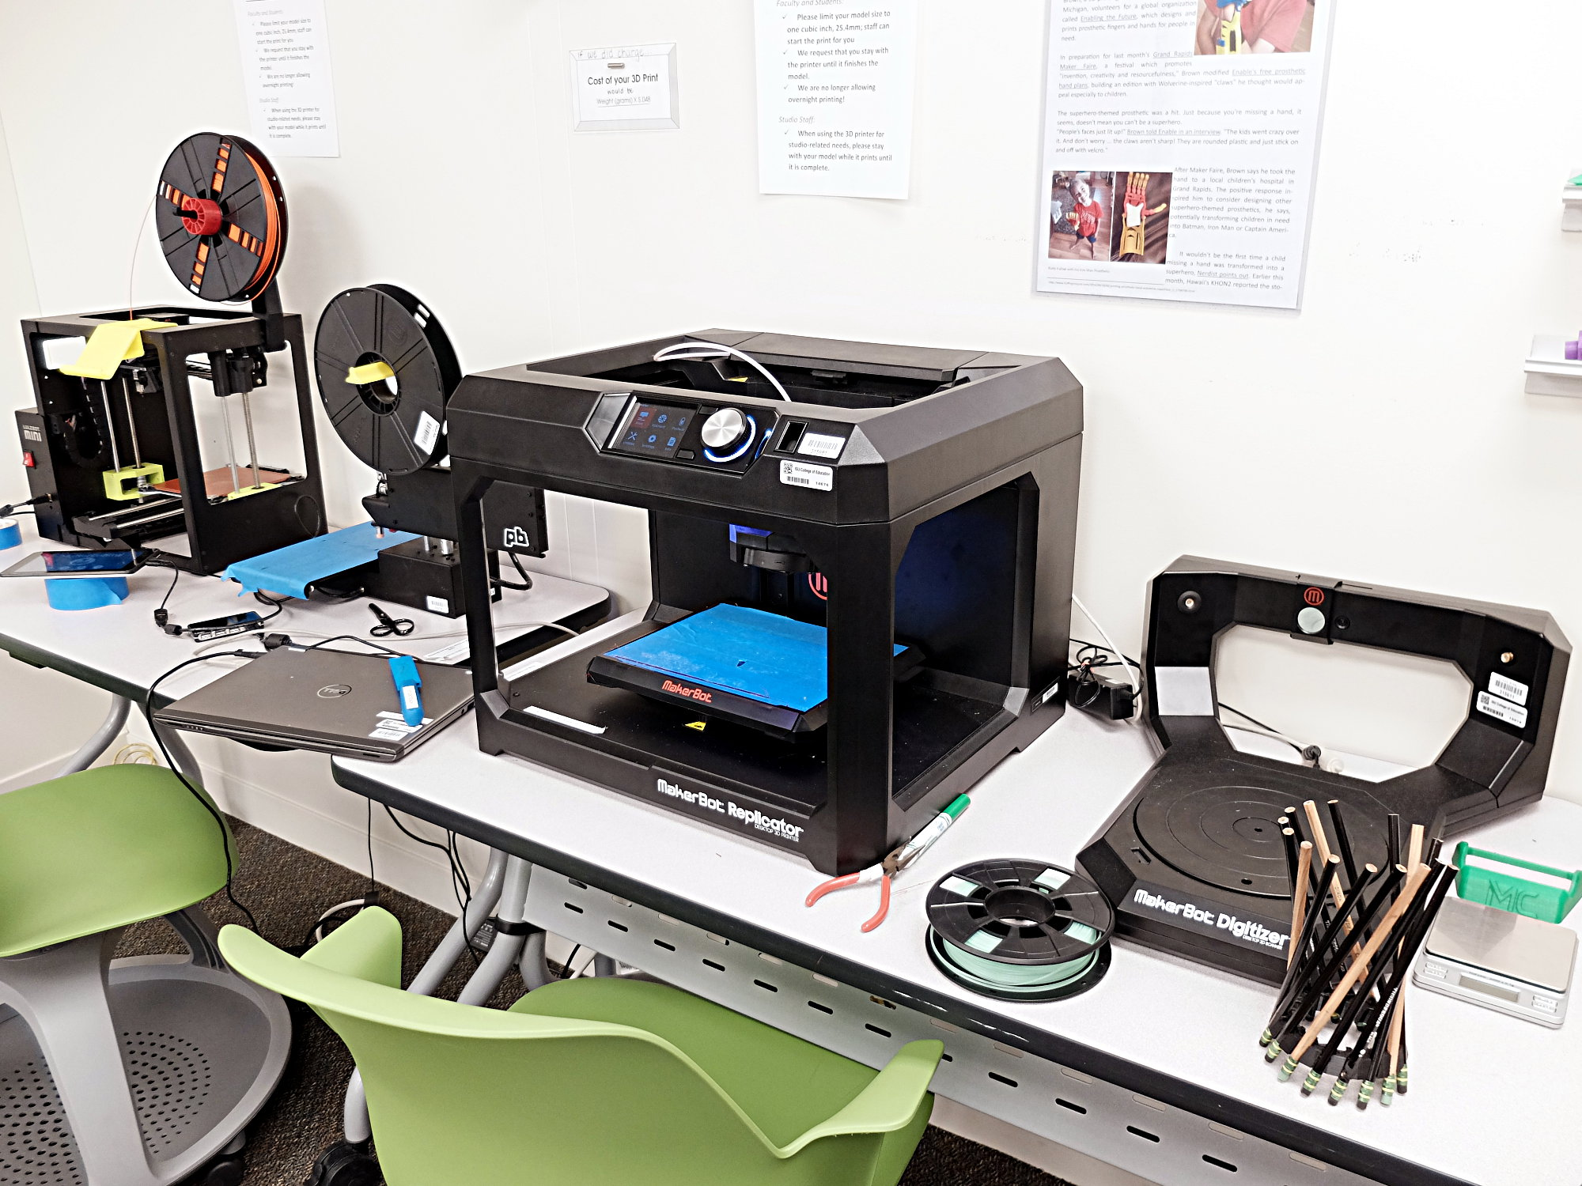
3D Printing lab examples: college of education

Slide 4
Mission for 3d printing program aligns with mission of college supporting it, affects all decisions that follow
Business college studies industrial disruption and roi, focus on demystification and industry concepts
Fine Arts enables creation of prototypes and artwork
Industrial Technology explores the technology itself
Libraries visualize public maker spaces
...and so on
GW

Slide 5
Simple explanation of 3d printer
Object is to demystify, make accessible
Imagine inkjet printer depositing ink on x-y axes
Then add 1 more axis, Z, straight up, and use solid material instead of ink
BAM! 3D printer.
GW

Slide 6
But all colleges support some common elements
Shared experience saves time and money
Ideas germinate across colleges
Actual support documents can be available to everyone
GW

Slide 7
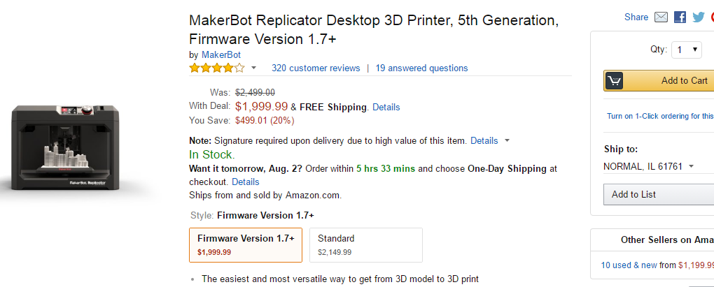
MAKING PURCHASE DECISIONS
AF

Slide 8
PURCHASING decisions
Which 3D Printer is Right for you?​
​
There is a wide range of pricing options on 3D Printers.​
​
Lulzbot Mini – $1250.00​
PrintrBot Metal– $599.00​
Flashforge Creator – $1059.00 ​
Monoprice – $649.99​
​MP Select Mini 3D Printer – $199.00(!!!)
Sources: https://www.3dhubs.com/best-3d-printer-guide#plugnplay​
http://www.monoprice.com/product?p_id=11614​
AF

Slide 9
Purchasing Decisions
Although important, price is not the only thing that should be considered when buying a 3D printer.
Other Questions To Ask
What do you need?
What do you hope to accomplish with your 3D printers?
What kind of lab/workspace are you trying to create?
AF

Slide 10
Purchasing Decisions: What do you need?
Consider the projects that you want visitors to the space to be able to do
The most common printing material is extruded plastic.
However, there are also plastic blends, wood, nylon, and even metal – based materials available to print with.
Do you want to just introduce people to the device? Or, do you want to give them lots of options to create with?
Do you want an established model or "bleeding edge" technology?
Source: http://3dprintingindustry.com/3d-printing-basics-free-beginners-guide/materials/
AF

Slide 11
Purchasing Decisions: What do you hope the printer will do?
Some questions to ask:
Do you want to print large models? Small models? Both?
Do you want to be able to perform DIY support work or customize parts? Or do you want everything "locked down?"
Is the printer going to be used heavily? Or just every once in a while?
AF

Slide 12
Purchasing Decisions: What Kind of Space do you want to create?
Some questions to ask:
Do you want a space where people can just come in and work?
Is this a "hands-on" kind of space? Or is this a place where people can get a high-level view of what 3D printing is all about?
AF

Slide 13
Hardware and Software
AF

Slide 14
Hardware
There are six different types of 3D printer hardware:
Stereolithography(SLA): Uses liquid resin to create prints
Digital Light Processing(DLP): Uses liquid resin to create prints
Fused deposition modeling (FDM): Lays down materials in layers, one of the most common types in consumer machines
Selective Laser Sintering (SLS): Uses lasers to fuse materials together. Often used with metal media.
Selective laser melting (SLM): Uses lasers to fuse metal powders together into objects.
Electronic Beam Melting (EBM): Metal powder or wire is welded together using an electron beam. beam as the heat source
Sources:
https://www.additively.com/en/learn-about/electron-beam-melting
https://www.additively.com/en/learn-about/fused-deposition-modeling
https://www.additively.com/en/learn-about/laser-sintering
https://www.additively.com/en/learn-about/laser-melting
https://www.additively.com/en/learn-about/stereolithography
http://3dprintingindustry.com/3d-printing-basics-free-beginners-guide/processes/
AF

Slide 15
Hardware – Advantages and disadvantages
Stereolithography: Creates accurate parts with good finish, but can involve lots of post-production work
Digital Light Processing: Same as stereolithography, except with the added benefit that less resin is needed.
Fused Deposition Modeling: Reliable process by and large, but can have problems with layer adhesion and overall model accuracy. Most recognizable process.
Laser Sintering/Laser Melting: Produces stronger models than stereolithography and digital light processing, but with lower accuracy.
Electronic Beam Manufacturing: Extremely high quality, but expensive, process
Source: http://3dprintingindustry.com/3d-printing-basics-free-beginners-guide/processes/
AF

Slide 16
Software
There are two different types of 3D printing software: Proprietary and Open Source
Proprietary software is created by the manufacturer and is designed to run only on the printers it was made for. It is not designed to be modified by its users.
Open Source Software can be created by an individual or a team of people. Its code is publicly available, and can be modified by others so long as credit is given to the original creators.
AF

Slide 17
Software - Types
There are a number of diffferent kinds of software that are used in 3D printing:
Modeling – The software used to create a 3D model
Slicing – The software that creates the layers that make up the object
Printing – Translates the information(layers) from the slicing software into the finished object
Examples of Modeling Software: Trimble Sketchup, Tinkercad, Autodesk(all proprietary)
Examples of Slicing Software: Slic3r, Skienforge(both open source)
Examples of Printing Software: Printhost, Repetier-Host(both open-source)
Source: http://www.meccanismocomplesso.org/en/software-per-la-stampa-3d-quale-scegliere/
AF

Slide 18
SETTING ASIDE SUPPORT TIME
3D printers are devices that require lots of TLC. Parts may fail, filament may jam, and prints may not work. Regular maintenance is needed in order to keep them in working order.
How can we do this?
AF

Slide 19
Setting Aside Support time
Train student staff
Look for interested individuals and ask them to take a hand in the support
Weekly checks on the machines
Creating a "maintenance routine"
...And more!
AF

Slide 20
OPERATIONAL DECISIONS
Safety & Practicality
Keeping machines running
Keeping the experience educational for students!
GW

Slide 21
Materials
Partly a standardization decision – how many materials do you want to support?
Partly a safety decision – VOC aerosols, read materials safety sheets
Lowest VOC currently PLA
Partly a product decision – Prototypes or finished products? Art objects or working models?
GW

Slide 22
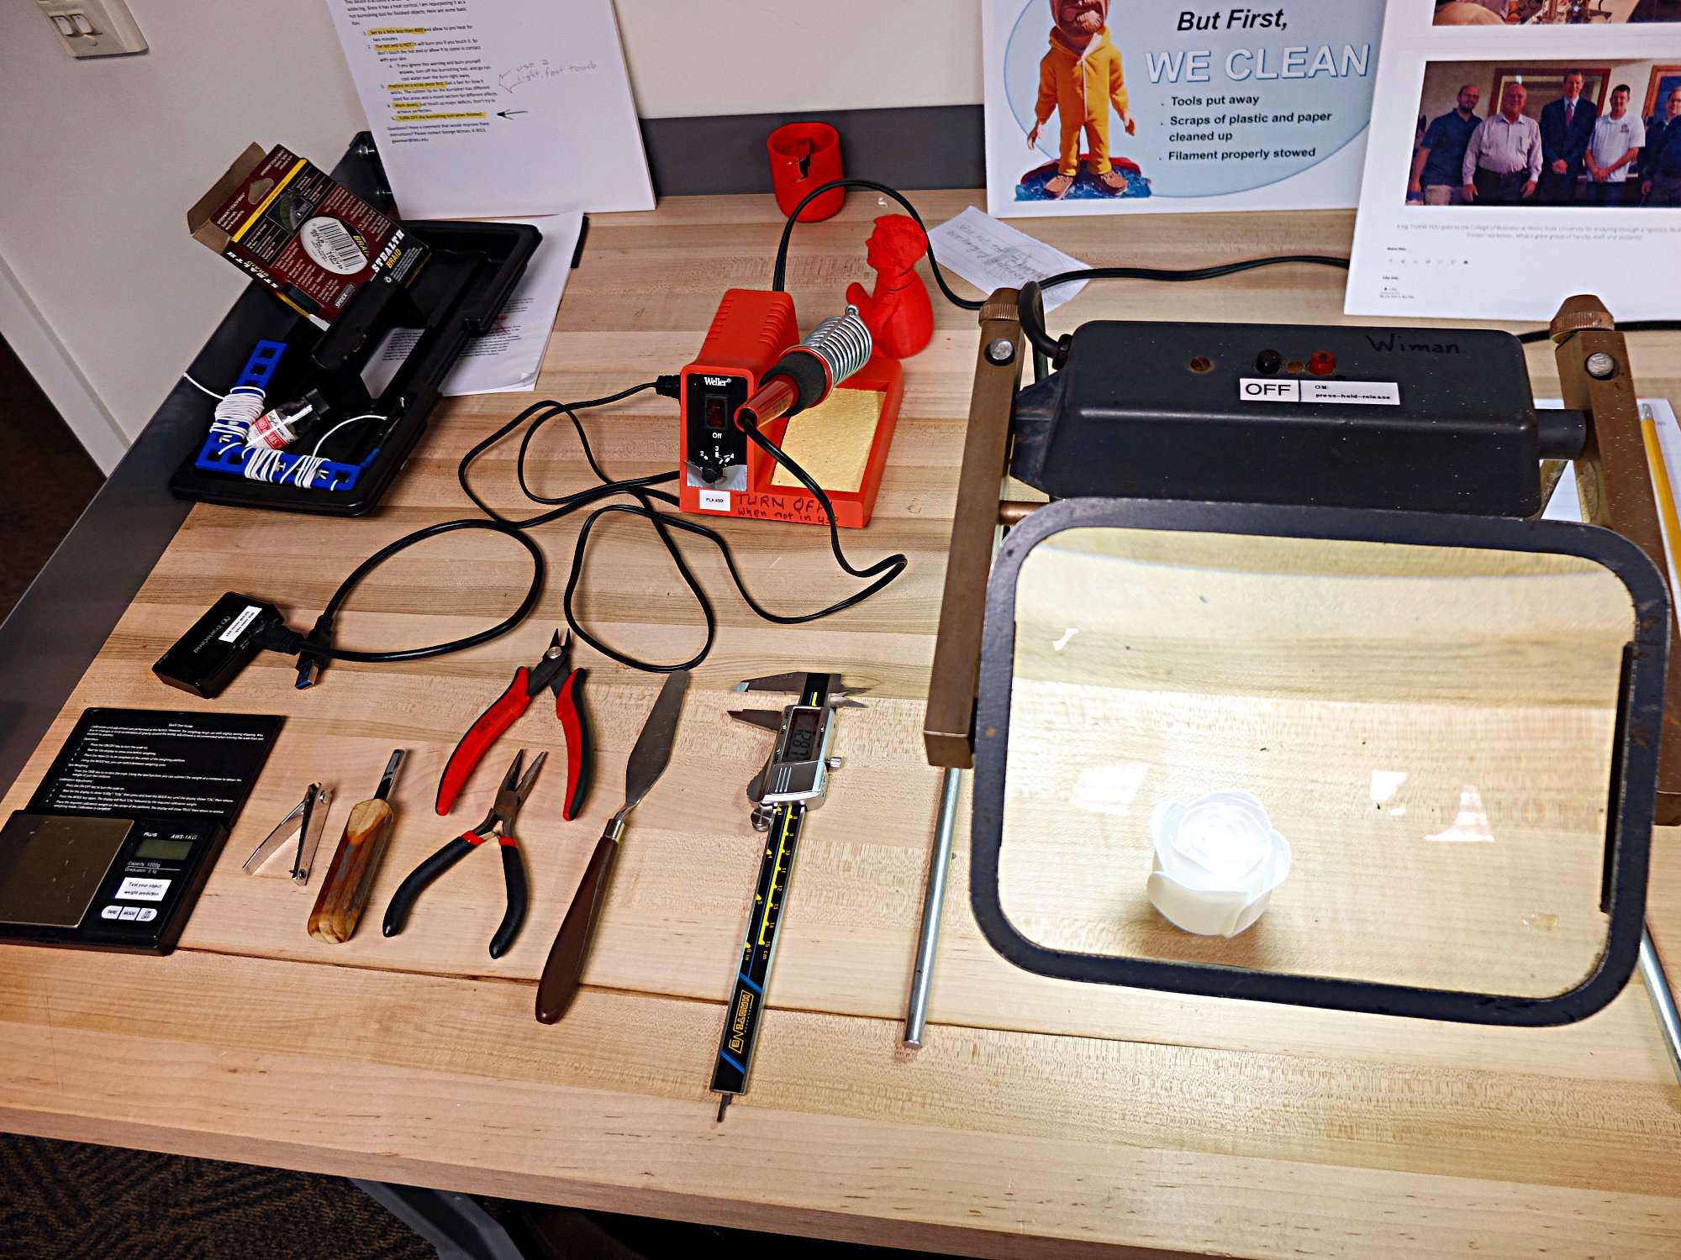
Tools and materials
Tools for use by support personnel (Keep locked up)
Tools for use by students (In our model, not for machine maintenance, but Measuring and finishing tools)
GW

Slide 23
Division of tool availability
What tools available to students
What tools locked up

Slide 24
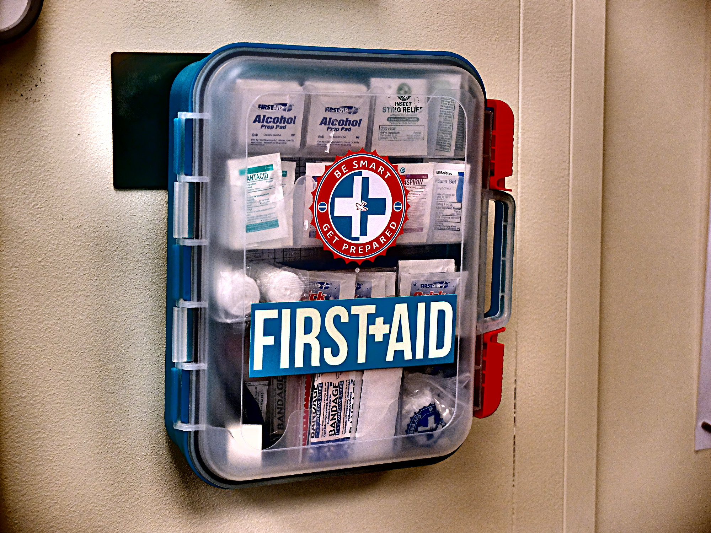
First aid and safety equipment
EYE PROTECTION
Safety gloves for use with chisel
Band-aids, because other than chisel usage serious injury unlikely
More advanced first-aid for use by support personnel
Fire extinguisher
Thermal link wiring
GW

Slide 25
Safety training
Eye protection
Minor burns
Removing supports without lacerations Glove on holding hand
Fans
GW

Slide 26
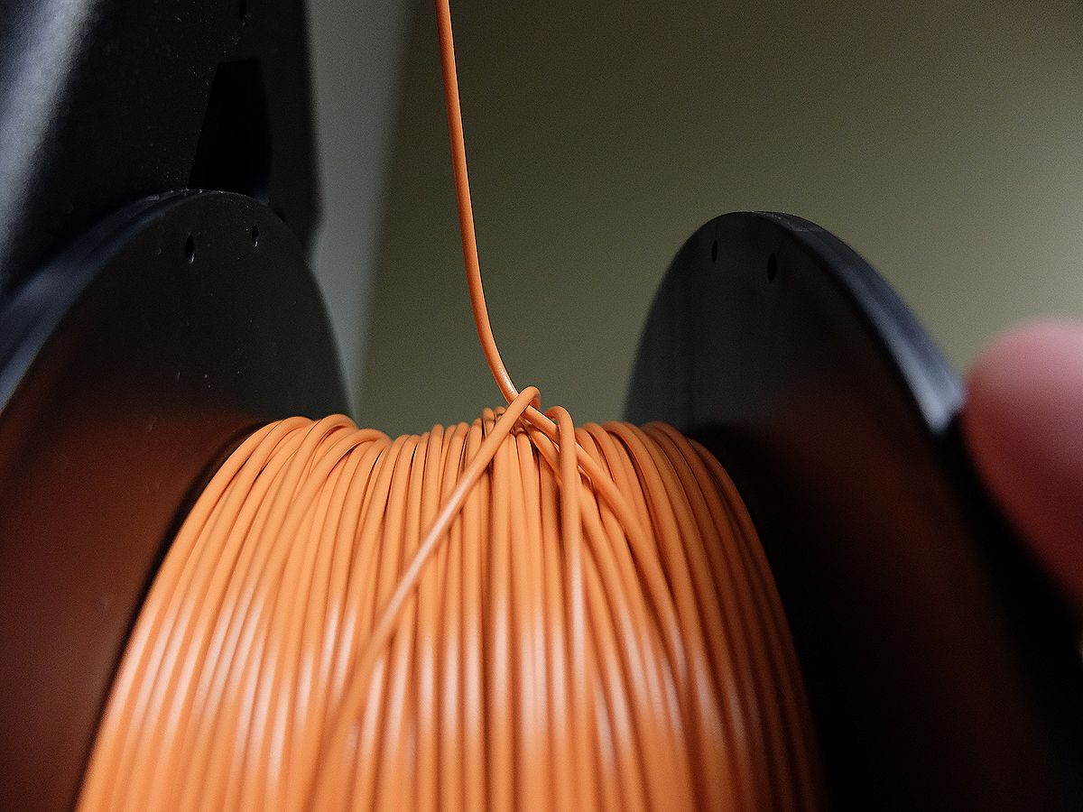
Routine servicing
Who changes filament
Who levels bed
Who repairs
GW

Slide 27
workflow
U of I workflow = students bring in gcode files, pick up prints
COE Workflow = Students can create or download their own files, then print the items with guidance from student staff. Students are responsible for monitoring their print and picking it up when done.
COB workflow = students slice and print their own stl files, same as COE workflow. Students pair their prints with form beginning at print stage.
Student expectations
GW

Slide 28
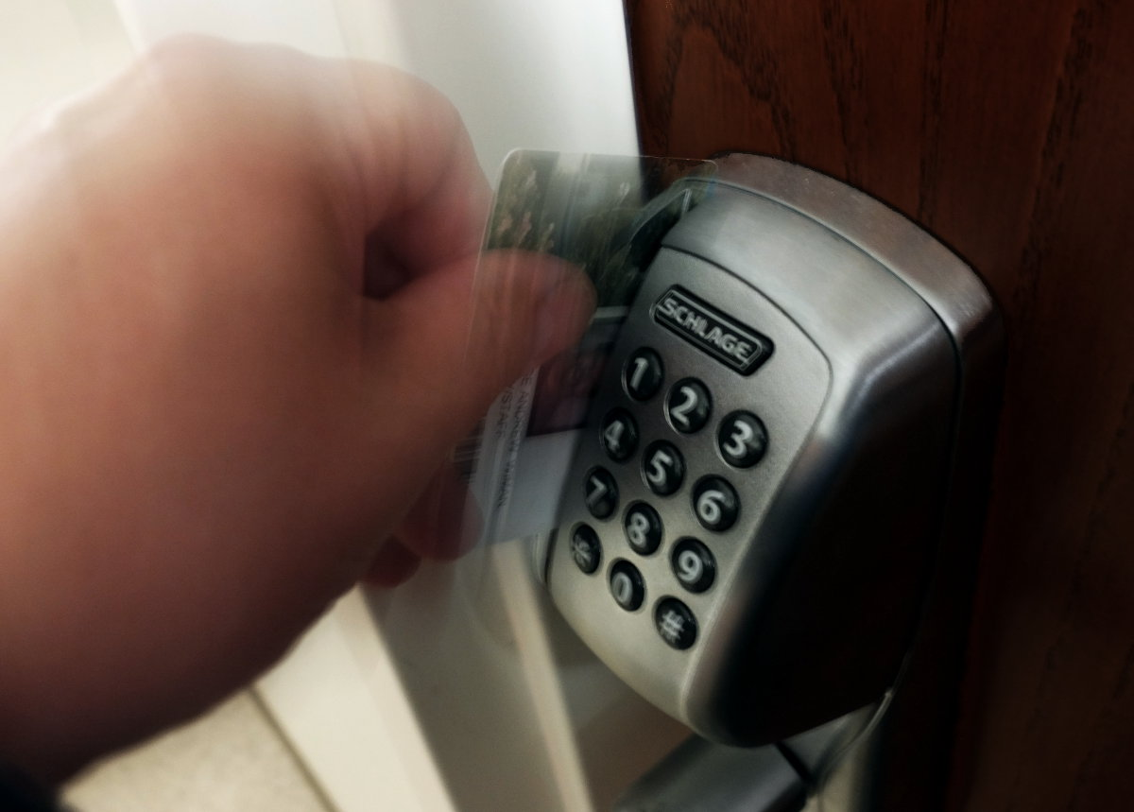
Lab access
Door
Student liaison
Hours
GW

Slide 29
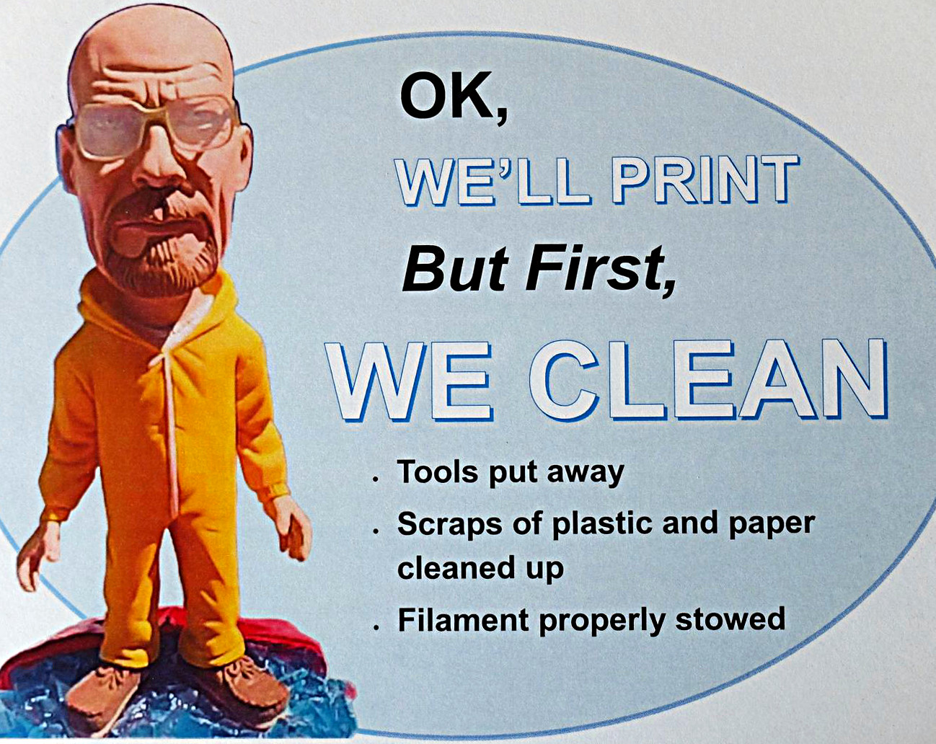
Student expectations
Cleaning
Safe use
Hands off the hands-off stuff when in lab
GW

Slide 30
Collecting, providing, and training a body of knowledge for support personnel and users
In-lab documents, online videos
In-lab Whiteboard
Blog
Slack
Meeting students and student liaisons
GW

Slide 31
COMMUNICATING WITH users and OTHER SUPPORT UNITS
Cherwell kb
Slack
Facebook group
Blogs
Videos
Handouts
Lab time
Not email so much
GW

Slide 32
Support blog
GW

Slide 33
Cherwell & Reggienet
Reggienet PERFECT if lab is for a single class
Cherwell Still developing
interface a work in progress
requires login
Does it lend itself to pedagogy?
Not a discussion platform
GW

Slide 34
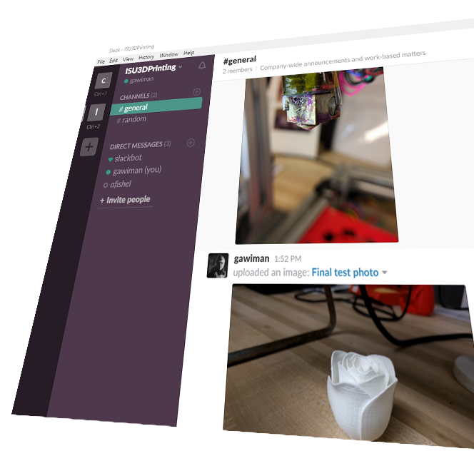
Slack: isu3dprinting
Why slack
For support staff & student liaison
Fill out email for invitation
Others can join, just email us
GW

Slide 35
Facebook Group
GW

Slide 36
Support objects
Printed objects mounted on cards with explanatory text
GW

Slide 37
CONCLUSION + Q&A
Alex & George
AF
GW

