Slide 1
#ISUCIT

Slide 2
ScreenConnect
Remote Access Tool for Support and Collaboration
Richie Szaflarski
#ISUCIT

Slide 3
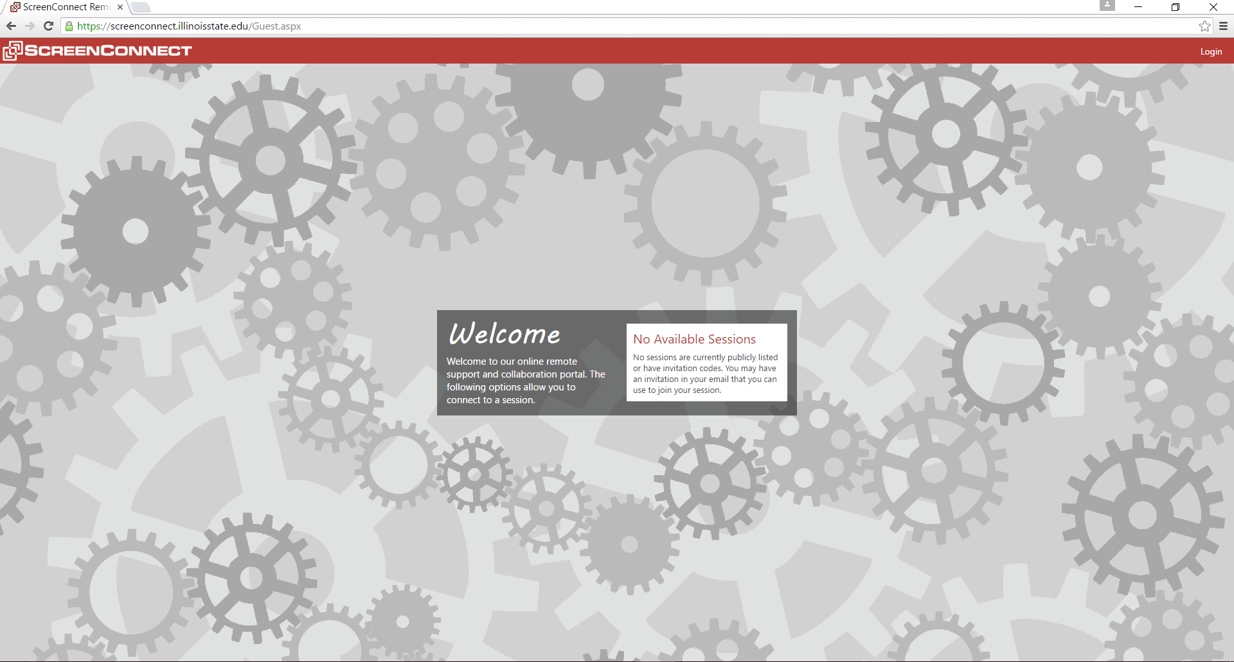
General Information
Hosted onsite – https://screenconnect.ilstu.edu
Works on-campus or off-campus
Uses Active Directory authentication
Alternative to Teamviewer or LogMeIn
Licensing based on concurrent sessions
#ISUCIT

Slide 4
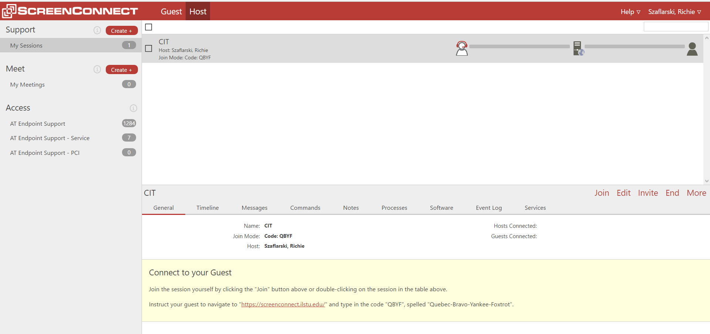
Remote Support
Remote connection between a host and a guest
Host creates session and instructs guest how to connect
No prior software install required
Most useful for one-time sessions
#ISUCIT

Slide 5
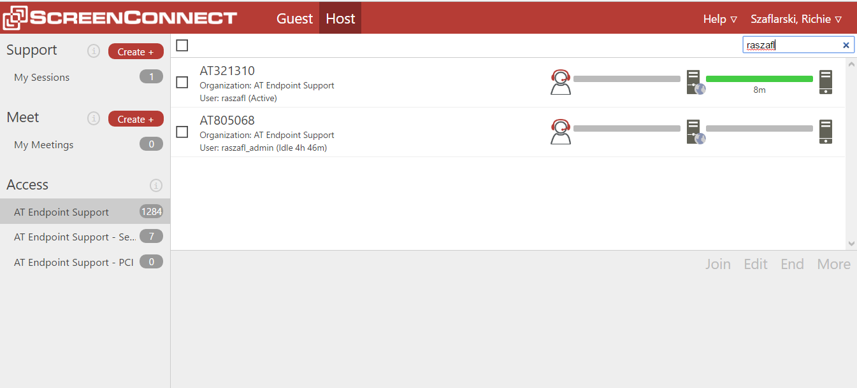
Remote Access
Remote connection between a host and a client
Host can initiate remote session without a customer present
Requires ScreenConnect client installed before hand
Most useful for frequent remote sessions
#ISUCIT

Slide 6
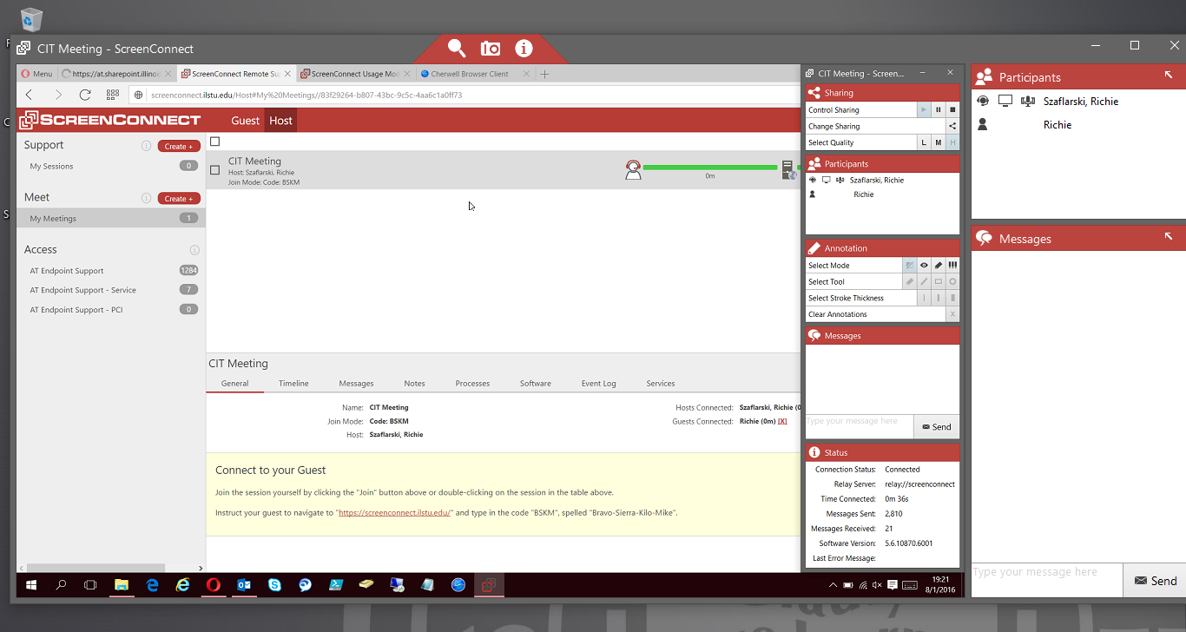
Remote Meetings
Remote connection between a host and multiple guests
Presenter creates meeting session and instructs guests how to connect
Host and guests can share a single application or entire Desktop
Features a chat and conference-call environment
#ISUCIT

Slide 7
#ISUCIT

