Slide 1
#ISUCIT

Slide 2
#ISUCIT

Slide 3
Project Management
……..all around………
Dean Plumadore, MS, PMP, ITIL
#ISUCIT

Slide 4
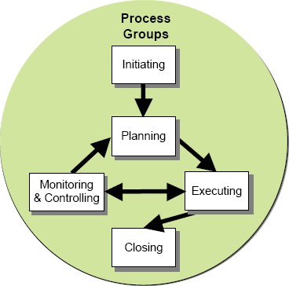
We all manage projects; we don't need to be a project manager (PM) to do that. Let's talk about how we can better manage those things we all call "projects.” You know, those little efforts that happen frequently enough you wish you could "remember what you did last time.” What can the project management discipline teach us to incorporate into those small projects we do every day. We'll talk about planning, budget–time–scope relationships, risks and "Plan B," and lessons learned. You can share ideas you may have to make these efforts easier and more predictable. Bring a project you are working on, and we'll see if these tips can help.
#ISUCIT

Slide 5
Let’s talk about this stuff
PMBoK, PRINCE2, and Project Management
Small Projects and Common Sense
Templates
Project Lessons Learned
Project List
Q&A
#ISUCIT

Slide 6
But, most of us have small projects that “magically” get done.
A “ big project” that has lots of moving parts and lots of activities……
Magic
Happens
Here
#ISUCIT

Slide 7
What is a Project?
Dictionary: An individual or collaborative enterprise that is carefully planned and designed to achieve a particular aim.
PMI: A project is a temporary endeavor that has a defined beginning and end in time with defined scope and resources. It is unique in that it is not a routine operation, but a specific set of operations designed to accomplish a singular goal.
Common definition “The disciplined, structured, and organized application of common sense to manage a temporary effort”.
“Just follow the recipe” is not a project.
#ISUCIT

Slide 8
Triple Constraint +1 or the PM Tetrahedron
Balancing the effort to do a project, the cost of the materials, and the “stuff” the customer wants….all while maintaining a high level of quality.
#ISUCIT

Slide 9
Yes, but… what about the stuff I do?
What do we do differently?
-- OR --
Do we “just know”?
-- AND --
What do we leave behind?
-- for ourselves, others, ourselves?
#ISUCIT

Slide 10
Small Project “template”
Scope/Objective – what are we doing and maybe why in a few paragraphs
Needs – in a numbered list in basic priority
Assumptions – in a numbered list
Risks – in a numbered list in basic priority
Team – Who and what are they doing
Timeline – this is really what its all about, who’s doing what and when will it be done.
Acceptance – knowing when it’s done.
Lessons Learned - What can we improve for next time?
#ISUCIT

Slide 11
Scope for Thing
The purpose of this project is to create and deploy a thing. The project is complete when the thing does something, but not everything, and has passed the tests that prove the thing does something we wanted it to.
#ISUCIT

Slide 12
Needs – in a numbered list
Sample from a Security Camera Project:
Cameras to be a minimum of 3 megapixels in resolution and vandal resistant rated and outdoor rated as appropriate.
NVR Server space to record video for 30 days. Axis Design Tool indicates a minimum of 5 Tb for disk storage.
vLAN for 172. address assignments of cameras.
vLAN must be routable, as video will be stored on a NVR server in Julian data center or somewhere else on campus. vLAN 496 should be used.
List of staff computers for video viewing client installation:
ISU PD views live and recorded video from cameras.
ISU, SAIT, will send IP addresses to installation contractor prior to installation.
#ISUCIT

Slide 13
Assumptions in a numbered list
Sample assumptions from a security camera project:
This effort is an extension of the new video recording infrastructure on campus.
NVR Server software is site licensed and no cost to this project.
Client software is site licensed and no cost to this project.
Each camera will require a software license.
Contractor/installer is needed for camera installations.
Contractor/installer will install data wiring as a provision of the grant.
IP Cameras will use PoE.
Other departmental users of the system will not view live or recorded video from these cameras.
ISU Presidential approval is needed as there are currently no cameras at these locations.
Video data will not be backed up. Server will include data redundancy technology to minimize risk of data loss.
Existing Server and storage will be used for 35 days of video.
#ISUCIT

Slide 14
Risks - in a numbered list
Sample risks from a security camera project:
Presidential approval of camera locations.
Building schedules will affect installation schedule.
ISU Surveillance Policy 1.1.7 requirements.
http://policy.illinoisstate.edu/conduct/1-1-7.shtml
Server needs to be replaced every five to six years.
Cameras will need to be replaced every four to six years.
Video data is backed up for 5 days and used for restoration of the server in the event of catastrophic failure.
Asbestos review.
#ISUCIT

Slide 15
Team Members and Timelines
Team Members:
Project Sponsor – Who’s paying the bills
SME & SPOC – Who’s the “one”
SME – Who else knows a lot
Project Manager – Is this you?
Technical SME – Other technical SMEs
Others:
Data Wiring – ????
Contractor/Installer – ?????
ISU Facilities Planning – ?????
ISU Facilities – ?????
Timeline with Deliverables and Responsible Party:
Overall Project Target Date: June 30, 2017
Due Date | Party | Deliverable
12/15 | Project Team | Project Discussion for scope, budget, etc.
1/20 | Dean | Contractor site visit and quote.
3/17 | Dean, Telecom | Site visit with ISU Telecom.
4/1 | Project Team | Site visit for scope verification
4/15 | PM | Project Plan to Customer.
5/1 | Sponsor | Project Approval with funding.
5/14 | Project Team | Project kick-off.
#ISUCIT

Slide 16
Acceptance, Sign-off, Verification, Approval, etc…..
A Project has an End
How do we know we’re done?
Why do this and write it down?
Is the project work done?
Did we deliver what was specified in objective and needs?
#ISUCIT

Slide 17
Project Lessons Learned
What did you learn to make the next project better?
How do you document those items?
Example with Security Camera Plans.
Progressively more complex plans
Why?
#ISUCIT

Slide 18
Who’s got a project?
Scope/Objective
Needs
Assumptions
Risks
Team
Timeline
Acceptance
Lessons Learned
Have you started?
Do you know when it’s done?
Have you done anything similar?
Does the team know when it’s done?
#ISUCIT

Slide 19
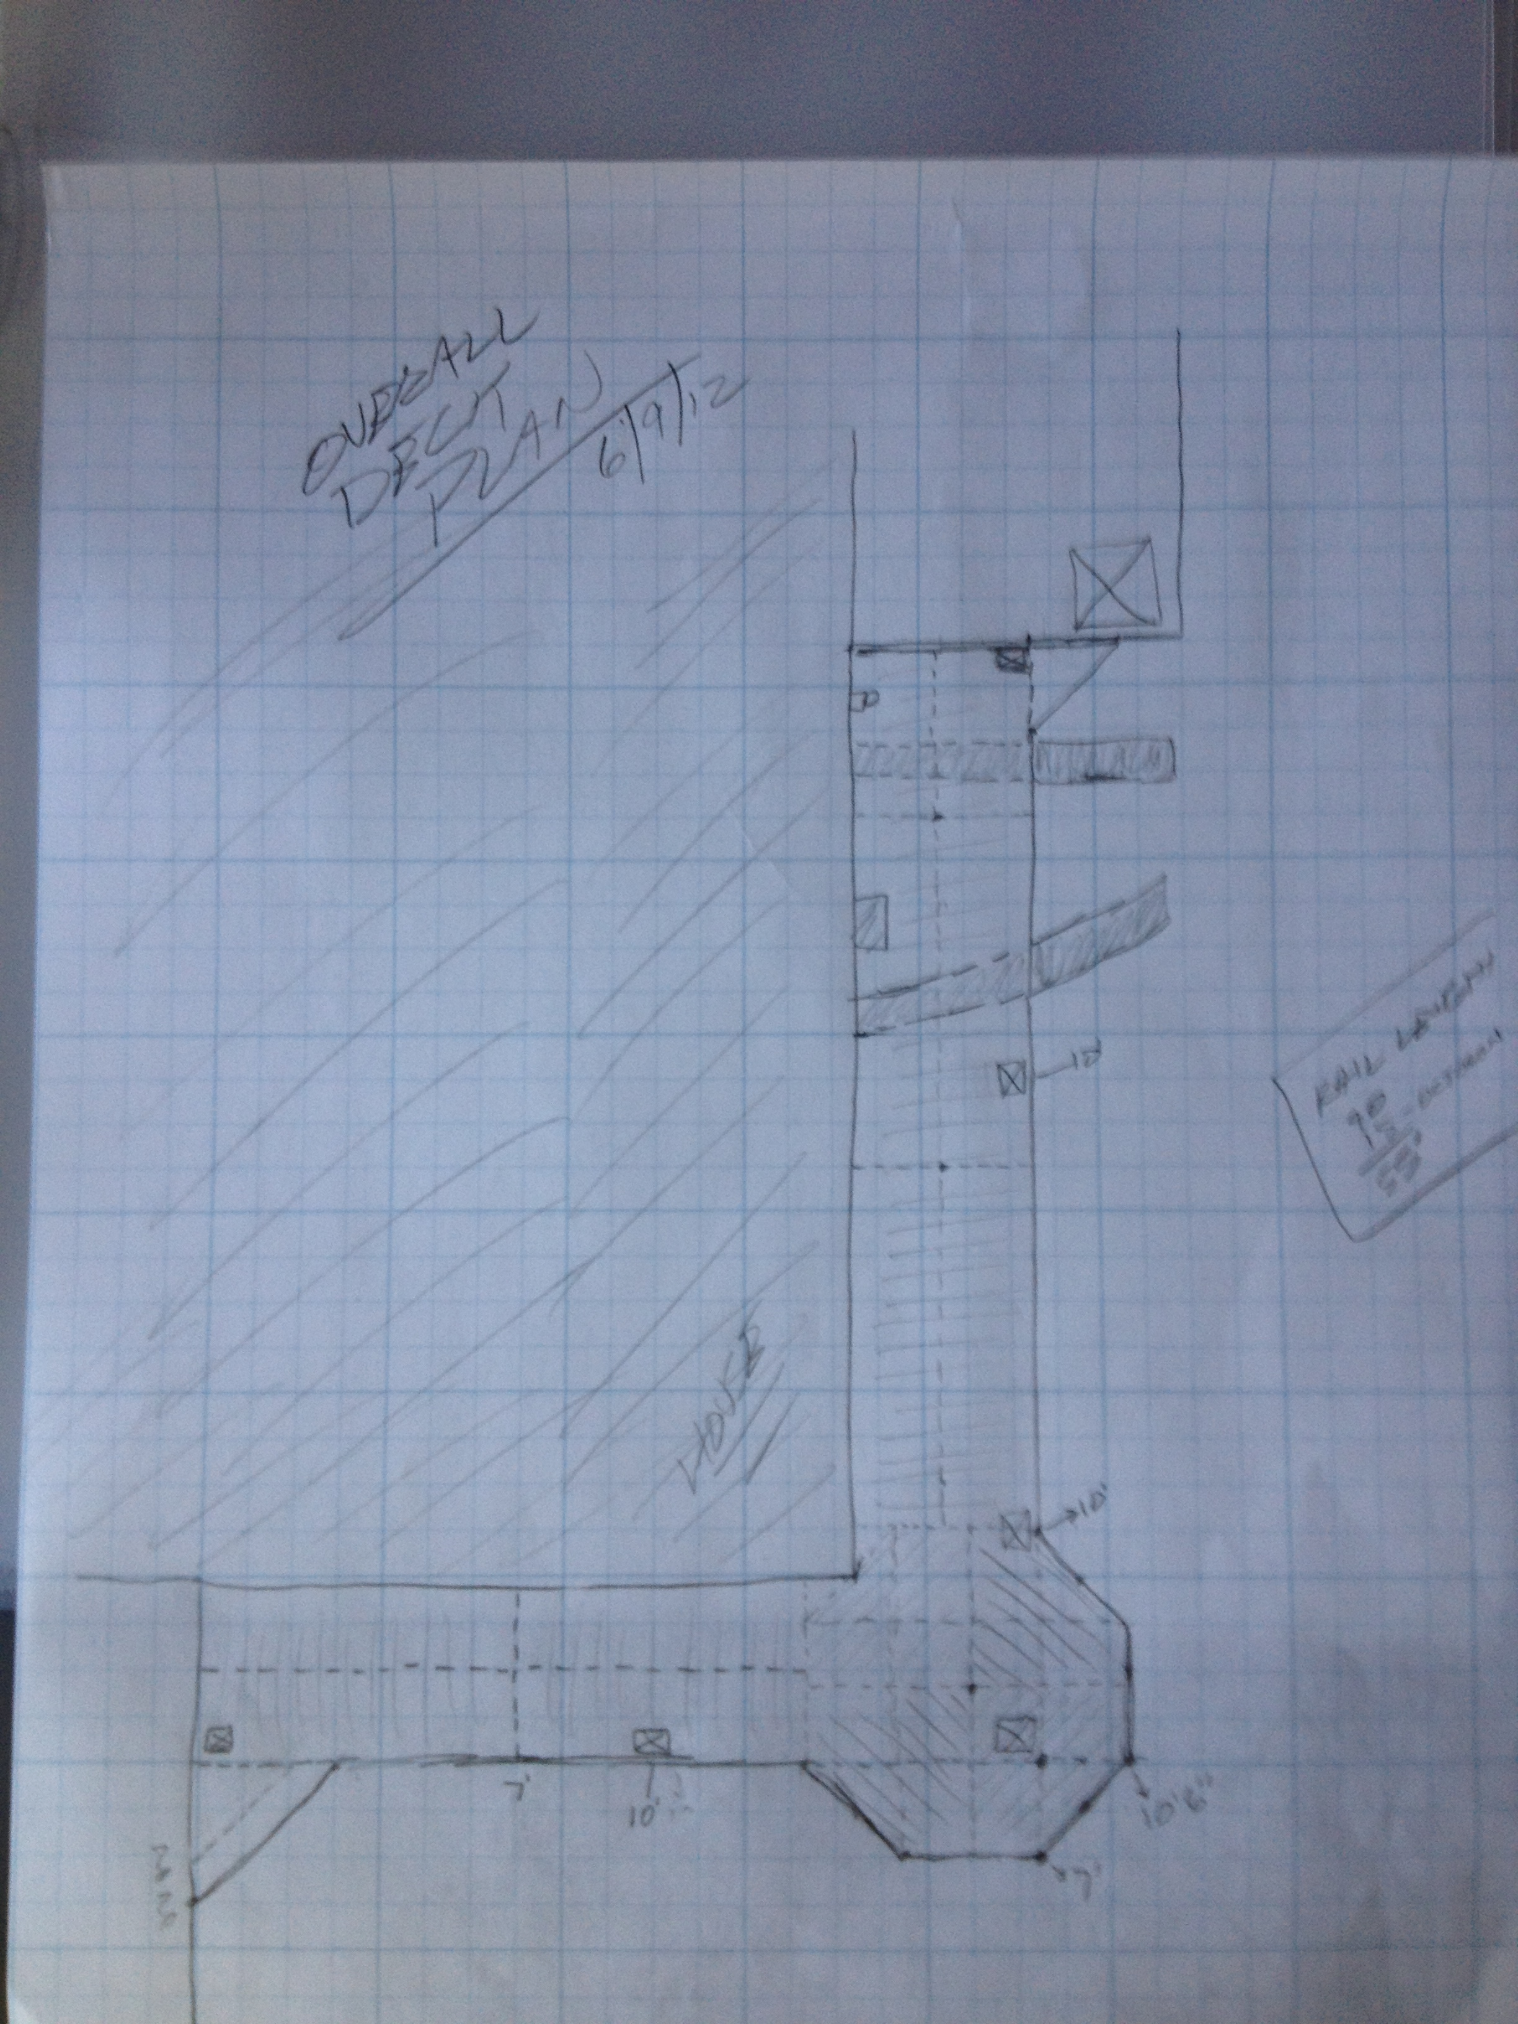
“Build a Deck” Project
Check out the “template” from this company who builds decks: https://www.rona.ca/en/projects/Plan-the-construction-of-a-deck
#ISUCIT

Slide 20
Q & A
Did you see an application?
What’s 1 thing you might use?
depluma@ilstu.edu
Template for FourWinds Displays and Conf Room Tech, Security Cameras, Micros Upgrade, Business Case, docs available. Drop me an email and I’ll send these to you.
#ISUCIT

Slide 21
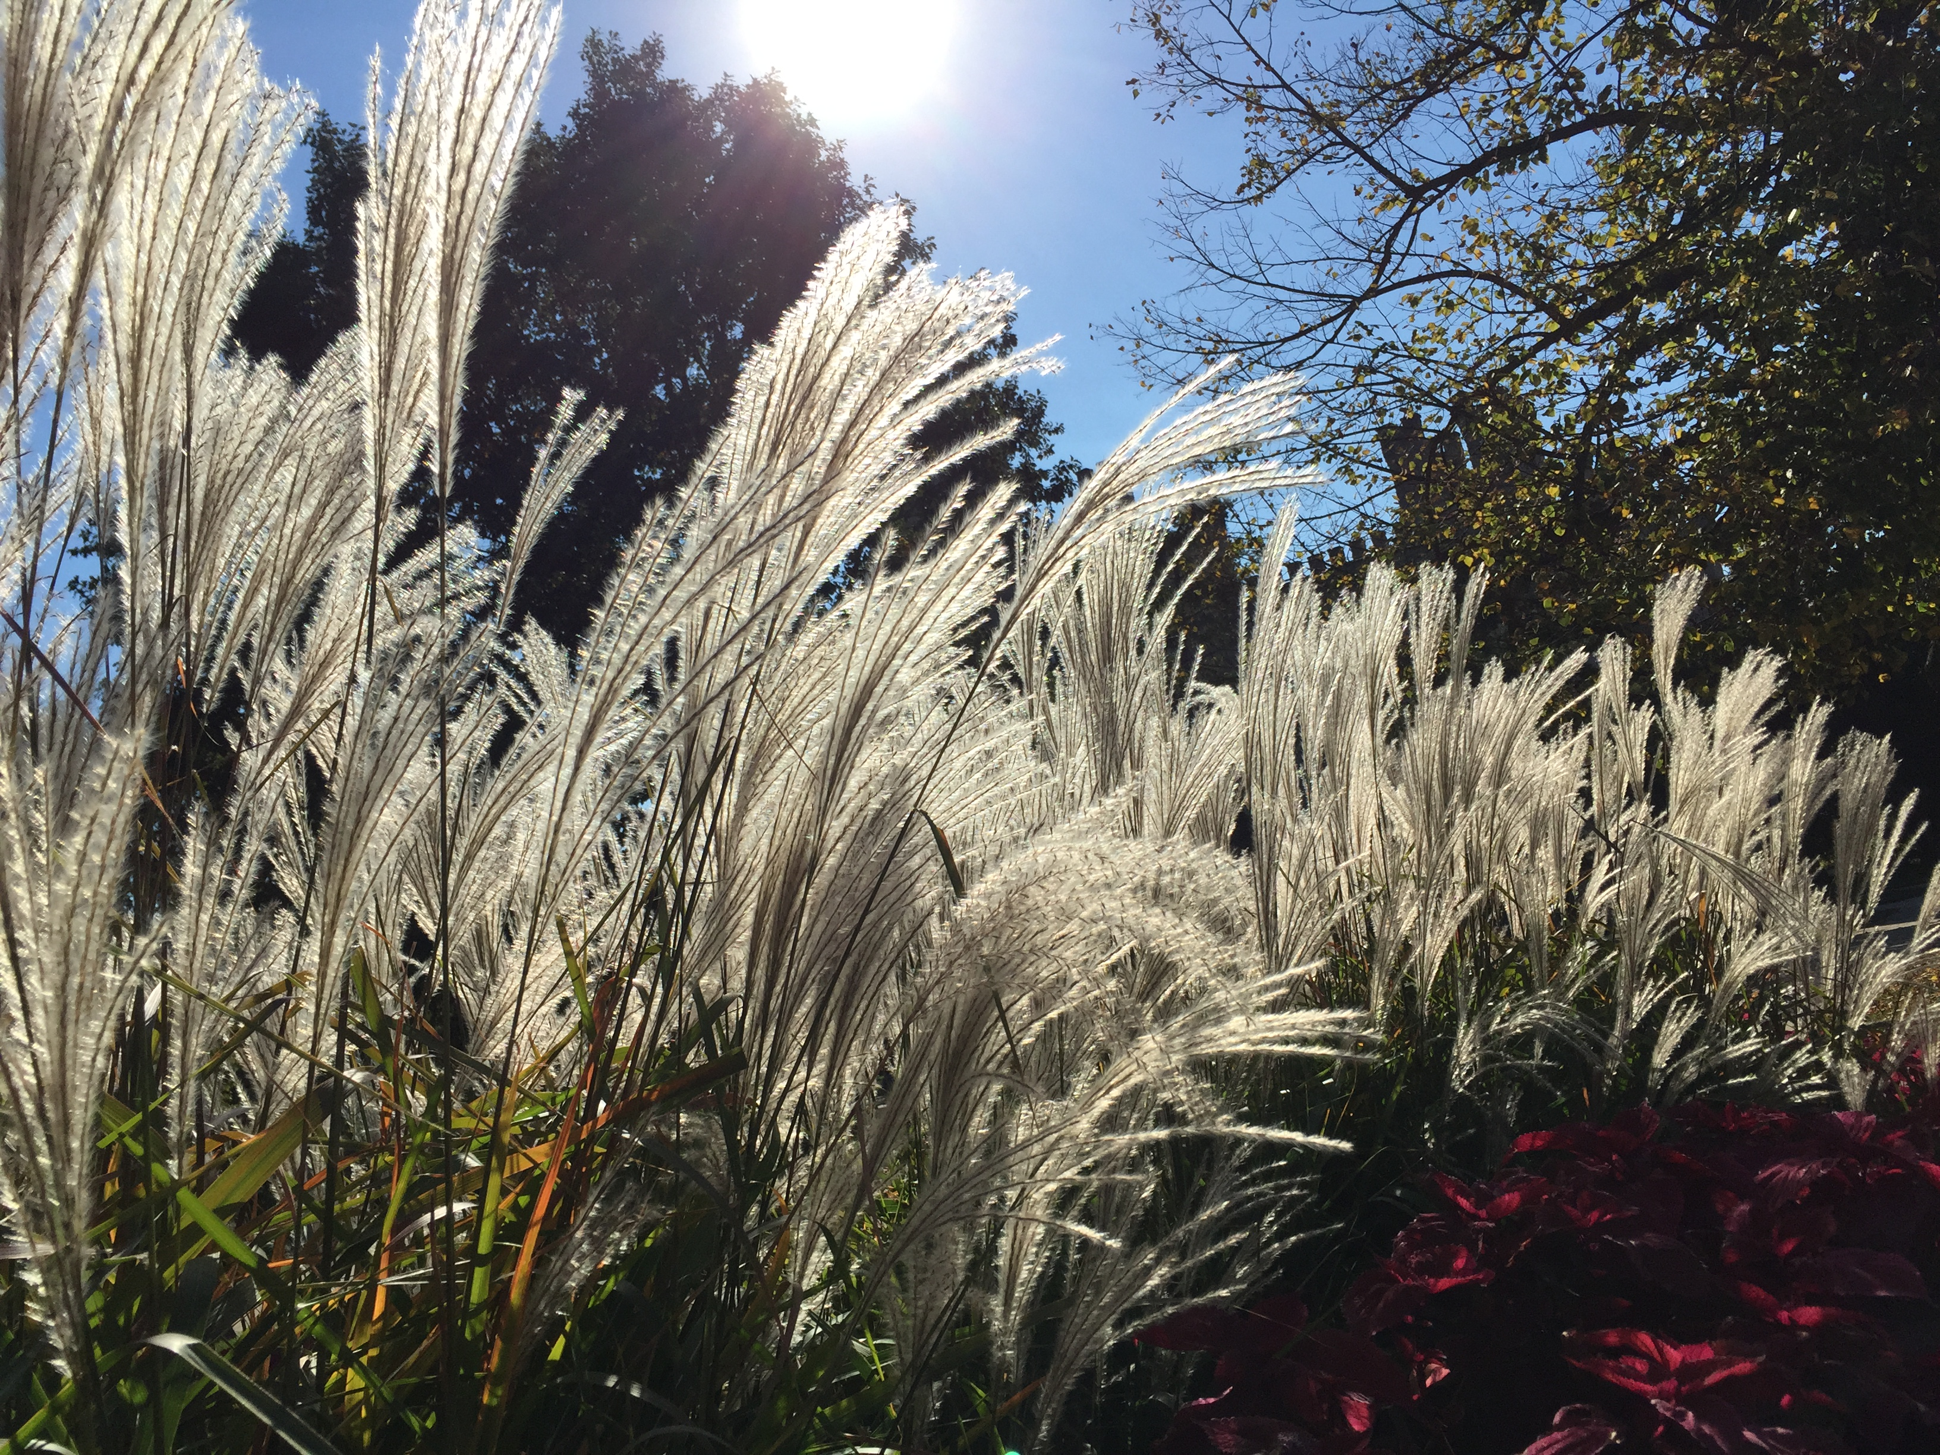
Thank you
#ISUCIT

Slide 22
#ISUCIT

