Slide 1
#ISUCIT

Slide 2
Onboarding
The Past, Present, and Future
Lisa Mason
Dave Schaafsma
Tony Brook
Dan Taube
#ISUCIT

Slide 3
Today’s Objectives
Overview the onboarding process
Detail specific pain points
Share improvement efforts
Open to audience discussion
#ISUCIT
Notes:
Overview of process to include current day activities. From the point a candidate accepts the offer to their first day, what happens?
Specific pain points will outline system and people issues that break the process. Primarily, incomplete or delayed communication for the new hire.
Improvement efforts to discuss the various initiatives in AT, HR, and the university-wide Enterprise Security Domain Team.
Audience discussion opportunity for questions, feedback on their own experiences, suggestions to improve.

Slide 4
Welcome to ISU! Day One
The Good
The Bad
The Ugly
Account Activated
Computer Setup Early
Email Working
Account Activated
Computer Setup Late
Email Partially Working
Account Can’t Activate
No Computer Setup
Email Unavailable
What causes these outcomes?
#ISUCIT
Notes:
Continue from the intro, explain the general idea that this is focused on the individual new hire experience.
Give simple examples of the three phases
Explain that through our three focuses, we will hopefully answer why the bad and ugly happens.

Slide 5
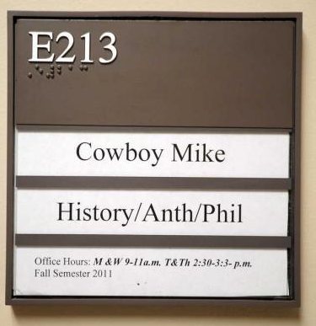
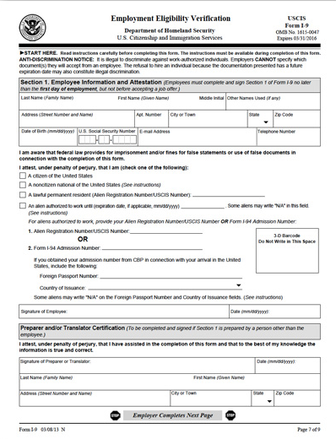
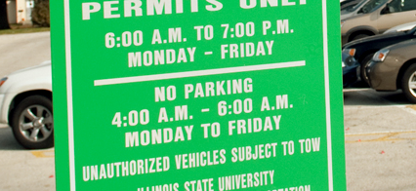
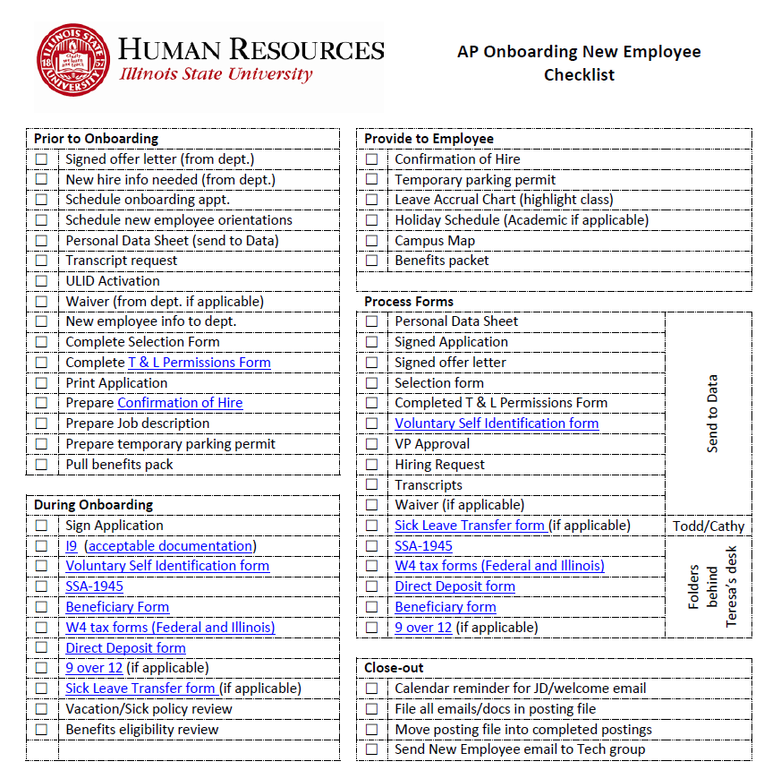
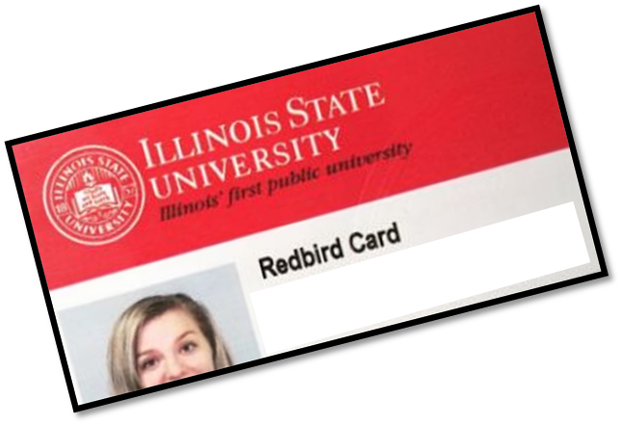
#ISUCIT
Notes:
Lisa Mason to overview and discuss checklist.

Slide 6
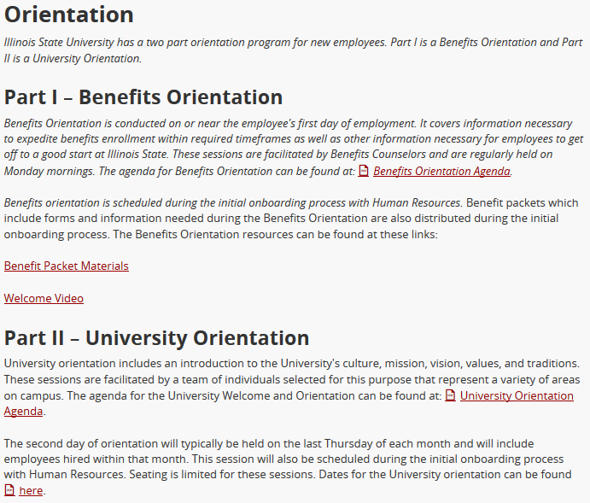
#ISUCIT
Notes:
Brief discussion of Orientation changes as part of the on boarding process.

Slide 7
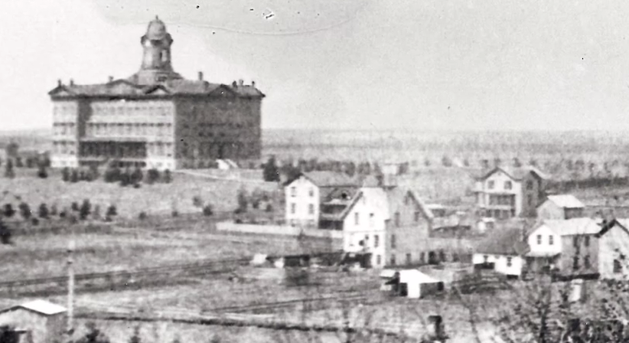
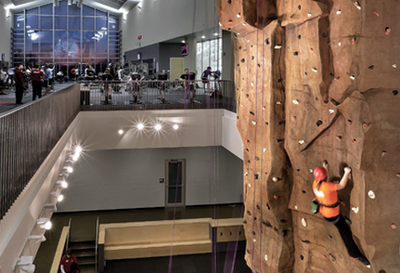
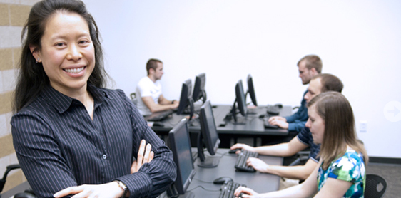
#ISUCIT

Slide 8
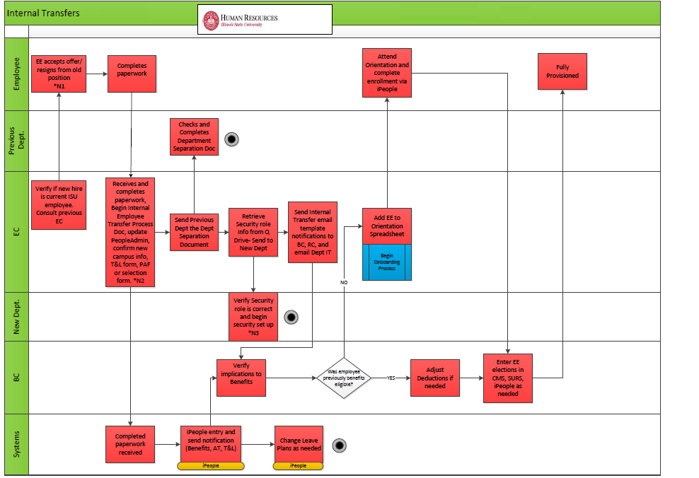
#ISUCIT
Notes:
The piece of the process we are trying to work on.

Slide 9
Some Raw 2015 Numbers
New Hires - 365
Transfers - 348
Rehires – 1481 ( Students, GA’s and NTT make up the bulk)
#ISUCIT
Notes:
These number are just how many times that transaction happened in the system.

Slide 10
Equipment and Access
The Good
The Bad
The Ugly
Early Notice of New Hire
Match to Existing Employee
Standard Software Only
Supervisor Approvals Received
Two-Day Notice of New Hire
No Detail of Permissions
Long List of Special Software
No Supervisor Approvals
No Notice of New Hire
No Detail of Permissions
No Software Needs
No Hardware Needs
#ISUCIT
Notes:
Notification is step one. Without that, no IT support unit can prepare for delivery of services.
Most cases of bad or ugly are simply late or no notice to the proper individuals.
Working towards reducing areas of individual approvals for supervisors. Previously great delays just for them to sign off of.
Standardization of software and equipment allows for shorter turn around. Leveraging software deployment for self-installation to reduce need for manual install.

Slide 11
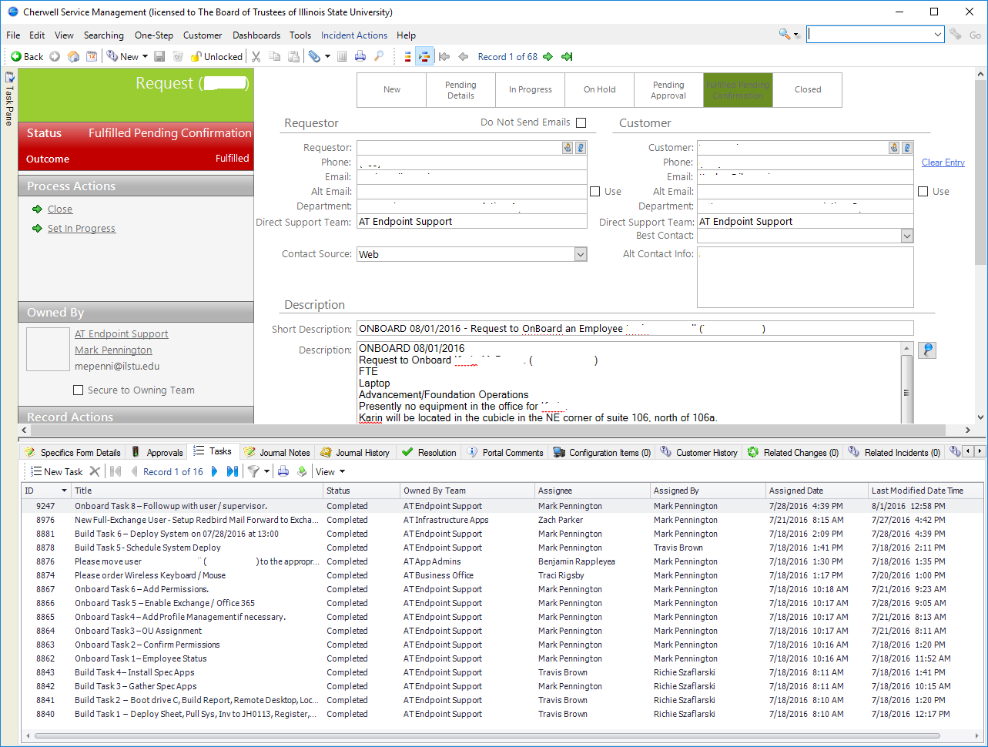
Toolbox of Endpoint Support
Keys to Success
Early Notification
Existing Employee to Copy
Reduce Supervisor Approval
Contacts in Departments
#ISUCIT
Notes:
Discuss tools available to my team and how we use them.
Cherwell for formal request tracking to onboard. Tasks for individual activities.
PowerShell script to complete information looking and provisioning of access.
Keys to success

Slide 12
What systems are involved?
First Question: What is a system?
Source of Work Record: HCM system (iPeople)
Source of Person Record: SIS system (Campus Solutions)
Source of Identity: Oracle Identity Manager
#ISUCIT
Notes:
Tony Begins speaking

Slide 13
How do the systems impact onboarding?
Systems acting in concert
Provisioning of Resources – sometimes slow
Email, computer logins, address book information
Directory information
Security & Access
#ISUCIT

Slide 14
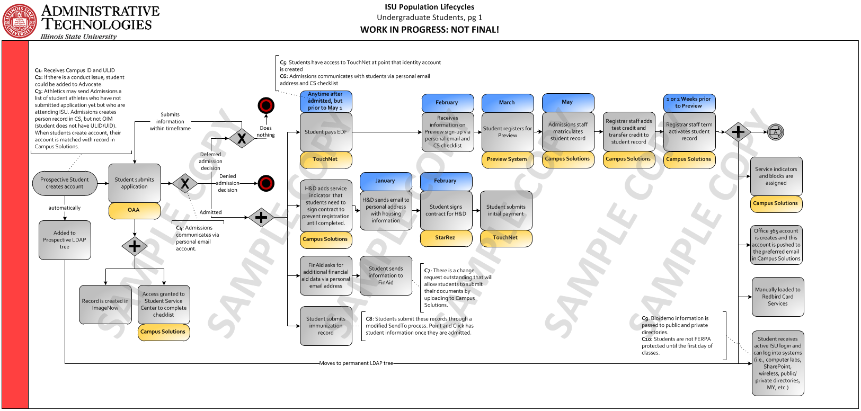
Function Dictates Technical Implementation
#ISUCIT

Slide 15
Continuous Improvement
Enterprise Security Domain Team (ESDT) Effort
Plan for the entire lifecycle
Solid business practices, well documented
Allow processes to change – if something isn’t working, why keep it?
#ISUCIT

Slide 16
Long-Term Improvement
Oracle Identity Manager maturity
Automation of communication
Customer-facing experience – Staff is just as much a customer as the students are!
Integrity and Security of the university comes first
#ISUCIT

Slide 17
Feedback
High Level – Revisit ongoing attempts at improvement
Recommendations
Success Stories and Challenges: “Things we Missed”
Positive feedback loop – working together to make everything better
#ISUCIT

Slide 18
#ISUCIT

