Slide 1
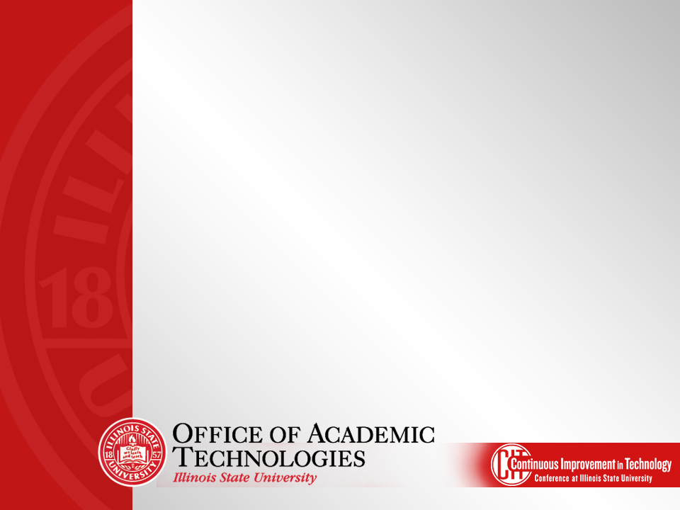
Welcome Remarks from
Dr. Janet Krejci,
Vice President for Academic Affairs and Provost

Slide 3
Accomplishments
Campus Solutions
Interaction Hub (Portal)
Room Scheduling (Series 25)
Housing and Dining (StarRez)
Identity Management (OIM)

Slide 4
Implementation Approach
Critical Success Factors
Milestones
Spotlights
Collaborative workspace (big room)
Daily stand-up meetings
Effective change management
Regular production releases

Slide 5
Items Remaining
TouchNet
Computer-Aided Facility Management (CAFM)
Information Technology Service Management (ITSM)
Mainframe Data Transition
Business Intelligence

Slide 6
Mainframe Data Transition
Identification of data
Work with business partners/data owners
Storage based on requirements
Migration of data

Slide 7
Business Intelligence
Business Intelligence (BI) unites data, technology, analytics, and human knowledge to optimize business decisions and ultimately drive an enterprise’s success. BI programs usually combine an enterprise data warehouse and a BI platform or tool set to transform data into usable, actionable business information.
Source: TDWI (The Data Warehouse Institute)
http://tdwi.org/portals/business-intelligence.aspx

Slide 8
Business Intelligence
Initial Focus – Operational Reporting
Identify data needs
Determine structure of data
Migrate data to warehouse
Data available in Cognos
Standard reports created as needed
Training for users

Slide 9
Business Intelligence
Current Status
Admissions data/reports available
Initial Financial Aid reports available
Enrollment data in progress
Census data in progress
Cognos training available end of June

Slide 10
Formstack/Web Survey

Slide 11
State of the WEB

Slide 12
Mobile is the future of everything
EDUCAUSE - Higher Education’s Top 10 Strategic Technologies report:
Mobile initiatives allow us to promote and advance the University's reputation and brand (Educating Illinois Goal 3, Strategy 4)
“The year 2015 is all about mobile;
7 of the top 10 strategic technologies are related to mobile computing.”

Slide 13
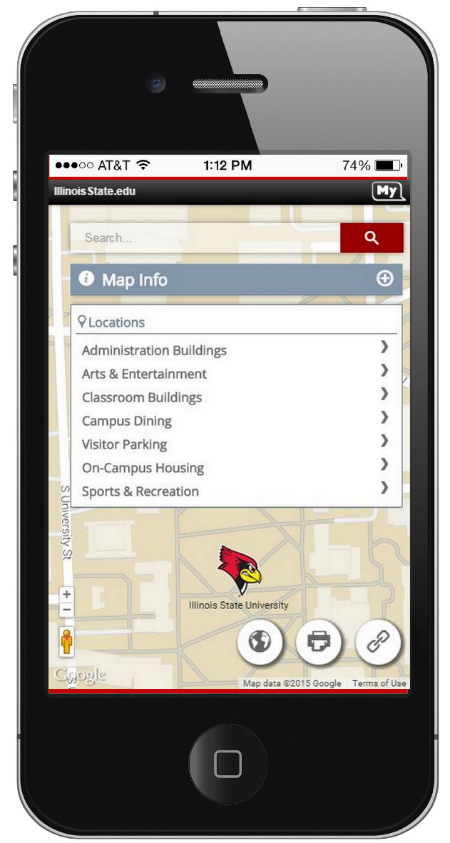
WEB: Mobile friendly & Easy to use
Enhance the mobile web presence for Illinois State University
Develop mobile interfaces for Enterprise applications
“UX is the overriding measure of success for every technology project.”

Slide 14
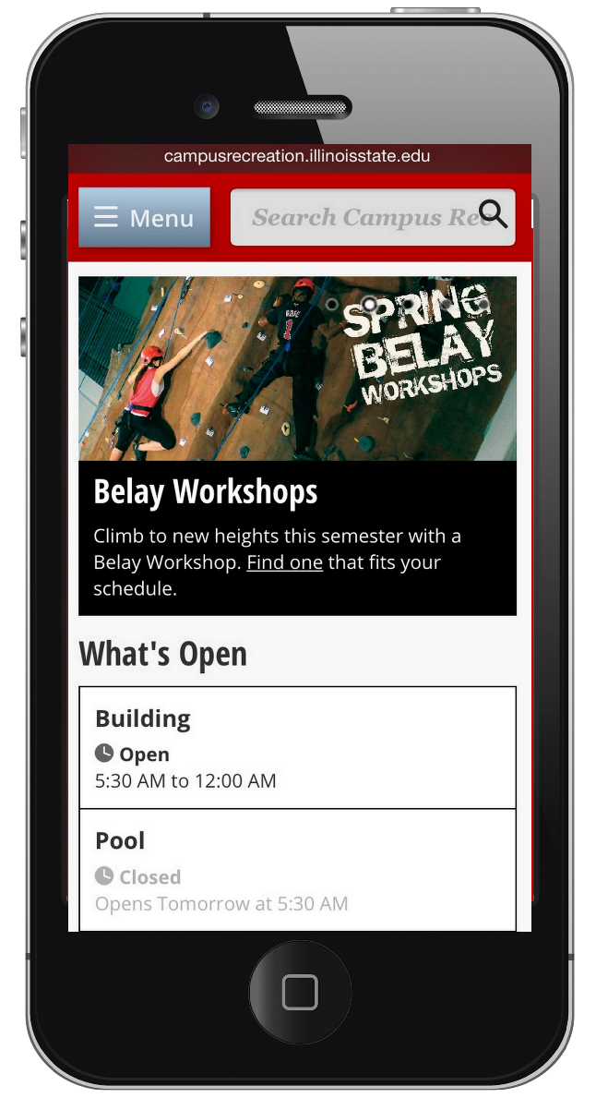
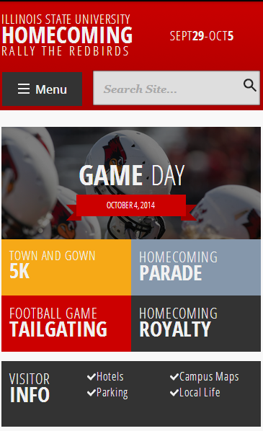
1. Illinois State’s mobile presence
“Facilitate accessibility to information resources by all members of the University community” - IT Strategic Plan
60+ Responsive websites launched
30+ In the past 4 months
How do we accomplish this?
Solid responsive template features
WEB’s Complexity/Prioritization rubric
Basecamp for project management
60+ Responsive websites launched
30+ In the past 4 months

Slide 15
Mobile usage at Illinois State
Increase Recruitment (Admissions)
- 107% traffic increase from 2013 to 2014
- 47% of the visits originate from mobile
- 760,000 mobile page views in 2014
Increase Retention (Campus Rec)
- National Intramural Recreational Sports Association - Creative Excellence Award
- 53% of the visits originate from mobile
Create goal oriented websites!

Slide 16
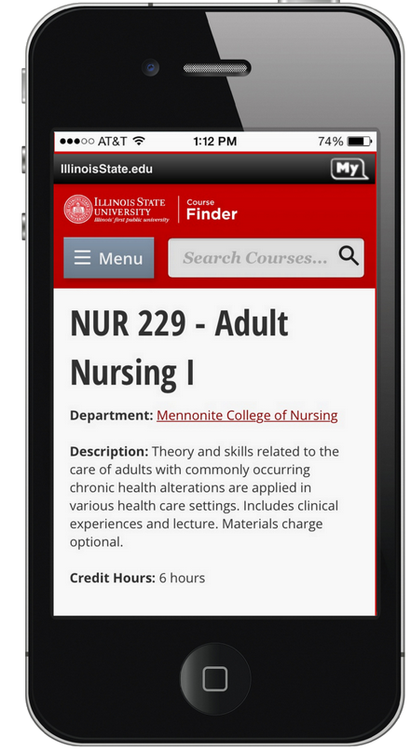
2. Mobile for Enterprise applications
Course Finder – blueprint on how ISU can leverage CS data with mobile & modern User Interface
AWS, Formstack, Guidebook – enhancing communications and delivering time/budget savings to the institution
Google SEO – ready for significant impact on mobile search results

Slide 17
HCM (iPeople) Upgrade
HCM upgraded to 9.2 and integrated with Campus Solutions
Campus Solutions will be the Source of Record for all People information

Slide 18
Identity Overview

Slide 19
Info on ULIDs
Having a ULID doesn’t mean you have access to any service
Ex. Prospect ULID only gives access to Admissions Application and Go.IllinoisState
No more reuse of ULIDs

Slide 20
ITSM Implementation
Phase 1 (Go live summer 2015) | Phase 2 (Go live summer/early fall 2015) | Phase 3 (go live November 2015) | Phase 4 (Go live March 2016)
Change Management | Incident Management | Service Level Management | Problem Management
Knowledge Management | Request Fulfillment | Release Management | CMDB – remaining CI types
Service Catalog | Self-Service Portal | SCCM Integration | Reservation Manager
CMDB – Infrastructure CI types | Customer Profile Populated | New Discovery Tool integration* | Lightspeed Replacement**
Basic Authentication |  | CMDB – Endpoint CI types | Project/Portfolio Management**
Email Integration
Basic Discovery Tool Integration
Customer Profile Setup
Named users established
Security Groups
ITSM Implementation Timeframe
All phases have a corresponding development cycle – workshops, requirements, configuration, training, User Acceptance Testing, and Go Live.
* Dependent upon release of new discovery tool by Cherwell
** Optional implementations, decisions pending

Slide 21
News and Notes

Slide 22
Infrastructure Operations and Networking (ION) updates

Slide 23
Wireless Project update
Phase I complete!
Updated designs and equipment
Bone Student Center, Milner, Schroeder Hall, Moulton Hall, Williams Hall, Julian Hall, Science Lab Building, Ewing manor, Student Accounts Building, MLAB, NSB, Office of Residential Life, University Galleries in Uptown Station
Swap-outs completed
Turner Hall, Alumni Center, College of Fine Arts buildings, Hudelson, ITDC, President’s Residence, Uptown Crossing, Energy House, Educational Administration Building
Phase II beginning later this summer!
Includes:
Edwards Hall, Hovey Hall, Stevenson Hall, Degarmo Hall, Student Services Building, State Farm Hall of Business, CPA, Office of Energy Management, Vidette Building, Nelson Smith Building, Old Union, Turner Hall, Warehouse I &II, Fitness Center and more.
Additional swap-outs to further buildings on campus
GuestNet changes
Updating coverage on the Quad

Slide 24
Office 365 update
Prepping to build production Office 365 hybrid email environment
Targeting early Fall ‘15 for Student email cutover
Looking for early adopter units
Plan to migrate remaining mailboxes on campus to Office 365 over fall semester/winter break

Slide 25
VoIP/UC update
All campus buildings converted to VoIP phones.
Recent upgrade in December of ‘14 brought campus to latest version.
Remaining work in U-high underway to be completed before Fall ‘15. In discussions about Metcalf.
UC (Jabber) available to all faculty and/or staff.
Instant messaging client
Soft phone capability
Control your desk phone
Interact with your voicemail
Persistent chatrooms
WebEx news

