Slide 1

CS for IT Support Staff
CIT Conference

Slide 2

Welcome to… Campus Solutions for IT Support Staff

Slide 3


Objectives
High Level Overview of Campus Solutions
Users
FAQ
Resources and Help
Ask Questions

Slide 4


Campus Solutions
SIS

Slide 5
Campus Solutions
Student Information System (SIS) that will replace the current mainframe
Web-based – accessed online
Oracle PeopleSoft product - same software that powers iPeople

Slide 6
Campus Community
Stores bio/demo information for students, faculty, and staff.
Names, addresses, phone numbers, national IDs, etc.
Central hub of system.
Campus Community
Notes:
Campus Community – hub of the system that stores bio/demo data like names, address, numbers, etc.

Slide 7
Admissions
Accepts student applications
Processes app fees and documents
Evaluates applicants
Accepts applicants into programs and plans
Admissions
Campus Community
Notes:
Recruiting and Admissions - handles the University’s admission process, including student applications and associated documents, fees, and evaluation.

Slide 8
Student Records
Academic information
Course catalog
Schedule of classes
Grading
Transcripts and degrees
Registrar’s Office
Admissions
Student Records
Campus Community
Notes:
Student Records - manages all academic information. Generally does everything the Registrar's office handles.

Slide 9
Financial Aid
Evaluates award eligibility
Disburses loans, scholarships, and grants
Awards waivers
Maintains compliance data for reporting
Admissions
Student Records
Campus Community
Financial Aid
Notes:
Financial Aid – does what you would imagine

Slide 10
Student Financials
Charges tuition and fees
Bills students
Issues refunds
Processes collections
Prints tax forms
Student Accounts Office
Admissions
Student Records
Campus Community
Financial Aid
Student Financials
Notes:
Student Financials - essentially equivalent to ISU's Student Accounts.

Slide 11
Academic Advisement
Admissions
Student Records
Tracks progress toward the degree
Creates advisement reports
Campus Community
Academic Advisement
Financial Aid
Student Financials
Notes:
Finally, Academic Advisement tracks students' progress toward their degrees.
*Question: Why is this important? Anyone want to guess? Bueller? Bueller?
Because what you do in your module effects other modules and because they effect you
Example – can’t give financial aid to a student unless they are admitted.
The good part about what I’m going to show you today is that you will only have view access to the Admissions screens, so you can’t really change anything.
You can see the other modules surrounding Campus Community.
A lot of the data in the system is stored and shared there.
Acts as the master repository of personal data to ensure that the Jordan Jeffers we admit is the same one that we matriculate, and loan money to, and bill, and graduate at the end of his degree.

Slide 12










Users

Slide 13

Students
Register for Classes
View Progress Toward Degree
Accept/Decline Financial Aid
Pay Bill
View Grades
And More!
Go.illinoisstate.edu

Slide 14
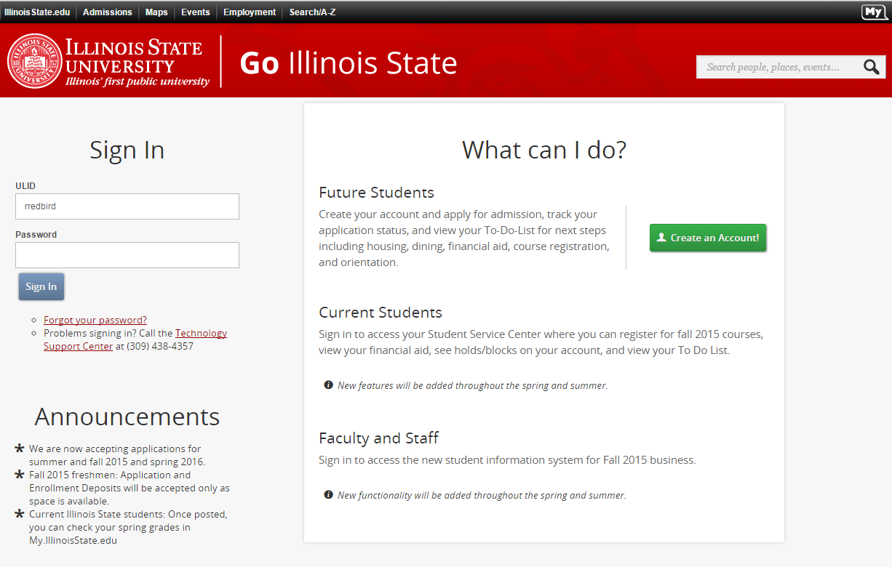

Slide 16
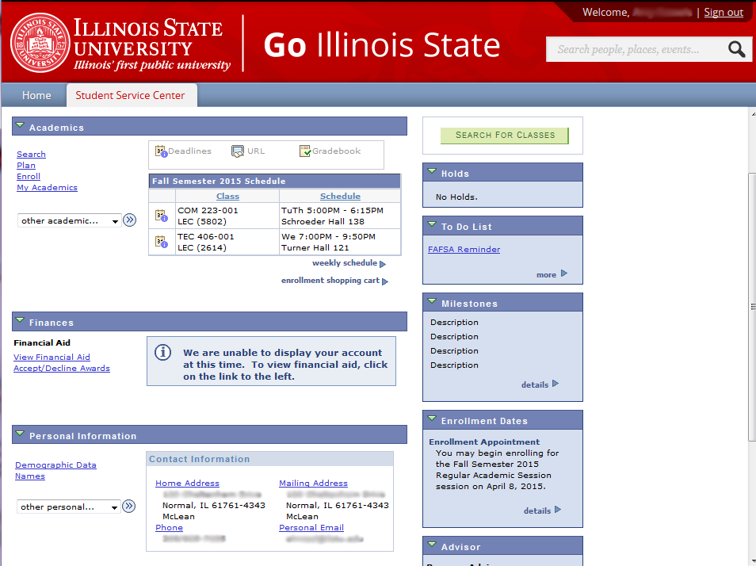

Slide 17
Faculty
Class Schedule
Class Rosters
Textbook Information
Final Exam Schedule
Assign Grades
Approve Grades
Go.illinoisstate.edu

Slide 18
Staff
Varies Greatly
Overrides
Student Information
Class Scheduling
Most things that were done on the Mainframe will be done in Campus Solutions
sis.illinoisstate.edu

Slide 19


Slide 20



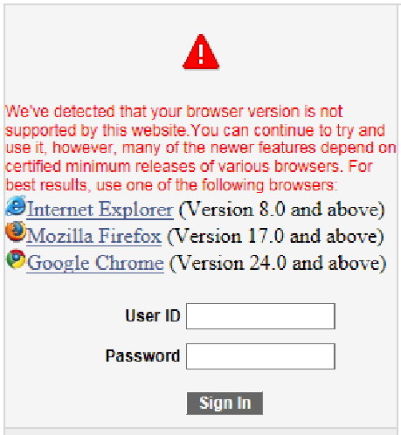


Best Web Browser

Slide 21
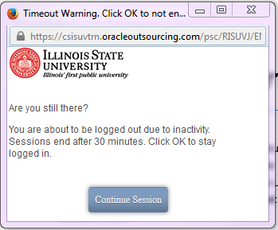


Browser Requirements

Slide 22

Mobile Devices

Slide 23
Time Out Message

Slide 24
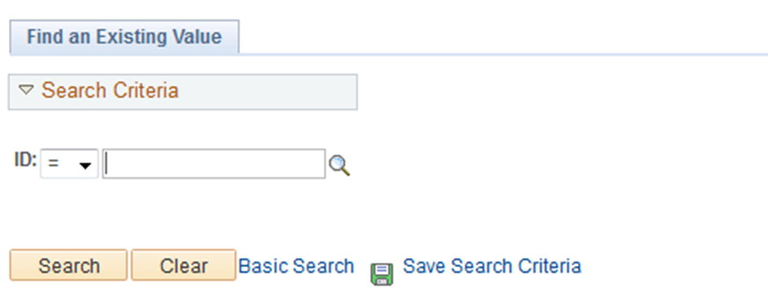
Empl ID vs. UID

Slide 25

Empl ID vs UID
The ID number of people in Campus Solutions.
  Not the same as UID or User ID
UID/ Campus ID | Empl ID/ ID | ULID/ User ID
856-23-1098 | 1000-139-733 | rrredbi

Slide 26
User Access
Role Based = Pages
Row = Data on the Page
Contact the Technology Support Center

Slide 27


Getting Help
Technology Support Center
supportcenter.illinoisstate.edu
supportcenter@ilstu.edu
438 – 4357

Slide 28




Slide 29
Getting Help
Training Team
at.illinoisstate.edu/training
ATtraining@ilstu.edu

Slide 30
Trainings
Since August of 2014
How many Classes
Notes:
Academic Advisement
Financial Aid
Student Financials
Textbook
Teacher Education
Student Records
SEVIS/Admissions
Students
Faculty

Slide 31



Thank you!
at.illinoisstate.edu/training/
or
Notes:
We’re going to take a lot of time for questions now,
Any other questions you have as well, I’m happy to answer.

Slide 32
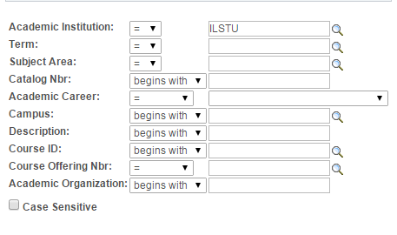
User Defaults
I have to keep typing in ILSTU over and over. Who do I set that to fill in automatically?

