Slide 1
Campus Solutions
Get to know the new
Student Information system

Slide 2
Introductions
Lisa Lindenfelser & Jordan Jeffers
ATtraining@IllinoisState.edu
AT Service Communication & Training Team | Client Services
Part of the LEAPForward Project

Slide 3
Overview
What is Campus Solutions?
What does it do?
Who is going to use it?
Benefits of Campus Solutions
New terminology

Slide 4
Overview
Demonstration of Campus Solutions
Search/Match
Effective dating
Student Services Center
Developer tools

Slide 5
Overview
Timeline of Implementation
Training
Support
Questions

Slide 6
Campus Solutions
Student Information System (SIS) that will eventually replace the current mainframe system
Web-based
Oracle PeopleSoft product - same software that powers iPeople

Slide 7
Campus Solutions Modules
Six different modules make up Campus Solutions:
Campus Community
Recruiting and Admissions
Student Records
Financial Aid
Student Financials
Academic Advising

Slide 8
Campus Community
Stores bio/demo information for students, faculty, and staff.
Names, addresses, phone numbers, national IDs, etc.
Central hub of system.
Campus Community

Slide 9
Admissions
Admissions
Accepts student applications
Processes app fees and documents
Evaluates applicants
Accepts applicants into programs and plans
Campus Community

Slide 10
Student Records
Admissions
Student Records
Academic information
Course catalog
Schedule of classes
Grading
Transcripts and degrees
Registrar’s Office
Campus Community

Slide 11
Student Records
Financial Aid
Evaluates award eligibility
Disburses loans, scholarships, and grants
Awards waivers
Maintains compliance data for reporting
Admissions
Campus Community
Financial Aid

Slide 12
Student Records
Student Financials
Charges tuition and fees
Bills students
Issues refunds
Processes collections
Prints tax forms
Student Accounts Office
Admissions
Campus Community
Financial Aid
Student Financials

Slide 13
Student Records
Admissions
Academic Advisement
Tracks progress toward the degree
Creates advisement reports
Generates “What if?” analyses
Campus Community
Academic Advisement
Financial Aid
Student Financials

Slide 14
Who will use Campus Solutions?
Probably you
Office of Admissions, Financial Aid Office, Student Accounts, Office of the University Registrar, and University College
Academic department staff, instructors, advisors, students, and technical support staff throughout the University.

Slide 15
Benefits
Table sharing powerhouse
Information is integrated throughout the system
Reduces repetitive data entry
Eliminates duplicate and orphan records
Enables flexible processing of information

Slide 16
Benefits
Friendly user interface
Complex in some ways
Less reliant on code

Slide 17
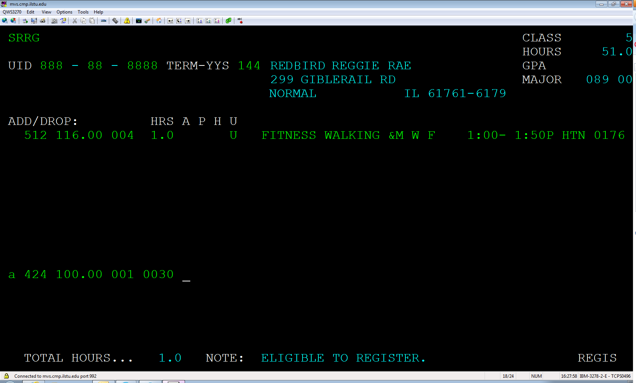
Screenshot from mainframe

Slide 18
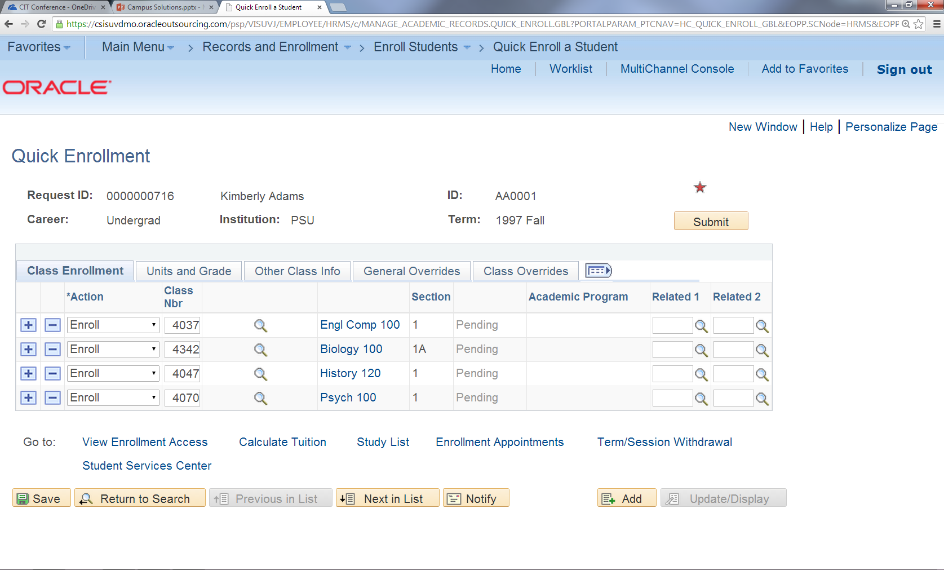
Screenshot from Campus Solutions

Slide 19
Benefits
Easy to update
Vanilla implementation with no customizations
Better customer service
Staff can see exactly what student is seeing in Student Services Center
Effective Dating
Data is inactivated rather than overwritten, maintaining historical records

Slide 20
Academic Structure
Institutional Structure
Institution
We have one institution at Illinois State
Academic Group
Highest level division of institution, concerned with "big picture" issues

Slide 21
Academic Structure
Career – Coursework undertaken by a student
Program – The entity to which the student applies, is admitted, graduates from
Plan – Course of study; Degree is issued at the plan level
Sub-plan – Areas of specialization within a plan

Slide 22
Academic Structure
Career
Undergraduate
Program
College of Arts & Sciences: Undergraduate
Plan
English
Sub-plan
Creative Writing

Slide 23
Demonstration

Slide 24
Developer Tools
Most work can be done without any coding or development
PeopleCode – Powerful, flexible programming language built into Campus Solutions
SQR, SQL – Used in a variety of ways, such as Query Manager
Equation Engine – Financial Aid packaging process, complex fees, and population selection

Slide 25
Timeline
August 4, 2014
Campus Community and Admissions go live for Fall 2015 students.
Mainframe and Campus Solutions will be in use at the same time, but for different populations.

Slide 26
Timeline
February 2015
Student Records, Student Financials, Financial Aid, and Academic Advising go live for Fall 2015 students.
Not all functionality will be in use by this time.

Slide 27
Timeline
September 2015
All student information system tasks will be off of the mainframe and in Campus Solutions.
December 2015
Mainframe will be decommissioned.

Slide 28
Training & Support
Training began in February for LEAPForward team members and functional leads.
Future training will be provided by training team in July:
In-person training
Job Aids
Online support – glossary, step-by-step instructions, videos, interactive tutorials

Slide 29
Training & Support
Technology Support Center (TSC) will provide technical support for Campus Solutions.
Single point of contact for all incidents, problems, and requests, just like today.
TSC will route questions to appropriate departments. (developers, infrastructure, end point support, etc.)

Slide 30
Questions?
ATtraining@IllinoisState.edu

