Slide 1
ReggieNet Overview for IT Staff
Charles Bristow, Center for Teaching, Learning, and Technology

Slide 2
Agenda
Course provisioning process
Basic course template
Where to find help
Grade submission process
Common problems
Questions

Slide 3
Course provisioning
For every section officially on the books, a ReggieNet course site is created
Timed to coincide with beginning of registration
Instructors of record and students added automatically

Slide 4
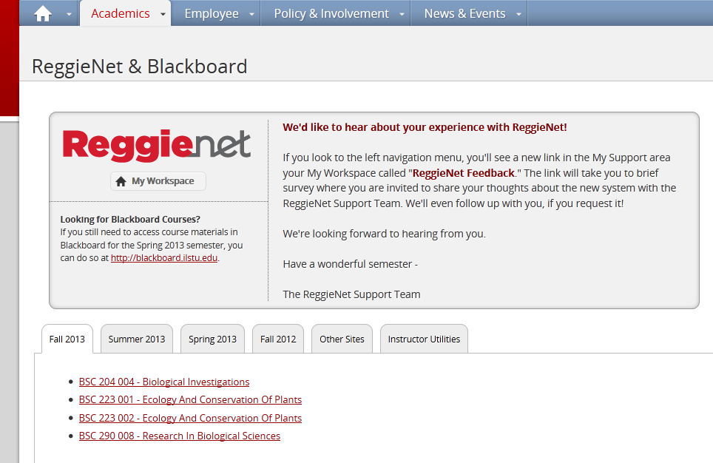
Course Combination

Slide 5
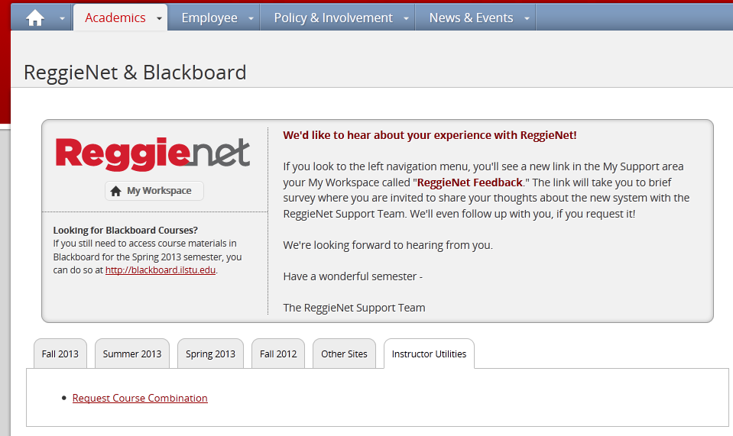
Course Combination

Slide 6
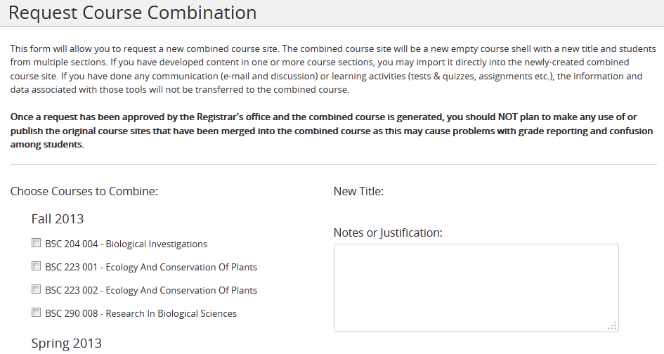
Course Combination

Slide 7
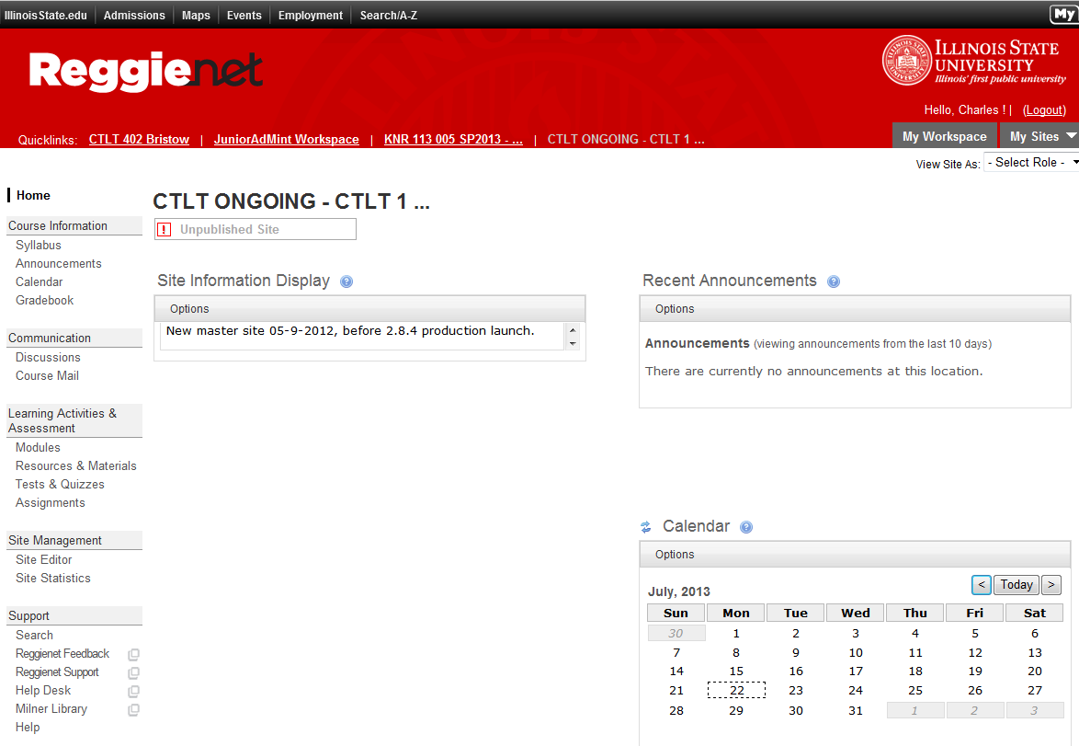
Basic Course Template

