Slide 2
Project Management in Technology at ISU
Ed Vize and Dean Plumadore

Slide 3
Agenda
Introduction to Project Management Methodology
PM and ITIL-What is the difference?
Matrix Management and how a PM fits
Project Lessons Learned-What are they and how do they help?
Portfolio Planning and Prioritization

Slide 4
What is a Project?
It’s a temporary group activity designed to produce a unique product, service or result.
Why is this important?

Slide 5
Typical Project

Slide 6
Project Management Book of Knowledge (PMBoK)
Project Management Institute (PMI) created and maintains standards.
Project Management is the application of skills, knowledge, tools, and techniques to meet the needs and expectations of stakeholders of a project.
Project management guides projects through a process to improve predictability and prevention of risk, not recognition and reaction.
Common definition “The disciplined, structured, and organized application of common sense to manage a temporary effort”.

Slide 7
What does a Project Manager Do?
Applies knowledge, skills, and techniques to execute projects effectively and efficiently.

Slide 8
Triple Constraint

Slide 9
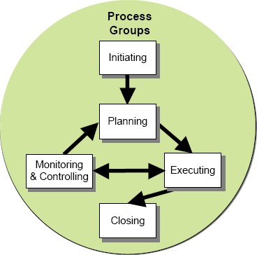
Process Areas
5 Process Phases of a project:
Initiation
Planning
Executing
Monitor and Control
Closing

Slide 10
Knowledge Areas
Integration Management
Scope Management
Time Management
Cost Management
Quality Management
Human Resource Management
Communications Management
Risk Management
Procurement Management

Slide 11
PM and ITIL-What is the Difference?
PM is a method of building a service.
ITIL is a method of supporting the service.
ITIL begins about where PM ends.
Project Managers should be familiar with ITIL Service Design and Service Transition.
Project needs to create a Service Design Package for Service Operations.

Slide 12
An answer to the relationship

Slide 13
Another answer….

Slide 14
Matrix Management
Functional management (Traditional)
Projectized management (very new)
Matrix management (kinda where we are)

Slide 15
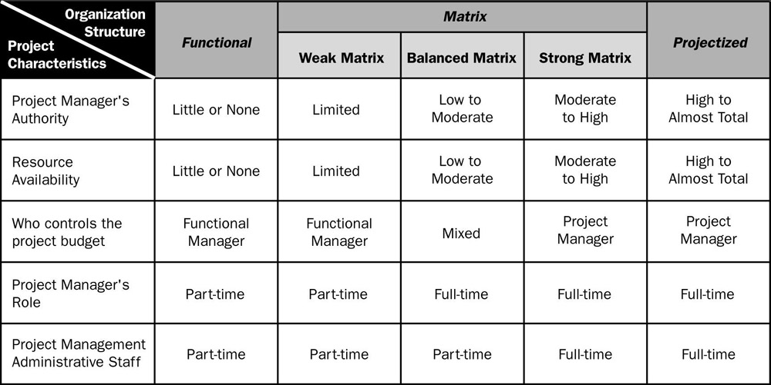
Comparison

Slide 16
Project Lessons Learned
What did you learn to make the next project better?
How do you document those items?
Example with Security Camera Plans.
Progressively more complex plans
Why?

Slide 17
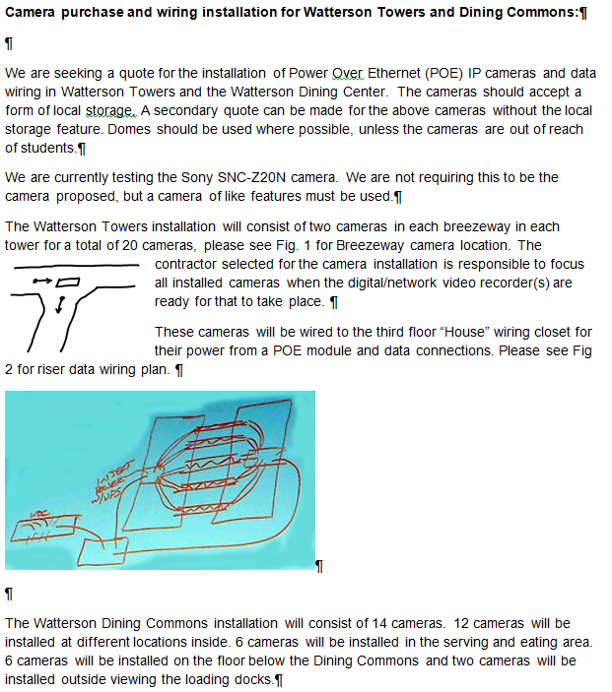
Began here……2008
Lots of emails
To-Do lists
Little documentation
“we just know”
“Lots and lots of things in my head”

Slide 18
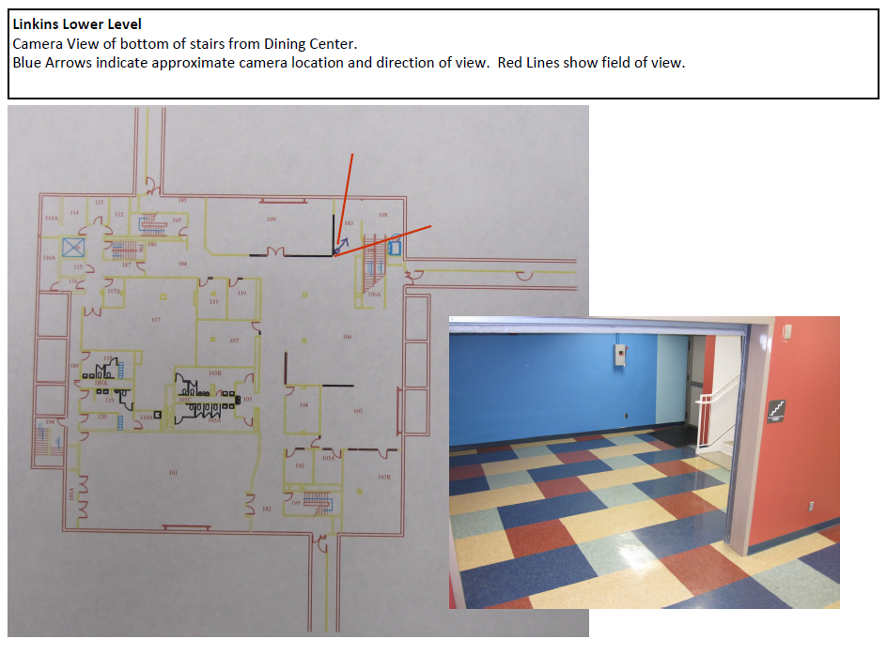
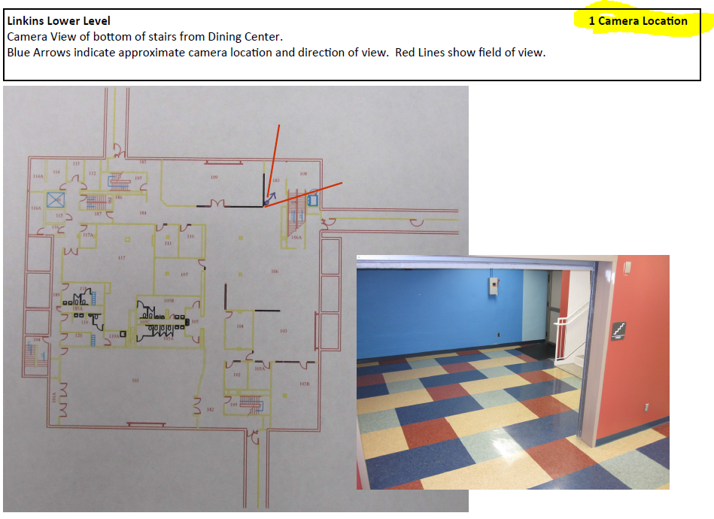
Then here….2009-10
More documentation
for installation, etc.
“less in my head”

Slide 19
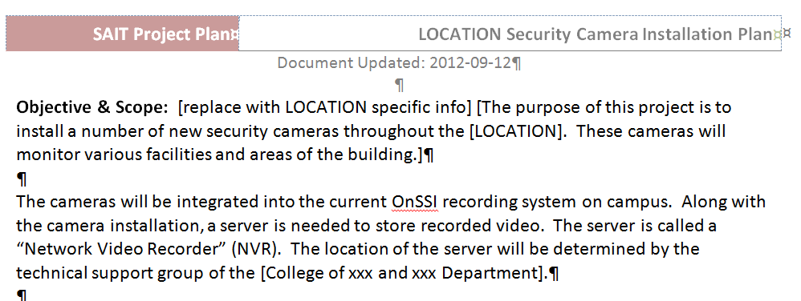
And then…..2011
Templated document with:
Needs
Assumptions
Risks
Team membership
Document updates
Timeline with responsibilities
Site specifics with pictures and text
“even less in my head”

Slide 20
Now…..2013 Template includes (5 cams, 12 pages)
10 needs
12 project assumptions
7 Risks
20 Timeline items
Financial Budget template/calculator
Storage/bandwidth template
Location information template, floor plans, pics
Appendix for Vendor info, ISU PD site survey suggestions, asbestos review, etc.
“not so much in my head”

Slide 21
Portfolio Planning and Prioritization

Slide 22
Portfolio Management
Pipeline Management
Resource Management
Change Control
Risk Management

Slide 23
Portfolio View

Slide 24
Benefits to Portfolio Planning
Select projects with scope that supports the organizational goals.
Balance demand with capability and capacity.
Ensure projects are prioritized appropriately.
Projects remain aligned with customer goals throughout their execution.
Projects receive the support and oversight needed to be completed successfully.
Switch Priorities and redeploy resources quickly.

