Slide 1
ImageNow Demonstration
Rob Dwyer
July 2013

Slide 2
About ImageNow
ImageNow - Flagship product of Perceptive Software
Enterprise Content Management (ECM)
2004 - 100 employees
Today over 1200 employees
Perceptive Software purchased by Lexmark in 2010 for $280 million
Focus on business processes and less on printers
Acquisitions under Lexmark – (headed by Perceptive Software Division)
Brainware –Intelligent Capture
ISYS – Enterprise Search
Nolij – Web Based Document Imaging
ACUO Technologies – Clinical Document Management
Twistage – Cloud platform to manage video, audio, and images
AccessVia – Retail Signage/Electronic Tags
Palla Athena – Business Process Management

Slide 3
History at Illinois State University
Purchased in 2004 by EMAS
Went Live
Registrar’s Office - January 2005 (15 User Seats)
Financial Aid - March 2005
Admissions – September 2005 (~25 User Seats)
Expanded
Honors/Admissions – 2006
Comptrollers – 2008
Athletics/Registrar – 2009
Housing - 2009
University College – 2013
~ Graduate School (Web Services) - 2009
Today
66 User Seats (over 160 different users connected in June 2013)
14 Production Scanners
Enterprise Level Application – Administered by EMAS IT & AT – (Jamie Turner & Dan Taube)

Slide 4
Pros and Cons
Con – Money for product and hardware
Client Seats, Scanners, Dual Monitors, etc.
Con – Setup Time
Initial planning, setup, and Training
Con – Hardware device required to access document
Con – Takes time to scan and link a document
Pro – Time Saving
Document Retrieval / Better Customer Service
No more moving paper files from office to office or building to building
Pro – Documents accessibility – available everywhere and at same time
More flexible work environment
Pro – Space Saving/Paperless
No File Cabinets
Green
Pro – Less likely to lose documents
Pro – Security
Pro – Document Automation
Websites, faxes, workflow routing, integration with other systems, document retention
Pro – Disaster Recovery
Multiple layers of redundancy and backups

Slide 5
ImageNow Document
What is a Document?
List of pages indexed by fields
ImageNow Indexing Fields
Drawer, Folder, Tab, Field3, Field4, Field5, and Document Type
Drawer and Document Type are fixed values
Folder, Tab, Field3, Field4, Field5 are free form
Drawers and Document Types are the basis for most security
Document Type Custom Properties
Data about the Document
Unlimited
Name/Data Type

Slide 6
ImageNow Client
Client
Windows client, Web client, and Mobile client
Currently we only use the Windows client
No passwords stored – Setup using AD authentication
Clients are thin clients
All requests and data via ImageNow Server
Client licenses are concurrent

Slide 7
Application Plans
Application Plan
Used to retrieve a list of documents
Used to link documents
Manual
User manually enters value
Learnmode
ImageNow grabs data from other windows applications
Security
View or Link user access

Slide 8
Capture & Batches
Capture is used to import pages
Capture Profiles
2 Modes – Single Document or Batch
3 Sources – File, Scanner, ImageNow Printer
Batches setup by proposed drawer
Can route to Workflow
ImageNow Printer
Installed with client
Allows anything you can print to be imported into ImageNow
Batches used to store unlinked pages
Security based on proposed drawer
User also has to have access to the Batches
3 Steps: Scan, QA, Link
After scanning pages show up in Batches at Scan complete step
QA – Quality Assurance step
Step through each page and rescan if necessary
Link step
Step through and link each page using an Application Plan
Document then created

Slide 9
Document Searches, Tasks, & Projects
Documents icon is used to search for documents
Simple Search – Usually search on unique index value like UID
Advanced Search – Search on index values and/or document metadata
Views
All Searches done on a view
Views usually drawer specific
Columns are customizable
Projects (aka Folders in latest release)
Used to group documents together that are processed together
Tasks
Work assigned to a user for document
We currently don’t implement Projects and Tasks
Icons are hidden from most users

Slide 10
Workflow
Workflow is used to process documents
Workflow is comprised of queues and routes
Workflow Queue is like a virtual inbox
Routes are connections between queues
Routing usually starts with scanning into a system queue or import queue which has routing rules and routes to another queue based on index fields
Workflow processing usually ends with a complete queue

Slide 11
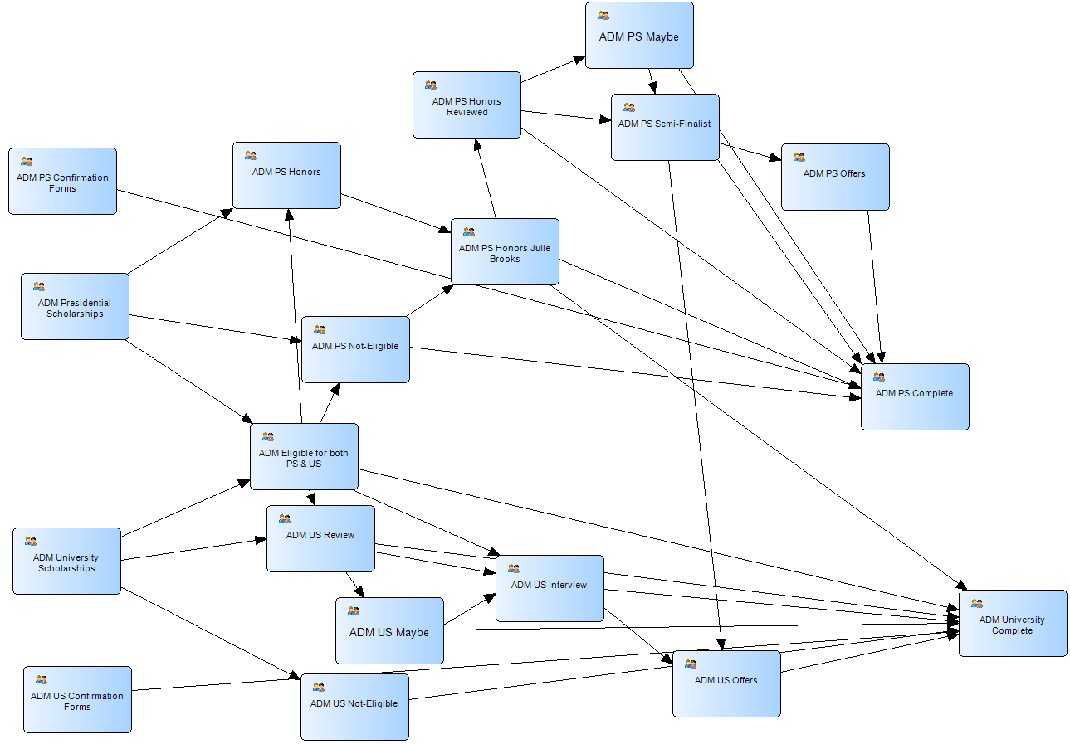
Workflow Sample - Scholarships

Slide 12
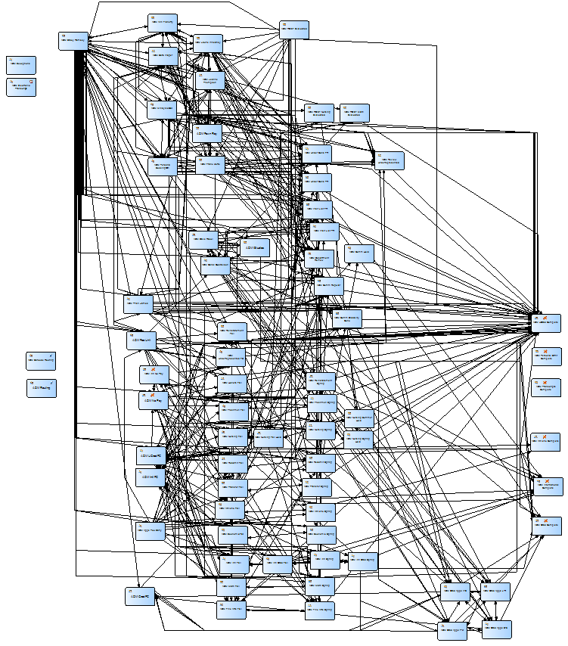
Workflow – Admissions Processing

Slide 13
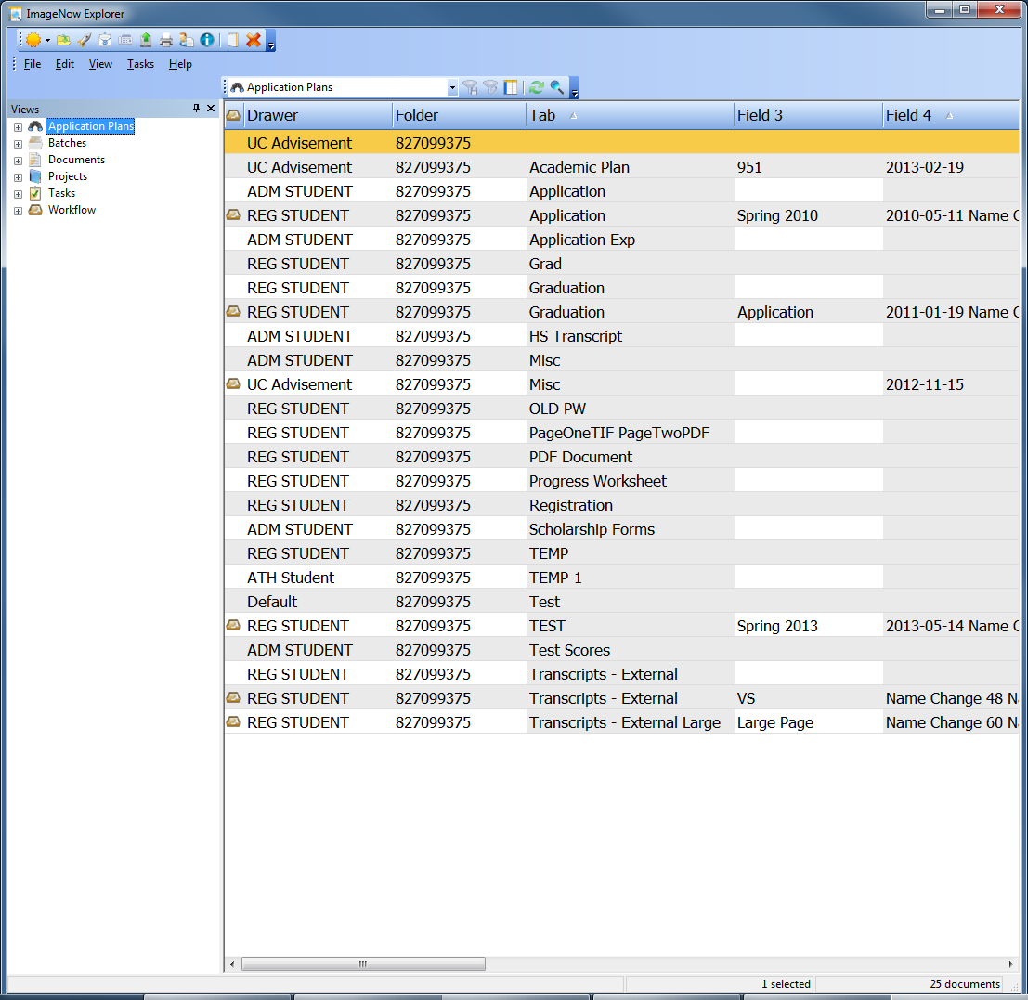
ImageNow Explorer
ImageNow Explorer is used to list related documents
Used to navigate to documents you want to view
Used by Application Plans, Document Searches (Views), Workflow Queues, Batches
Views are customizable
Columns Customizable
Fields
Document Metadata (Pages, Dates, Users)
Workflow Status

Slide 14
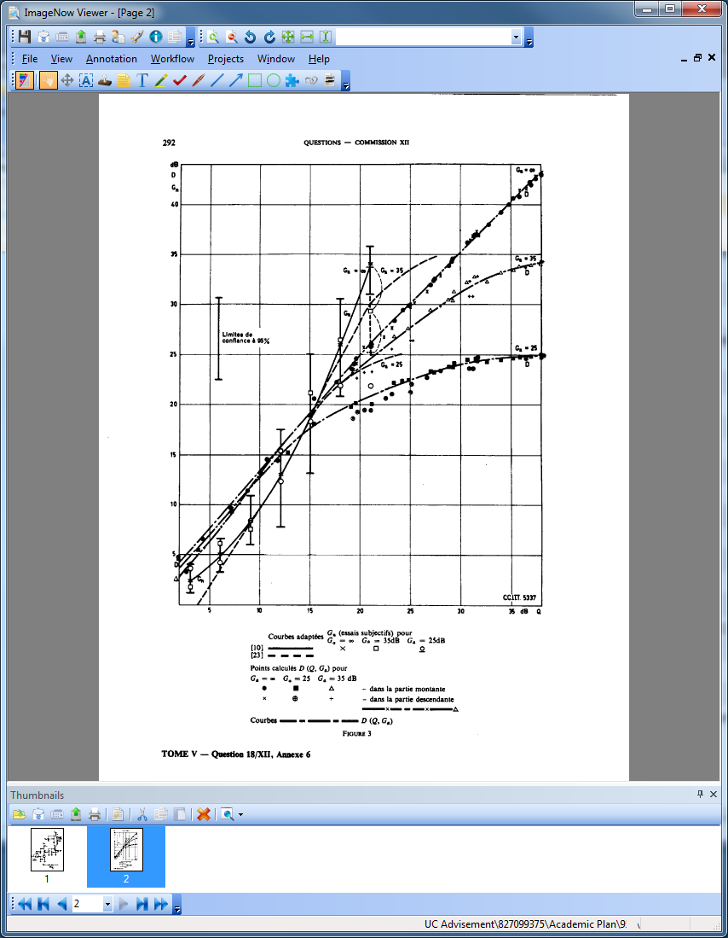
ImageNow Viewer
ImageNow Viewer Displays Document
User Customizable
View and manipulate Custom Properties
Thumbnails
Annotations
Sticky Notes
OLE Attachment
Related Documents
Workflow Routing

Slide 15
Live ImageNow Client Demo

Slide 16
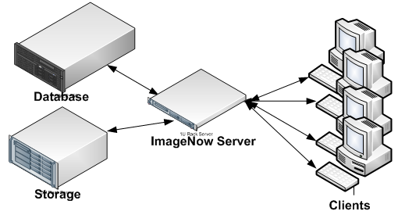
Server Setup
3 Server-side Components – Server, Database, Storage
Server is virtualized
2 Cores 2 GB RAM
16 ImageNow Services
Database - SQL Server 2008 R2 - SYSSQLSERVER
Hardware mirror Julian/John Green
Run on backend of mirror
Storage – SAN
Used to store images and some annotations

Slide 17
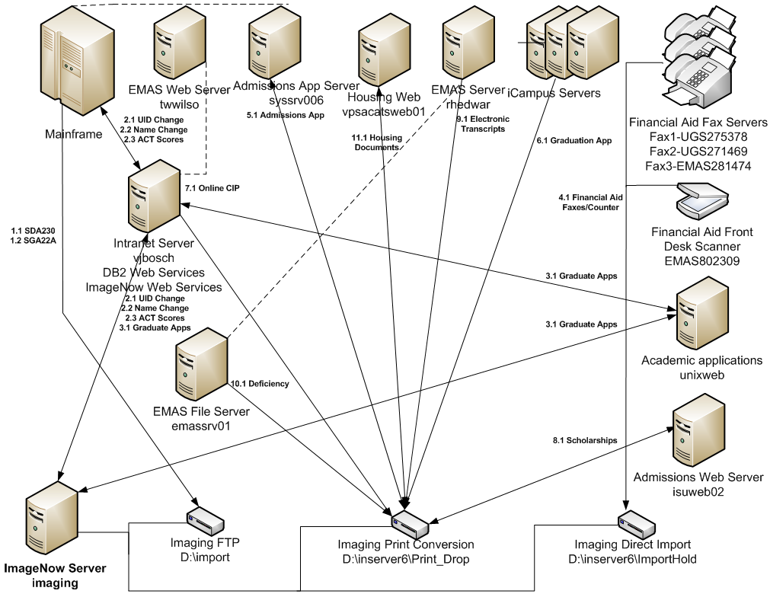
Server Interaction with External Systems

Slide 18
ISU Automated Documents
Admissions Scholarships & Acceptance
Admissions Application
Personal Statement & Reinstatement Statement
Financial Aid Faxes
Electronic Transcripts
Graduation Applications
Housing Emails
Petition for Graduation Exceptions
Transfer Students – Courses in Progress
Graduation Deficiencies
Academic Progress Summaries
Teacher Certificate Endorsements

Slide 19
iScripts & Document Automation
ImageNow iScript is a scripting language based on JavaScript with access to document imaging objects
iScripts can be fired from a scheduled task or an ImageNow Event
Example: Copy Document iScript
Financial Aid Routes to a SSN/UID Change Queue
Queue fires iScripts which then copies the document for the Registrar and routes both documents
Example: Move Admission Documents to Registrar Drawer
Nightly iScript job moves Admissions documents which are no longer being processed to Registrar
Other nightly jobs
UID Change
Name Change
Populate ACT Score
Daily Reports
User usage and page/document creation/Field Validation

Slide 20
Web Services & Server Imports
ImageNow exposes many document imaging objects via Message Agent (Web Services)
Uses SOAP to exchange XML over HTTP/HTTPS
Session created with an ImageNow User, so access restricted to that user
Graduate School uses to view admissions documents
Apply to My Program created by Alex Skorpinski & Brad Cable
List of Documents on website
Click document to view PDF of document
Server document imports done with Import Agent
We have 2 Import Agents running; one for TIFs and one for PDFs
Filenames store field index values
ADM STUDENT_827099375_Application_Summer 2013_Grad Student-At-Large_DWYER ROB_Default.PDF
Most PDFs converted to TIFs before Import
Documents routed to Import Agent queue
Import Agent queue fires iScript which then routes document based on field values

Slide 21
ImageNow Server Administration (ISA)
ISA is a Server Application
Shows status of System
Services (aka Agents)
Users
License Usage
Workflow Queues
Storage Configuration

Slide 22
Live ImageNow Server Demo Conclusion

