Slide 1
An ISU Evaluation of Virtual Desktop Infrastructure

Slide 2
Project Team Members
Dudley Roach
Majeed Abu-Qulbain
Alexander Fishel
Bryan Gill
Ryan Grahs
Patrick Healy
Krena Hoyt
Pete Juvinall
Ballard McCleskey
Kevin McMahon
Dave Rathke
Chad Scheiman
Paul Unsbee

Slide 3
Project Summary
Goal
The goal of this project is to research and evaluate the various HVD environments and make a recommendation on a scalable implementation plan and the resources it would require.
Scope
This project was asked to look at campus wide HVD solutions for both lab/classroom environments and faculty/staff workstations.

Slide 5
Research phase
Universities
University of Connecticut
Heartland Community College
Indiana University
Clemson
Michigan State
Vendors
Citrix
Dell
Microsoft
Nutanix
Unidesk

Slide 6
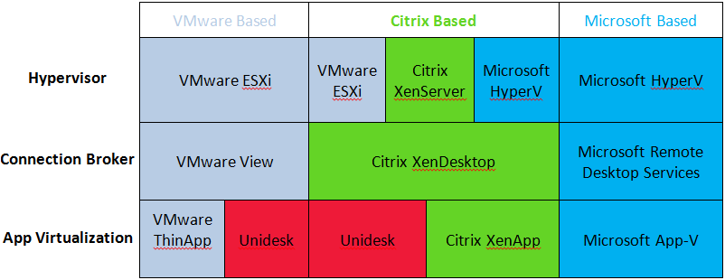

Slide 7
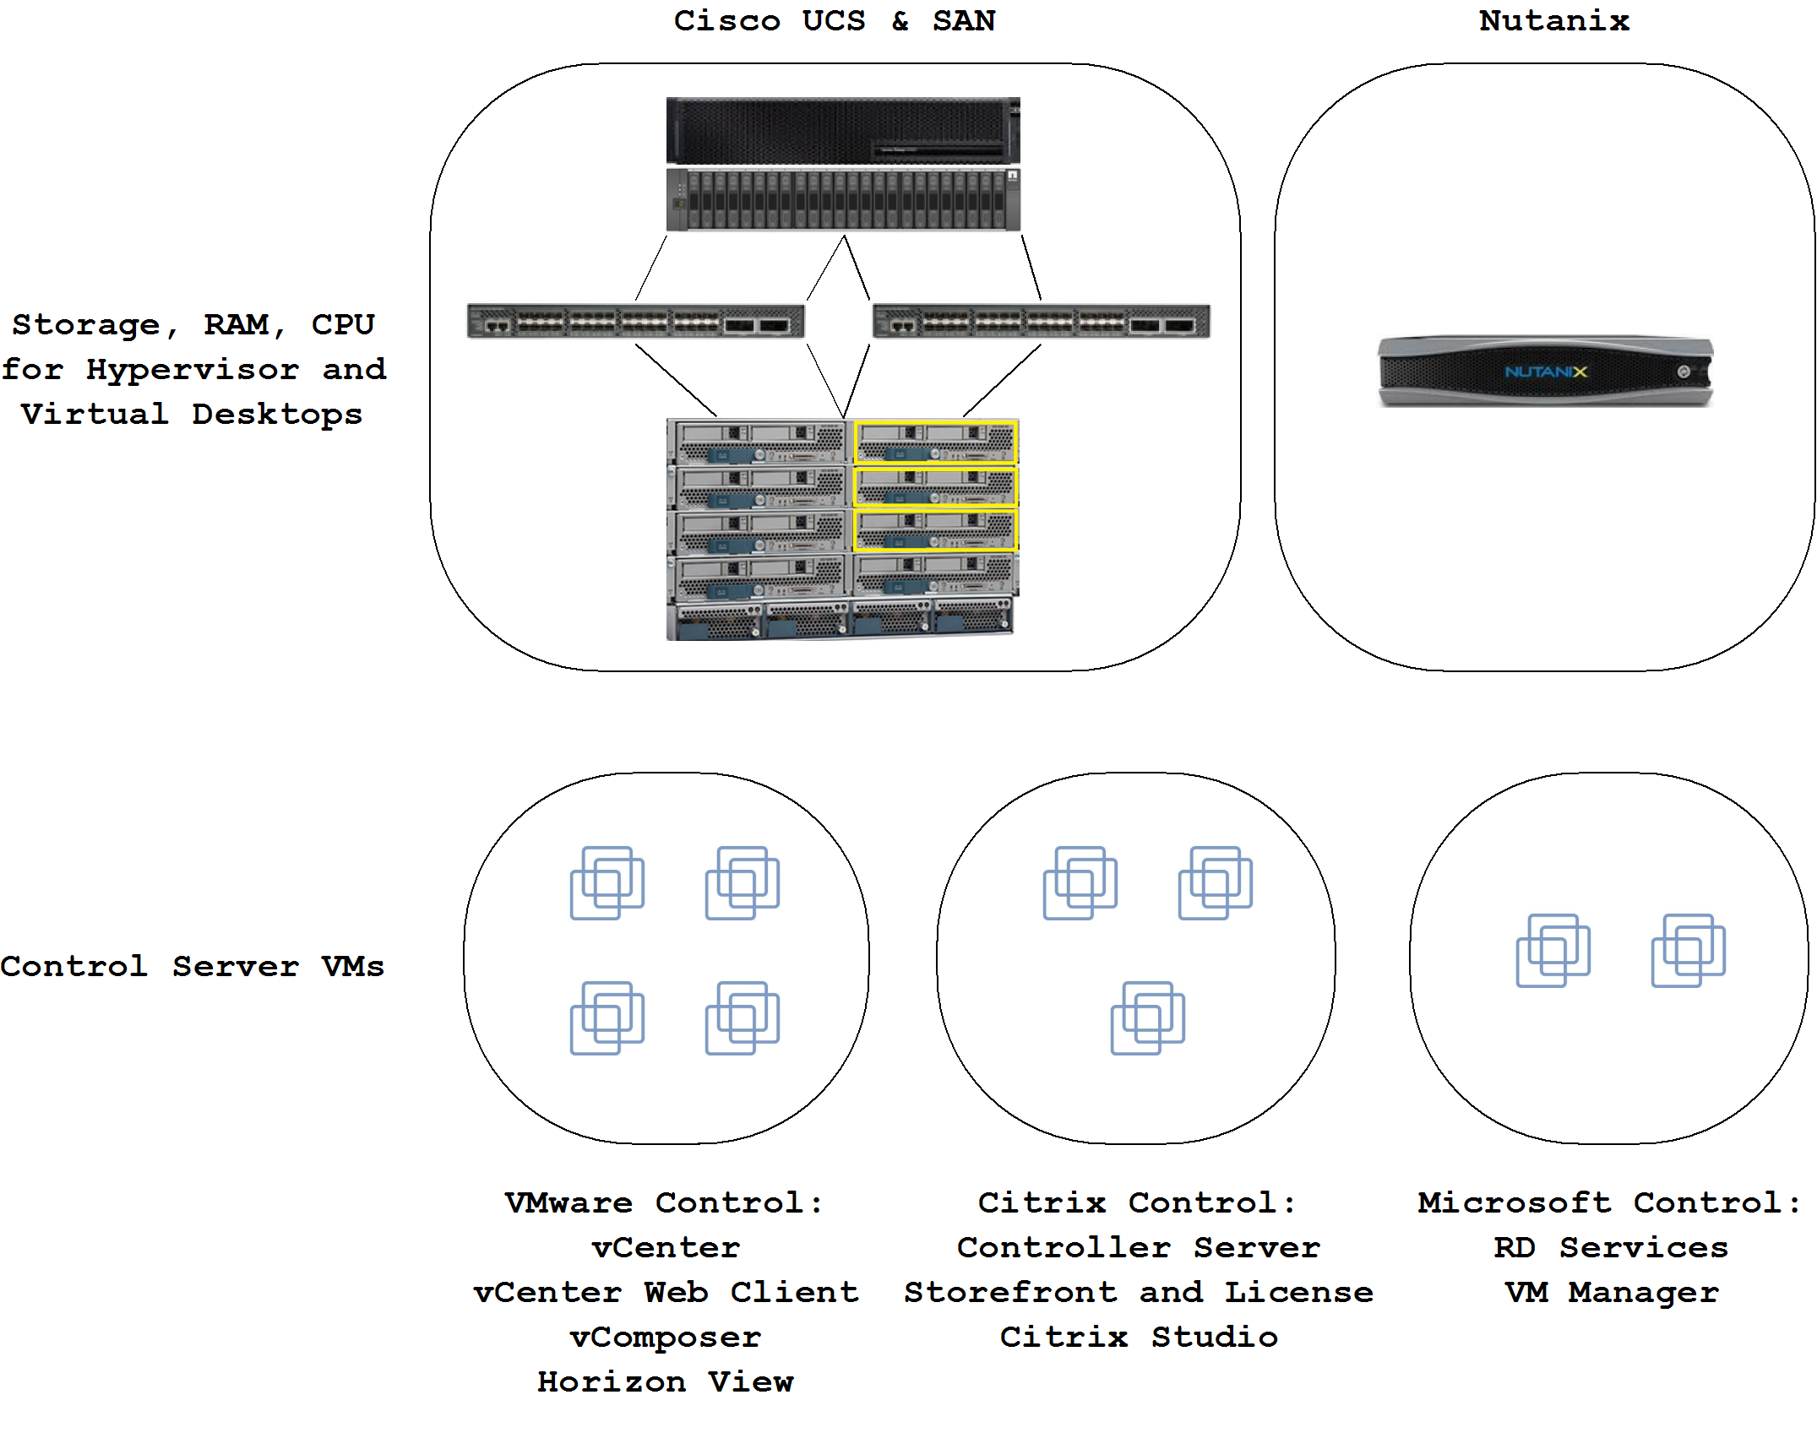

Slide 8
What’s it going to run on? (endpoint testing)

Slide 9
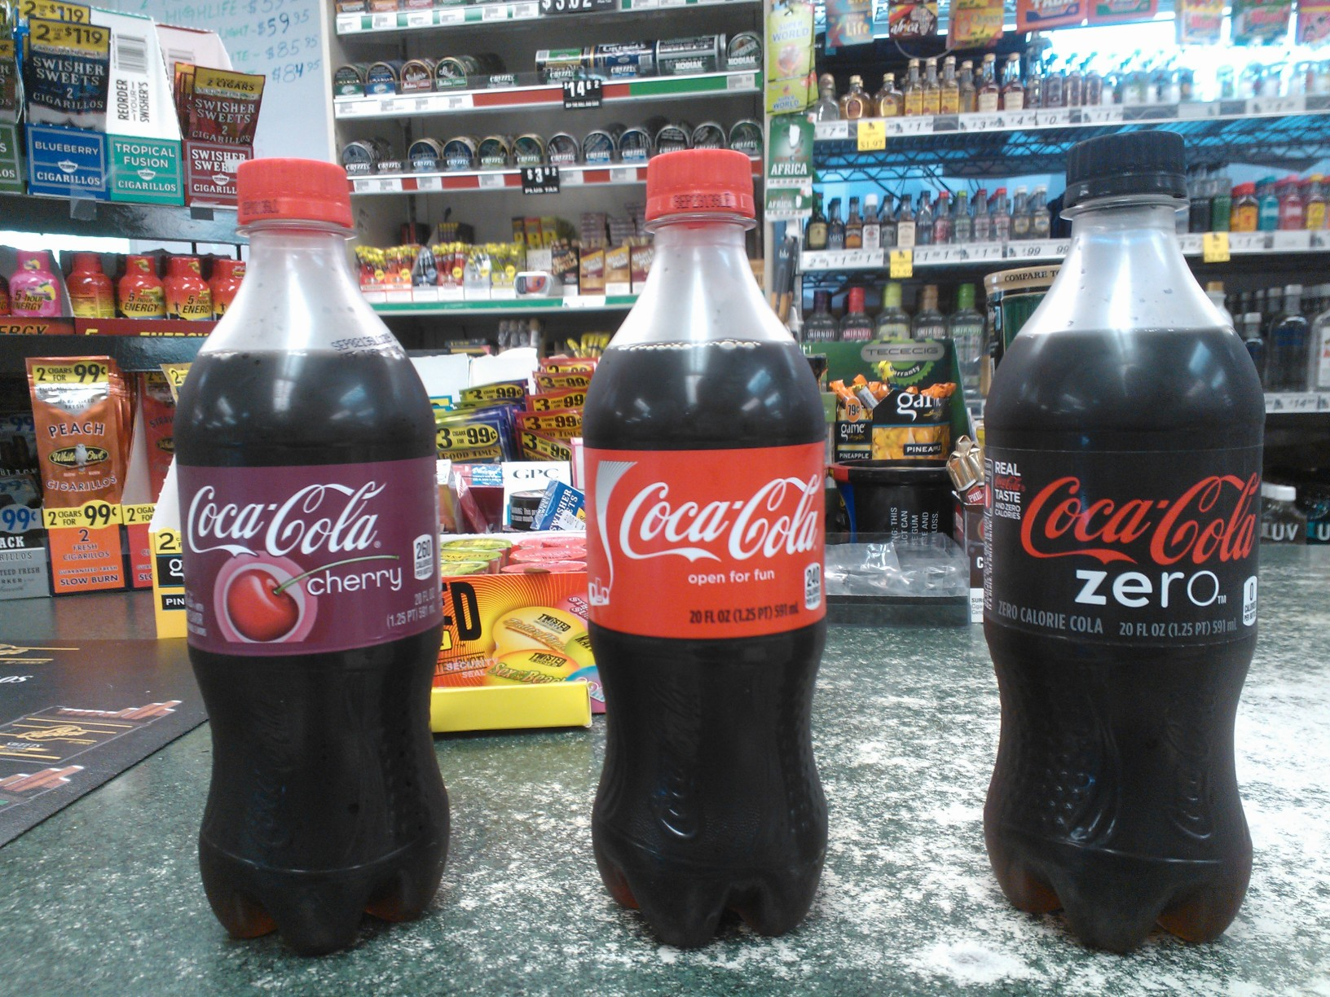

Slide 10
Thick
Thin
Zero
Existing machines
Minimal updating
Connection broker independent
Increased Graphics
Long recap cycle
Connection broker dependent
Inexpensive
Minimal management

Slide 11
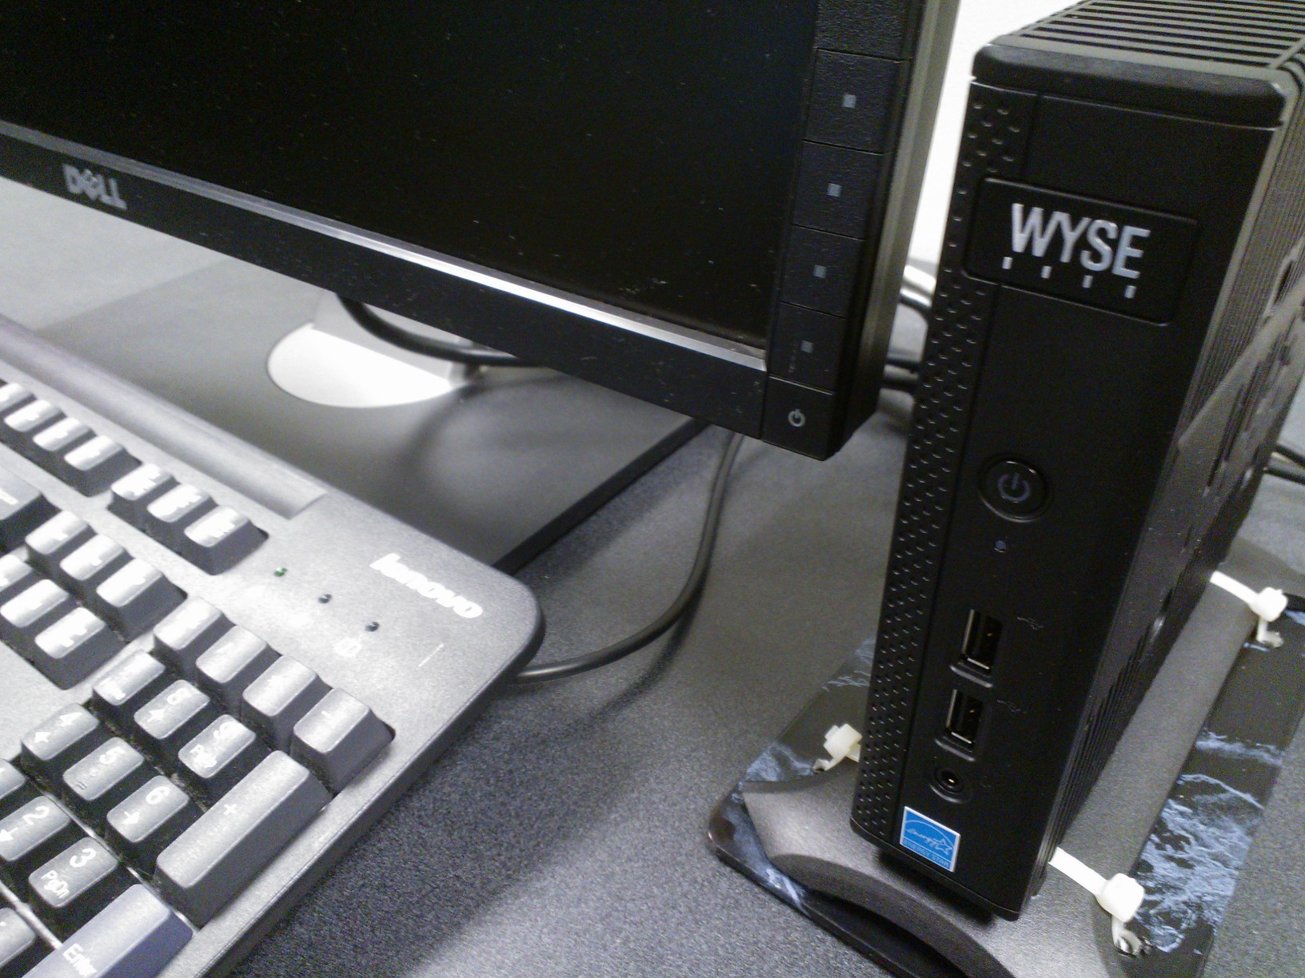

Slide 12
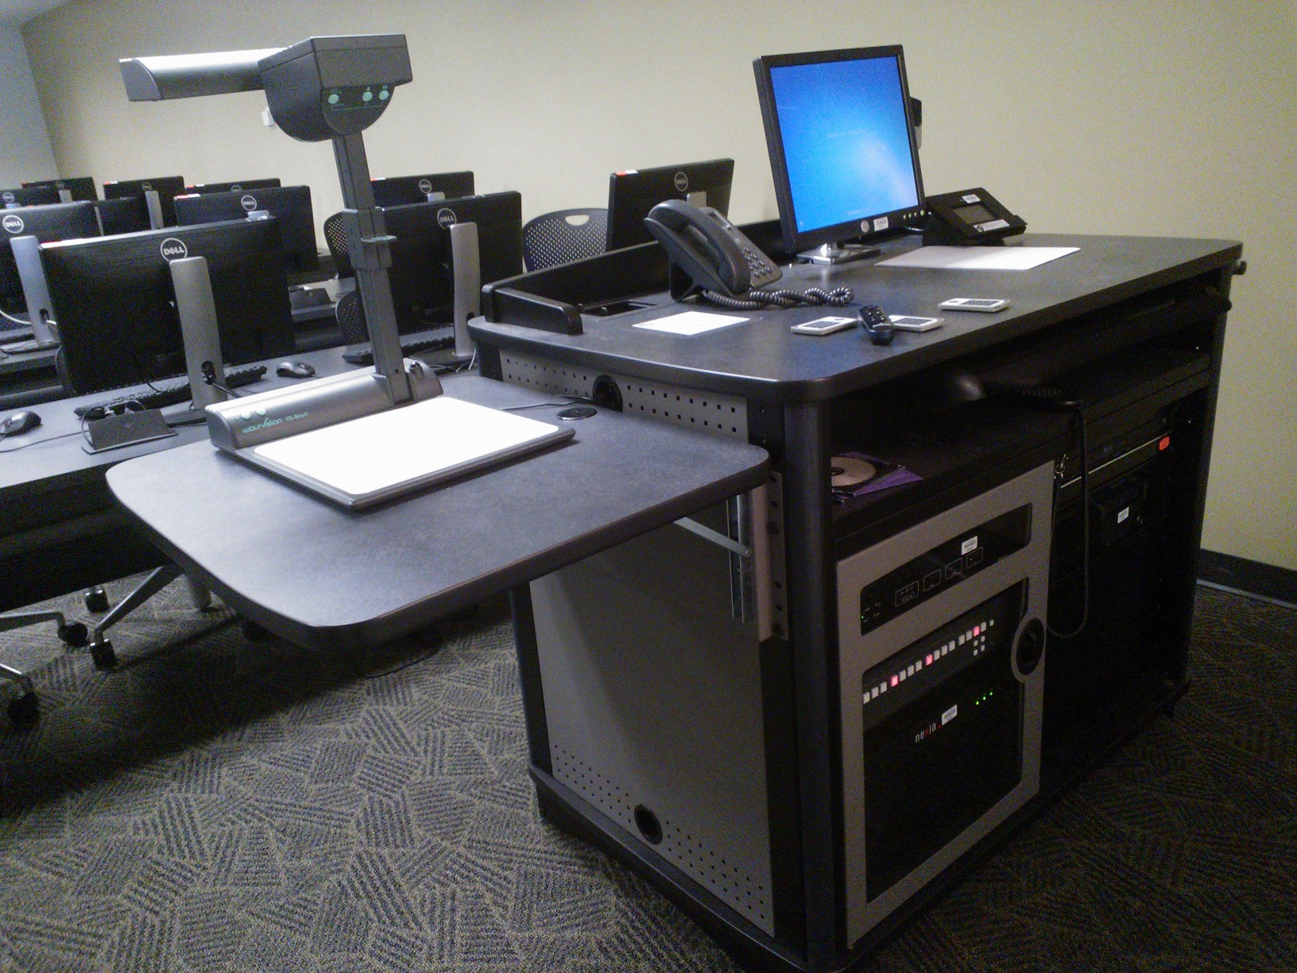

Slide 13
Questions?

