Slide 1
Computation for ISU’s College of Engineering: Needs and Trends 2024 Spring CITx Friday February 23, 2024
Thomas K. Keyser, Ph.D.
Founding Dean of Engineering
Illinois State University

Slide 2
Agenda
About Me
Current Status of College
Building Renderings
Needs of the College
Software
Hardware
Future Needs
Questions and Answers

Slide 3
About Me
BS Mechanical Engineering - New Mexico State University
MS Industrial and Systems Engineering – Colorado State University
PhD Industrial Engineering – Clemson University
I Love to Code and I Used to Be Diabolical
BASIC

Slide 4
About Me
My Interests
Distributed Computing
Optimization
Simulation
Engineering to a broader community
Engineering in a developing world

Slide 5
Current Status of College
Date | ISU Milestones
April 2023 | Founding Dean Dr. Thomas Keyser
August 2023 | Founding Chair of Mechanical Engineering Dr. Nesrin Ozalp Founding Chair of Electrical Engineering Dr. Vijay Devabhaktuni
October 28, 2023 | First Industry Advisory Board Meeting
January 15, 2024 | Illinois Board of Higher Education Approves all 3 Bachelor of Science Degree Programs
April 2024 | Associate Dean of Engineering Equity, Inclusion & Student Success Director
August 2024 | Founding Faculty of Mechanical & Electrical Engineering
August 2025 | First Cohort of Students
August 2026 | College of Engineering Building is Completed

Slide 6
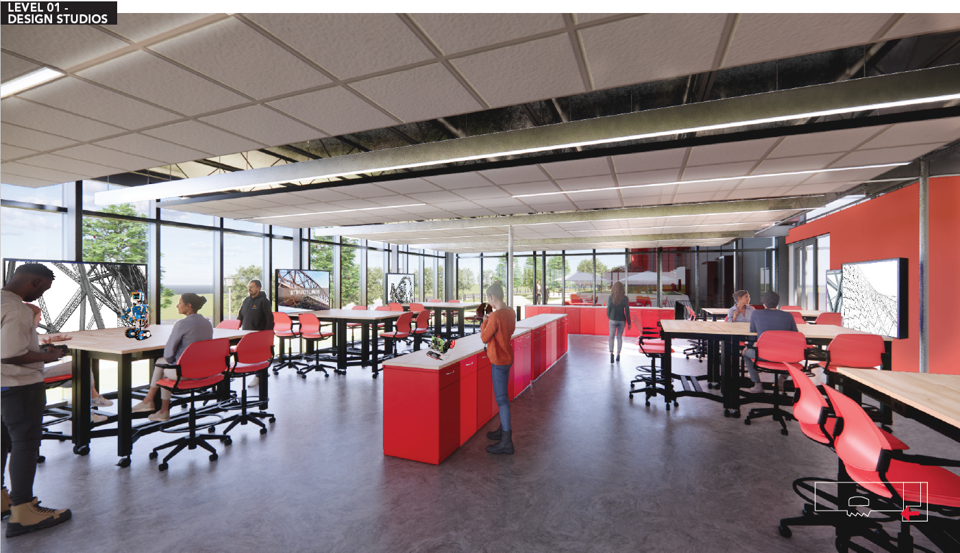
CEG Renderings

Slide 7
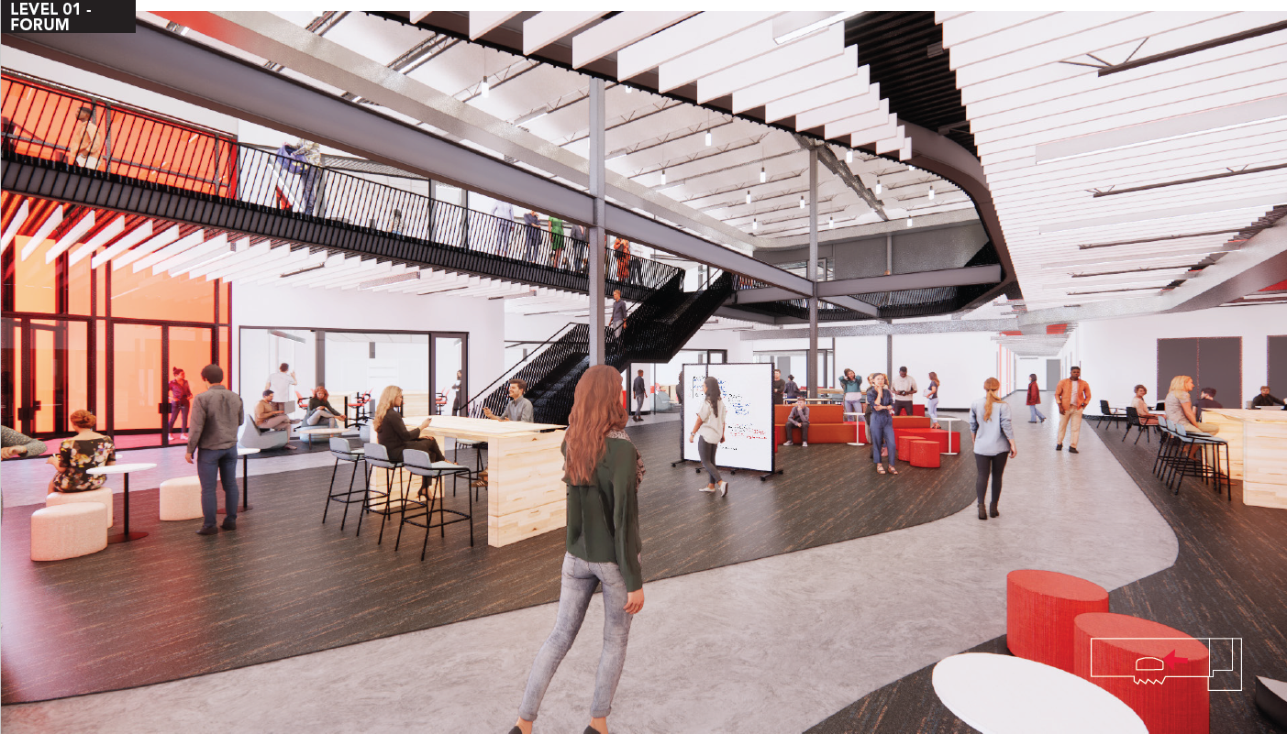
CEG Renderings

Slide 8
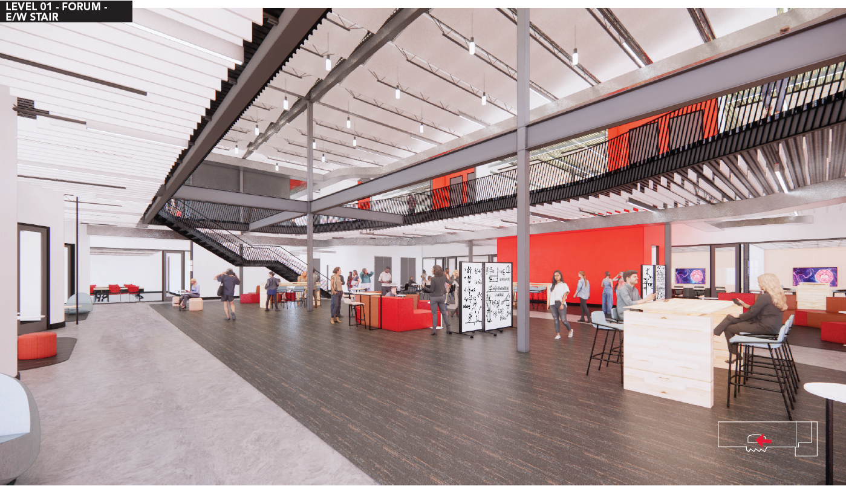
CEG Renderings

Slide 9
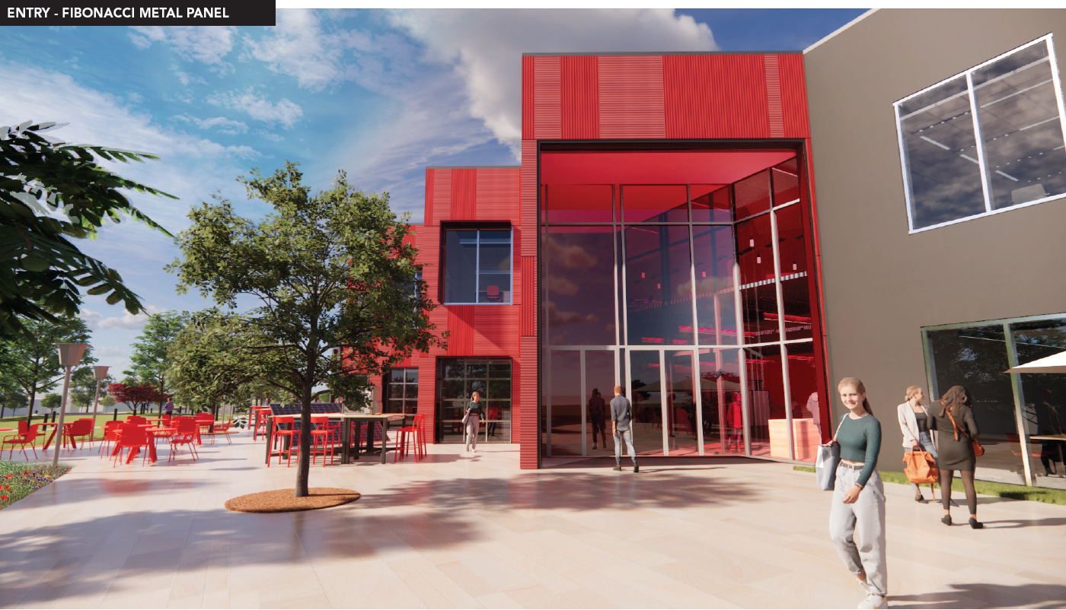
CEG Renderings

Slide 10
College Needs - Software
Software
MS Office (Excel/VBA)
Solid Modelling / Design (Solidworks; Siemens NX)
MATLAB, LabView, High Level programming Languages (C, C++, …)
Analysis Tools (STAR CFM, Ansys, PSPice, …)
Multitude of Specialty Software (Arduino IDE, Embedded C, FEM, …)
IOT Support
Software Associated with Equipment (Data Acquisition, Scopes, Flowmeters, Additive Manufacturing, CNC, Ladder Logic,…)

Slide 11
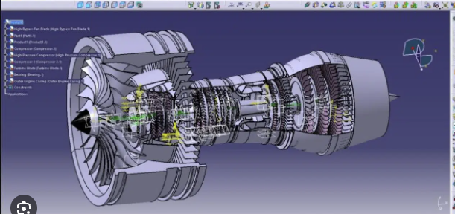
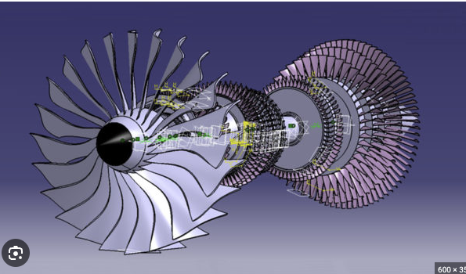
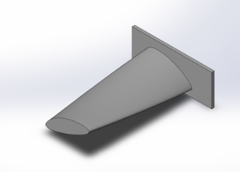
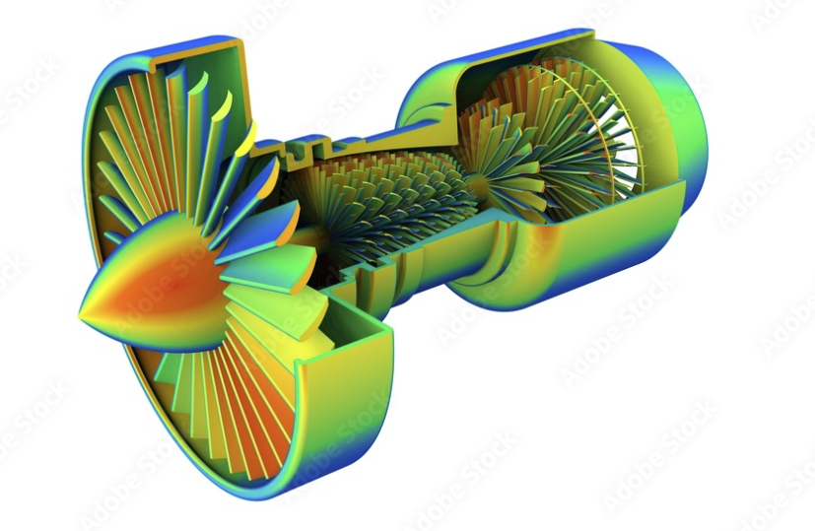
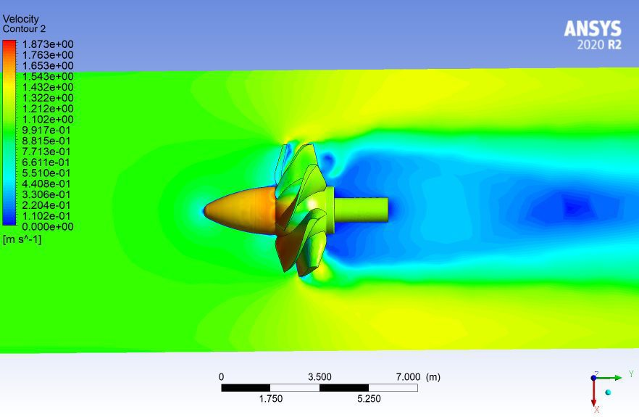
College Needs - Software
Example Software in Design

Slide 12
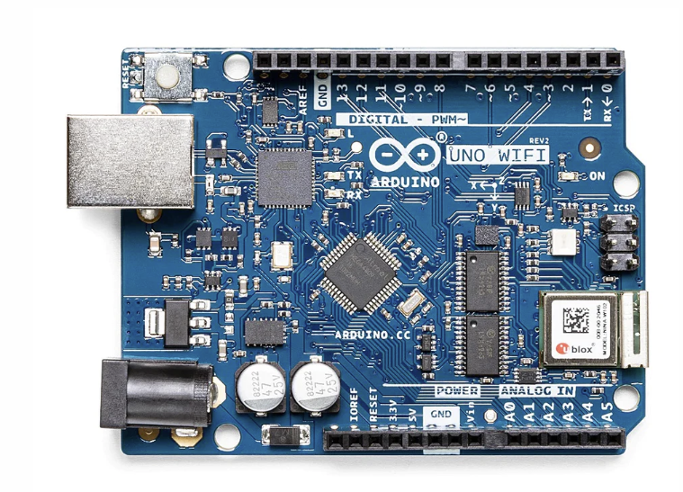
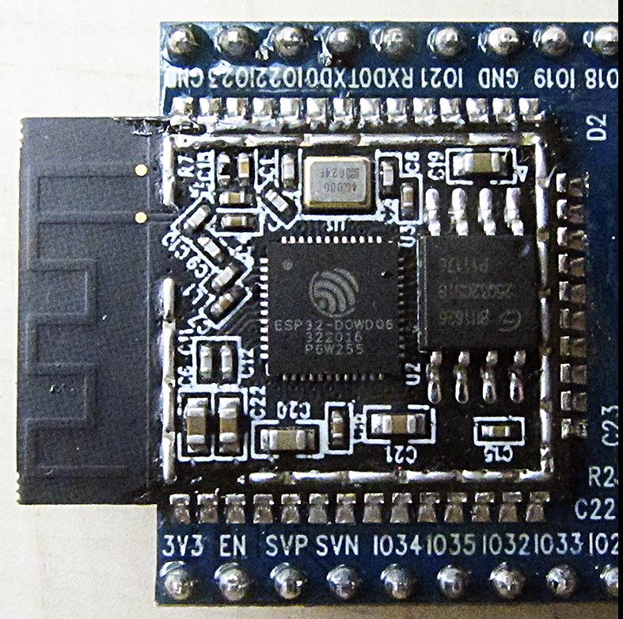
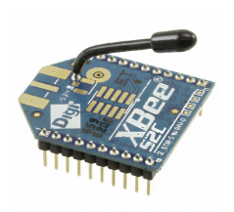
College Needs - Hardware
Hardware
Cloud Storage
College Laptop Program
HPC
Lab Workstation Support
Specialty Laboratory Hardware Support (Robotics and Controls)
Data Acquisition, Electronic Bench, Robotics, Additive Manufacturing, CNC, PLC’s,…)
Networking Access (Wired and Wireless)

Slide 13
Future Needs
Foreseeable Future
Cloud Storage / Optimization / Computation / Design
HPC Expansion and Support
Specialized Workstations
Partnerships with Federal Research Labs and Other Universities
Computer Engineering
Increased IOT / Remote Sensing
Linux / GPU based Workstations

Slide 14
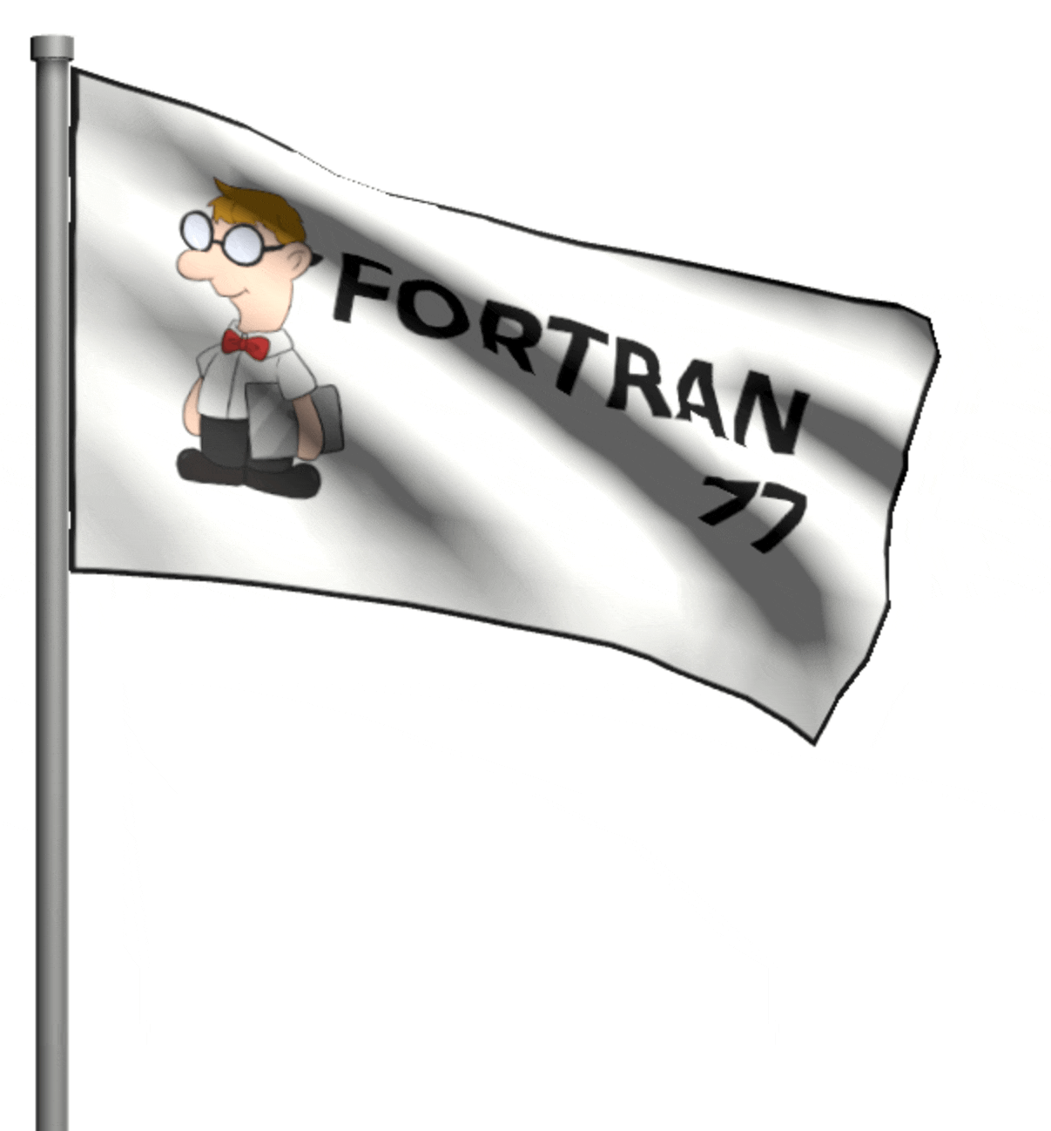
Questions and Answers

