Slide 1
Knowledge Management Roundtable: Best Practices, Tips & Tricks
Facilitated by:
Christopher Brandt:
Manager, Client Services Knowledge and Training Team
ctbrand2@ilstu.edu
Tyler Piper:
Interim Director of IT Service Management
tspiper@ilstu.edu

Slide 2
Public v. Non-Public Content
Public
Anyone with an internet connection may access
May be shared with anyone
May be published by the Knowledge and Training Team, plus the owners of a handful of other Confluence
Any information targeting ISU customers
Non-Public
Only authenticated users may access
May be shared only with those who have been granted permission to access
May be published by anyone with permission to edit in the Confluence space
Internal process documentation

Slide 3
Do I Need a Space for That??
What is the intention?
If the ability to simply collaborate/share content is the goal, permission settings may be more appropriate.

Slide 4
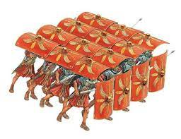
Permissions/Sharing
Sharing/Permissions Settings:
Space Level
Section Level
Parent article Level
Individual article Level
Child objects inherit permission settings from their parent objects by default.
Child object permissions may be changed to be more restrictive than their parent object(s), but not less restrictive.

Slide 5
Knowledge Champions
Future State
Illinois State University Departments desiring to create and manage their own public content may designate one or more “knowledge champions) who will receive training and access to create and edit content in the public space

Slide 6
Confluence Roadmap

