Slide 1
ROY D. MAGNUSON | COOPER CUTTING | JENNIFER FRIBERG
Reimagining Learning
Navigating Artificial Intelligence in Higher Education

Slide 2
Our map for today
WHAT HAVE WE BEEN DOING
QUESTIONS AND SOME ANSWERS

Slide 3
SECTION 1 | WHAT IS EVEN HAPPENING?
What have we been doing?

Slide 4
What have we been doing at Illinois State?
Increasing AI Literacy
Work
WORKSHOPS, PRESENTATIONS, LUNCHES, ONE-ON-ONE DISCUSSIONS
Continuing to Learn
READING PAPERS, ATTENDING CONFERENCES, ENGAGING WITH SCHOLARS
THIS IS AN ONGOING, UNENDING PROCESS
Coordinating Across the University
FROM THE STUDENT CODE OF CONDUCT TO RESEARCH AND TEACHING GUIDELINES
Learning How to Be Prepared
ADAPTIVE, INFORMED, AGILE, CONSIDERATE

Slide 5
What else can we do?
We can't stop.
Face challenges, embrace ethical implications
SECURITY, LACK OF REGULATION, BIASES, PRIVACY, ACCESSIBILITY
Use generative AI creatively and cautiously
Build understanding, increase literacy
INTERNALLY, AND EXTERNALLY

Slide 6
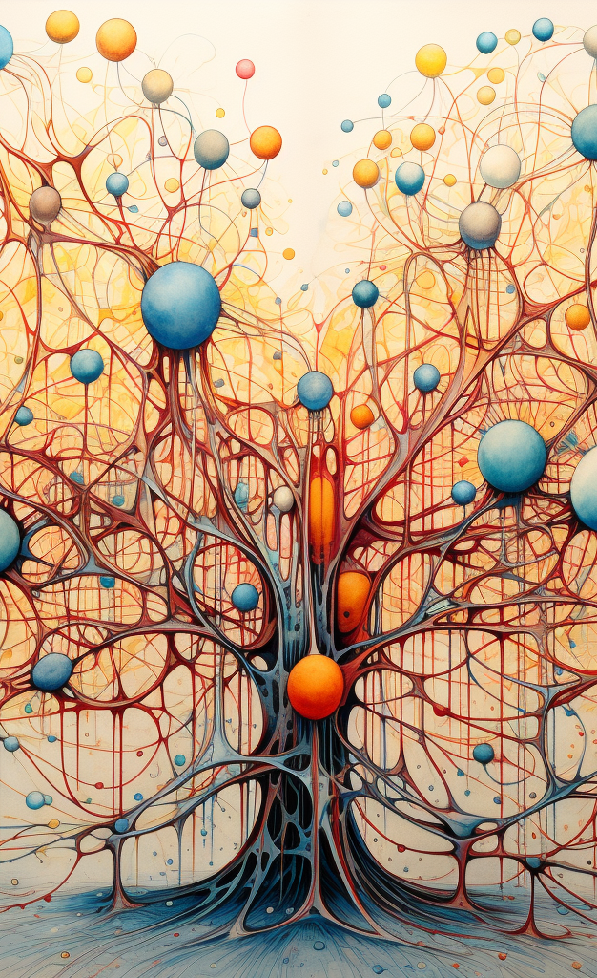
What else can we do?
Embody the opposite of AI
In a world where information has a net-zero value, humanity will be valued more than ever.
FACE TO FACE EXPERIENCES, HUMAN INTERACTION, ACCESS TO FACILITIES, COMMUNITY OUTREACH
Let AI free us to be more human

Slide 7
Committee for the Responsible Use of AI
Steering Committee
Work
DIRECT REPORT TO THE CABINET, CO-CHAIRED BY AA AND TS
Work
Four Subcommittees
CHAIRED BY SUBJECT AREA EXPERTS: TEACHING, RESEARCH, GOVERNANCE, OPERATIONSED
CAMPUS-WIDE REPRESENTATION (STAFF, STUDENTS, FACULTY, ADMINISTRATION)
Operations Subcommittee
CHAIRED BY CRAIG JACKSON, FOCUSED ON HOW WE ENABLE FACULTY, STAFF, STUDENTS
HOW DO WE KEEP PEOPLE SAFE

Slide 8
Questions and Discussion
Teaching
Research
Operations

