Slide 1
Modernize"d" IAM
Ian Bruckner, Jeremiah Haywood, Ben Rappleyea
IAM: Identity and Access Management

Slide 2
IAM Participants
Digital Transformation & Process Imprvment.
CISO
Infrastructure Operations & Networking
Enterprise Applications
Client Services
Business Office
Project & Portfolio Management
Project Manager
Business Analyst
Office of IAM
Manager
IAM Admin
IAM Admin
Cloud, Compute, Auth
Infra. Architect
OpenShift Admin
Auth Admin
Auth Admin
Directory Admin
Directory Admin
Database Admins
Manager
Postgres DBA
Oracle DBA
Web
Web Designer
Web Developer
Application / Integration Developer
Technology Support Center
Assistant Director
Support Center Manager
Analysts
Incident Manager
Knowledge / Training Analyst
Technology Support Center
Vendor Management Specialist
CMDB & Release Management Specialist
Marketing & Communication Coordinator
ERP Team
Manager
Technical Analyst
ERP Admin
Developer
Distributed / College IT Units
“real world” quality assurance testing and early adopters
Unified Comm.
UC Admin
LOB Applications
8 App Admins
Endpoint Support
~5 sys admins

Slide 3
Projects
Sync Appropriate Person Data to AD & LDAP
Started Nov 2016 > finished Oct 2018
3914 hours of effort in TS alone... Heavy extra time with HR & Registrar
inCommon Collaboration Success Program Engagement
Started Oct 2020 > finished Jul 2021
965 hours of effort
Modernize IAM
Started Aug 2021 > anticipated* finish: Sept 2023 (major work finished Jul 2023)
8900 hours of effort and counting
Notes:
3 major projects

Slide 4
Project Scope: Sync to AD & LDAP
​Major deliverables:
Identity Data Dictionary | Help - Illinois State (built on Confluence)
Best-effort implementation using legacy IAM system & ERP
Account attributes & affiliations
eduPerson schema
New “Identity Table” in our ERP, ready for midPoint & Grouper
Follow-on efforts began to utilize the affiliations and identity table to reconcile directories with scripting, making up for shortcomings in our legacy IAM system
Notes:
First of the three major projects
Show data dictionary

Slide 5
Project Scope: inCommon Engagement
PM-led debriefings
Readied our org for success
PostgreSQL
Infrastructure as Code
Container strategy
Developed IAM architecture
Formed relationships with peers
Notes:
Second of 3 major projects
Every other week did labs on the high-level concepts
Learned the tools more intimately, long training sessions/labs, access to the devs

Slide 6
Project Scope: Modernize IAM
Major co-req’s delivered
Massive expansion of OpenShift
PostgreSQL training and support contract
Major deliverables:
Launch & migrate all SSO integrations to Shibboleth + M365 MFA (where applicable)
Launch & migrate all affiliation group calc to Grouper
Replatform custom Account Management tool & launch midPoint
Notes:
Third of three major projects

Slide 7
Sampling of requirements management
Authorization and Access (AA)
AA.1 - Determine Authorization and Access Mechanisms
AA.1.1 - Midpoint GUI and API Authorization Investigation
AA.1.2 - Grouper Authentication
Deployment (DP)
Grouper Deployment (DPG)
DPG.1 - Grouper on Openshift
DPG.1.1 - Grouper IaC strategy
DPG.1.2 - Grouper Secrets/Keystore
DPG.1.3 - Grouper Aggregated Logging
DPG.1.4 - Grouper upgrade strategy
DPG.1.5 - Grouper Monitoring
DPG.1.6 - Openshift Resource Sizing for Grouper Components
DPG.1.7 - Work with ION and the business office to procure needed openshift resources
DPG.2 - Grouper Upgrade Strategy and Steps
DPG.3 - Grouper Tree/Folder Structure
Midpoint Deployment (DPM)
DPM.1 - Midpoint on Openshift
DPM.1.1 - Midpoint IaC strategy
DPM.1.2 - Midpoint Secrets/Keystore
DPM.1.3 - Midpoint Aggregated Logging
DPM.1.4 - Midpoint Monitoring
DPM.1.5 - Midpoint upgrade strategy
DPM.1.6 - Midpoint Clustered Deployment
DPM.1.7 - Upgrade Midpoint to 4.4
DPM.1.8 - Openshift Resource Sizing for Midpoint Components
DPM.2 - Midpoint on Postgres
DPM.2.1 - Primary Node Setup
DPM.2.2 - Secondary Node Setup
DPM.2.3 - AWS Node Setup
DPM.2.4 - Load test of primary and secondary
DPM.2.5 - Upgrade DB version from 12 to 13
DPM.2.6 - Midpoint on Postgres test cluster
DPM.2.7 - Production postgres
DPM.2.8 - Postgres manual failover
DPM.2.9 - Postgres automatic failover
Transition Plan (DPTP)
DPTP.1 - Develop Plan for Seeding Identity data into Midpoint
DPTP.1.1 - Live Syncing Account Self Service Generated data from OIM to Midpoint
DPTP.2 - Account Self Service Transition Plan
DPTP.3 - OIM to Midpoint Transition Plan
DPTP.4 - Vendor Support
DPTP.4.1 - Identify Midpoint and Grouper FX used
DPTP.4.2 - Request and Eval support options
DPTP.4.3 - Obtain vendor support
Provisioning (P)
P.1 - Username Generation
P.1.1 - Configure mapping in default user template
P.1.2 - check against list of ULIDs not to use during ULID Generation
P.2 - UID Generation
P.2.1 - Configure mapping in default user template
P.3 - Email Generation
P.3.1 - Configure mapping in default user template
P.4 - LDAP Provisioning
P.4.1 - Review LDAP Schema and confirm attribute use
P.4.2 - Provision LDAP Groups
P.4.3 - LDAP Account Provisioning
P.5 - AD Provisioning
P.5.1 - AD Account Provisioning
P.6 - Azure Provisioning
P.7 - Trusted Resource Reconciliation
P.8 - Midpoint User Template
P.9 - Determine DLID Provisioning Strategy
P.10 - Grouper Subject Source Provisioning
P.10.1 - Configure Midpoint to provision to Postgres db
P.11 - Delayed Delete
P.12 - Credential Provisioning
P.12.1 - Investigate Credential Mapping
P.13 - Attribute Based Entitlements
Roles (R)
R.1 - AFL_* roles back to CS
R.2 - Role Sync/Assignment
R.3 - Role and Primary Affiliation handling within Grouper and Midpoint
Reconciliation/Synchronization (RS)
RS.1 - midPoint users
RS.1.1- Targeted Reconciliation/Recompute for all Active Users (all sources and targets)
RS.2 - Directory Accounts
RS.3 - OIM to Midpoint transition state
RS.4 - Password Flow
RS.5 - Manager/Reports to data management
RS.6 - Synchronize Affiliation Data From Grouper to CS
RS.6.1 - Create db for affiliation consumption
RS.6.2 - pickup and deliver affiliation data to CS
RS.6.3 - Create SQL Grouper provisioner
RS.6.4 - Configure CS to receive affiliation data
RS.7 - Midpoint event processing (midpoint to CS)
RS.7.1 - Add passwordchangedatetime to table
RS.7.2 - Sending Email back to ERP
RS.7.3 - Sending UID back to ERP
RS.7.4 - passwordlastchangedate
RS.7.5 - Turn on message flow to CS
RS.8 - CS to Midpoint
RS.8.1 - Create CS Identity table
RS.8.2 - subscribe to CS identity table
RS.8.3 - Integration to deliver PPD to midpoint
RS.8.4.1 - Full Sync of the ISU Identity Table (weekly, bi-weekly, or monthly)
RS.8.4.1 - Incremental/Real Time Sync from ISU Identity Table
RS.8.4.2 - Livesynch Monitoring/Continue on error
RS.8.5 - Scheduled reconciliation / full sync of Active population
RS.9 - Remove Samba Attributes/ObjectClasses
RS.10 - Turn off live sync from OIM
Self-Service (SS)
SS.1 - REST API Discovery
SS.2 - Account Recovery
SS.3 - Self-Service Integration
Integration References
Notes on exporting openshift hosted pg db
SS.3.0 - Modify IAM interface for dual-write capability to OIM & Midpoint
SS.3.1 - Refactor base level API usage
SS.3.1.1 - Set Adobe Student Value
SS.3.1.2 - Removal of SMB Password Hashes
SS.3.1.3 - Retrieve Basic Midpoint User Info
SS.3.1.4 - Update/Specify Electronic Signature Policy
SS.3.1.5 - Update/Specify Multi-Factor Authentication (MFA)
SS.3.1.6 - Update/Specify Preferred Name
SS.3.1.7 - Update/Specify Non-ISU Email Address
SS.3.1.8 - Update Password Expiration Display
SS.3.2 - Refactor front end web interface usage
SS.3.2.1 - Removal of Security Questions
SS.3.2.2 - Account Activation Process
SS.3.2.3 - Leverage 3rd Party Email for Account Recovery
SS.3.2.4 - Account Refresh
SS.3.2.5 - Update Password complexity and history in integration
SS.3.2.6 - Forgot my username functionality
SS.3.2.7 - Forgot my password/Password reset functionality
SS.3.2.8 - Implement Have I Been Pwned API
SS.3.3 - Implement Password Complexity and History
SS.3.4 - Password Canary Function Replication
SS.4 - MFA Handling
Auditing (A)
A.1 - Assess user/data auditing features
A.1.0 - Review and investigate data provenance features
A.1.1 - Test data investigation scenarios
A.2 - Assess audit logs
A.3 - Midpoint config to externalize audit table from primary repository
A.4 - Grouper Audit Log Output
A.5 - Grouper Database Size and Retention
Data Validation (V)
V.1 - LDAP Data
V.2 - AD Data
V.3 - Automated Unit Tests
V.4 - Midpoint to CS
Grouper Provisioning (GP)
GP.1 - AD Group Provisioning
DP.1.4 - failover VIP
GP.1.1 - Create IAM OU in AD
GP.1.2 - Create AD Provisioner
GP.1.3 - Assign Provisioner to Affiliation Groups
GP.2 - LDAP Group Provisioning
GP.2.2 - Affiliation Groups
GP.2.3 - LDAP Groups in use currently
GP.3 - Loader Failsafes
GP.3.1 - Create test database
GP.3.2 - Test Failsafe Mechanism
GP.4 - Group Naming Conventions
GP.4 - Provision Role Data to DB for Midpoint
GP.4.1 - Configure Provisioner
GP.4.2 - Validate data being put into table
GP.4.3 - Create Pivot Table of Data
IAM Operations Support (IOS)
IOS.1 - Central IAM Info Page
IOS.1.1 - Brainstorm potential requirements
Notifications (N)
N.1 - Password Expiration Notifications
N.1.1 - Configure Password Expirations in Midpoint
N.1.2 - Filter out Metcalf and U-High Population
N.2 - Account Expiration Notifications
N.2.1 - Configure Account Expiration Notifications in Midpoint
N.3 - Get notification templates into GIT
IAM Brainstorm
Extension Attribute 1 Values
IAM Pre-hire Solutions
IAM Transtion Plan Checklist
Midpoint TEST Release Communication
TSC Requirements Brainstorm
Notes:
Just the midpoint & grouper portion of the Modernize IAM requirements

Slide 8
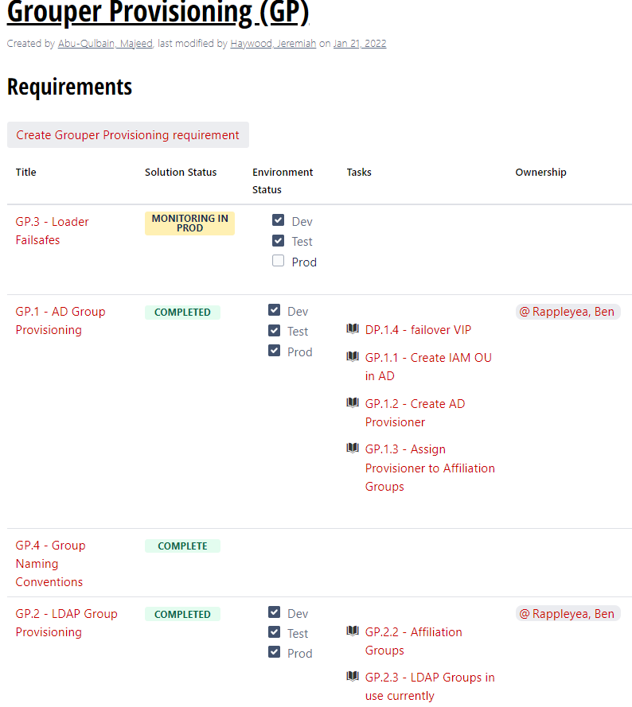
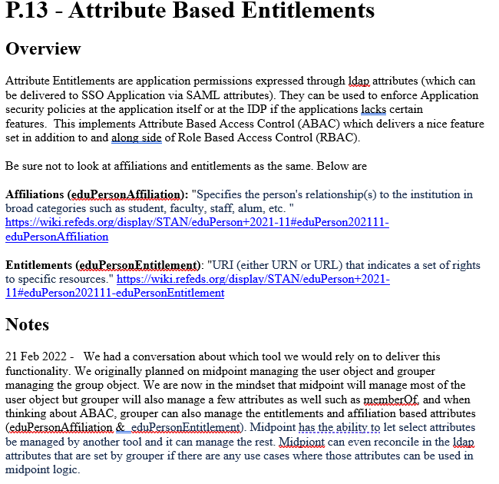
Sampling of requirements management
Lesson Learned
Notes that should really be action items didn’t turn into action items of their own, we lost sight of them and
Notes:
Every requirement from the previous page had this level of detail

Slide 9
Up Next
Any questions on what we’ve done… past tense?
Questions
Standard Secondary Account Provision (Grouper and Midpoint working together)
Delegated access control via Grouper
Automated application-level access provisioning beyond LDAP & AD

Slide 10
Standard Secondary Account Provisioning
Current state
Varying naming conventions
Multistep provisioning process
Future state
Standardization
Improved secondary account lifecycle
Multitude of provisioning options

Slide 11
Secondary Account Examples
Scenario 1
Recently hired student employee needs a secondary account to fulfill work duties
Scenario 2
An admin account is requested for a full-time employee to complete tasks that require elevated access
Scenario 3
A student employee transitions between two different jobs

Slide 12
Live🤞demo

Slide 13
Delegated access control via Grouper
Automated group management (talked about more on next slide)
Ad hoc group management for AD and LDAP
Moving to flat provisioning in AD
Group attestation

Slide 14
Automated application-level access provisioning beyond LDAP & AD
Loader jobs
Reference groups

