Slide 2
Welcome to the 2023 CIT Annual Conference

Slide 3
IT News

Slide 4
IT News Rules of the Road
This session is being recorded and will be posted to the CIT web site
Please keep your mic on mute
Questions are welcome if time permits at the end
In person attendees, raise your hand we’ll bring the mic to you
Online attendees, put your question in chat and we will repeat it in the room

Slide 5
“Yes, You Can with Canvas!”
Instructor Resources
Don’t forget about Canvas Studio (Add-on Tool for Video/Multimedia)
Contact CIPD - https://prodev.illinoisstate.edu/canvas/
Student Resources
Online Training - http://www.ilstu.edu/quickstart
Everyone can always contact the Technology Support Center and use online help.
https://help.illinoisstate.edu/technology/support-topics/canvas
Todd Smoak

Slide 6
“Yes, You Can with Canvas!”
No Roadblocks, but still a few speed Bumps
Some LTIs (add-on tools) still in progress of being setup
Midterm Grades Process is being reworked to use Canvas and is still in progress
Todd Smoak

Slide 7
Actionable Insights to Drive Your Strategy
Denise Cushaney

Slide 8
Success depends on strategy and execution in a complex environment with many moving parts
8 © 2023 Gartner, Inc. and/or its affiliates. All rights reserved.

Slide 9
You are equipped with the insights, guidance and tools to execute on your strategy
Gartner for Technical Professionals gives technical domain architects the actionable research, expert guidance and interactive tools to deliver on their leaders’ tech strategy.
Architects will get support to understand emerging technology, what they need and how it fits in their specific environments. They will also have access to strategic advice on what products to buy and how to deliver initiatives tied to their critical priorities. Access to reference architectures, planning guides, technology assessments and more will enable them to accelerate project timelines, avoid costly pitfalls and validate solutions.
RESTRICTED DISTRIBUTION
9 © 2023 Gartner, Inc. and/or its affiliates. All rights reserved.

Slide 10
You and your team have access to actionable insights and support for technical implementation and execution
Lead Role (CIO, CISO, CDAO, SWEL)
Senior Technology Leader
Technical Domain Architect
Plan
Assess
Design
Business and IT Strategy
Planning and Management
Technical Implementation and Execution
Anticipate the Future
Enable Business Change Through Technology
Drive Innovation
Optimize Org Structures
Reduce/Avoid Costs
Insights Into Best Practices
Connect With Peer in Similar Roles
Clarity Within the Vendor Landscape
Optimize Contract Negotiations
IT Spending & Benchmarks Data for Better Decision Making
Business of IT topics – SVM, PPM
Insights Into Best Practices
Connect With Peers in Similar Roles
Create the Technical Strategy
Optimize Technical Architectures
Assess, Select & Deploy Technologies
Develop & Execute Project Roadmaps
Skills Development
Insights Into Best Practices
Connect With Peers in Similar Roles
Denise Cushaney

Slide 11
Access to GTP empowers your technical domain architects to deliver value across the organization
Accelerate Projects and Improve Outcomes
Reduce Spend on IT Investments
Build and retain critical skills
Trim project hours
Significantly reduce time researching and meeting with multiple vendors
Increase productivity with frameworks and tools for developing technical approaches
Quickly address and solve project challenges with GTP analysts
Mitigate risk and pitfalls
Accelerate implementation by starting with a comprehensive project plan backed by Gartner best practices
Validate technical approach
Avoid costly architecture decisions that are expensive to change
Avoid partner scope creep, unneeded complexity, and vendor lock in
Reduce spend
Select technologies and eliminate unnecessary capabilities in vendor contracts through vendor research and peer review
Minimize need for external consultants by equipping your team so they can retain project ownership
Close skill gaps through in-depth “how-to” technical guidance
Expand and modernize skillsets with Gartner resources
Attract, progress and retain talent
Stay ahead of technology trends with Gartner research
Drive a culture of continuous improvement and learning
Denise Cushaney
Notes:
With GTP, your technical domain architects will have what they need at their fingertips to deliver on your strategy – which will in turn, deliver value across the organization.
Significantly reduce time and increase productivity by having the frameworks and tools for developing approaches all in one place.
Avoid costly architecture decisions or partner scope creep that you may have with a vendor.
And fill in any skill gaps through the actionable “how-to” technical guidance provided within GTP.
Your team will have the confidence to implement and execute.

Slide 12
Architects across domains turn to Gartner for their most pressing questions
Top questions
Infrastructure Architects
How do I enable resilience, disaster recovery and data protection in my platforms and solutions?
How do I design, implement and/or optimize cloud-native infrastructure?
How do I design an automation strategy to support our organization’s DevOps initiatives?
Security Architects
How can we use modern strategies and design patterns to enhance our overall security posture?
How do we protect our SaaS, IaaS and PaaS with native or third-party tools?
How do I manage privileged access to infrastructure, apps and services?
Data Architects
How do we strategize our data management deployment spanning cloud and on-premise systems?
How do we leverage MDM principles, data quality and metadata management to support D&A governance?
How do we develop a scalable architecture and manage orchestration across our data pipelines?
Software Architects/Engineers
How can we apply agile practices to deliver better products faster?
How do we implement DevOps to improve product delivery and increase customer value?
Which languages, frameworks, tools and practices should we use to build great applications?
Denise Cushaney
Notes:
Gartner for Tech Professionals answers the most pressing questions top of mind for technical domain architects across infrastructure, security, data analytics and software.

Slide 13
Your Technical Domain Architects have access to technical content to support each phases of your initiative
Plan
Assess
Design
Select
Research Content Types
Plan
Assess
Design
Planning Guides Annual technical trends and planning considerations
Solution Paths Roadmap to implement a new solution
Initiative Analysis Analyzing the business case, impact and plan for an initiative
Video Content Quick introductory notes on addressing key customer questions.
Single Assessments Discovery and assessment of a single technology or solution
Comparison Assessments Provides analysis and comparison of multiple technologies or solutions
Essential Skills Manage and cultivate existing and required skills
Decision Points Choose technical architecture based on unique customer requirements
Guidance Frameworks Step-by-step guidance to tackle a specific challenge, architecture or implementation
Reference Architecture Reference architectures across multiple use cases and capabilities
Solution Criteria Prioritized criteria's and requirements and RFP templates
Solution Comparisons Side-by-side product/service comparison
Additional Resources
Talk to an Expert: Speak with an expert analyst to develop strategy, review architecture, and/or design implementation plans.
Network With Peers: Understand how peers are leveraging new technologies and read peer reviews of vendors and products.
Attend Conferences: Summits, and Symposium
Denise Cushaney
Notes:
Now let’s dive a bit deeper into the types of technical content that your technical domain architects will have access to. Content is aligned to all phases of your initiative so there are Planning Guides, Single assessments, Reference Architecture, Evaluation Criteria and more. All detailed and actionable technical insights to ensure your team is set up for success.

Slide 14
GTP Deep Coverage Areas
SOFTWARE ENGINEERING
Application Architecture & Integration
Agile & Distributed Application Architecture
API Design, Delivery Management & Integration
Cloud-Native Architecture & Platforms
Application Modernization
Platform Engineering & Developer Experience
Microservices & Event-Driven Architecture
AI & ML in Application Architecture
Integration & Automation Platforms & Technologies
Low-Code Application Platforms
Architecture Patterns, Practices and Skills
Software Development & Engineering
Agile Software Development
DevOps Processes, Practices and Platforms
Software Quality and Testing Processes and Practices
Software Application Design and Development
Software Engineering Skills
DATA & ANALYTICS
Analytics & Artificial Intelligence
AI Core Technologies, Skills and Governance
AI Solution Implementation
Analytics and AI Architectures
Analytics Architecture and Modernization
Analytics and BI Solutions
Data Management Solutions
Master Data Management Architecture
Data Governance andApplication Information Management
Big Data Technologies & Architecture
Data Orchestration and Next Generation Integration
Data Engineering, Metadata Management and Automation
Data Management – Database Storage and Architecture, Modernization, Guiding Principles and Deployments
Next Generation Integration
SECURITY & RISK MANAGEMENT
Identity & Access Management
Architecting IAM
Authenticating and Authorizing Humans and Machines
Managing Identities, Privileges, Relationships, and Access Rights
Security Technology & Infrastructure
Security Strategy and Architecture
Application Security
Cloud and Infrastructure Security
Data Security
Endpoint Security
Network Security
Ransomware
Zero Trust Architecture
Security Operations
Security Monitoring and Incident Response
Vulnerability Management and Controls Validation
INFRASTRUCTURE & OPERATIONS
Infrastructure
Private & Hybrid Cloud
Data Center Architecture
Virtualization and Hyperconverged
Public Cloud Infrastructure
Edge Infrastructure
Platform Architecture
Modern Networking
Quantum Computing
Containers / Kubernetes
5G and Private Mobile Networks
Essential I&O Skills
IT Operations & Cloud Management
Automation of Infrastructure, Provisioning, Processes and DevOps
IT Operations Strategies and Practices
IT Service Management and Governance
Monitoring, Observability and AIOps
Cloud & Data Center Management Platforms
DevOps, Platform Engineering, SRE
Cloud Adoption & Governance
Capacity Planning / Cost Optimization
Cost Management and Resource Optimization
IT Service Continuity & Disaster Recovery
DIGITAL WORKPLACE & CRM
Digital Workplace
Microsoft 365, Exchange Online, SharePoint, Teams, OneDrive, Sync/Async Collaboration Solutions
Knowledge Mgmt., Content Mgmt. Enterprise Search
Endpoint Mgmt., Virtual Desktop, DaaS
Unified Communications, Contact Center, Meetings, Telephony
Collaboration & End-User Technologies
CRM and CX Architecture Approaches
Customer Data Management Technologies
Customer Engagement Technologies
Salesforce CRM Technologies
Modernizing Enterprise Apps for Digital
SaaS Adoption and Evaluation
Denise Cushaney
Notes:
When you look at the deep coverage included in GTP, what areas are your teams focused on today?
(Client picks a couple of areas)
That is great to hear, we have insights and experts to help you in these areas. Would you be interested in learning more? If so, I'll connect with my Technical Specialist and we can determine our next best steps.

Slide 15
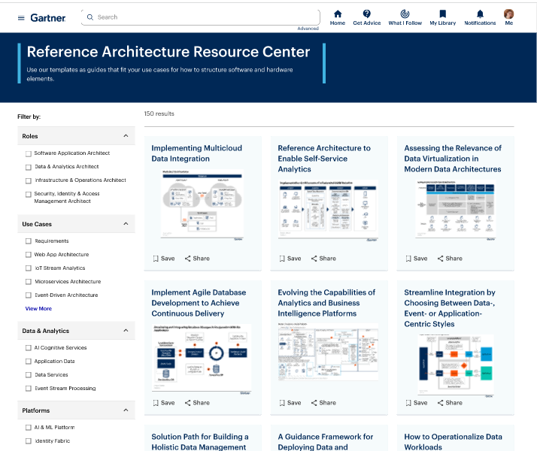
Gartner’s Reference Architecture Resource Center
Build architectures with confidence
Informed by Gartner’s rigorous research approach and client interactions, your team now has access to Gartner’s Reference Architecture Resource Center to find the right blueprint for your organization
What you’ll get –
Reference architectures based on Gartner client interactions and best practices
Insights to guide adaption to your environment
A collection of use cases and capabilities to easily navigate
Validation from a Gartner expert
Saves Time
Scalable
Unbiased
Use these foundational architectures as a starting point to create an architecture specific to your environment
Leverage reference architectures across multiple use-cases to build out a comprehensive, cross-domain Enterprise Reference Architecture
Access architectures and insights based on best practices and Gartner client interactions
Denise Cushaney
Notes:
Newly launched, our Reference Architecture Resource Center allows your technical domain architects to find the right blueprint for their organization.
Informed by Gartner’s rigorous research approach and client interactions, your team can access reference architectures across multiple use-cases and capabilities. This is intended to be a starting point as you create an architecture that is specific to your environment. And finally, once you are ready, you can validate with a Gartner expert.

Slide 16
Thank you!
Denise Cushaney
Sr. Account Executive, Gartner (& ISU Alum)
Denise.Cushaney@gartner.com
708.791.1045
Denise Cushaney

Slide 17
Confluence Status
40+ Spaces
Technology Support Teams
Technology Solutions + 7 Departmental Tech Teams
Functional Support Teams
EMDH, Facilities, FAO, HR, Payroll
Topic Specific Spaces (A Few Examples)
Accessibility, E-Commerce, EA, Esports
Tyler Piper
Notes:
CAS-IT
CAST-IT
CFA-IT
COB-IT
COE-IT
MCN-IT
SAIT

Slide 18
Confluence Article Stats
2023 Content Views January - July
Help.IllinoisState.edu -
Technology Articles -
Email Safety Tips – 109,000
Tracking Meeting Invitation Reponses in O365 – 31,000
Transferring OneNote to a New Owner – 27,000
217,000
798,000
Tyler Piper
Notes:
CAS-IT
CAST-IT
CFA-IT
COB-IT
COE-IT
MCN-IT
SAIT

Slide 19
Confluence 2023 Roadmap
Upgrade to Latest Release Version Available
Including Add-On Updates
Retire Docs.Ilstu.edu Domain
Establish Knowledge Champions Group
New Internal Landing Page
Tyler Piper

Slide 20
Cherwell ITSM
Cherwell Go Live – December 2015
First Ticket - Dec 16th @10:55 PM, #10028
Last Ticket – !?!?!
Project 10641: Implement ITSM Replacement
July 2023 – Summer 2024
Tyler Piper
Notes:
University of Wisconsin-Milwaukee completed this effort in roughly 9 months.

Slide 21
Ivanti Neurons for ITSM
100% Web Based Application
Better Performance
Mobile Apps
Customer Request Portal (A Good One)
Faster Form Development + Updates
Tyler Piper

Slide 22
CIT MVP Award
The MVP Award recognizes one full-time technical staff member each year in the Illinois State University community for outstanding contribution(s) to the support of faculty, staff, students, and/or operations, as well as collaboration with others.
Notes:
Ask the 3 nominees to stand, and deliver mug to them, then announce winner.

Slide 23
CIT MVP Award Nominee
Brian Bertalot
Technology Solutions EDA team

Slide 24
CIT MVP Award Nominee
Jim Johnson
Technology Solutions CCA team

Slide 25
CIT MVP Award Nominee
Gary Short
Tech Solutions Endpoint Support team

Slide 26
CIT MVP Award
And the 2023 winner is…
Jim Johnson
Tech Solutions CCA team
Notes:
Introduce Majeed Abu-Qulbain, who will say a few words and then Jim will also say a few words
Winner mug & plaque will be at instructor station, also deliver mugs to nominees
Note that the MVP Award winner and nominees have water bottles waiting for them on the table at the front of the auditorium

Slide 27
Congratulations on your retirement!
Charles Bristow (CIPD), August 2023

Slide 28
Thank you!
Many thanks to the
Presenters
and Tech Facilitators
who make a
hybrid CIT event possible
Notes:
Have presenters stand, and then tech facilitators
Note that they have CIT coffee mugs as a thank you on the table at the front of the auditorium
Have planning committee stand and thank them as well

Slide 29
ION - Infrastructure
University Farm Connectivity
WAN Router Upgrade
Campus LAN Upgrade (Access Layer)
Campus Wireless Upgrade (Phase 1 - 6E)
Craig Jackson

Slide 30
ION - Services
Ansible Automation Platform (SOE)
Shib/SSO – no more 30 minute delay
DMARC Implementation
Voice Upgrade (New CUBE’s)
Microsoft Services Hub
Craig Jackson

Slide 31
RCAB & BNIA
HPC - $420,000 grant money
AR/VR
Second Zero2Hero Session
VR-Assisted Scenario-Based Learning Grant
Central IL Cybersecurity Summit
Craig Jackson
Notes:
Total respondents = 8 (continuing to get more info from other researchers)
Departments = 5 (Chem, Physics, Info Tech, Math, Econ)
Total External Grants Applied = 8 (Dr Caplan is a finalist for an $8MM grant)
Total External Grants Approved - 4
Total External $’s to ISU = $420,085
Total Papers = 33
Total Presentations = 22
Total Students Involved = 13

Slide 32
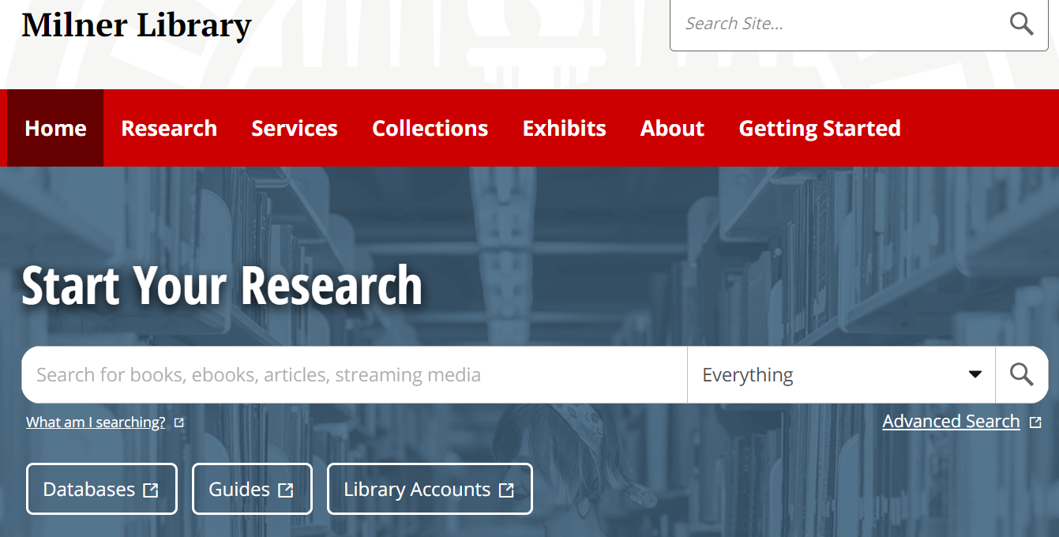
Uniform web presence
110 websites completed
15 websites in progress
18 websites remaining

Slide 33
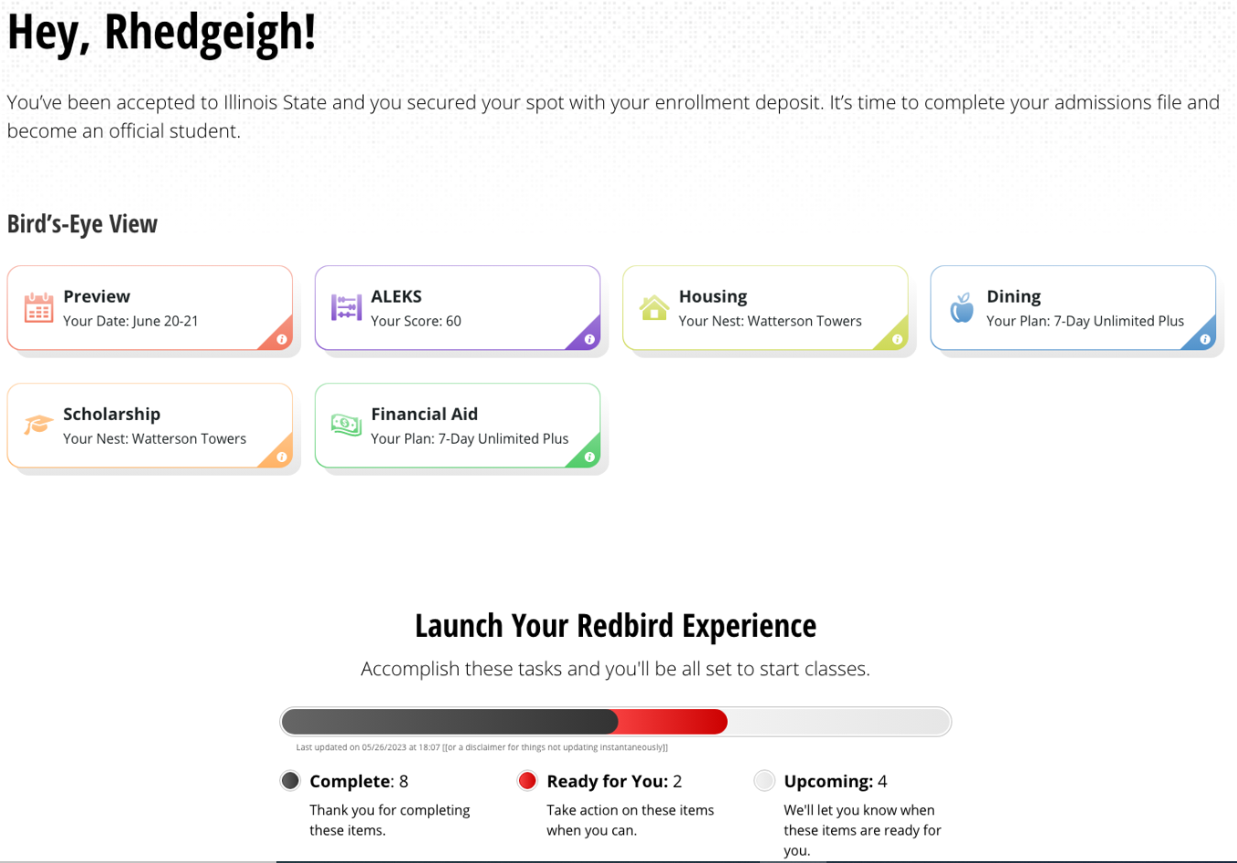
My.IllinoisState – Reimagined UX Design
Arturo Ramirez

Slide 34
Windows 11 Strategy
Windows 11 Campus Implementation Strategy Group recommendations
Review data for hardware readiness
Attrition preferred for upgrades, but in place where necessary
All supported machines should be managed by SCCM, and recommended to utilize ISU Build
Purchase Windows Pro with Autopilot as a future proof
ISU should develop a standardized and consolidated purchasing model for equipment to ensure equitable lifecycles for all
Carla Birckelbaw
Notes:
Windows 11 Campus Implementation Strategy group – representatives from all support teams – gathered to discuss a common strategy on implementing Windows 11 by EOS deadlines
We all have to comply with the same security standards, and Windows changes continuously now – not only easier than it used to be but more necessary for us to plan and proceed on the same path here
Good news is that 11 isn’t as major an upgrade, and in place upgrades appear to work pretty well – no big issues reported by those already using it
Report and data from SCCM on each team’s hardware readiness + status of OS versions for supported computers are in ISU IT Staff files in a folder labelled “Windows 11 Status”
The OS version data will be updated there at the beginning of each month so that you can check your progress

Slide 35
Windows 11 Key Dates
Great news! We are already 23% complete
Good news: Current final date for Windows 10 support is 10/14/25
Not so good news: 37% of our devices are on Windows 10 21H2, which is EOS 6/11/24
Carla Birckelbaw

Slide 36
Lab Prep for Fall
Reminder to get all lab machines into LabStats
TSC will update student-facing lab KBs with info from LabStats on number of machines, hours, uPrint options
Carla Birckelbaw

Slide 37
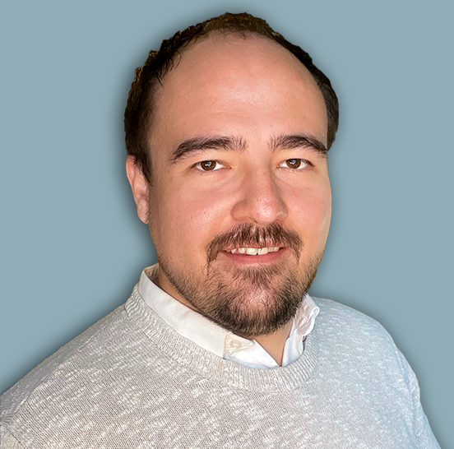
Information Security Brief
IAM Enhancements
Threat Landscape
Program Vision
Dan Taube
Chief Information Security Officer (CISO)
Dan Taube

Slide 38
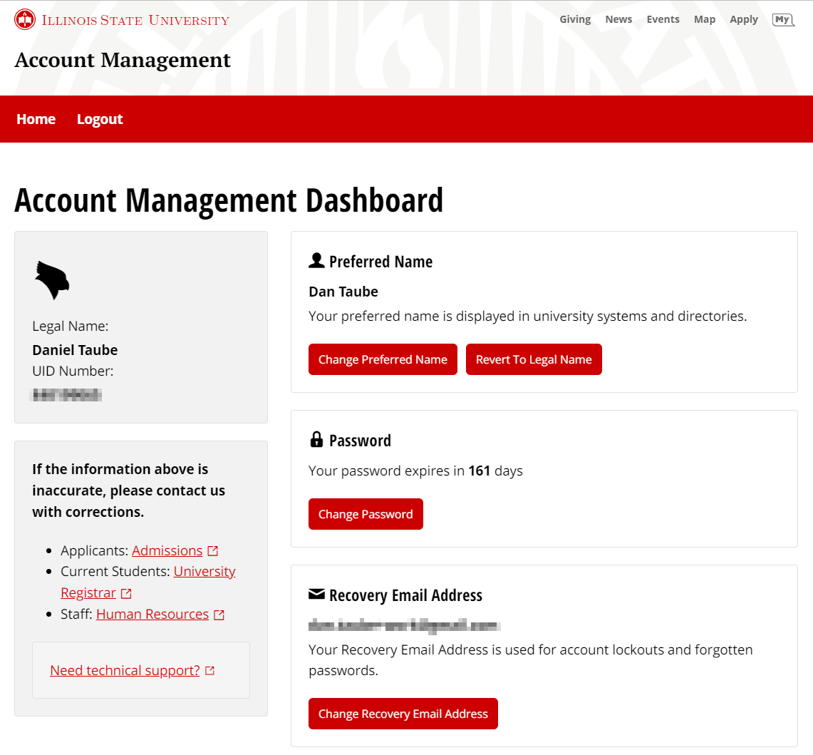
Identity and Access Management
New Design, Systems, and Capabilities
New Account Self Service
Prevents use of known breached passwords
Replaces recovery questions with emailed verification code
Provides modern codebase and user experience
New Identity System
Identity data fabric that ensures accuracy and enables innovation
Modern infrastructure with substantially greater performance
Instant access back to M365 post-expiration password change
Dan Taube

Slide 39
Threat Landscape
Audience Poll
Visit menti.com and enter code 1367 6366 to participate.
Anonymous and web-based.
Polls relate to industry reports on known information security incidents.
Disclaimer: Polling service being used is under personal license of Dan Taube and not the institution.
Dan Taube

Slide 40
Threat Landscape
Putting it All Together
Vulnerable systems and untrained users drive education data breaches.
Threat actors are quicker to successfully exploit significant vulnerabilities.
Top mitigators and amplifiers to breach cost are organization wide factors.
Dan Taube

Slide 41
Threat Landscape
Risks of Information Security Weaknesses
Financial/Compliance/Legal – Restoration costs, fines, and loss of funding.
Health/Safety – Human harm or loss due to system/network outages.
Operational/Human Capital – Loss of time for students, faculty, and staff.
Reputational – Loss of potential applicants, donors, and partnerships.
Dan Taube

Slide 42
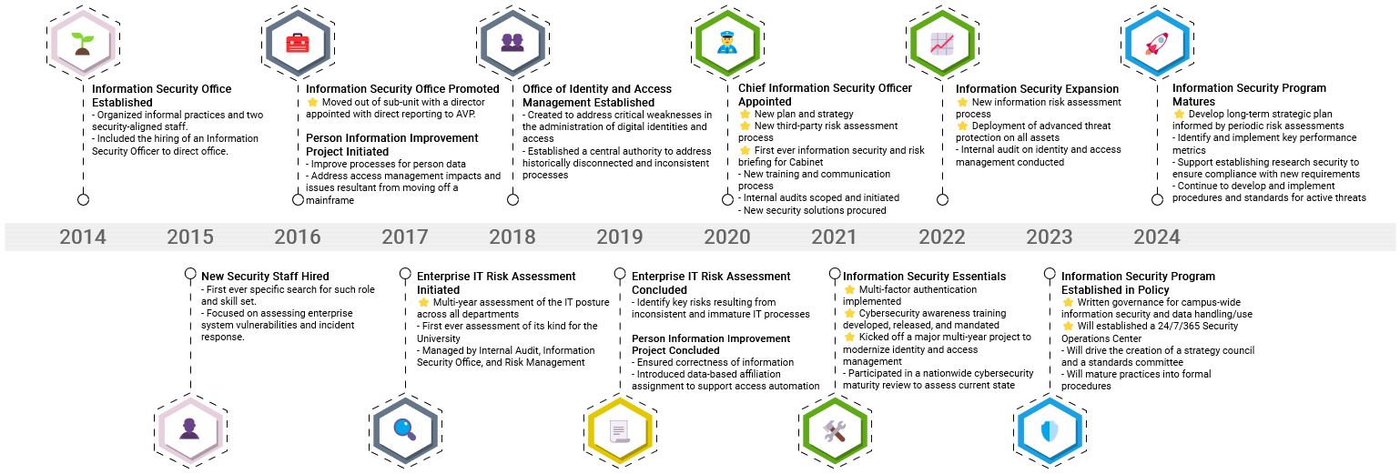
Information Security Program History
Dan Taube

Slide 43
Information Security Program Vision
Strategic, Not Reactive
Risk assessments to ensure effective prioritization and material progress.
Risk reporting to ensure effective communication and engagement.
Governance groups to ensure effective strategy and resources.
Dan Taube

Slide 44
Information Security Program Vision
Purposeful Direction and Engagement
Strategy Council to ensure program strategy and functions meet needs.
Standards Committee to ensure technical safeguards are appropriate.
Leads and Liaisons to ensure efficient communication and response.
Dan Taube

Slide 45
Information Security Program Vision
An Informed and Empowered Campus
Regular awareness training for the campus to stay ahead of threats.
Role-based education for those in positions with sensitive or controlled data.
Reporting for management to support prioritization and resource allocation.
Dan Taube

Slide 46
College Technology Directors Council
Mission
Advance the technology experience across the colleges by identifying, prioritizing, and advocating for collaborative solutions.
about.illinoisstate.edu/ctdc
Mike Regilio
Notes:
It' s my great pleasure to introduce everyone to The College Technology Directors Council! The CTDC is an evolution, of sorts, of the roles that Mark Walbert and Rosie Hauck have served in so well. We have a charter establishing our mission and scope and we also have some goals for the continued evolution of the group. Rosie and Charley have been key in the creation of the CTDC and I, along with my counterparts Matt Gromer, Liam Nance-Carroll, Matt Rutherford, Chandra Smith, Eric Yeager, and Paul Unsbee are very appreciative of the support from Rosie, Charlie, Rob Bailey, Jennifer Friberg, Jeff Grabb, Dave Greenfield, Tony Pena, and Pam Walden. So, as you hear from "the CTDC", you'll now know that we're representing the combined perspective of college needs. Feel free to reach out to me if there is anything we can do to help!

Slide 47
WebCheckout
Web Based / Hosted
Tiered Permissions (admins, fac/staff, and students)
Equipment Reservations
Loan Tracking
WebCheckoutAdmins@ilstu.edu
Mike Regilio
Notes:
Fine Arts, Business, Education, and Arts and Sciences have been collaborating on an equipment reservation and loan management platform with the main goal of providing our students with an easy self-service way to borrow laptops, cameras, and many other class tech resources. The solution we pursued is WebCheckout. This Fall marks the first full semester that we'll make it available to our students, so our processes are still young, but we wanted to share this info with the rest of the campus IT community in case any other areas are interested. Reach out to us at webcheckoutadmins@ilstu.edu!

Slide 48
That’s a Wrap!
More great sessions from 3:30-4:30 pm
Join us at the Pub II after CIT!
CITx in late February
Nominate one of our great student employees for the CIT Student MVP Award – cit.illinoisstate.edu/awards. Due 12/31/22.
Notes:
Remind presenters and facilitators to pick up their coffee mugs as they leave IT News

