Slide 1
Wrestling with the A.I. Revolution
Ben Bricker
IT Communication Specialist
Office of Technology Solutions

Slide 2
Agenda
Background Info
Thinking machines
A.I in the workplace
Personal A.I.’s
Doomsday Predictions

Slide 3
Doomsday Predictions
What have you heard?

Slide 4
Worst Case scenerios
Works too well
Paper clips
Steal your jobs
Humans misused
Misuse of copyright
Deep fakes
Tech Fails
Accidently racist (bias)
Thinking critically

Slide 5
Best scenarios
Jarvis (but not Ultron)
Medical diagnosis
Teaching subjects
Personalized tutorial
Mechanical complexity
Idea generation

Slide 6
Thinking machines
That don’t think like us

Slide 7
The tendency to perceive a specific, often meaningful image in a random or ambiguous visual pattern. The scientific explanation for some people is pareidolia, or the human ability to see shapes or make pictures out of randomness. Think of the Rorschach inkblot test.
par·​ei·​do·​lia ˌper-ˌī-ˈdō-lē-ə -ˈdōl-yə

Slide 8
How do they think?
Removing Bias…
Understanding A.I. motivations
Training data problem

Slide 9
A.I. in the Workplace

Slide 10
Industry
This technology is so powerful that we can staff our dev teams with 12-year-olds !

Slide 11
Education and Medicine will be massively impacted by A.I. within 5 years.
Emad Mostaque
Stability AI CEO

Slide 12
Will human be replaced or enhanced ?
Medical industry
What if you can have a conversation with WebMD and it new more about you then your doctor?
Education
Can we align education to apprenticeships instead of knowledge transfer?
Entertainment
The images in the presentation for example.

Slide 13
Personal A.I.s
How do we cope with this technology

Slide 14
Social Dilemmas
Technology optimized to capture and hold attention.
Social media usage has led to increasing anxiety
Is social media destroying society?

Slide 15
A.I. Fears
Humans struggle to adapt to the artificial environment that is “The Internet”.
Will A.I. make it worse?

Slide 16
Can A.I. provide perspective ?
What if personal A.I. was optimized for truth?
Could individualized A.I. advocate for us and search information that challenges our biases?
Give me context behind that statistic they just stated.

Slide 17
Why an A.I. Revolution?
The industrial revolution changed society in ways that humans did not expect. It up-ended the way that we interact with the physical world. A.I. will upend the way human interact with the digital space.

Slide 18
Why not renaissance?
The cultural renaissance in Europe, looked back with romantic eyes at the classical era to inspire their future.
Can we look at what we have lost in the past 100 years and purposefully reintroduce it?

Slide 19
Thoughts?

Slide 20
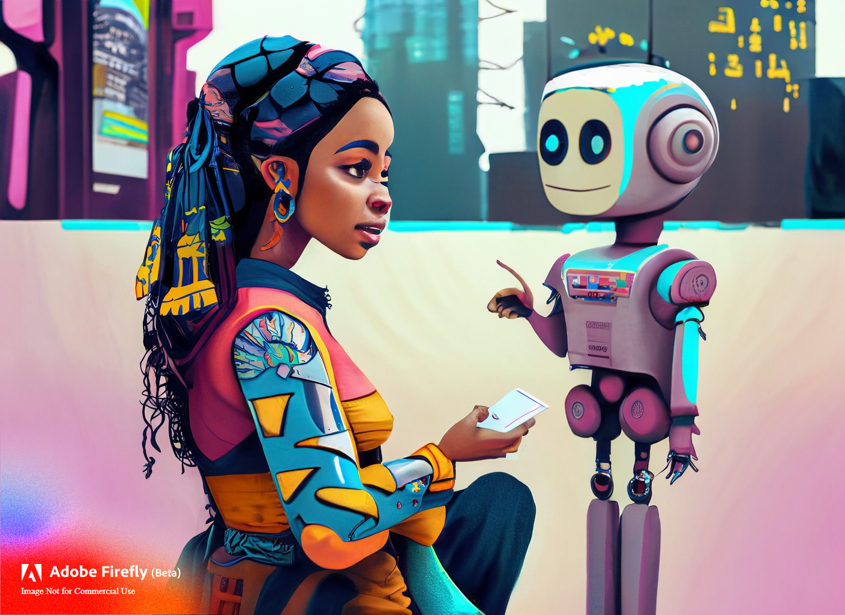
Let continue the conversation.
Ben Bricker
brbrick@ilstu.edu
cit.IllinoisState.edu

