Slide 2
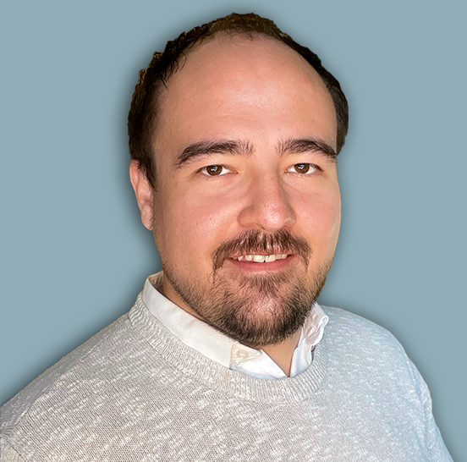
Information Security Program Status, Strategy, and Roadmap
Session Agenda
Purpose of the Program
Program Design Strategy
Program Maturity Assessment
Program Vision and Roadmap
Dan Taube
Chief Information Security Officer (CISO)

Slide 3
Purpose of the Program
Effective and Adequate Information Security
Protects against threats to the Illinois State University mission.
Protects individual members from personal harm.
Enables new opportunities for students, faculty, researchers, and staff.
It is a growing requirement under various federal funding programs.

Slide 4
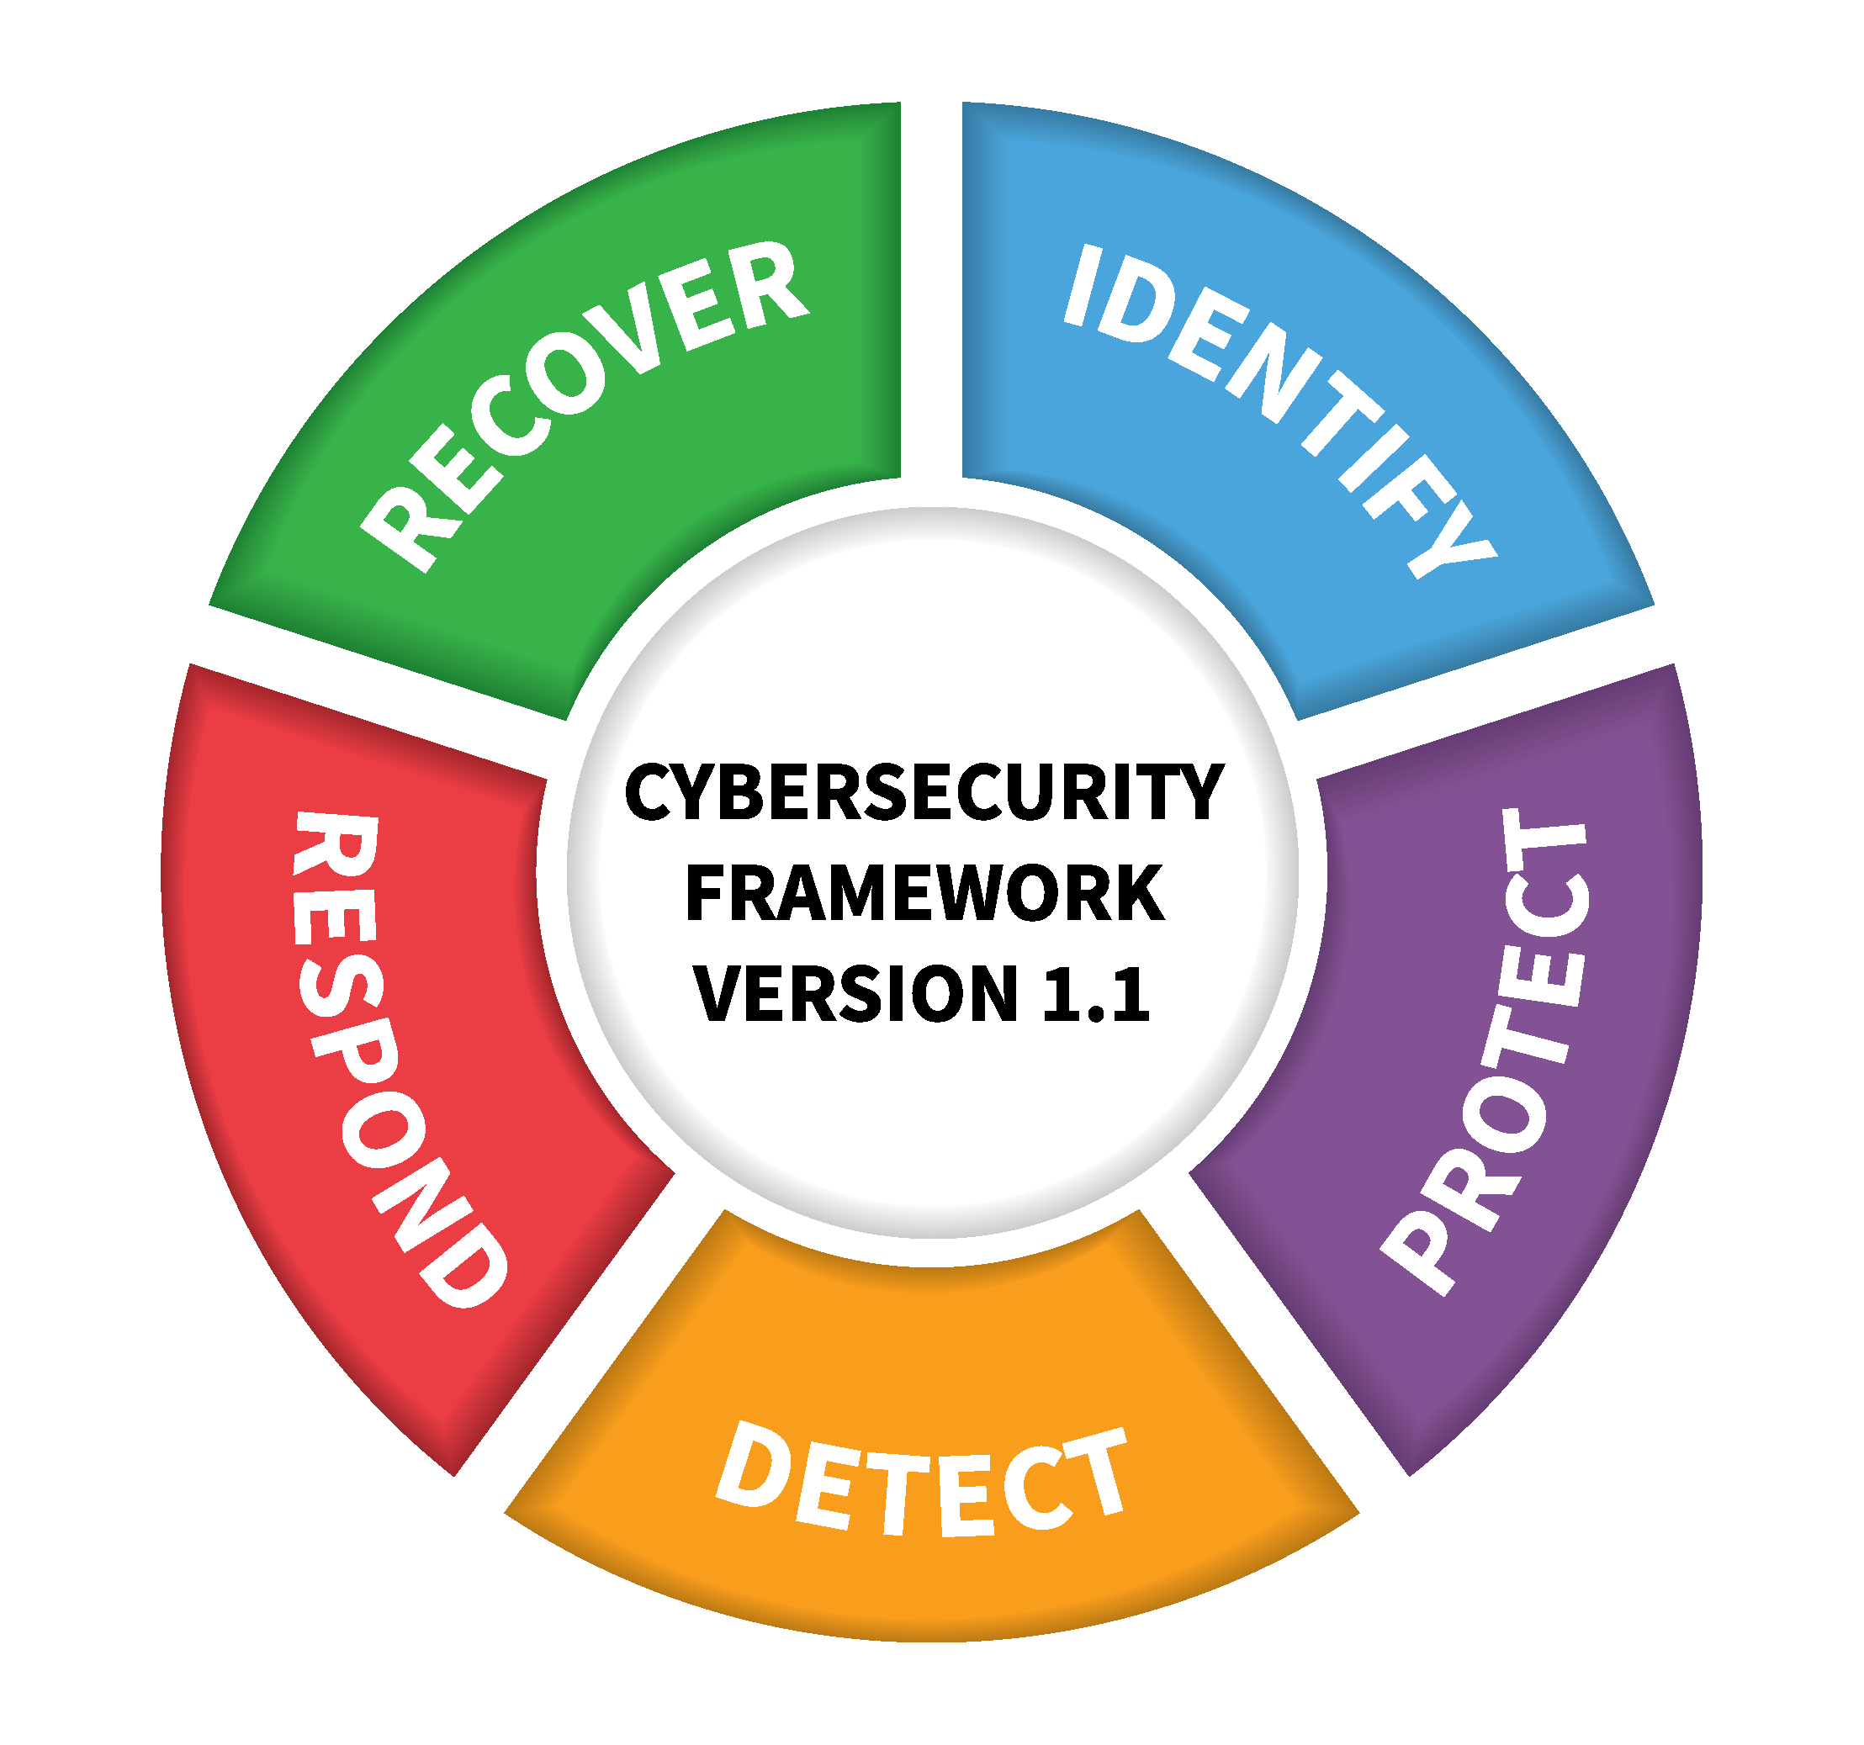
Program Design Strategy
Intentional Selection and Use of Frameworks

Slide 5
Program Design Strategy
Functions, Categories, and Measurability

Slide 6
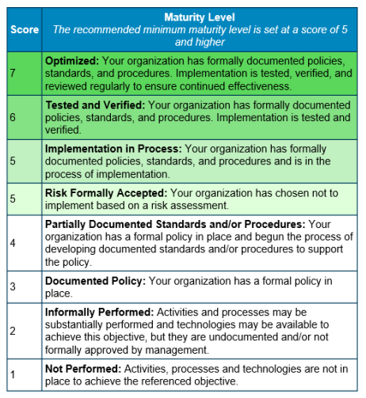
Program Maturity Assessment
2022 Nationwide Cybersecurity Review
Assesses NIST CSF maturity directly.
Conducted annually by DHS and MS-ISAC.
Requirement for some federal grants.

Slide 7
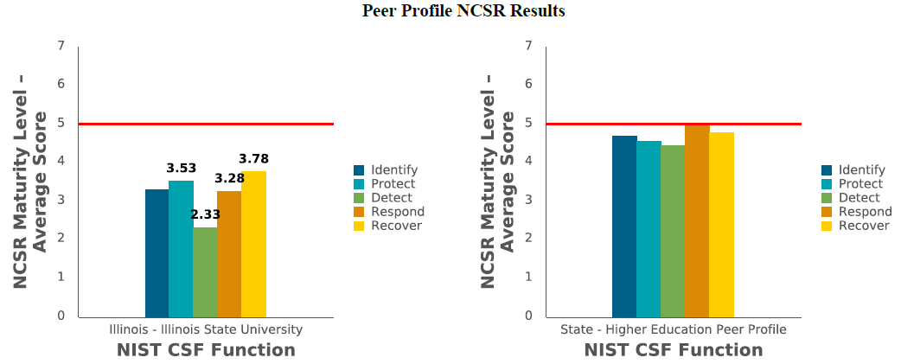
Program Maturity Assessment
2022 Nationwide Cybersecurity Review
3.33

Slide 8
Program Maturity Assessment
CIS Controls and Safeguards Risk Assessment
Risk assessment specific to Federal Student Aid requirements.
Narrow scope but echoes what we see in the NCSR.
64% of identified risks would be reasonably addressed by writing policy.

Slide 9
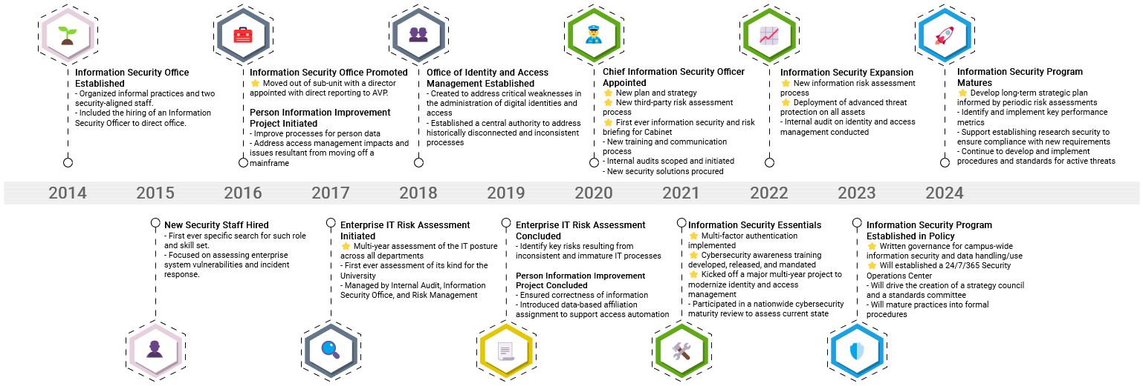
Program Vision and Roadmap

Slide 10
Program Vision and Roadmap
Policy and Governance
Written policy and procedure is the material factor missing currently.
Policy is not simple written and established, it requires collaboration.
Governance should be set in motion by policy, but critical need warrants action sooner.

Slide 11
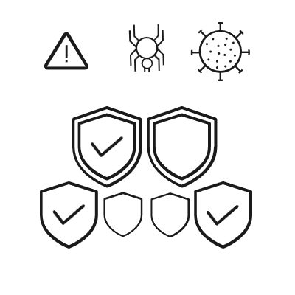
Program Vision and Roadmap
Security is a “Journey”
Our Past
Our Present
Our Future
Inconsistent Results
DIY Security
2014 – 2020
Foundational Program
Reactive Priorities
2020 – 2023
Written Policy
Risk-Based Prioritization
2023 – My Retirement?

Slide 12
Information Security Program Status, Strategy, and Roadmap
Open Discussion and Questions
Are you interested in how your role fits within the program?
Does the strategy align with higher education and ISU?
Would you want to participate in supporting the program’s success?

