Slide 2
Electronic Signature Use in Digital Processes
Session Agenda
Illinois UETA versus Federal ESIGN
Legal Requirements for Electronic Signature
Electronic Signature Solutions
9.8.8 Electronic Signature Procedures
Electronic Signature Use Case Examples
Dan Taube
Chief Information Security Officer (CISO)

Slide 3
Illinois UETA versus Federal ESIGN
Illinois Uniform Electronic Transaction Act
Uniform Acts are centrally drafted laws adopted independently by states.
Adopted by Illinois in 2019 and replaced the Electronic Commerce Security Act.
Provides a legal framework for electronic signatures and transactions.
Illinois was the 49th state to adopt UETA.

Slide 4
Illinois UETA versus Federal ESIGN
Electronic Signatures in Global and National Commerce Act
Primary purpose is to establish electronic signatures as legally valid.
Used to address gaps in state laws or where no state law exists.
Permits state UETA laws to supersede/expand upon the federal act.
Illinois UETA supersedes ESIGN for most operations and transactions.

Slide 5
Legal Requirements for Electronic Signatures
Legal Definition
"Electronic signature" means an electronic sound, symbol, or process attached to or logically associated with a record and executed or adopted by a person with the intent to sign the record.

Slide 6
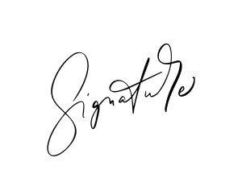
Legal Requirements for Electronic Signatures
Electronic Sound, Symbol, or Process
The “thumbs up” emoji has indeed been ruled valid in some countries.

Slide 7
Legal Requirements for Electronic Signatures
Attached or Logically Associated with a Record
Consider how the electronic signature can be directly linked to the record that was electronically signed.
This overwhelmingly relies upon technical and process decisions.

Slide 8
Legal Requirements for Electronic Signatures
Executed or Adopted by a Person with Intent to Sign the Record
Consider the evidence you would have that demonstrates the intent to sign and to do so specifically in an electronic form.
This overwhelmingly relies upon the text located at the point of signature.

Slide 9
Legal Requirements for Electronic Signatures
Distilled and Organized
1. Present and obtain consent from the signer to do business electronically.
2. Demonstrate intent to sign generally and specifically in electronic form.
3. Associate all records with primary record being electronically signed.
4. Retain all records including evidence for as long as terms are in effect.

Slide 10
Electronic Signatures versus Digital Signatures
Greater Assurance but Greater Complexity
Digital signatures are a form of electronic signature that involves the use of digital certificates to cryptographically sign documents.
Digital certificates can be self-signed or issued by a certificate authority.
Requires technical knowledge and process steps to verify and trust properly.

Slide 11
Electronic Signatures versus Digital Signatures
Illinois Digital ID Example
The State of Illinois offers anyone a digital ID that provides a digital certificate that can be used to digitally sign documents.
- Illinois residents complete an online form.
- Non-Illinois residents must mail a notarized application to the state.
- Requires logging into proprietary software for each use of digital certificate.
- Digital certificates expire and require renewal every few years.

Slide 12
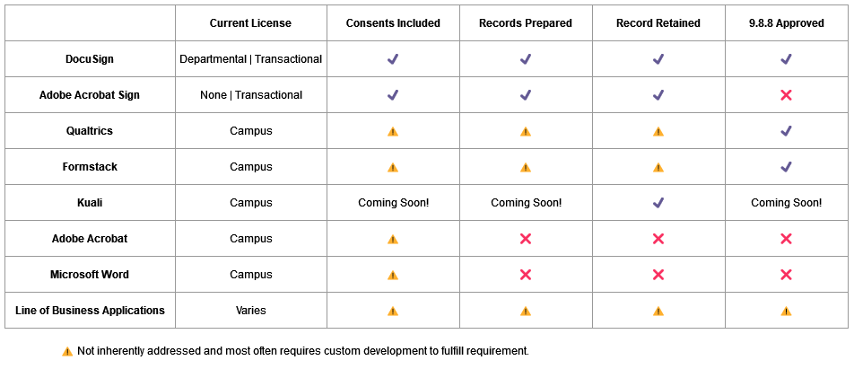
Electronic Signature Solutions

Slide 13
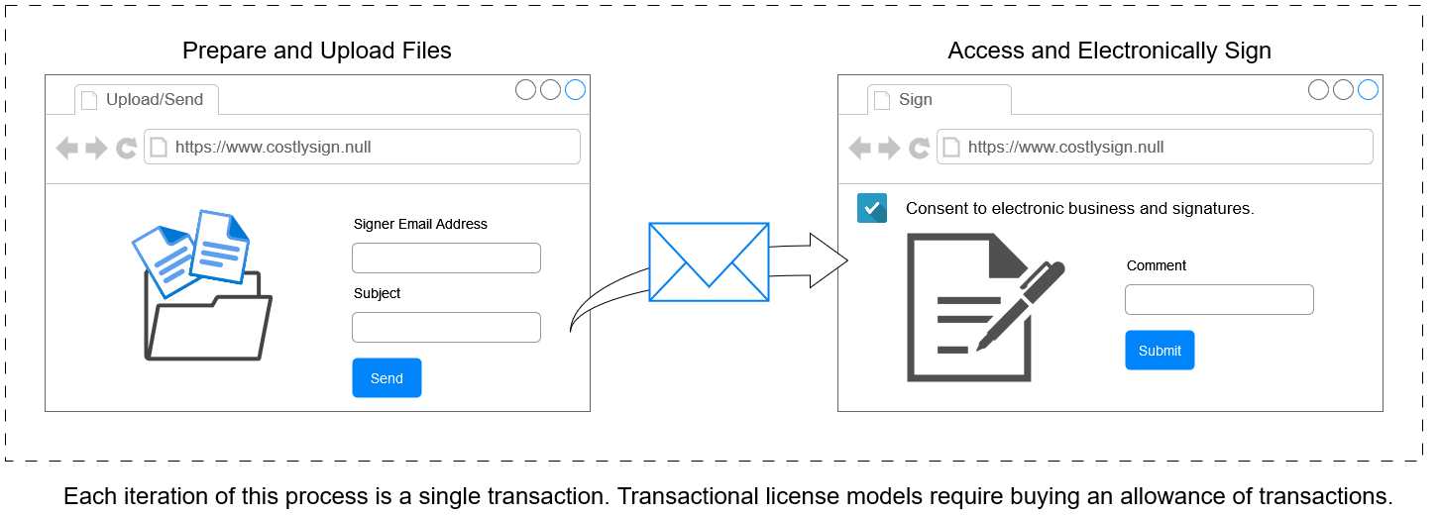
Electronic Signature Solutions
Transactional Solutions

Slide 14
Electronic Signature Solutions
“Acrobat” Software versus “Acrobat Sign”
Adobe “Acrobat” is software to read, author, and edit PDF files.
Adobe “Acrobat Sign” is a transactional cloud service for electronic signatures.
“Acrobat” alone does not produce legally valid electronic signatures.
“Acrobat Sign” (formerly “Adobe Sign”) is not currently licensed for use at ISU.

Slide 15
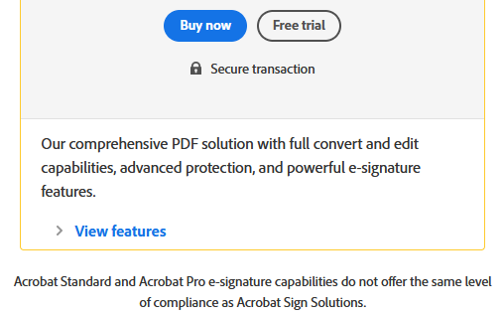
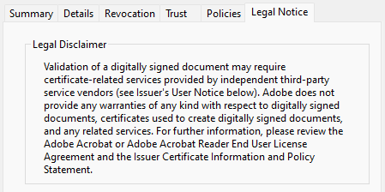
Electronic Signature Solutions
Buried Legal Disclaimers for “Acrobat” Software
Product Feature Disclaimer
Buried Digital Certificate Disclaimer

Slide 16
Electronic Signature Use Case Examples
9.8.8 Electronic Signature Procedures
Assesses risk of proposed use (record being signed and solution to sign).
Involves a data steward for record and Information Security Office.
Required for new solutions as well as new used of existing solutions.
Originally created with previous Illinois law and overdue for an update.

Slide 17
Electronic Signature Use Case Examples
Assurance Level Should Match Risk Level

Slide 18
Electronic Signature Use in Digital Processes
Open Discussion and Questions
What use cases do you have that we can discuss?
Do you have electronic processes that could use improvement?
How might you consider your exposure with invalid methods?

