Slide 1


Slide 2

Effectively Assessing Information
Security Gaps and Risks
Session Agenda
Information Security Program Risk Strategy
Center for Internet Security (CIS) Resources
Information Risk Assessment Process
Interactive Assessment Scenario
Dan Taube
Chief Information Security Officer (CISO)
Mike Schlemmer
Governance, Risk, and Compliance (GRC) Analyst

Slide 3
Information Security Risk Program Strategy
What is information risk?
Information security is purposed in ensuring the confidentiality, integrity, and availability of information.
Information risks are the combination of likelihood and impact of threats to the confidentiality, integrity, and/or availability of information.

Slide 4
Information Security Risk Program Strategy
What is the goal of a risk assessment?
Consider the interests of all parties that may be harmed by assessed risks.
Reduce risks to a level that would not require a remedy to any party.
Identify safeguards that are not more burdensome than the risks they protect against.
These are the three principles of the Duty of Care Risk Analysis Standard (“DoCRA”).

Slide 5
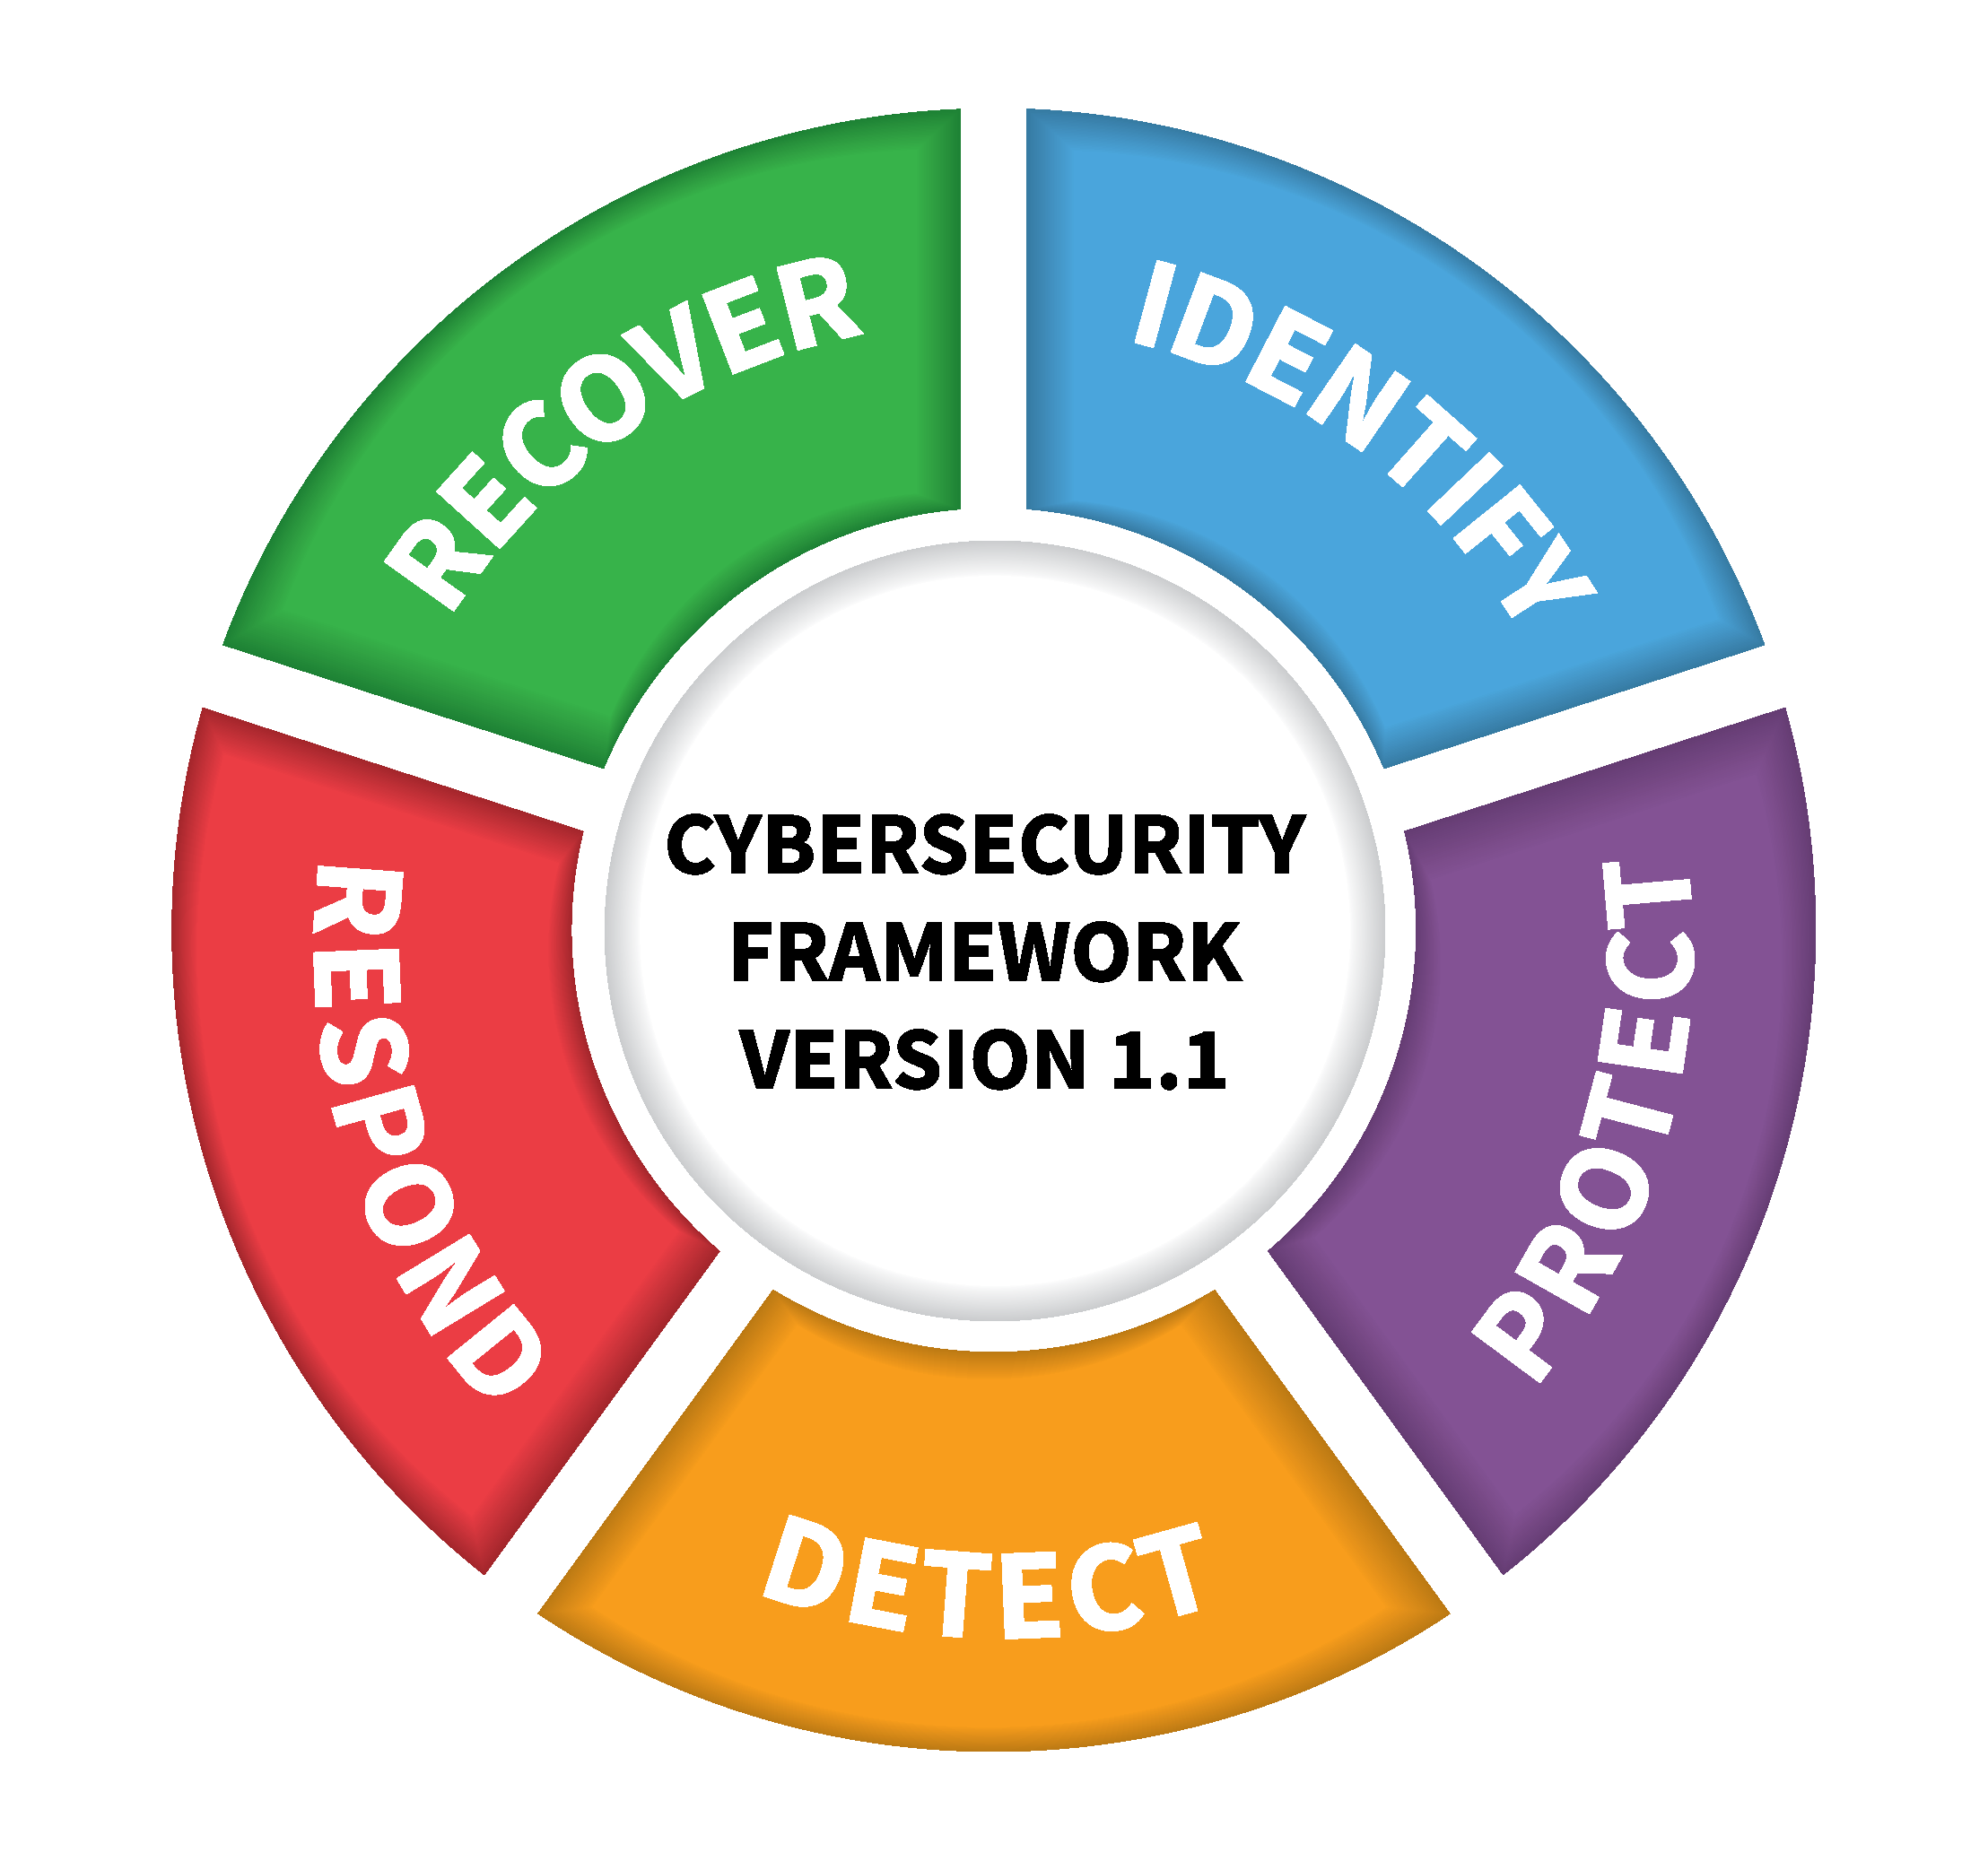


Information Security Risk Program Strategy
Frameworks and Interoperability

Slide 6
Center for Internet Security (CIS) Resources
About CIS
Non-profit organization that focuses on enhancing the cybersecurity readiness and resilience of public and private sector entities worldwide.
Providing guidance, best practices, and tools for effective cyber defense.
Manages the Multi-State Information Sharing and Analysis Center (MS-ISAC) in partnership with the Department of Homeland Security.

Slide 7
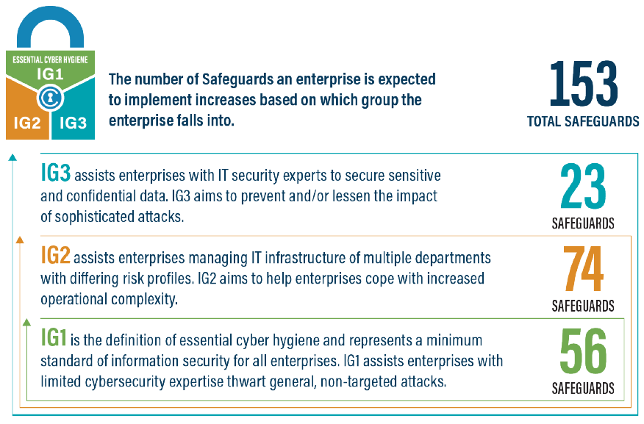
Center for Internet Security (CIS) Resources
About the CIS Controls

Slide 8
Center for Internet Security (CIS) Resources
About the CIS Risk Assessment Method (RAM)
Risk assessment toolkit that leverages the CIS Controls and safeguards.
Adaptive to the risk context and scope that is most appropriate.
Provides risk management evidence and identifies priorities.

Slide 9
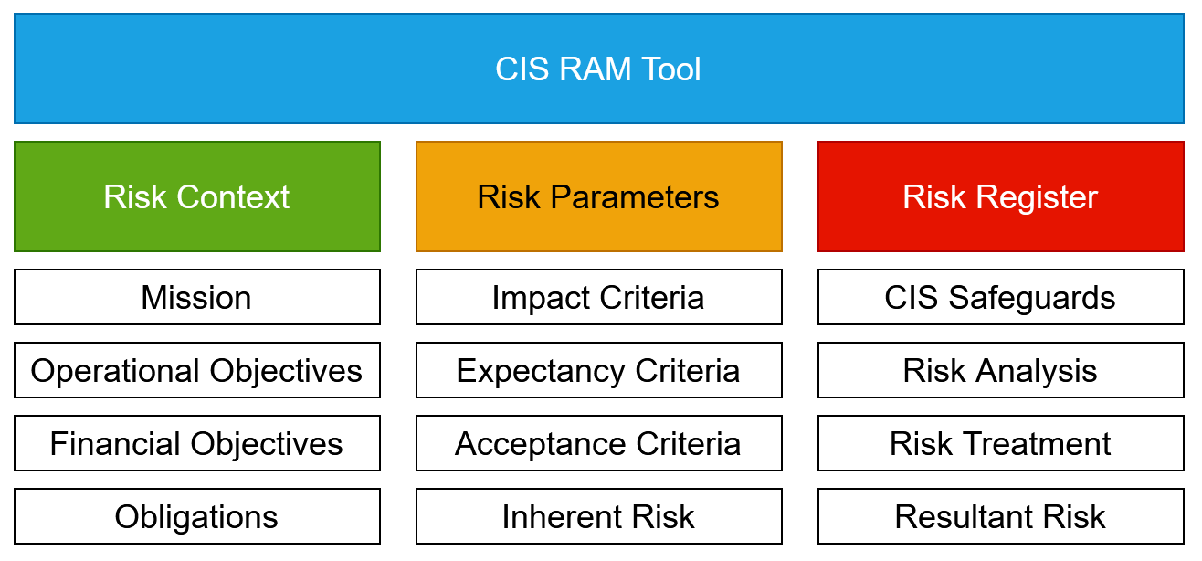
Center for Internet Security (CIS) Resources
CIS RAM Components

Slide 10
Information Risk Assessment Process
Scoped, Collaborative, and Guided
Overall process is guided by the CIS RAM tool.
Scope of assessment defines resources, time, and overall effort.
Supporting documents created for increased efficiency and communication.

Slide 11
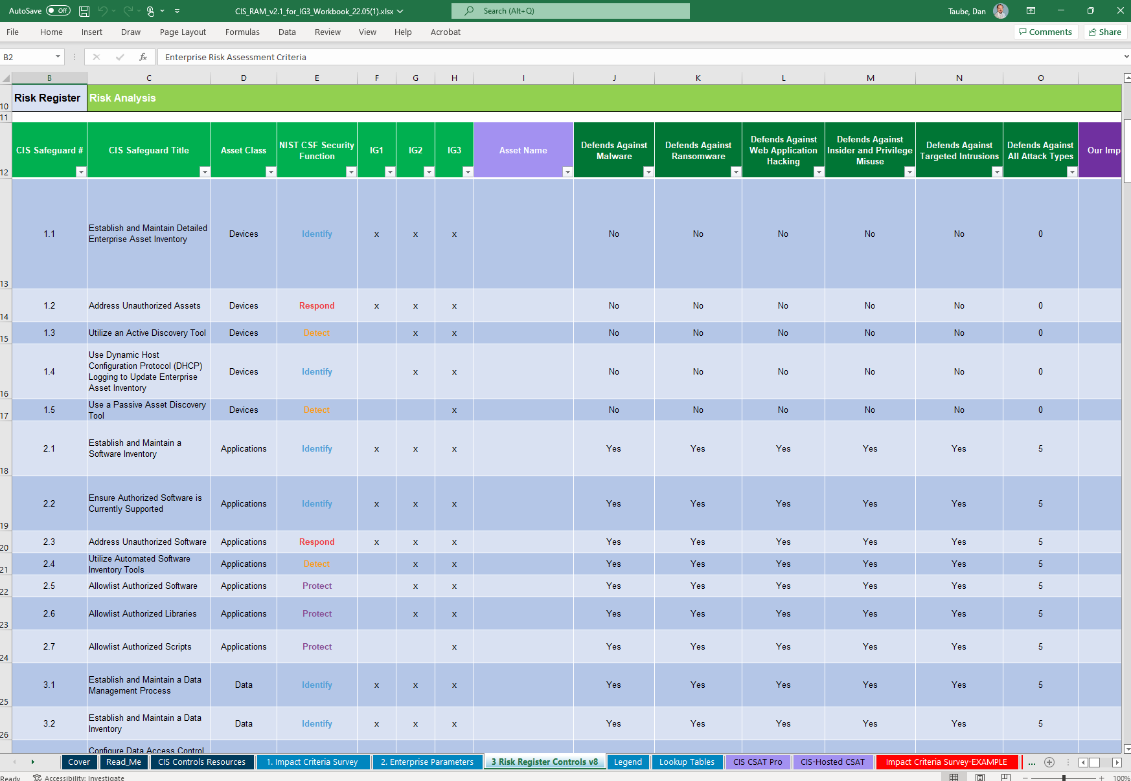
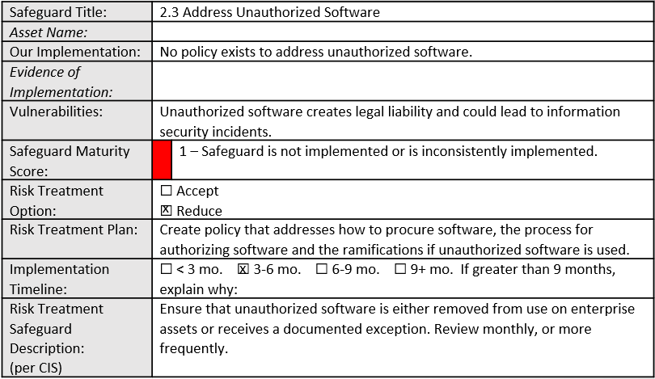
Information Risk Assessment Process
Documents and Materials Used
CIS RAM Spreadsheet
Treatment Worksheet
Engagement Letters
Safeguard Evidence
Reports

Slide 12
Information Risk Assessment Process
Critical Importance of Scoping
Risk assessments are purposed in supporting risk management decisions.
Ineffective scoping produces ineffective results and failure to meet key goal.
Scope can include data, systems, processes, and even people.

Slide 13
Information Risk Assessment Process
Risk Parameters Enable Risk Scoring
Risk parameters translate risk appetite into values for risk scoring.
CIS RAM provides prompts to guide selection of risk parameters.
Supporting resources provide detailed guidance for full use of the CIS RAM.

Slide 14
Information Risk Assessment Process
Risk Treatment Provides Context
What is in place or can be implemented to reduce the scored risk?
Is the scored risk acceptable in the context of the assessment scope?
Which risks are unacceptably high and requires prompt treatment?

Slide 15
Information Risk Assessment Process
Scored Risk, Adjusted by Treatment, Identifies Priorities
Risks can be reasonable and acceptable with justification.
The risk assessment process and results are the justification.
Steady progress with informed priorities is a defensible position.

Slide 16
Interactive Risk Assessment Scenario
Droid Interface Services for the Galactic Empire
Mission
Reliably implement universal interfaces for the wide variety of droids in use by the Galactic Empire.
Operational Objective
Maintain our position as the sole provider of droid interfaces used by the Galactic Empire.
Obligation
Protect the Galactic Empire systems from compromise by unauthorized droids.

Slide 17
Interactive Risk Assessment Scenario
Droid Interface Services for the Galactic Empire
Obligation
Protect the Galactic Empire systems from compromise by unauthorized droids.
What is our appetite for an acceptable impact of a risk to this obligation?
What would we view as a catastrophic impact?
An unauthorized droid can connect to the interface but cannot reach critical systems.
An unauthorized droid can connect to the interface, reach critical systems, and comprise all security.

Slide 18
Interactive Risk Assessment Scenario
Droid Interface Services for the Galactic Empire
Obligation
Protect the Galactic Empire systems from compromise by unauthorized droids.
How can we describe a risk to our obligation as unlikely?
What about describing it as a certainty?
Design and implementation would reliably prevent most occurrences of the threat.
Design and implementation would not prevent any occurrences of the threat.

Slide 19
Interactive Risk Assessment Scenario
Droid Interface Services for the Galactic Empire
Obligation
Protect the Galactic Empire systems from compromise by unauthorized droids.
What controls or safeguards might be effective to mitigate risk?
Address unauthorized hardware and software (CIS 1.2, 2.3).
Use an intrusion detection system (CIS 13.2, 13.3)
Manage access for remote assets based on system details (CIS 13.5)

Slide 20
Interactive Risk Assessment Scenario
Droid Interface Services for the Galactic Empire
Obligation
Protect the Galactic Empire systems from compromise by unauthorized droids.
What is our risk appetite for expectancy and impact (1-5 scale)?
Expectancy: 2. Unlikely, most occurrences prevented.
Impact: 3. Unacceptable, but correctable.
Expectancy (2) * Impact (3) = Acceptable Risk Score (6)

Slide 21
Interactive Risk Assessment Scenario
Droid Interface Services for the Galactic Empire
Obligation
Protect the Galactic Empire systems from compromise by unauthorized droids.
What is our maturity on a scale of 1-5 for our intrusion detection system?
2. Safeguard is implemented fully on some assets or partially on all assets.
CIS RAM formulas combine risk parameters, safeguard maturity, and impact if safeguard fails.
This safeguard maturity gives a risk score of 12 in the RAM. Well above our acceptable range of 6.

Slide 22

Interactive Assessment Scenario
Droid Interface Services for the Galactic Empire

Slide 23
Interactive Risk Assessment Scenario
Droid Interface Services for the Galactic Empire
Obligation
Protect the Galactic Empire systems from compromise by unauthorized droids.
What treatment options do we have?
3. Safeguard is implemented on all assets would result in a risk score of 4. In range of 6.
Alternatively, a compensating control is a treatment option that can reduce risk.
If we cannot effectively treat within an acceptable risk score, then we have identified a priority.

Slide 24
Information Risk Assessment Recap
Risk Assessments Enable Results
Risk assessments are time intensive, challenging, and simply unexciting.
However, the results can be the key to management support and relief.
Of note, risk assessments are becoming standard in federal regulation.

Slide 25
Effectively Assessing Information
Security Gaps and Risks
Open Discussion and Questions
Are you interested in working with us to conduct a risk assessment?
Would you like a copy of supporting resources for your own review?
Would you be interested to learn and adapt our process?

