Slide 1
ISU’s Private Cloud Infrastructure: The Now and Future
Majeed Abu-Qulbain – Enterprise Architect/Interim ION CCA Manager Zach Parker – Cloud System Administrator Kevin Selinger – Cloud System Administrator Craig Watts – Cloud System Administrator

Slide 2
Overview
Review and reflect on Current State
Review plans for future state
Comparison of Current and Future
Cloud Strategy
Questions and Discussion
Notes:
Majeed - Quick overview on what we will cover in the presentation:

Slide 3
Private Cloud | Public Cloud
Self-managed Networking, Storage, and Server Hardware, virtualization software usually in an on-premise datacenter. Large upfront investment or Equipment lease (usually 3-5 years at a time) | Shared, multi-tenant virtualization platform, generally available to the public and managed by a business (AWS, Microsoft Azure, Google Cloud are the big ones, but there are any many more) – Several different pay per use models Cloud specific tooling and self-service features Renting someone else’s computer
Notes:
Majeed - Quick overview on what we will cover in the presentation:

Slide 4
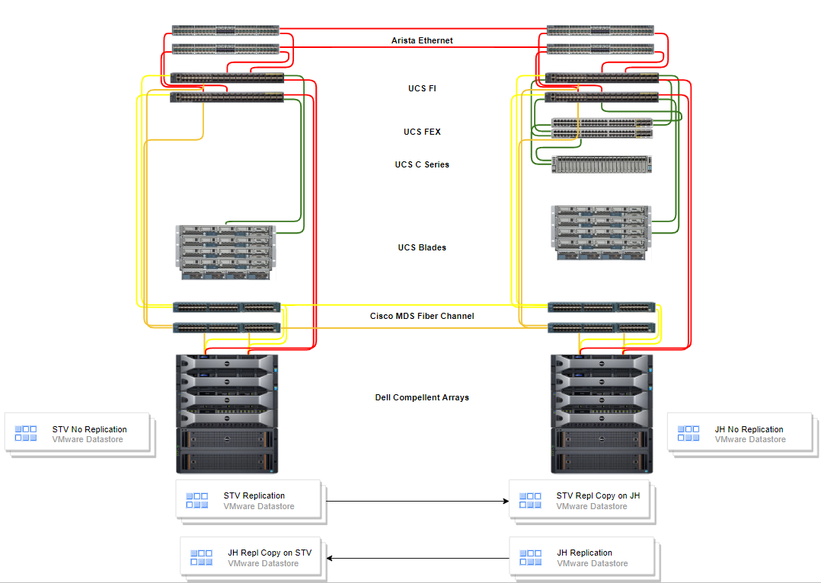
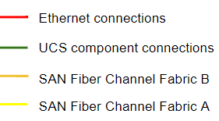
STV
JH
Current State Private Cloud
Notes:
Zach: - Talk over the visual
Describe the different components of the hardware stack, what they are (high level)
Describe the vmware datastores types and it relates to Virtual Machines

Slide 5
Current On-Premise Stats
Quick Stats on total capacity
Total: hosts – 34 servers (includes ocp, vdi, UC, cook hall)
Total: CPU cores across both JH/STV – 600 cores
Total: RAM across both JH/STV - 23Tb
Total: Storage in Compellent – 2.5Pb
Total: VM Windows - 744 Total: VM Linux - 376
Notes:
Zach:
Quick Stats on total capacity
Total: hosts – 34 servers (includes ocp, vdi, UC, cook hall)
Total: CPU cores across both JH/STV – 600 cores
Total: RAM across both JH/STV - 23Tb
Total: Storage in Compellent – 2.5Pb
Total: VM Windows - 744 Total: VM Linux - 376
Quick Stats on typical utilization

Slide 6
Reflection on Current – Things we like
Compellent SAN - Live Volume: Cross DC replication/Failover
Compellent SAN – Data tiering/progression
UCS – Hardware Management Features
VMware – Virtual Machine balancing across nodes, datacenters, and datastores
Notes:
Things that really worked
- Cross datacenter replication
- Stretch/metro cluster – HA Automatic/Flip of a switch failover from one datacenter (jh) to another (stv)
- UCS
- many nice management features (hardware profiles) allow very easy hardware replacements without much manual re-configuration
- Has been rock solid, very much in the background
- Rack Management is very nice – heavy reduction in cabling
- modular blade approach reduced the need to have a lot of hands on hardware activities
- Compellent
- introduction of live volume (replication between jh and stv arrays) had a major improvement on quality of life for storage available and maintenance operations
- data tiering/progression – the ability to place the most accessed data on high speed drive, while allowing the infrequently accessed data to slower higher capacity drives
- vmware
- Its been the glue that brings the stack together
- it is the only currently state component that will continue to exist in the future state environment
- self manages and balances both compute and storage resources across the hardware in an automatic fashion Challenges:
All sub components in the stack have to be managed independently which takes a good amount of effort around planning and execution (requires several different skills sets)
Cross vendor troubleshooting can be difficult (lots of finger pointing initially)
Consolidating so many workloads/services to a single (even if redundant) system can have a greater impact (such as the 2 San controllers from storage perspective)
- More important as of sept when we are in a single DC – 2 Array controllers are a critical failure point
-

Slide 7
Reflection on Current – Challenges
Several components that require updates and the research needed to confirm compatibility across them
Cross vendor troubleshooting (finger pointing)
Huge consolidation of workloads on a single - dual controller storage system – Any impact can be a large impact
Notes:
Things that really worked
- Cross datacenter replication
- Stretch/metro cluster – HA Automatic/Flip of a switch failover from one datacenter (jh) to another (stv)
- UCS
- many nice management features (hardware profiles) allow very easy hardware replacements without much manual re-configuration
- Has been rock solid, very much in the background
- Rack Management is very nice – heavy reduction in cabling
- modular blade approach reduced the need to have a lot of hands on hardware activities
- Compellent
- introduction of live volume (replication between jh and stv arrays) had a major improvement on quality of life for storage available and maintenance operations
- data tiering/progression – the ability to place the most accessed data on high speed drive, while allowing the infrequently accessed data to slower higher capacity drives
- vmware
- Its been the glue that brings the stack together
- it is the only currently state component that will continue to exist in the future state environment
- self manages and balances both compute and storage resources across the hardware in an automatic fashion Challenges:
All sub components in the stack have to be managed independently which takes a good amount of effort around planning and execution (requires several different skills sets)
Cross vendor troubleshooting can be difficult (lots of finger pointing initially)
Consolidating so many workloads/services to a single (even if redundant) system can have a greater impact (such as the 2 San controllers from storage perspective)
- More important as of sept when we are in a single DC – 2 Array controllers are a critical failure point
-

Slide 8
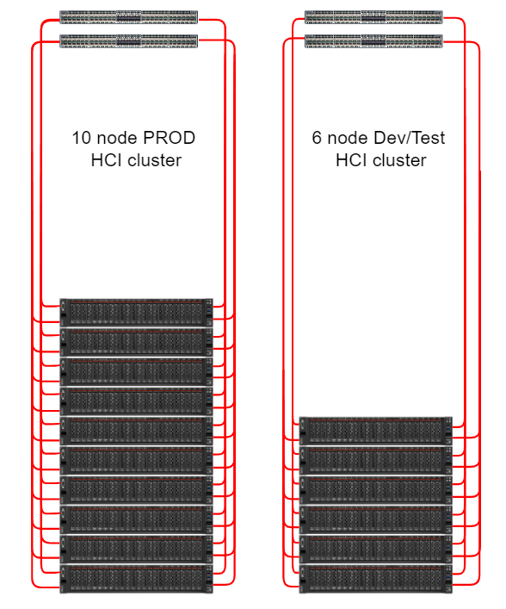
Future State (HCI)
HCI Per Node details Model: Lenovo ThinkAgile VX7531 Certified Node CPU: Intel Xeon Platinum 8358 32C 250W 2.6GHz Processor x 2 RAM: 16 x 64G = 1024G
Scalability scale up & scale out options
Ethernet only networking
Notes:
Vmware VSAN based Hyper Converged Infrastructure (HCI):
HCI Per Node details Server type: Lenovo ThinkAgile VX7531 Certified Node CPU: Intel Xeon Platinum 8358 32C 250W 2.6GHz Processor x 2 RAM: 16 x 64G = 1024G DISK: 3 x ThinkSystem 2.5" U.2 P5600 1.6TB Mixed Use NVMe PCIe 4.0 x4 HS SSD (Cache drives) 9 x ThinkSystem 2.5" PM1643a 3.84TB Entry SAS 12Gb Hot Swap SSD (Capacity Drives) 3 disk groups per node, each disk group contains 1 cache drive and 3 capacity drives
Also plenty of empty slots to add additional disks and/or entire diskgroups
Scalability:
- scale out options: ability to add storage, cpu and ram at the time by adding server nodes (much cheaper than adding a new Storage Array, Blade chassis + blades)
- scale up options: Add more RAM and Disks to existing servers nodes

Slide 9
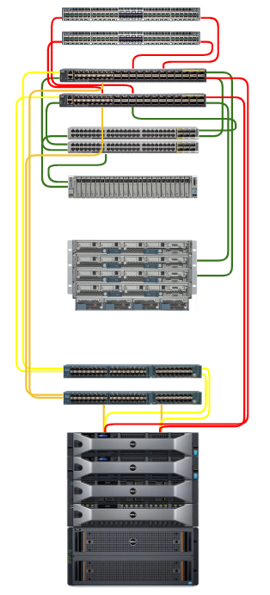
Comparing the differences
Current State
Future State
Notes:
Compare and contrast the management of the HCI stack to the current state Storage and compute will be combined
no external SAN arrays (to host vm disks. There will still be external deep storage solution for workloads that have large multi-Terabyte data needs because it is to expensive to house all of that data on an all flash setup)
no external fiber channel Storage network
Storage is now software defined where vmware’s VSAN technology will leverage all local disk across all server nodes into a resilient storage cluster
No physical network components (servers will plug directly into the Arista DC )
No vendor Lock in
Servers are high performing commodity hardware that have the ability to run hypervisor other than vmware if the situation with vmware changes – No appliance based vender lock in scenario
Favorable differences in the effort required to update components
- Only need to update vmware ESX and VSAN components and underlying server firmware (no external storage equipment or storage network
- One node at a time, node will be drained (vms will be evacuated, server will then be updated, and health check before the update process proceeds)
Availability differences
Vmwares VSAN N+2 architecture compared to compellent’s dual controller in a single datacenter
Troubleshooting: - less moving parts
- single vendor to support virtualization, virtualization networking, and storage (vmware)
- reduced hardware support needs (Lenovo supports server nodes)

Slide 10
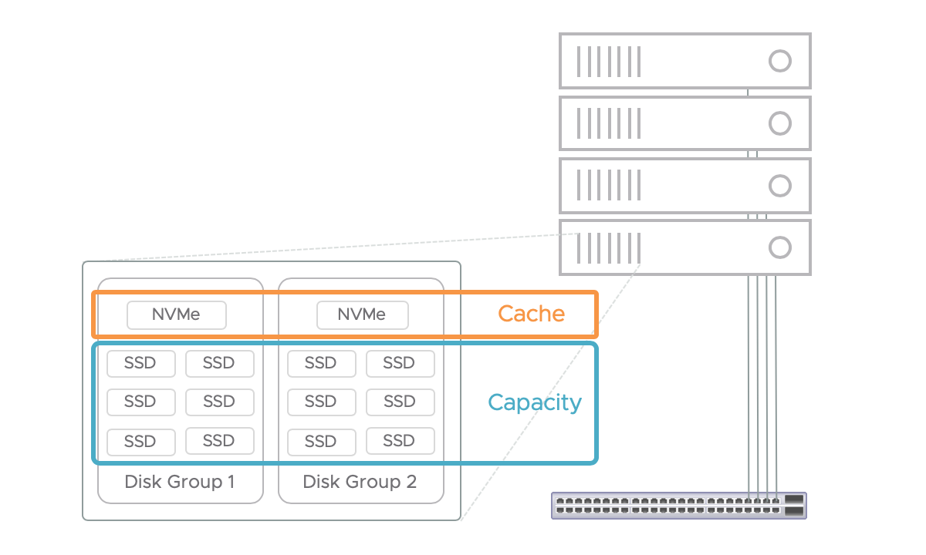
Future State (HCI) – VSAN Disk groups
Notes:
Visual of HCI disk group concepts

Slide 11
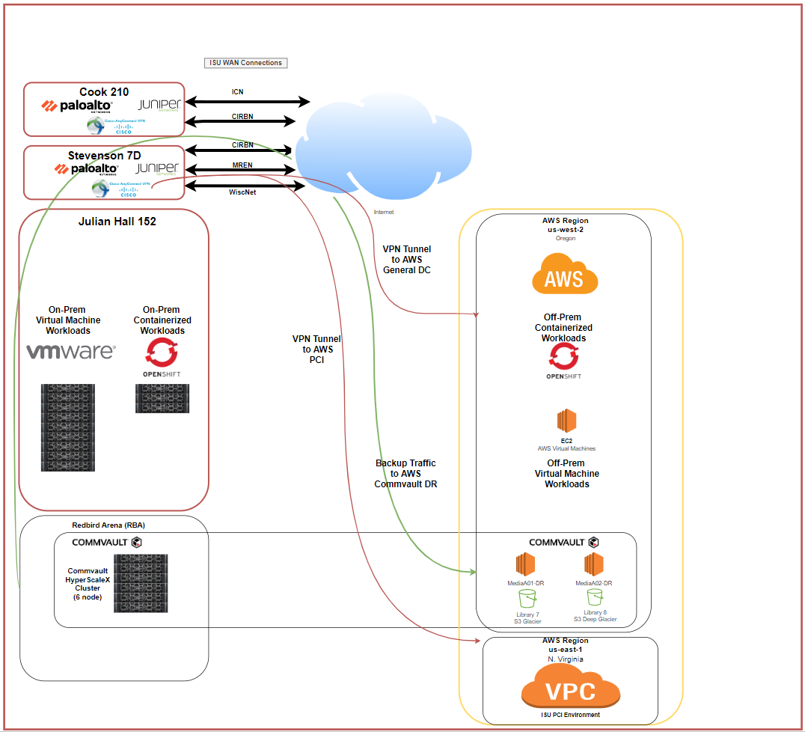
A Hybrid Cloud Strategy for ISU
Not a Cloud First Strategy

Slide 12
Any Questions?
Notes:
We can use the following questions to spark conversation if needed: What is the point of clusters in a single datacenter?
What about the second datacenter site? Without STV what if something happens to JH?

