Slide 1
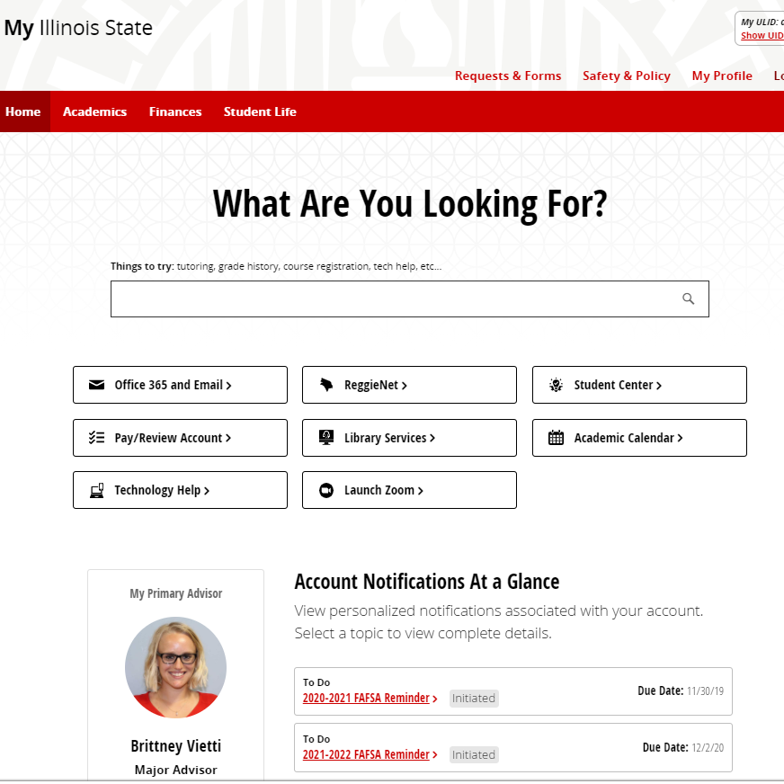
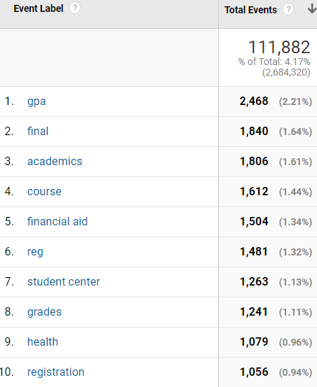
My.IllinoisState.edu Popular search terms

Slide 2
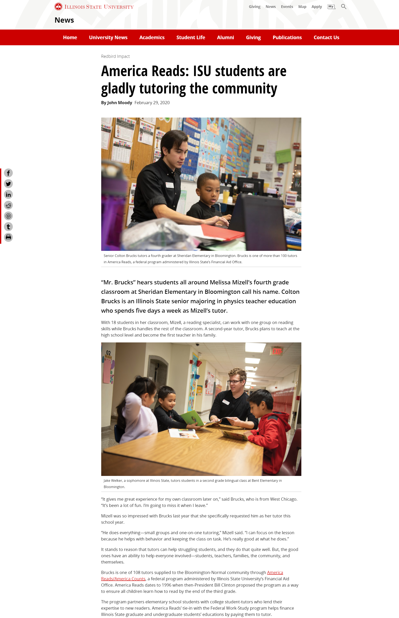
News.IllinoisState.edu
Modern new theme
WordPress platform
Hosted by CampusPress
Strong collaboration between Media Relations, Tech Solutions and UMC

Slide 3
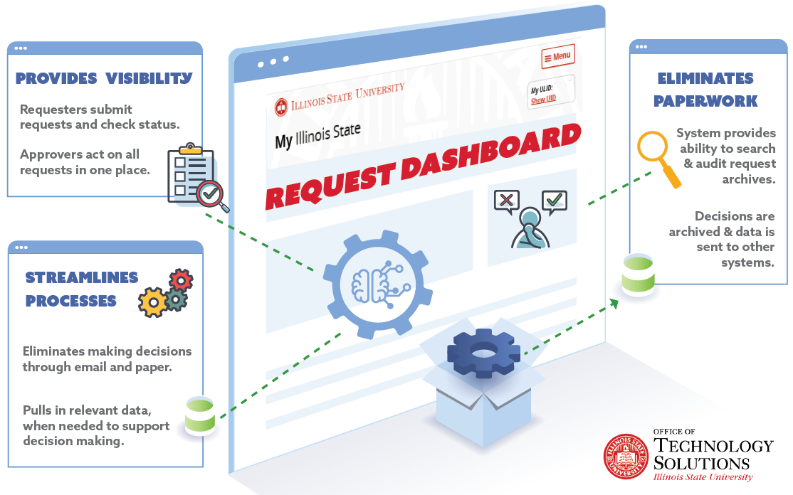
Coming Spring 2021 – Enterprise Workflow
Todd Smoak

Slide 4
Coming Spring 2021 – Enterprise Workflow
Todd Smoak

Slide 5
Coming Spring 2021 – Enterprise Workflow
Todd Smoak

Slide 6
Coming Spring 2021 – Enterprise Workflow
Todd Smoak

Slide 7
Coming Spring 2021 – Enterprise Workflow
Todd Smoak

Slide 8
Coming Spring 2021 – Enterprise Workflow
Todd Smoak

Slide 9
How to assist with Student Success?
Assemble data in the Data Warehouse Engagement focused- Activities and Learning
Provide new reporting in Cognos and PowerBI
Evaluate data for Predictive features.
Deliver resources or interventions needed for students.
Rachel Hart

Slide 10
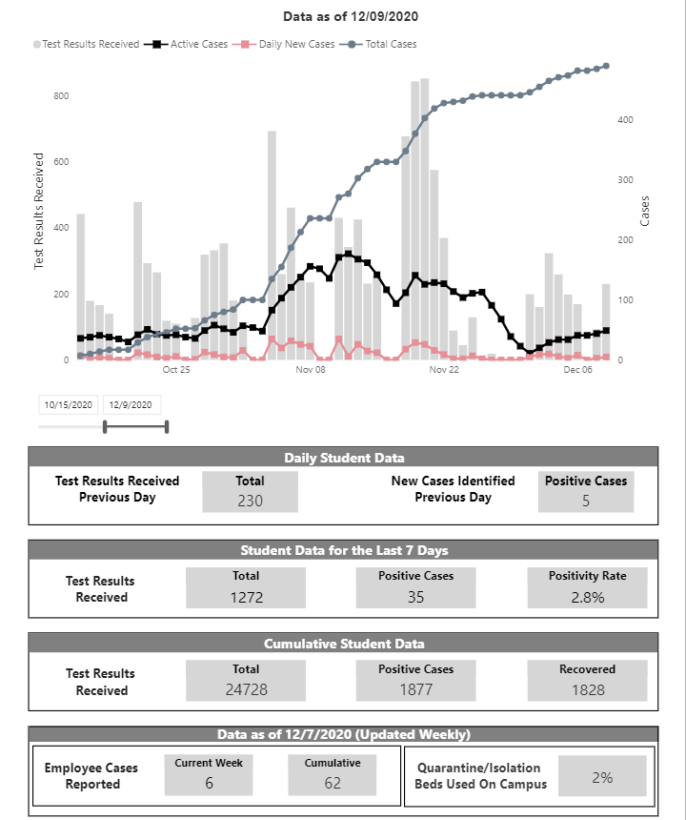
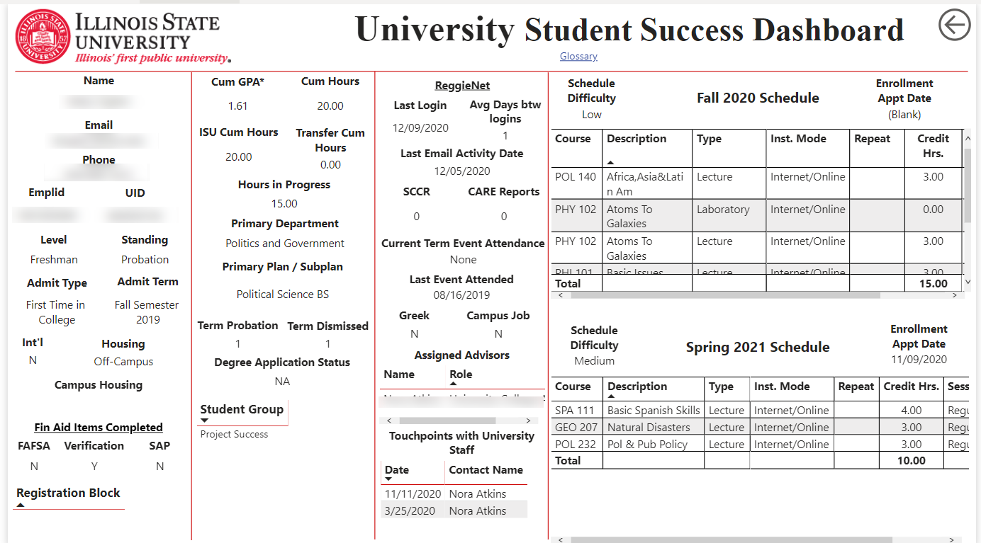
Data Informed Decision Making
Covid Dashboard
Student Success Dashboard
Rachel Hart

Slide 11
Cherwell: Upcoming Changes
Reminder: Monthly Release Schedule
Revised Record Classification System
Incident Form 2.0

Slide 12
Revised Record Classification System
Services: 10 → 5
Categories: 71 → 12
Subcategories: ~45
In TEST Now!

Slide 13
Current Incident Form

Slide 14
Incident Form – 2.0
Notes:
Currently being built for testing.

Slide 15
TSC News
Ticket Closures
2019: 19,330
2020: ?
26,835

Slide 16
Service Catalog
Found on ITHelp.Ilstu.edu
Notes:
Now available on IT Help.
Information on the services available to our users based on their role (student, faculty, or staff)
Design is a work in process with filtering being a focus.
Review and if you would like to add items put a ticket into AT Knowledge and Training

Slide 17
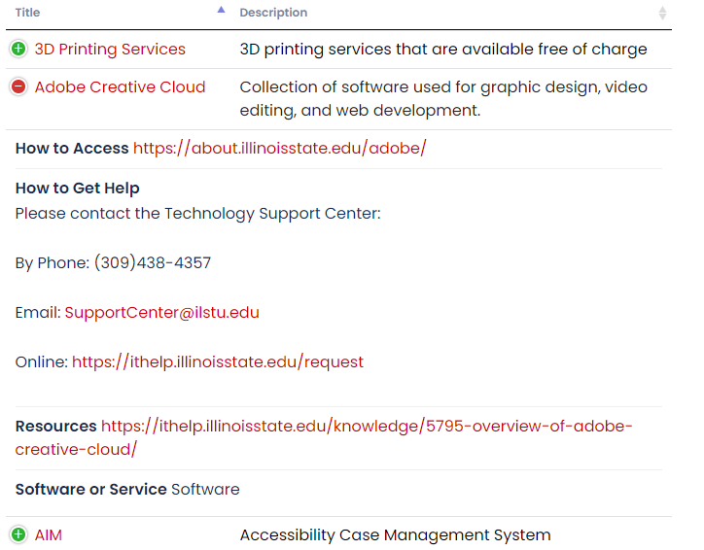
Service Catalog
Navigation Improvements
AT Knowledge and Training
Notes:
Now available on IT Help.
Information on the services available to our users based on their role (student, faculty, or staff)
Design is a work in process with filtering being a focus.
Review and if you would like to add items put a ticket into AT Knowledge and Training

Slide 18
ReggieNet Support
First Level ReggieNet Support
Students and Staff = No Problem!
Faculty Support
2021: Increased TSC Support
Almost everything that isn’t App Admins (Incidents) or Course Dev“ I want to start using ReggieNet” (CTLT).
Notes:
Continuous Service Improvement
We knew we could do better!
TSC will be the first contact. CTLT will forward Faculty contacts encouraging TSC as the first level support to then follow proper escalation process.
*If this sounds like something the TSC can do for your service please contact me.

Slide 19
Dave Greenfield

Slide 20
Client mass purchasing
Expecting new laptops to announce in early January (available in April)
We will invite major vendors (Dell, Lenovo) to do campus roadmap presentations in February
Survey of campus depts in late February
New standard models in late March
Dave Greenfield

Slide 21
Notes
TechZone Points
Apple silicon macs are here
Reminder for student Adobe licenses: Sign-up required at About.IllinoisState.edu/Adobe
Logitech Webcams are in-stock
Check website for hours next weeks (during break)
Dave Greenfield

Slide 22
Upgrades
Upgrading the Core & Distribution Switches
WAN Firewall Upgrade
RBA – DAS
New Mass Email System
OpenShift Platform
Enterprise Architecture – DR Efforts
Craig Jackson
Notes:
Core upgrade starts Dec, Distribution through 2021
RBA-DAS in Jan 2021
New Mass Email System in first quarter of 2021
EA – Interim DR Plan and service maps; more to come in 2021 (WAN, Jump box, etc)

Slide 23
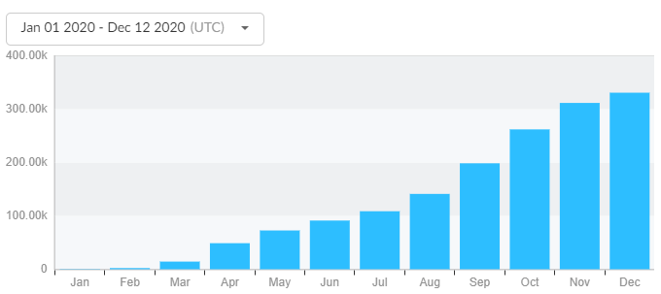
Craig Jackson
Notes:
Jan – 904
Feb – 2230
Mar – 14,369
Apr – 48,835
May – 72,673
Jun – 91,292
Jul – 108,698
Aug – 141,194
Sept – 198,454
Oct – 262,089
Nov – 311,671
Dec - 330,830

Slide 24
Migration to replace O365 Video
Copy complete, syncing new content
Live date – January 1, 2021
Craig Jackson
Notes:
I will mention SDS so they are all aware of this

Slide 25
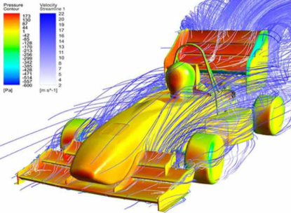
High Performance Computing
Craig Jackson
Notes:
1360 cores
5760 Gigs of RAM
24 "normal nodes"
1 "big mem node" (384Gb vs 192 for those jobs that can't be pushed across multiple nodes)
2 GPU nodes (they include a nVidia tesla V100S GPU)
Approximately 102Tb of available user storage

Slide 26
Information Security & Risk Brief
2020
2021
Key Threats
Key Efforts
Key Goals
Email Attacks
Device Encryption
Raise Awareness
Ransomware
Multi-Factor Auth
Establish Standards
Data Loss
Advanced Protection
Add Critical Controls
docs.illinoisstate.edu/informationsecurity/program
Dan Taube

