Slide 1
Email: isucit@illinoisstate.edu
RoF Channels
#ISUCIT

Slide 2
Welcome to CITx Spring 2019
Dean Plumadore as the Emcee
Sponsors: AT, OAT, SAIT, TechZone, and COB
Suggestion Box
After Event at the Bone, Prairie Room
MVP - Student today, Full-Time in August
RoF Channels
#ISUCIT

Slide 3
Welcome to CITx Spring 2019
News Items
Carla and Tyler on Cherwell and such
Craig, Katie, and Devin on 5/18-19
DavidG on TechZone
Ben on Apps
Kevin on security
RoF Channels
#ISUCIT

Slide 4
Welcome to CITx Spring 2019
Redbirds of a Feather Sessions (RoF)
All Things Apple
Matt Gromer in 150
IT Show and Tell – Automation and Bots
Nathan Stien in 148
IT Show and Tell – Everything Else
Bill Hamann in 133
Services Offered to Students
Katy Killian and Dean Plumadore in 132
RoF Channels
#ISUCIT

Slide 5
CITx Spring 2019 - Keynote
Jana Albrecht
Associate VP, Enrollment Management
Presentation
RoF Channels
#ISUCIT

Slide 6
Who is EMAS?
A Day in the Life
Fun Enrollment Facts
New/Continuing Initiatives

Slide 7
Who Is EMAS?
RoF Channels
#ISUCIT

Slide 8
EMAS Units
Enrollment Management and Academic Services consists of:
Admissions
Financial Aid
Honors
University College
University Registrar

Slide 9
A Day in the Life
RoF Channels
#ISUCIT

Slide 11
Fun Enrollment Facts
RoF Channels
#ISUCIT

Slide 12
10-Year Stable Enrollment

Slide 13
New Enrollment – 10th Day
 | Fall 2017 | Fall 2018 | 1-year change
New FTIC | 3,352 | 3,689 | +337 | +10.1%
New Transfer | 1,810 | 1,817 | +7 | +0.4%
New Grad degree seeking | 679 | 631 | -48 | -7%
New International Students | 139 | 205 | +66 | +1.5%

Slide 14
Future Enrollment Challenges
Demographics
Out-Migration / Competition
Affordability
MAP and Pell Grant erosion
Loan averse
Deep discounting
RoF Channels
#ISUCIT

Slide 15
Fall 2019 Applications-As of 4/27/19
 | Fall 2018 | Fall 2019 | 1-year change
FTIC | 13,427 | 17,484 | 4,057 | +30%
Transfer | 3,092 | 3,577 | 485 | +15.7%
Graduate | 1,700 | 2,142 | 442 | +26%

Slide 16
Fall 2019 Admits-As of 4/27/19
 | Fall 2018 | Fall 2019 | 1-year change
FTIC | 10,594 | 12,817 | 2,223 | +21%
Transfer | 2,147 | 2,261 | 114 | +5.3%
Graduate | 733 | 932 | 199 | +27.1%

Slide 17
How did we do it?

Slide 18
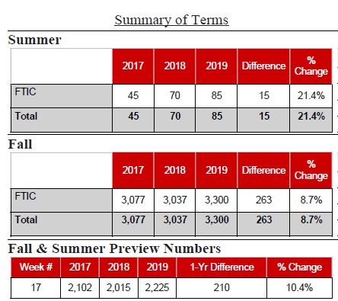
Enrollment Deposits

Slide 19
Enrollment Deposits
It took us all summer to reach 3,983 deposits last year!
Currently, we are sitting at 4,030 deposits for Fall 2019!

Slide 20
New/Continuing Initiatives
E-Sports
Slate improvements
Preview and Transfer Day systems
Website upgrades
MY
EDA – retention modeling
INTO – application and faster processing
Chat Bot
RoF Channels
#ISUCIT

Slide 21
Financial Aid Projects
Cognos report comparing ISIR/FAFSA application. Simplified and reduced the amount of time counseling staff spend on identifying changes made to students’ FAFSA records.
Processes to update State MAP Grant records for quick processing when the state extended the suspense date.
Loan Aggregate Update Bolt-On—Students’ loans were being reduced because of a lack of functionality in CS. With the help of another school, a bolt-on has eliminated student issues and has saved many hours of manual work.

Slide 22
Admissions Projects
IT staff were integral in the RFP/procurement process for Slate
IT staff did a terrific job implementing SLATE
IT staff were crucial in clarifying responsibilities in maintaining the application, security/permissions, etc. This was very helpful in establishing a productive working relationship for the future.
IT staff have been involved in developing our eSports footprint on campus, and they understand the benefits of such a program to our recruitment efforts.

Slide 23
University College Projects
HUGE shout out for getting Preview to work in Slate.
Big thanks to SO MANY PEOPLE for getting the waitlist to work…..Yeah!

Slide 24
What EMAS staff say about IT staff
Outstanding service provided no matter what
Always willing to assist
A joy to work with
Gets issues resolved quickly and pleasant to work with
Patient and thoughtful
Goes above and beyond to communicate and explain
A pleasure to work with

Slide 25
What EMAS staff say about IT staff
Made my processes bearable
IT staff work hard to truly understand the complexities of financial aid
Demonstrates all the qualities you want in a co-worker
Always willing to help solve problems and answer questions

Slide 26
Bottom Line
If the system doesn’t work, we don’t work.
So THANK YOU for everything you do!!!

Slide 27
Questions??
RoF Channels
#ISUCIT

Slide 28
AT – Client Services
Carla Birckelbaw
And
Tyler Piper
RoF Channels
#ISUCIT

Slide 29
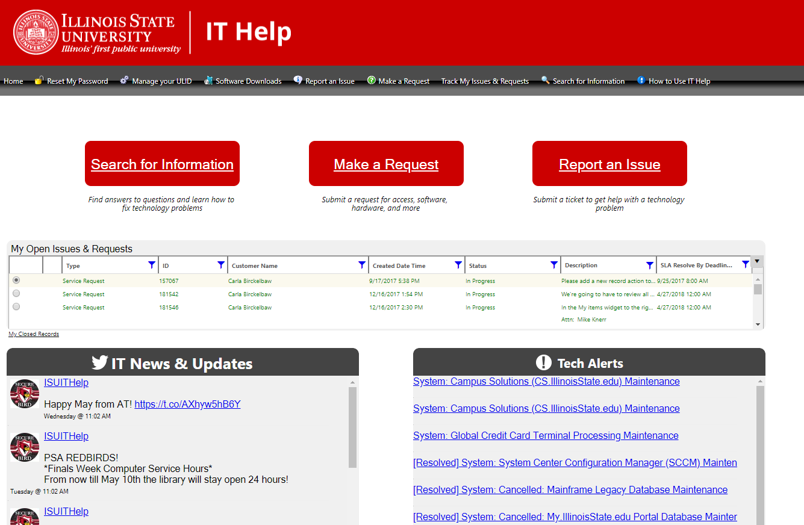
New and Improved IT Help site
Current IT Help

Slide 30
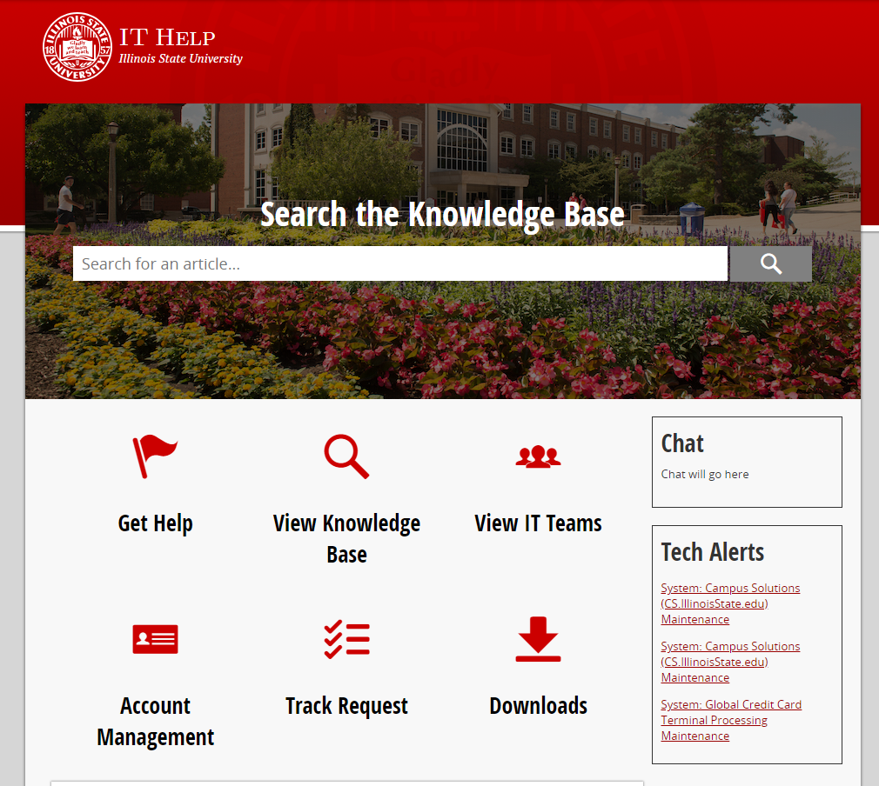
New and Improved IT Help site
Basic submission form
No login to view knowledge articles
Information on IT teams
Simple look and feel, consistent with other University sites
ithelp.illinoisstate.edu address will shift to this site

Slide 31
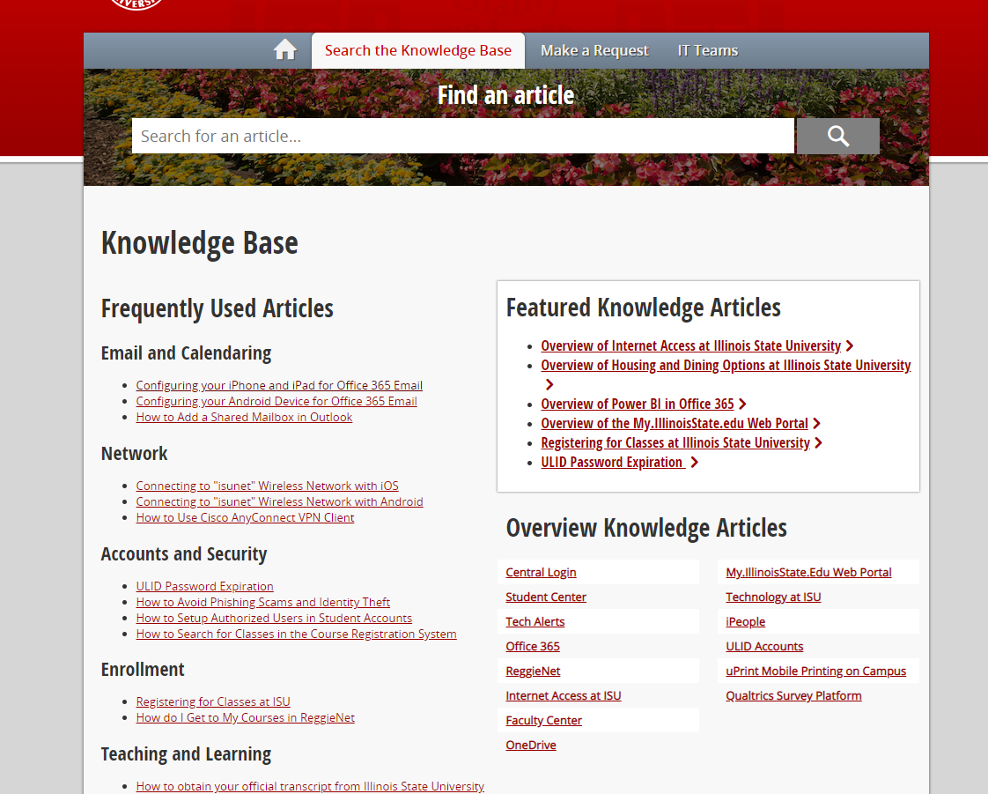
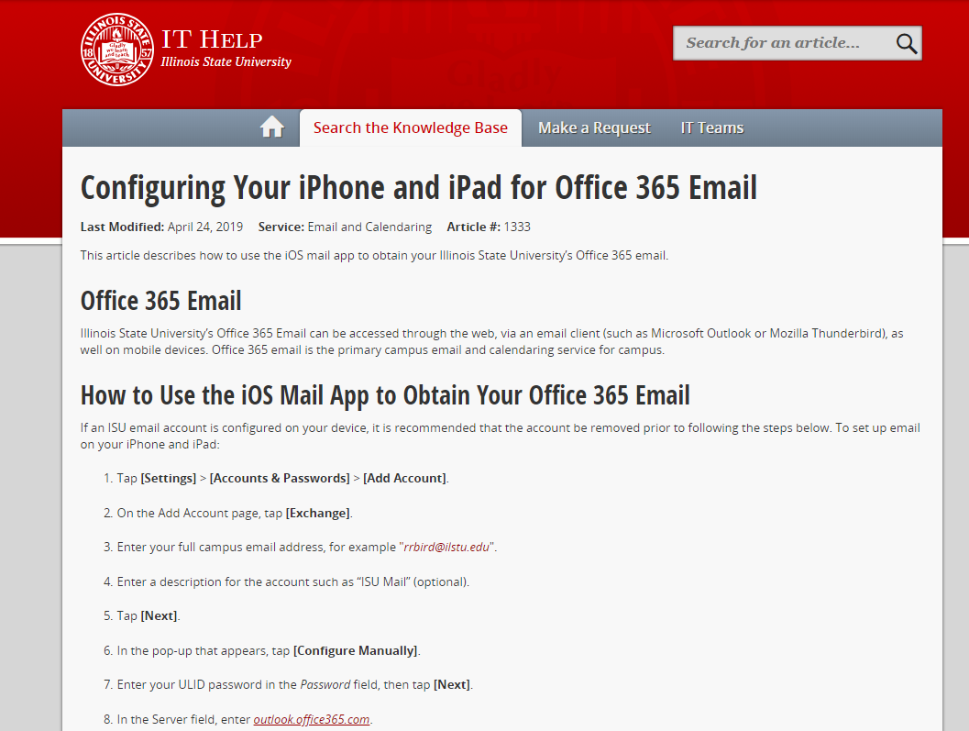
Easy Access to Knowledge

Slide 32
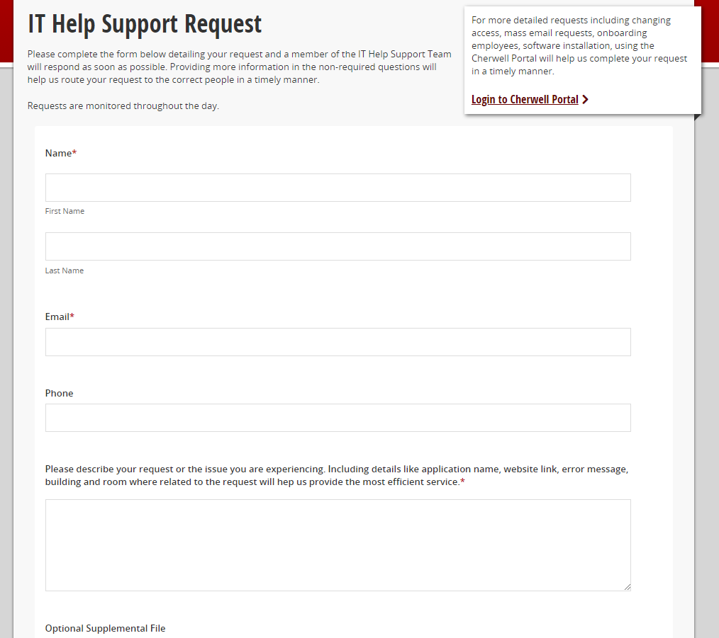
Simple Submission Form
Easy, quick submission
Link to remaining request forms in IT Service Portal
Creates ticket in TSC queue in Cherwell

Slide 33
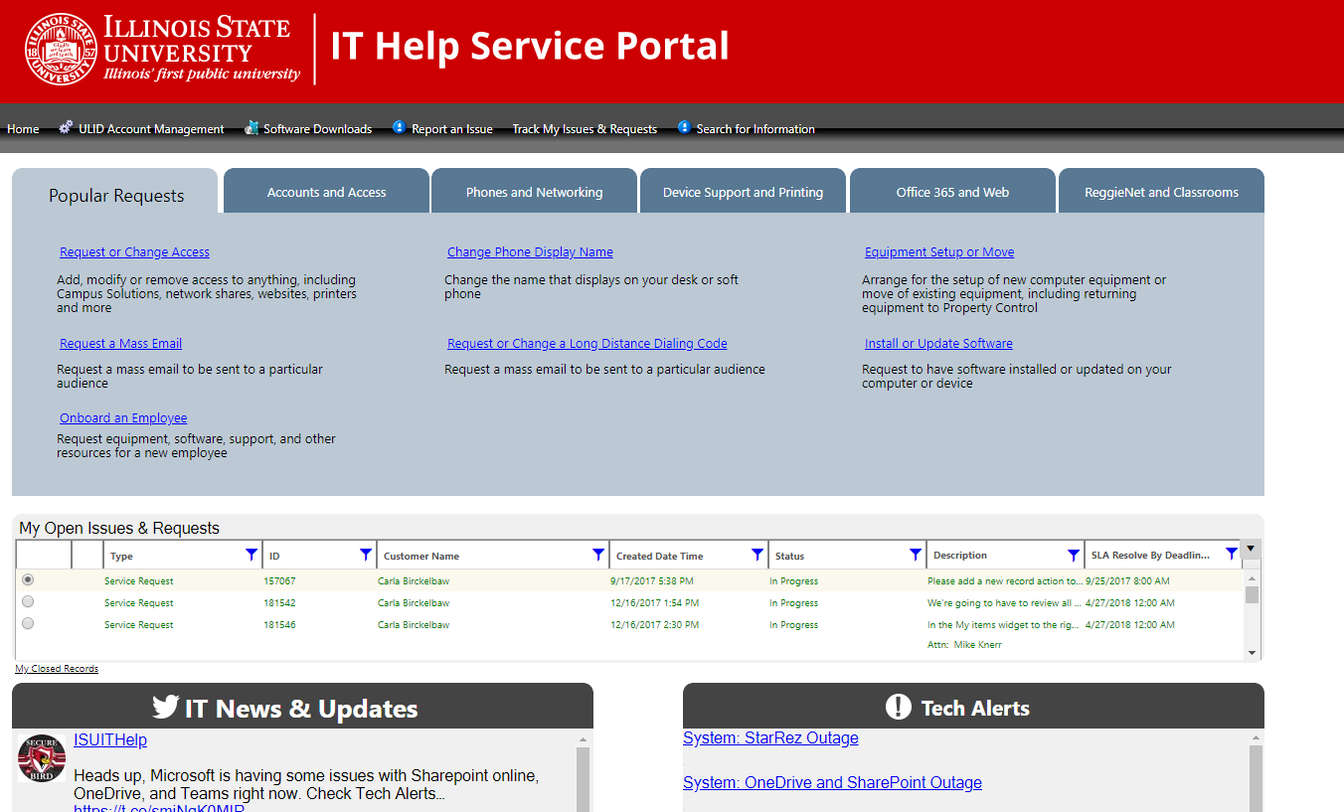
IT Help Service Portal
Some service requests remain in the Cherwell portal, linked from IT Help site
Tracking issues & requests (for now)
Everything on the portal home page – 1-2 clicks to anything
Popular Requests represent 75% of all requests

Slide 34
Service Request Reduction & Simplification
Current IT Help
Issues & Requests
10 services
72 request forms (56 unique)
New IT Help Service Portal
Requests only
5 services
37 request forms (30 unique)
11 of the unique forms are simple forms or links
Thanks to the Forms Working Group for the recommendations that led to these changes!

Slide 35
How do I get help?
IT Help Site
ithelp.illinoisstate.edu
Always start here
Submit issues and basic requests
Search the knowledge base
Access to Downloads
IT Help Service Portal
Cherwell portal (linked from IT Help site)
Detailed requests
Track issues & requests
Planned release: late May 2019

Slide 36
Coming Soon
Live Chat - Bomgar
Chat with the TSC (pilot project)
Available from the IT Help site
Integrates with Cherwell
New Tech Alerts system - Statuspage
Allows for more granular alert categories
More flexible notification options
Better user (and backend) experience overall

Slide 37
Cherwell Record Classification Revision Proposal
Progress Report
RoF Channels
#ISUCIT

Slide 38
Working Group Members
Tyler Piper – AT TSC
Seth Engeman – CFA
Sam Dockery – COE
George Wiman – COB
Eric Schuller – CAS IT
Tim Tribble – SAIT
Ben Hendrix – CAST
Matt Helton – Milner

Slide 39
Classification System Structure
IT Facing
Record Type – Incident, Service Request, and Infrastructure Incident
Service – Broad in Scope
Category – Types of the Service(s)
Subcategory – Specific Incident/Request types that have a need to be classified separately.
Reporting (but cannot be tracked solely by CI).
SLA
Ticket Routing
Specifics Form
Configuration Item (CI)

Slide 40
Production vs Proposed Structure
Production Structure*
Services = 10
Categories = 71
Subcategories= 217 Total/43 Unique
Current Proposed Structure
Services = 5
Categories = 15
Subcategories = 62 Total/44 Unique
One Subcategory Removal (Some Adds)
Combined Submit Incident & Ask My IT Team a Question (Submit Ticket)

Slide 41
Services
Existing System (10)
Proposed System Draft (5)
Accounts and Security
Applications
Datacenter and File Services
Email and Calendaring
Equipment and Software
Network
Phones and Fax
Teaching and Learning
Technology Support & Training
Web and Collaboration
Accounts and Access
Applications and Web
Datacenter and File Services
Hardware
Network

Slide 42
In Progress & Upcoming
Testing & Feedback Phases
IT Staff Survey
Continuous Improvement – Subcategory and Specifics Forms
RoF Channels
#ISUCIT

Slide 43
AT - ION
Craig Jackson
Director
with Katie and Devin
RoF Channels
#ISUCIT

Slide 44
O365 DLP Test
Purpose
Protect against Highly Restricted Data from being inadvertently / inappropriately shared
Active Test Group
Assessing specific data types
Receive notifications and tips

Slide 45
Data Center Network Upgrade
Increased redundancy, efficiency, security, and visibility of the network
Increase from 10Gbps to 100Gbps
Servers in the datacenter can connect with fiber optics now at 1g, 10g, 25g, 50g, or 100g
Firewall integration for east-west traffic

Slide 46
Upgrade Date: 5:00am May 18th to 5:00pm May 19th
While most IT services will be impacted, a few we wanted to specifically mention that will NOT be available:
Authentication
Account Directories
Storage
Databases
Campus Phones
VPN Access
Wireless
Enterprise Applications (Peoplesoft, O365, Reggienet, Ellucian Colleague (Datatel), Cognos, Cherwell, etc...)
The following services should be available throughout the maintenance:
Power
Electronic Door Access
Wired Network Access (Internet only)
Credit Card Terminals
TV Service
RoF Channels
#ISUCIT

Slide 47
CITx Spring 2019
CIT MVP Awards
Full-Time Award - $1,000, August CIT
Student Award - $500, May CITx
Put towards professional development
https://cit.illinoisstate.edu/awards/
Thanks to Charley, Mark, and Rob for the support
RoF Channels
#ISUCIT

Slide 48
CITx Spring 2019
Student CIT MVP Award
Anyone can nominate a Student Tech
Been a Student Tech
Eligible to win once every 4 years
https://cit.illinoisstate.edu/awards/
RoF Channels
#ISUCIT

Slide 49
CITx Spring 2019
Student CIT MVP Award - Nominees
Alyssa Tipsword Kizer – AT
Mantas Nakas – SAIT
Jared Evans – SAIT
Anderson Klay – AT
Casey Johnson – AT
Jeremiah Haywood – AT
Morgan Cunningham – AT
RoF Channels
#ISUCIT

Slide 50
CITx Spring 2019
Student CIT MVP Award - Winner
Jeremiah
Haywood
RoF Channels
#ISUCIT

Slide 51
CITx Spring 2019
Redbirds of a Feather Sessions
All things Apple
Matt Gromer in 150
IT Show and Tell – Automation and Bots
Nathan Stien in 148
IT Show and Tell – Everything Else
Bill Hamann in 133
Services Offered to Students
Katy Killian and Dean Plumadore in 132
RoF Channels
#ISUCIT

Slide 52
Student Technology Support
David Greenfield
Director
RoF Channels
#ISUCIT

Slide 53
Mass Purchase Information
May 15 – Requisition Deadline (orders over $5k)
Mid-June – Realistic Deadline for orders under $5k (pending campus arrival before 6/30/19)
Teams channel in ISU IT Staff: TechZone Purchasing…

Slide 54
Mass Purchase Information
Product Roadmaps – “Lunch ‘n Learns”
Dell
Tues May 21
11:00AM
STV401
Lenovo
Thur May 23
11:00AM
STV401

Slide 55
Proposed Univ Recommendation – Fall 2019
Office 365 ProPlus
Windows OS computers (managed; shared access; assigned; personally owned)
OneNote 2016 can be added as separate application
Office 2019
Mac shared computers
Mac assigned computers if not using user license
Note: Win/Mac user Office365 licenses available via ULID logon at office365.ilstu.edu

Slide 56
Adobe Software Updates
Year2
ISU User License: All Fac/Staff/GAs - NO CHANGE
Via app or package - upgrade any time
ISU Serial License: Labs/Classrooms/Open Areas
Now Shared Device License
Working to federate students

Slide 57
Administrative Technologies - APPS
Ben Mengarelli
Assistant Director
RoF Channels
#ISUCIT

Slide 58
What’s New in APPS…
In PeopleSoft Land
New Hosting Provider
Advisor Changes
New Class Registration
In Enterprise Apps
Monitoring
Cherwell Performance

Slide 59
What’s New in APPS…
In WEB
Developing a Design System
My.IllinoisState
Midterm Grades interface
Admissions content for prospective student
Fiscal Tab
Budget Center
RoF Channels
#ISUCIT

Slide 60
AT – Information Security Office
Kevin Crouse
Director
RoF Channels
#ISUCIT

Slide 61
Insight VM – Vulnerability Manger
Penetration Testing
New State of Illinois Cybersecurity Audit
RoF Channels
#ISUCIT

Slide 62
CITx Spring 2019
CIT Awards – presented in August
Full-Time Award - $1,000
Put towards professional development
https://cit.illinoisstate.edu/awards
Thanks to Charley, Mark, and Rob for the support
RoF Channels
#ISUCIT

Slide 63
CITx Spring 2019
Redbirds of a Feather Sessions (RoF)
All Things Apple
Matt Gromer in 150
IT Show and Tell – Automation and Bots
Nathan Stien in 148
IT Show and Tell – Everything Else
Bill Hamann in 133
Services Offered to Students
Katy Killian and Dean Plumadore in 132
RoF Channels
#ISUCIT

Slide 64
CITx Spring 2019
Thank you to the
CIT Planning Group
Carla, Paul, Jeff, Liam, Tyler, Bill, and I
RoF Channels
#ISUCIT

Slide 65
CITx Spring 2019
Thank you for coming
Would you like to join the CIT Planning Group?
Next….go to the RoFs
Then……go have a burrito…….
Email: isucit@illinoisstate.edu
RoF Channels
#ISUCIT

Slide 66
Email: isucit@illinoisstate.edu
RoF Channels
#ISUCIT

