Slide 1


Slide 2

Welcome!

Slide 3
IT News
Fall 2019 CITx

Slide 4
Made possible by..
Administrative Technologies
The Office of Academic Technologies
And
Student Affairs IT

Slide 5
Student Affairs News

Slide 6
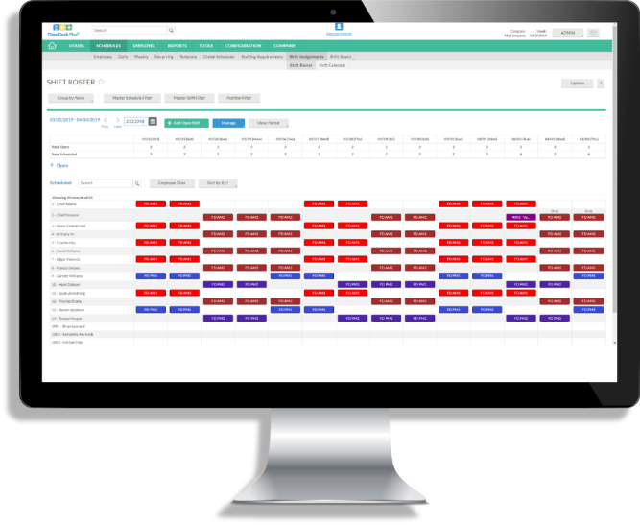
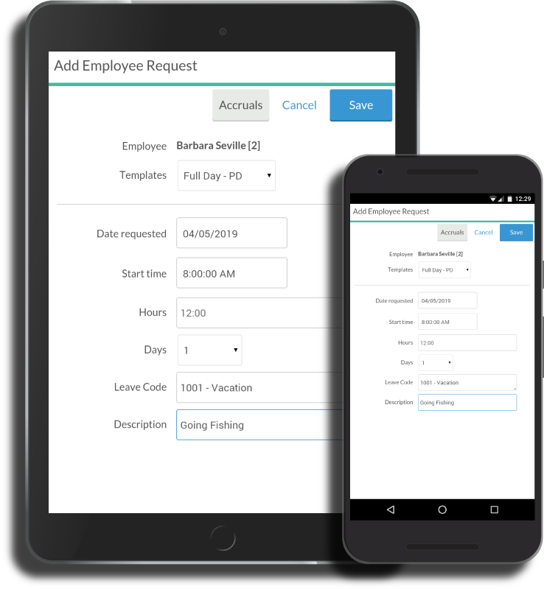

Timeclock Plus
Replacing Kronos
Implementation will start in January
AT will support this solution once implemented

Slide 7
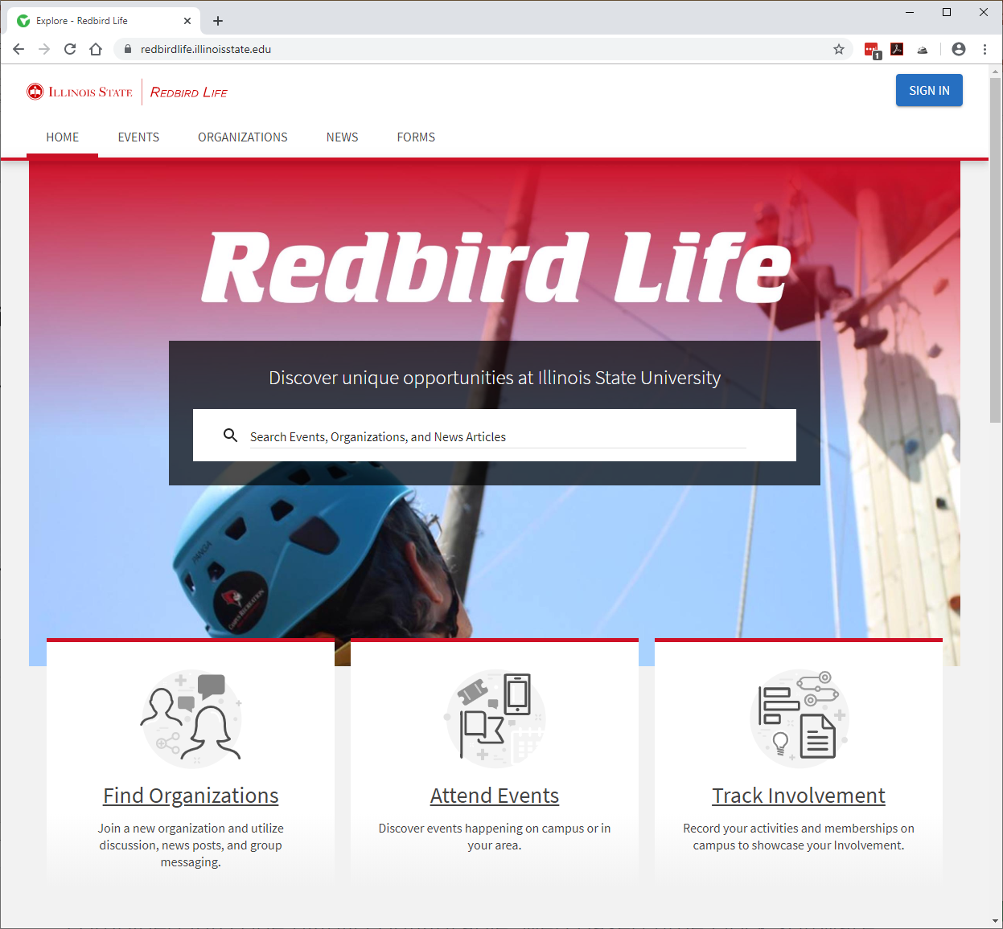
Redbird Life Update
411 Active Organizations
4168 Involved Users
Over 650 Events Posted
9000 Unique Attendees Using Event Pass

Slide 8
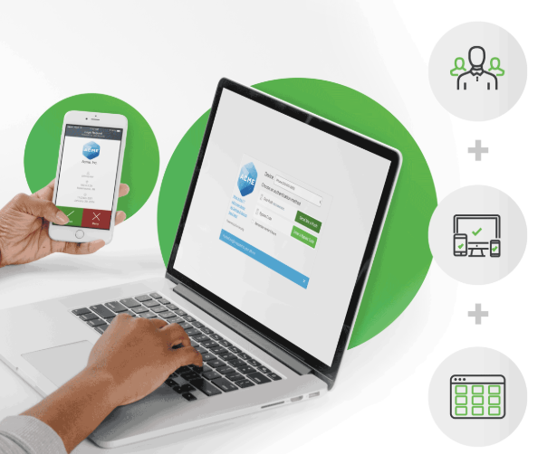


Duo
Limited Rollout of Two Factor Authentication for SAIT, UPD, SHS
Using Duo Push or Yubikey as second factor
Working with AT for Active Directory Sync

Slide 9

Redbird Esports
Varsity Esports program is launching this Fall
Esports Program Director has been hired
Design work has begun on a full esports facility in the BBC
Build out of an additional temporary Esports facility in the Recreation Center has begun

Slide 10



HR Systems

Slide 11
About.IllinoisState.edu
New WordPress platform (CampusPress) deployed 11/25
Aprox. 180 websites were manually rebuilt
Aprox. 80% for individuals and 20% for organizations.
1,025 emails sent as part of updating users
Comments from faculty:
  "Thanks for switching to WordPress." Diane Byers
  "Looks a lot better!" Laura Edwards
  "Thank you for the new website—it looks great!" Madeline Trimble
  "Awesome! I like the new webpage. Thank you all!" Wondy Seyoum

Slide 12
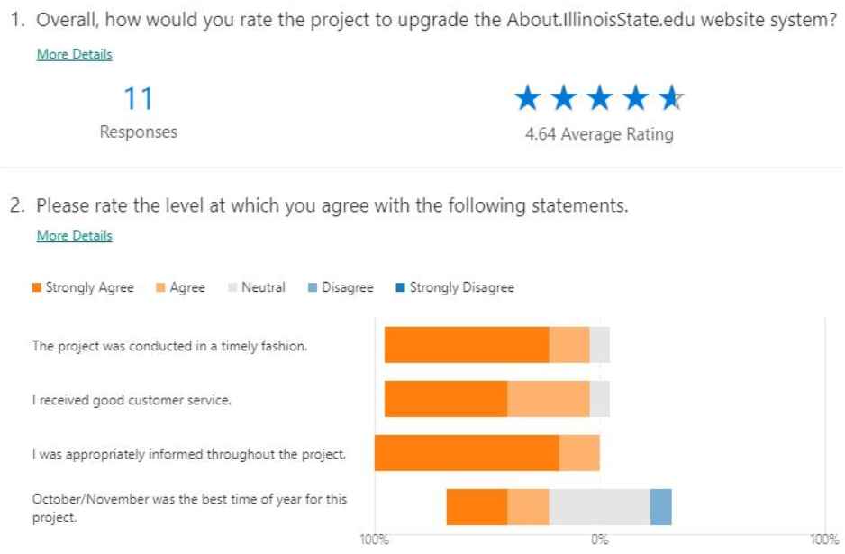
About.IllinoisState.edu

Slide 13
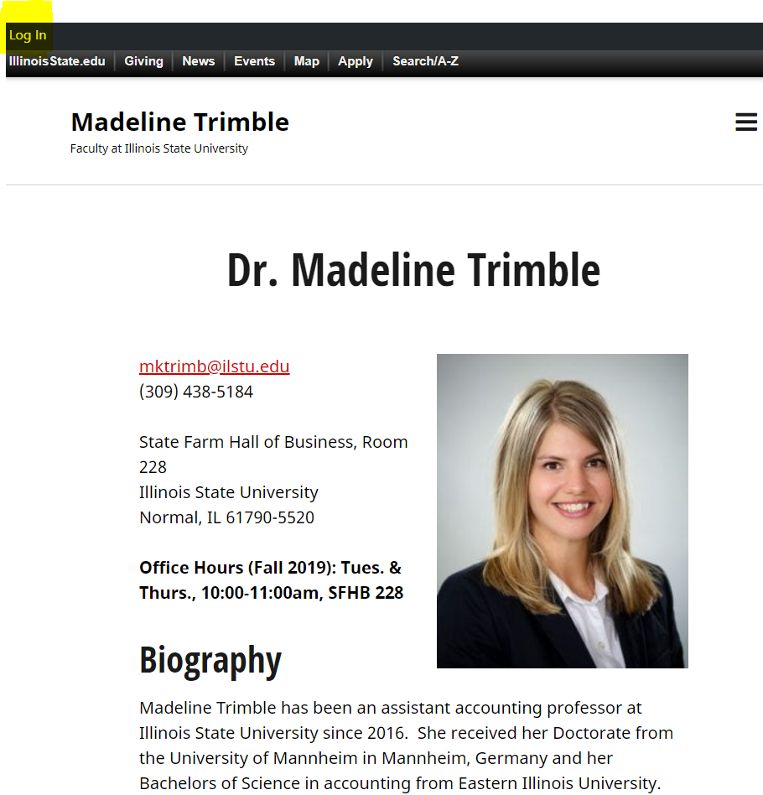
Additional info
Mainly hosts faculty sites, organizations, events, etc.
Leveraging About:
For Faculty, site is auto-provisioned with login
Other users/orgs, can request a site via ITHelp ticket

Slide 14

Seamless Integration
Personal Workspace

Slide 15

Zoom Cloud Recordings
Transcriptions
Captioning (Spring 2020)
20+ Zoom Rooms
Please check with Doug Smith before purchasing any hardware

Slide 16

External User Access
H: Drive Replacement

Slide 17

Redbird Esports
GenGames
Solar Car Team
XR @ ISU

Slide 18
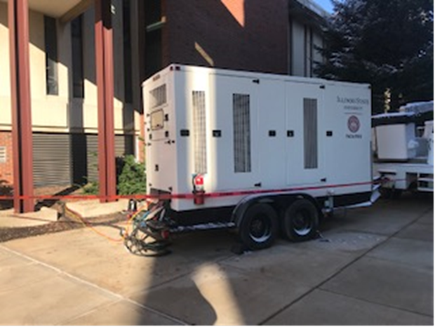


Julian Hall Power
High Voltage
99% of campus no idea there was an issue

Slide 19

Adobe license – Upgrade
Adobe – as of 1/1/20
ISU User License: All Fac/Staff/GAs - NO CHANGE
  Via app or package - upgrade any time
ISU Serial License: Labs/Classrooms/Open Areas
  Now Shared Device License
  Fac/Staff/GAs/Students logon
  Others create a free Adobe ID

Slide 20
Adobe license – Upgrade
Adobe Student options – as of 1/1/20
  Available in labs/classrooms with signon
  NEW – User license for personal devices
    Signup for access – Good till May 15 of each year
    Licenses for approx half of student body
    Solutions for Adobe cloud storage; refunds
        About.IllinoisState.edu/Adobe

Slide 21
University-Funded Software for 2019-20
Statistical Programs
  SPSS Premium (and Modeler)
  Includes Tables & Forecasting, NOT Amos
  SAS
  Mathmatica
  MiniTab
Other
  ESRI ArcGIS (Coming)

Slide 22
Ongoing University coordinated/
Unit-Funded Software
Jamf
  Setup and implementation completed
  Initial order was Nov 1, 2019
AirWatch
  Next cycle TBD

Slide 23
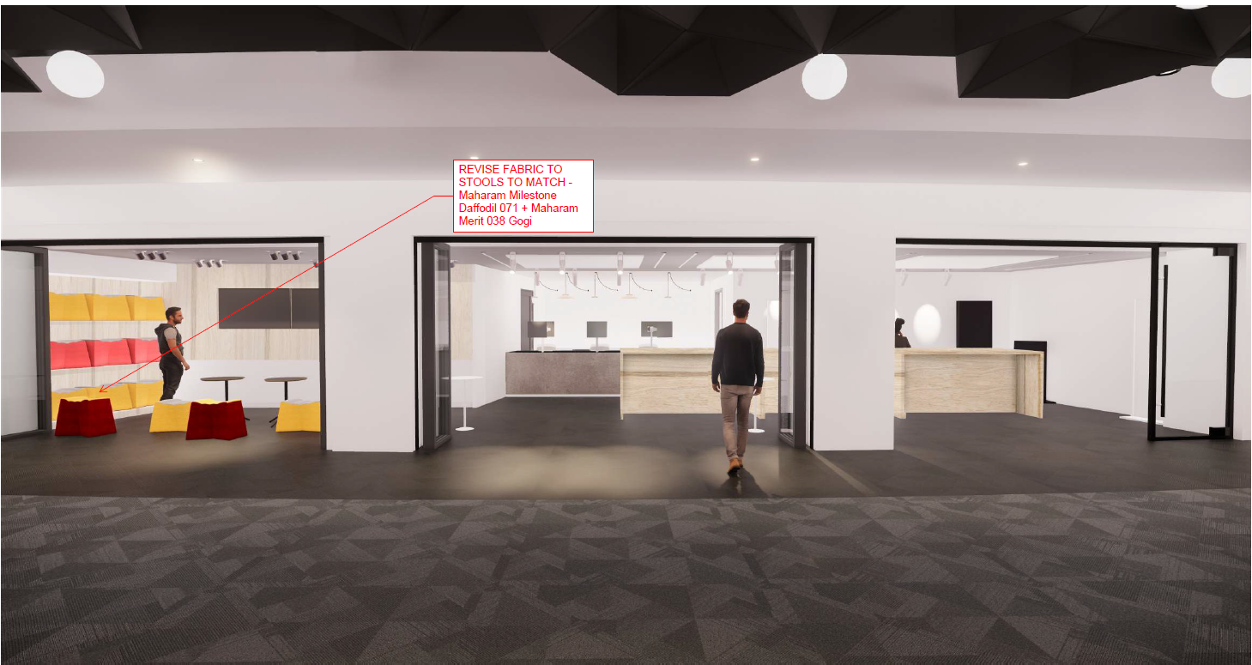

TechZone move: Spring 2020

Slide 24
2nd Annual
CIT Student MVP Award
Deadline is 12/31/19
CIT.IllinoisState.edu/Awards

Slide 25
2019 TechQual+ Survey Results
Notes:
Higher Education TechQual+ Project @ University of Georgia [ https://www.techqual.org ]
Started in 2006, based on SERVQual and, later, LibQual+ methodology
• Survey out on 11/04 to all F/S/S in survey pool for three weeks. Reminder sent on 11/18…
• 2019 Survey had the lowest response rate yet (but close to 2018)…
2013 — 329 completed the survey (56% of attempts)
2017 — 625 completed the survey (58% of attempts)
2018 — 223 completed the survey (43% of attempts)
2019 — 218 completed the survey (44% of 500 attempts)

Slide 26
The Survey Instrument

Slide 27
Content
Four Sections of 4-5 questions each on:
Connectivity and Access
Technology and Collaboration Services
Support and Training
The Quality of ISU IT Services (second year)
Mark Walbert

Slide 28
§1. Connectivity and Access
Tell us about your ability to access technology services through the Internet
Having an Internet service that operates reliably.
Having an Internet service that provides adequate capacity or speed.
Having an Internet service that provides adequate Wi-Fi coverage.
Having adequate cellular (or mobile) coverage throughout campus.

Slide 29
§2. Tech and Collaboration Services
Tell us about the quality of Web sites, online services, and technologies for collaboration
Having Web sites and online services that are easy to use.
Having online services that enhance the teaching and learning experience.
Having technology services that allow me to collaborate effectively with others.
Having systems that provide timely access to data that informs decision-making.
The availability of classrooms or meeting spaces with technology that enhances the teaching and learning experience.

Slide 30
§3. Support and Training
Tell us about your experiences with those supporting your use of technology services
Getting timely resolution of technology problems that I am experiencing.
Technology support staff who have the knowledge to answer my questions.
Receiving communications regarding technology services that I can understand.
Getting access to training or other self-help information that increases my effectiveness with technology.

Slide 31
§4. Quality of ISU IT Services
Tell us about the quality of Campus Solutions...
Tell us about the quality of ITHelp.illinoisstate.edu...
Tell us about the quality of Microsoft Office 365...
Tell us about the quality of My.illinoisstate.edu...
Tell us about the quality of ReggieNet...
Tell us about the quality of Adobe Creative Cloud…
Notes:
Second year for questions 14-18. New question on Adobe CC.

Slide 32
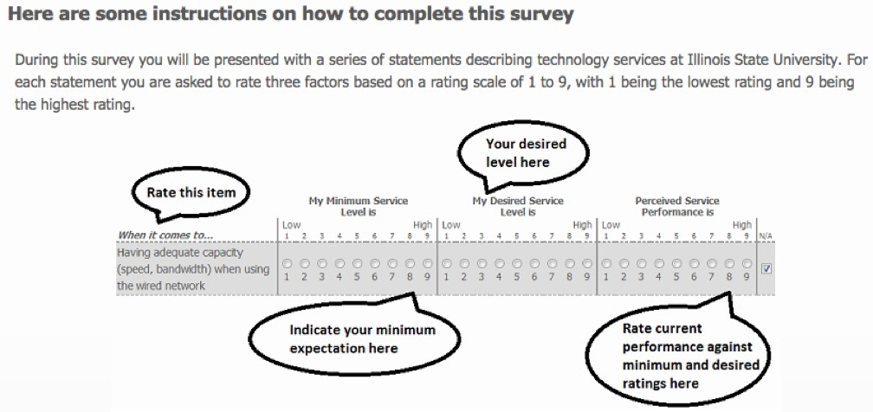
Question Format

Slide 33
Adequacy of Service Performance
When the perceived service performance exceeds minimum expectations, the resulting service level adequacy gap score > 0
When the perceived service performance is below minimum expectations, the resulting service level adequacy gap score < 0

Slide 34
Findings
Notes:
…of quantitative responses.

Slide 35
Adequacy Gaps
Notes:
Outliers removed (n = <205)
A response is considered an outlier if the Adequacy Gap Score is either greater than or less than two standard deviations from the mean Adequacy Gap Score.
This has the effect of removing the top 2.275% and bottom 2.275% of cases on an item by item basis.
Gray bar
Top = Desired service level
Bottom = Minimum service level
Orange bar
Rises if Perceived Service Level > Minimum
Falls if Perceived Service Level < Minimum
The Service Adequacy Gap Score indicates the degree to which end users minimum service levels are being met.

Slide 36
Positive Perceptions
Five service levels exceed the minimum expected:
Having an internet service that:
      operates reliably (Adeq. gap score = +0.16)
      provides adequate capacity or speed (+0.27)
  Communications I can understand (+0.22)
  Quality of Microsoft Office 365 (+0.19)
  Quality of Adobe Creative Cloud…. (+0.51)
Notes:
Outliers removed (n < 205)
...if the Adequacy Gap Score is either greater than or less than two standard deviations from the mean Adequacy Gap Score.
This has the effect of removing the top 2.275% and bottom 2.275% of cases on an item by item basis.
Statistically significant at the 5% level
In the 2018 Survey, the Adequacy Gap Scores were higher:
1. 0.44
2. 0.58
[ 3. was positive ]
[ 4. was positive ]
13. 0.28
But 12. was neutral
And 19. is new this year

Slide 37
Negative Perceptions
Five service levels are below the minimum expected:
  Web sites and online services that are easy to use (-0.39)
  Online services that enhance teaching and learning (-0.30)
  Systems that provide timely access to data [for] decision making (-0.35)
  Quality of Campus Solutions (-0.71)
  Quality of ReggieNet (-0.84)
Notes:
Outliers removed (n < 205)
Statistically significant at the 5% level
In the 2018 Survey, there were 2 negative Adequacy Gaps:
5. Web sites was neutral last year
6. Online services for T&L was neutral last year
8. the same as last year
14. worse last year
18. ReggieNet was neutral last year

Slide 38
Neutral Perceptions
Perceptions of the remaining 9 service levels are not statistically different from zero (they meet the minimum expected)
Mark Walbert

Slide 39
Adequate WiFi coverage
Adequate cellular coverage
Technology to collaborate with others
Classroom or meeting space technology that enhances teaching and learning
Timely resolution of technology problems
Tech support staff who answer my questions
Access to training or other self-help info
Quality of ITHelp
Quality of My.IllinoisState.edu
Notes:
Outliers removed
Not statistically different from zero (p > 0.05)

Slide 40
Responses Filtered by Role
Mark Walbert
Notes:
Outliers excluded

Slide 41
Faculty
Positive Perceptions
Negative Perceptions
Web sites (-0.99)
Online services for T&L (-1.05)
Classroom tech for T&L (-0.70)
Campus Solutions (-0.78)
Office 365 (-0.48)
ReggieNet (-1.82)
Mark Walbert
Notes:
Outliers removed (n = <69)
Statistically significant at the 5% level
Of the completed surveys (unfiltered):
33% were faculty (n=72) -3
24% were students (n=53)
41% were staff (n=89)
2% were not declared (n=4)

Slide 42
Students
Positive Perceptions
Negative Perceptions
Timely resolution of tech problems (+0.59)
Communications (+0.81)
Training (+0.93)
Office 365 (+1.13)
Creative Cloud (+1.13)
Campus Solutions (-0.82)
Mark Walbert
Notes:
Outliers removed (n = <45)
Statistically significant at the 5% level
Of the completed surveys (unfiltered):
33% were faculty (n=72)
24% were students (n=53) -8
41% were staff (n=89)
2% were not declared (n=4)

Slide 43
Staff
Positive Perceptions
Negative Perceptions
Creative Cloud (+0.58)
Timely access to data (-0.56)
Campus Solutions (-0.67)
Mark Walbert
Notes:
Outliers removed (n = <77)
Statistically significant at the 5% level
Of the completed surveys (unfiltered):
33% were faculty (n=72)
24% were students (n=53)
41% were staff (n=89) -12
2% were not declared (n=4)

Slide 44
Carnegie Group Comparison
ISU Compared with other Research Universities (Low)
Mark Walbert
Notes:
Outliers included

Slide 45
ISU Mean Adequacy Score Exceeds Peer Group
Having an Internet service that operates reliably. (0.21 > 0.07)
Having an Internet service that provides adequate capacity or speed. (0.37 > 0.16)
Having an Internet service that provides adequate Wi-Fi coverage. (0.08 > 0.01)
Having adequate cellular (or mobile) coverage throughout campus. (-0.03 > -0.40)
Mark Walbert

Slide 46
ISU Mean Adequacy Score is Below Peer Group
Having Web sites and online services that are easy to use.
(-0.42 < 0.18)
Having online services that enhance the teaching and learning experience. (-0.34 < 0.25)
Having technology services that allow me to collaborate effectively with others. (0.01 < 0.37)
Having systems that provide timely access to data that informs decision-making. (-0.46 < 0.03)
The availability of classrooms or meeting spaces with technology that enhances the teaching and learning experience. (-0.23 < 0.06)

Slide 47
ISU Mean Adequacy Score is Below Peer Group
Getting timely resolution of technology problems that I am experiencing. (-0.18 < 0.34)
Technology support staff who have the knowledge to answer my questions. (-0.19 < 0.35)
Receiving communications regarding technology services that I can understand. (0.13 < 0.69)
Getting access to training or other self-help information that increases my effectiveness with technology. (-0.07 < 0.62)

Slide 48
Changes in the Mean Values of Minimum Expectations
2017-2019 TechQual+ Surveys
Notes:
Outliers excluded

Slide 49
In the 2018 Survey, the mean minimum expectations by item were lower than most of the means for 2017 and 2019.
[ Exceptions are items 5 and 13. ]

Slide 50
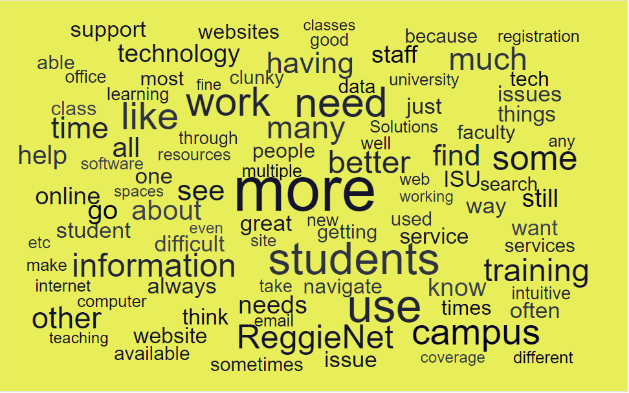
TechQual Comments - the words
Notes:
Explain how comments work

Slide 51
TechQual Comment Themes

Slide 52
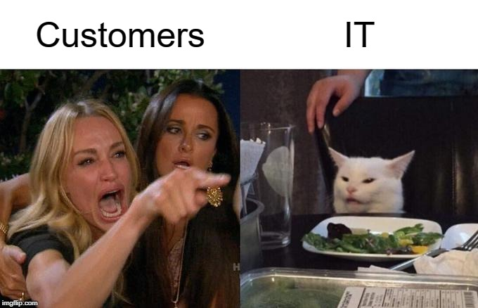
Rather than seeing it like this…
Notes:
So what do we do with this feedback?

Slide 53
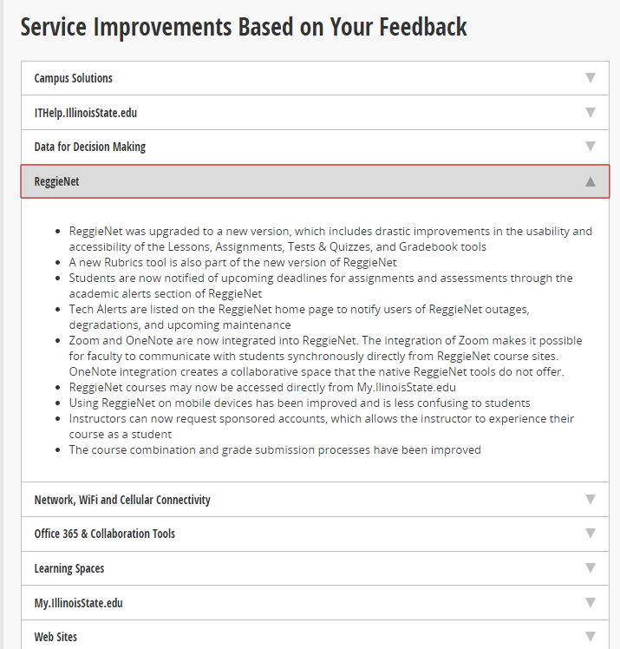
Taking it seriously
Feedback reviewed by stakeholder groups for the various services and changes made to address it
Transparent reporting of improvements based on TechQual feedback at
ITgovernance.IllinoisState.edu/survey

Slide 54

ITSM News
Upgrade to 9.6.3
12/16/19
Spring projects
Classification simplification
Reimagining the incident record

Slide 55

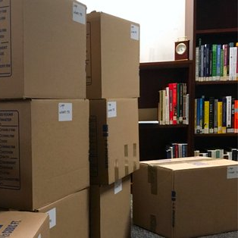
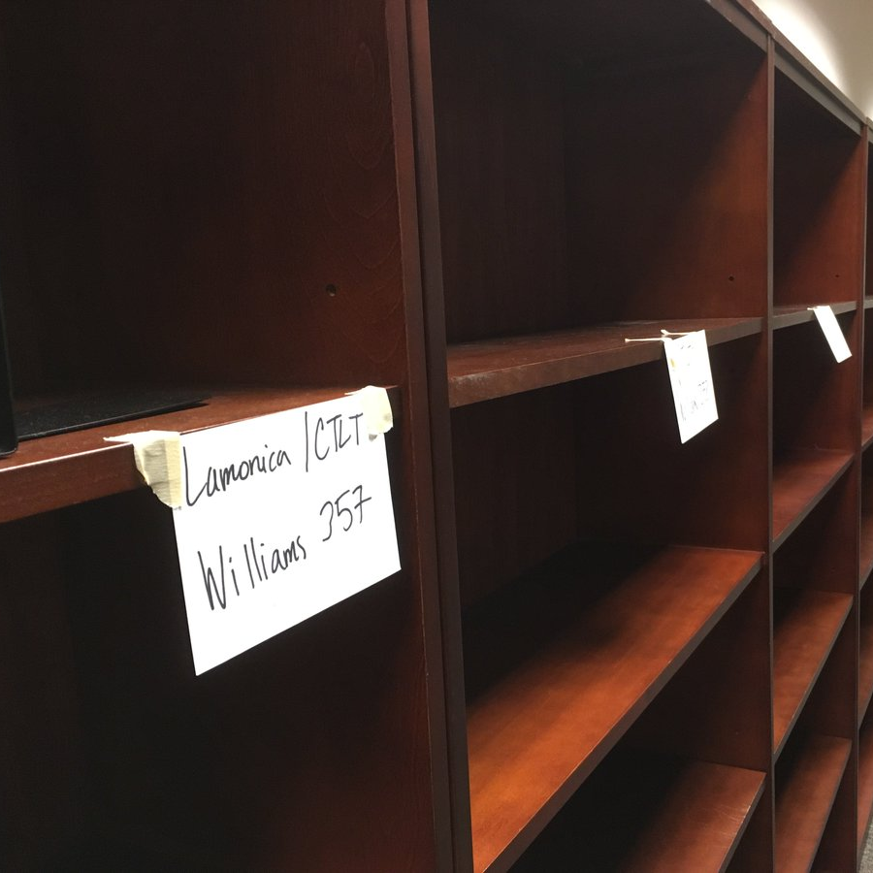
We’ve moved?!
Successful move to Williams Hall
No disruption of support service for ReggieNet

Slide 56
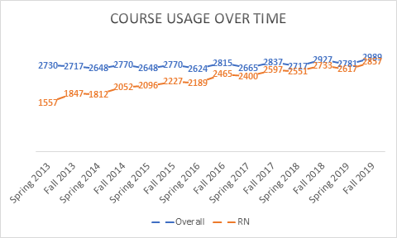
ReggieNet Adoption
 | Overall | ReggieNet | Adoption Rate
Spring 2013 | 2730 | 1557 | 57.03
Fall 2013 | 2717 | 1847 | 67.98
Spring 2014 | 2648 | 1812 | 68.43
Fall 2014 | 2770 | 2052 | 74.08
Spring 2015 | 2648 | 2096 | 79.15
Fall 2015 | 2770 | 2227 | 80.40
Spring 2016 | 2624 | 2189 | 83.42
Fall 2016 | 2815 | 2465 | 87.57
Spring 2017 | 2665 | 2400 | 90.06
Fall 2017 | 2837 | 2597 | 91.54
Spring 2018 | 2717 | 2551 | 93.89
Fall 2018 | 2927 | 2733 | 93.37
Spring 2019 | 2781 | 2617 | 94.10
Fall 2019 | 2989 | 2857 | 95.58

Slide 57
ReggieNet 19.3
Upgrade to 19 completed in July
New features
  Rubrics tool
  New T&Q interface
  Automatic reminders for Assignments

Slide 58
ReggieNet 20
Profile – name pronunciation
T&Q – soft delete
Gradebook – full screen mode
Assignments – new grading interface
Integration with OneDrive
Date manager

Slide 59
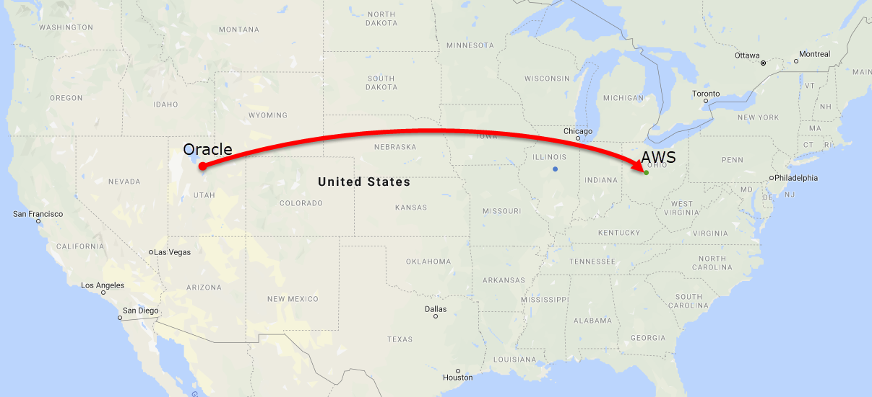

PeopleSoft Gets a new Home!
Before After

Slide 60
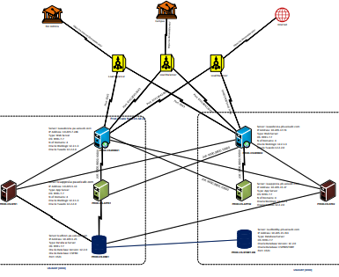
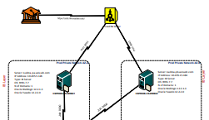

PeopleSofts New Home
33% of our scheduled process run times improved by more than 60 secs per process, the Top 3 Processes combined for more than 13 hours of savings...

Slide 61
CIT Informal Lunch
@ Meatheads
12:00 pm

Slide 62
Redbirds of a Feather Discussion Sessions 11 am – 12 pm
An Introduction to Apple Enterprise Management with Jamf
Facilitated by Matt Gromer
SHFB 148
Beyond the Sign-on: Using Departmental and University Login IDs for More
Facilitated by Dan Taube
SHFB 149
Preparing for Your Next Career Opportunity
Facilitated by Kevin Hand
SHFB 150
Hands-On Demo of VR Headsets
Facilitated by Roy Magnuson
CVA 109/110

