Slide 1
Email: isucit@illinoisstate.edu
RoF Channels
#ISUCIT

Slide 2
Welcome to CITx Spring 2018
Dean Plumadore as the Emcee
Sponsors: AT, OAT, SAIT, TechZone, and COB
Suggestion Box
After Event at the Buffalo Wild Wings (B Dubs)
CITnow – still a thing, next one’s not planned.
RoF Channels
#ISUCIT

Slide 3
Welcome to CITx Fall 2018
Redbirds of a Feather Sessions (RoF)
Everything Endpoint
Jeff Grabb in 131
Collaboration – Shared Goals and Shared Creation
Bill Hamann in 150
Take Charge of your IT Career at ISU
Andee Radliff and Dean Plumadore in 148
MS Teams – Anything Goes!
Paul Unsbee in 149
RoF Channels
#ISUCIT

Slide 4
CITx Fall 2018 - Keynote
Dr. Jan Murphy
Provost
Presentation
RoF Channels
#ISUCIT

Slide 5
Administrative Technology
Charley Edamala
Associate Vice President
RoF Channels
#ISUCIT

Slide 6
Empowering Journeys through
Digital Transformation

Slide 7
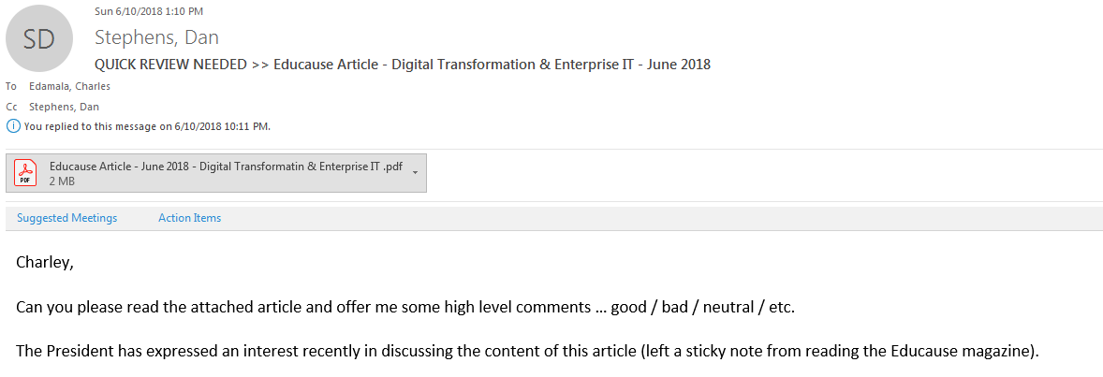

Slide 9
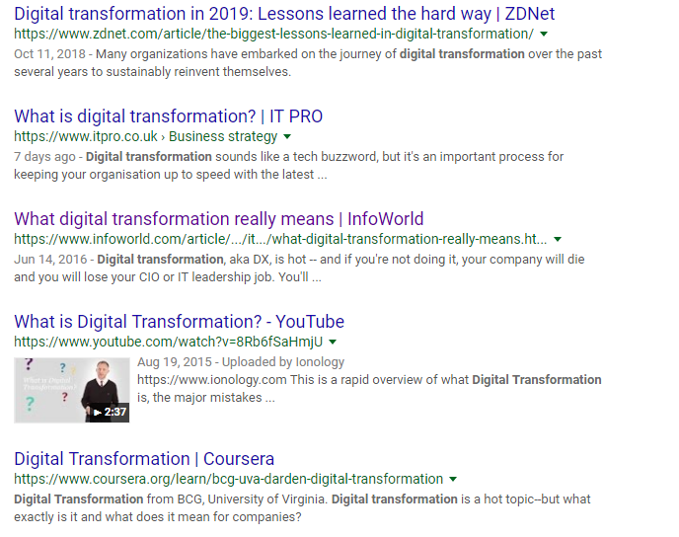

Slide 10
Digital Transformation
Digital Transformation in Higher Education
requires
better definition
clearer objectives

Slide 12
A
B
9th Grade
-1,100,000
C
HS Graduation
-1,000,000
-2,100,000
D
Freshmen in college
-505,000
-2,605,000
E
Sophomores in college
-95,000
-2,700,000
F
College Grad
4,000,000 are born every year in the US (Centers for Disease Control and Prevention, Births and Natality)
4,000,000 enroll in 9th grade (National Center for Education stats Fast Facts 2018)
2,900,000 graduate high school (Bureau of Labor Statistics, College Enrollment and Work Activity of Recent High School and College Graduates Summary2018)
1,900,000 enroll in college (Bureau of Labor Statistics, College Enrollment and Work Activity of Recent High School and College Graduates Summary2018)
1,395,000 make it to sophomore (73.4% of Freshmen enrolled- National Clearing House Research Center FIRST-YEAR PERSISTENCE AND RETENTION)
1,300,000 graduate in 6 years (68.61% of Freshmen enrolled, National Clearing House)

Slide 13
Digital Transformation
People – culture change
Process – flexible and agile governance
Technology

Slide 14
Digital Transformation
What can you do?
Know you make a difference.
Connect with faculty, students, and administrators
Experiment. Scale up. Experiment big.
RoF Channels
#ISUCIT

Slide 15
AT – Client Services
Tyler Piper
Interim Assistant Director
RoF Channels
#ISUCIT

Slide 16
Cherwell Record Classification
Classification System Working Group – January 2019
Current State
10 Services, 71 Categories, ~65 Unique Subcategories
Ambiguous options
Difficult to find what you need.
Unused or incorrectly used options
Future State
None of those things!

Slide 17
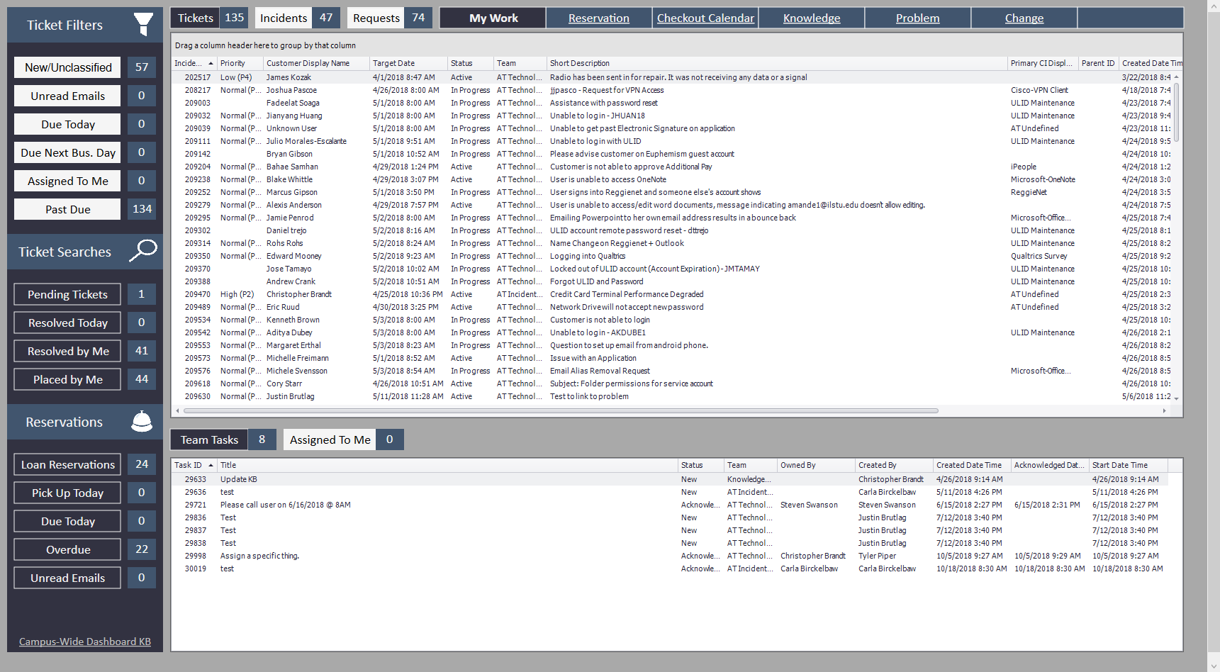
Cherwell My Work Dashboards
My Work – Campus Wide Default
1st Level Support (Incidents, Requests, & Tasks)

Slide 18
Cherwell My Work Dashboards
My Work Extended – Campus Wide Default
2nd Level Support
Incident, Requests, Tasks
Additions: Change, Problem, Projects, & Tech Alerts

Slide 19
My Work-Extended Dashboard

Slide 20
Incident Coordinator Contact Info
Cherwell Request Routing – AT Incident Coordinators
Email: AT CS - Incident Coordinators
ATCS-IncidentCoordinators@ilstu.edu
Report Impacts/Outages: Call the TSC at 438-4357
RoF Channels
#ISUCIT

Slide 21
Administrative Technologies - APPS
Arturo Ramirez
Director
RoF Channels
#ISUCIT

Slide 22
Something old, something new…
SharePoint Migration
600 sites left, down from original 2200+ sites
170 faculty sites (on hold until Campus Press)
264 moving soon (CAS has a bunch starting in Dec)
166 read-only sites
New technologies in the horizon
Automated testing (Katalon), Load testing (Gatling)
Chat bots, virtual assistants, API management platforms, low-code solutions

Slide 23
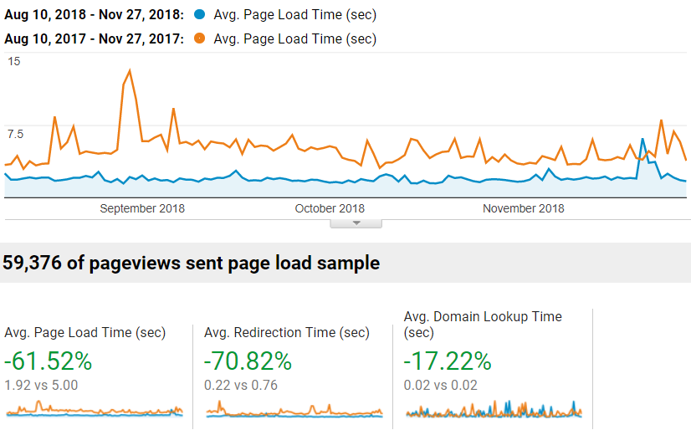
Enhancements to applications
CourseFinder.IllinoisState.edu
Access to entire Course Catalog
My.IllinoisState.edu
Enhanced performance

Slide 24
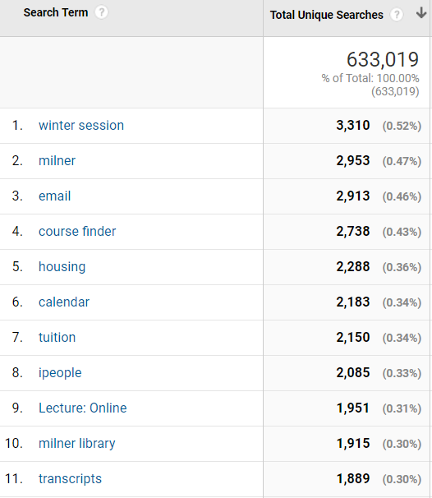
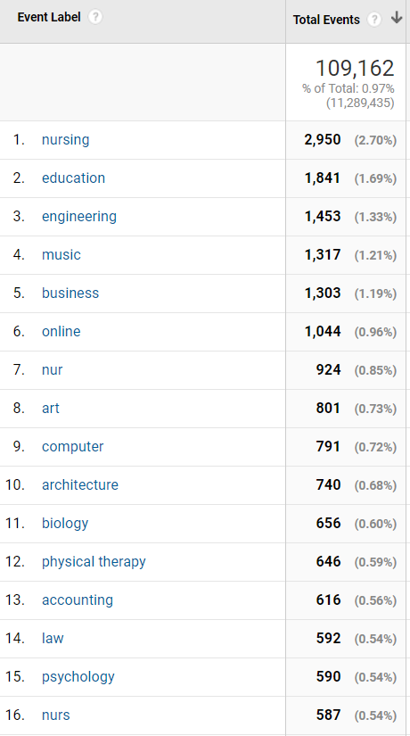
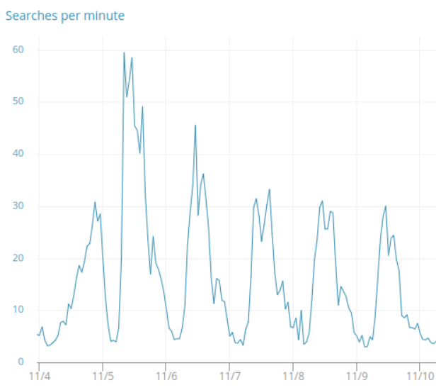
Search data
Search terms fall 2018
Notes:
1.nursing2,950(2.70%)
2.education1,841(1.69%)
3.engineering1,453(1.33%)
4.music1,317(1.21%)
5.business1,303(1.19%)
6.online1,044(0.96%)
7.nur924(0.85%)
8.art801(0.73%)
9.computer791(0.72%)
10.architecture740(0.68%)
11.biology656(0.60%)
12.physical therapy646(0.59%)
13.accounting616(0.56%)
14.law592(0.54%)
15.psychology590(0.54%)
16.nurs587(0.54%)

Slide 25
CITx Fall 2018
CIT MVP Awards
Full-Time Award - $1,000, August CIT
Student Award - $500, April CITx
Put towards professional development
Link is live
Thanks to Charley, Mark, and Rob for the support
RoF Channels
#ISUCIT

Slide 26
CITx Fall 2018
Student CIT MVP Award
Anyone can nominate a Student Tech
Been a Student Tech
Eligible to win once every 4 years
https://cit.illinoisstate.edu/awards/
RoF Channels
#ISUCIT

Slide 27
CITx Fall 2018
Redbirds of a Feather Sessions
Everything Endpoint
Jeff Grabb in 131
Collaboration – Shared Goals and Shared Creation
Bill Hamann in 150
Take Charge of your IT Career at ISU
Andee Radliff and Dean Plumadore in 148
MS Teams – Anything Goes!
Paul Unsbee in 149
RoF Channels
#ISUCIT

Slide 28
AT - ION
Craig Jackson
Director
RoF Channels
#ISUCIT

Slide 29
AT/ION
Eduroam - January 2019
Secure, worldwide roaming access
Internet access at any participating institution
101 countries

Slide 30
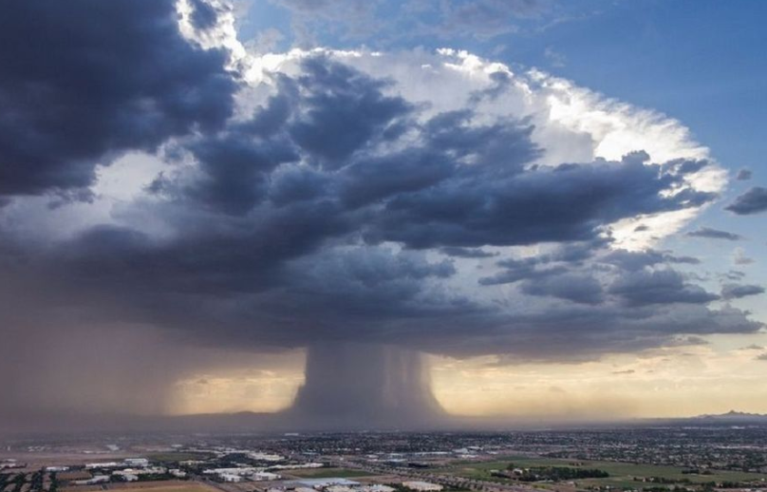
AT/ION – Phone Storms
RoF Channels
#ISUCIT

Slide 31
Student Affairs IT
Rob Bailey
Director
RoF Channels
#ISUCIT

Slide 32
Timekeeping and Scheduling
Planned Kronos upgrade for Winter break was cancelled due to rising costs
Cross functional team is currently drafting an RFP for a comprehensive timekeeping and employee scheduling solution.
This solution will be designed for enterprise-wide use.
All current users of both timeclock.ilstu and Kronos will be migrated to this new solution
Timeclock.ilstu will continue to be supported for current users until new solution is deployed
Target for deployment is summer 2019

Slide 33
Low Code
Knack low-code solution has been in place for about a year now
Great success in providing departments solutions for items that lack vendor solutions, but don’t need full stack development
Several IT units have been using the solution successfully

Slide 34
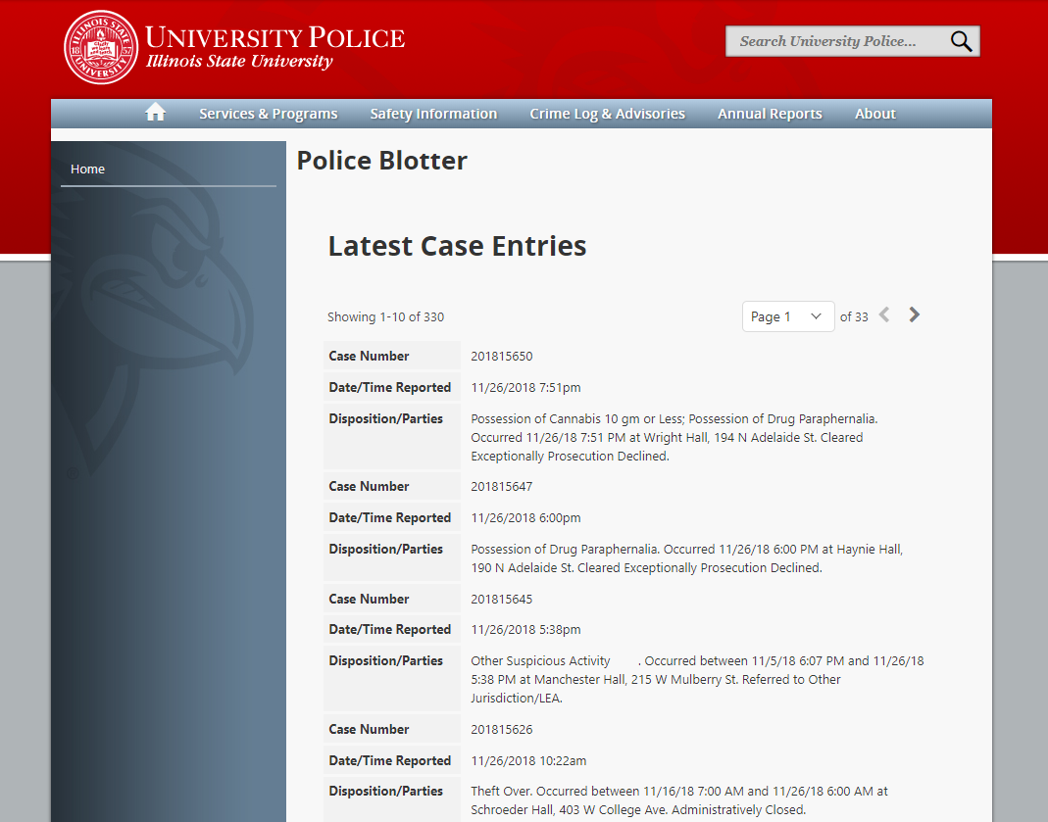
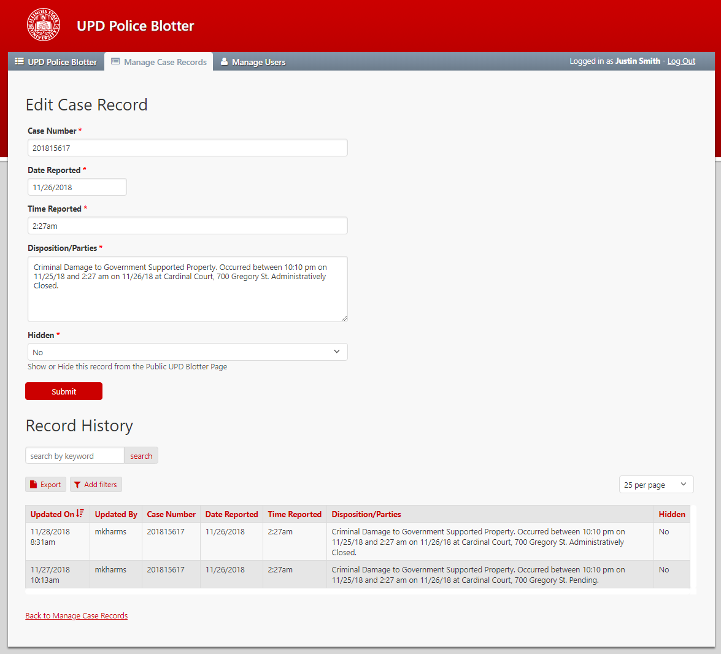
University Police Blotter

Slide 35
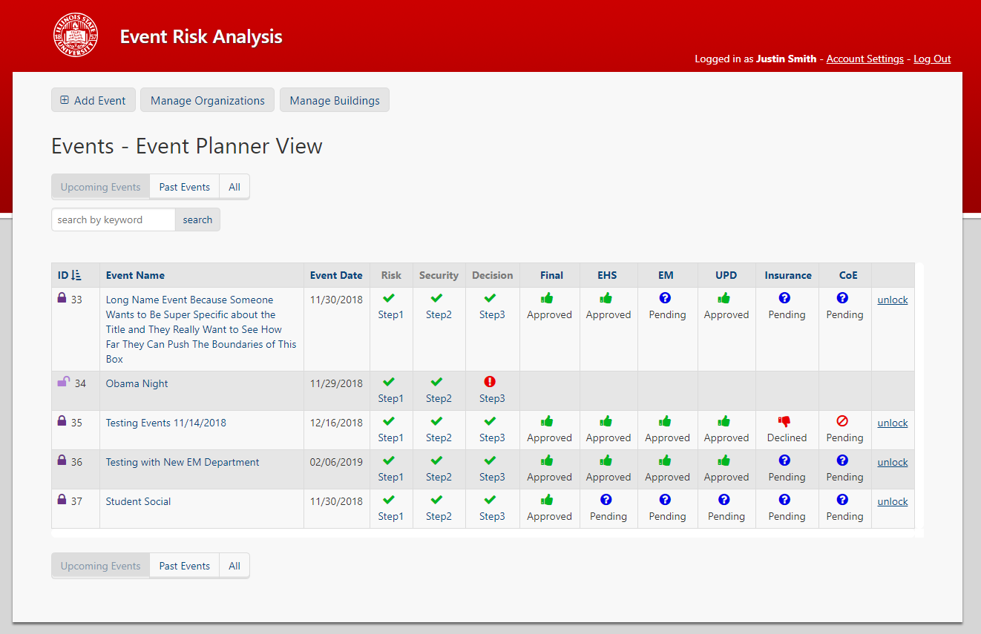
Event Risk Analysis

Slide 36
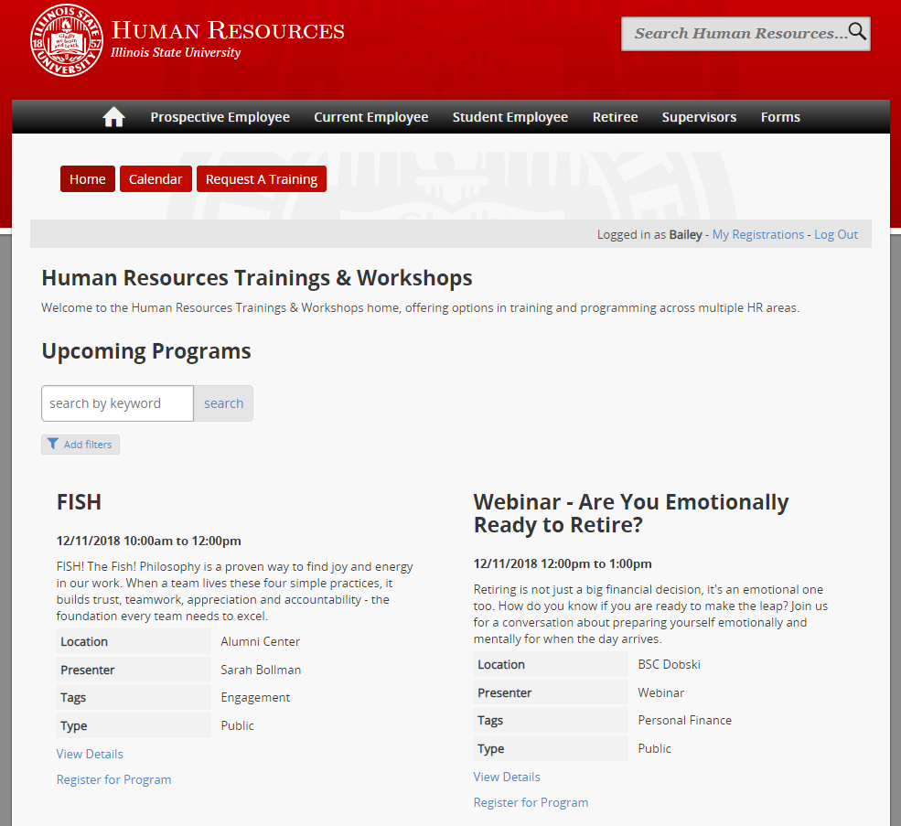
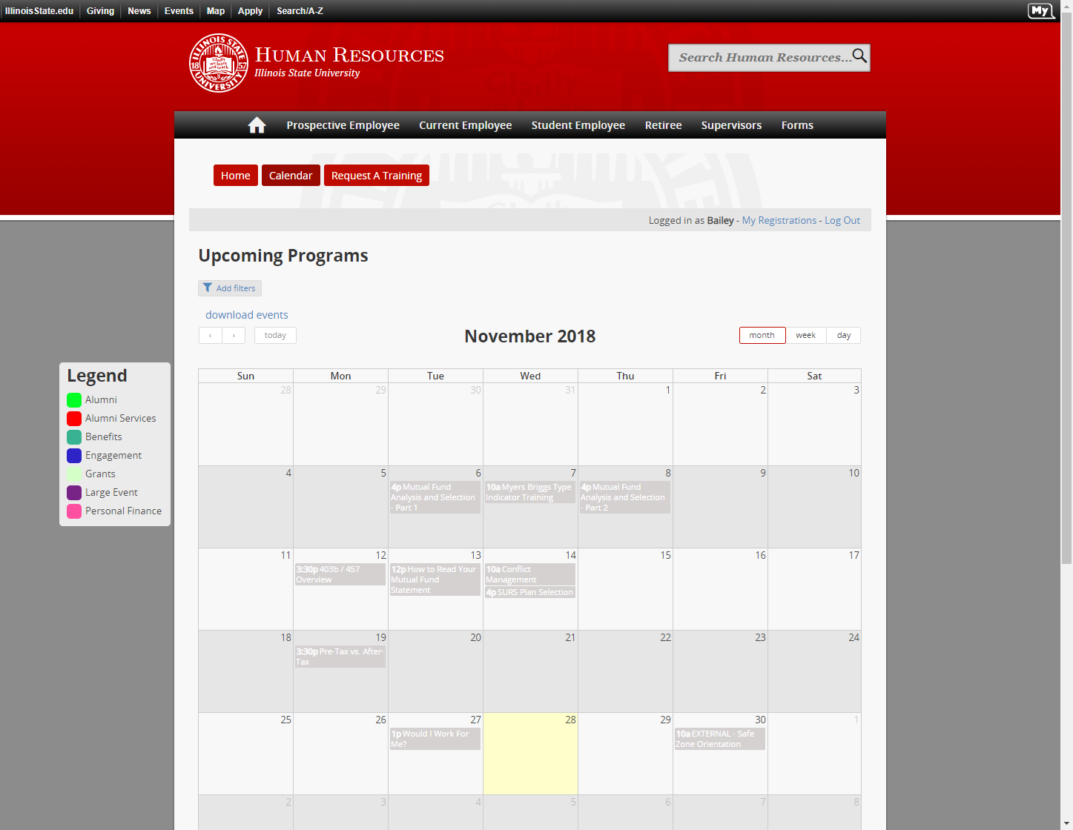
HR Programming Portal

Slide 37
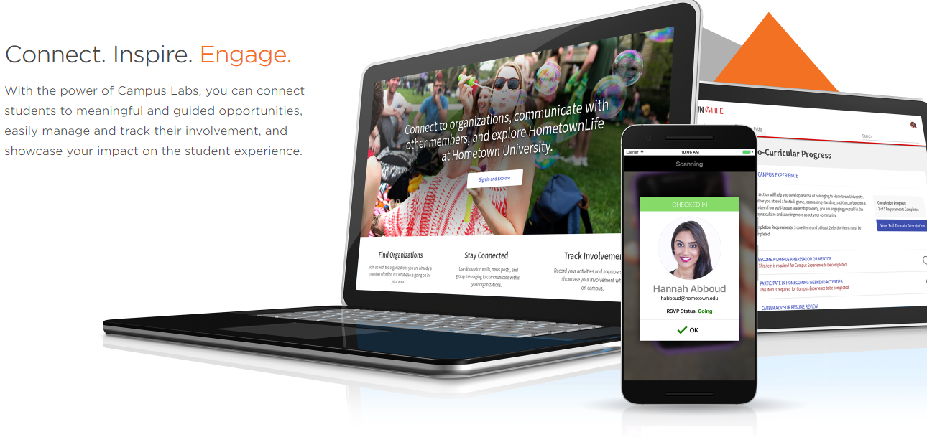
Student Engagement Solution

Slide 38
What is it?
Campus Labs Engage is a comprehensive web and mobile application for the management of student engagement and involvement.

Slide 39
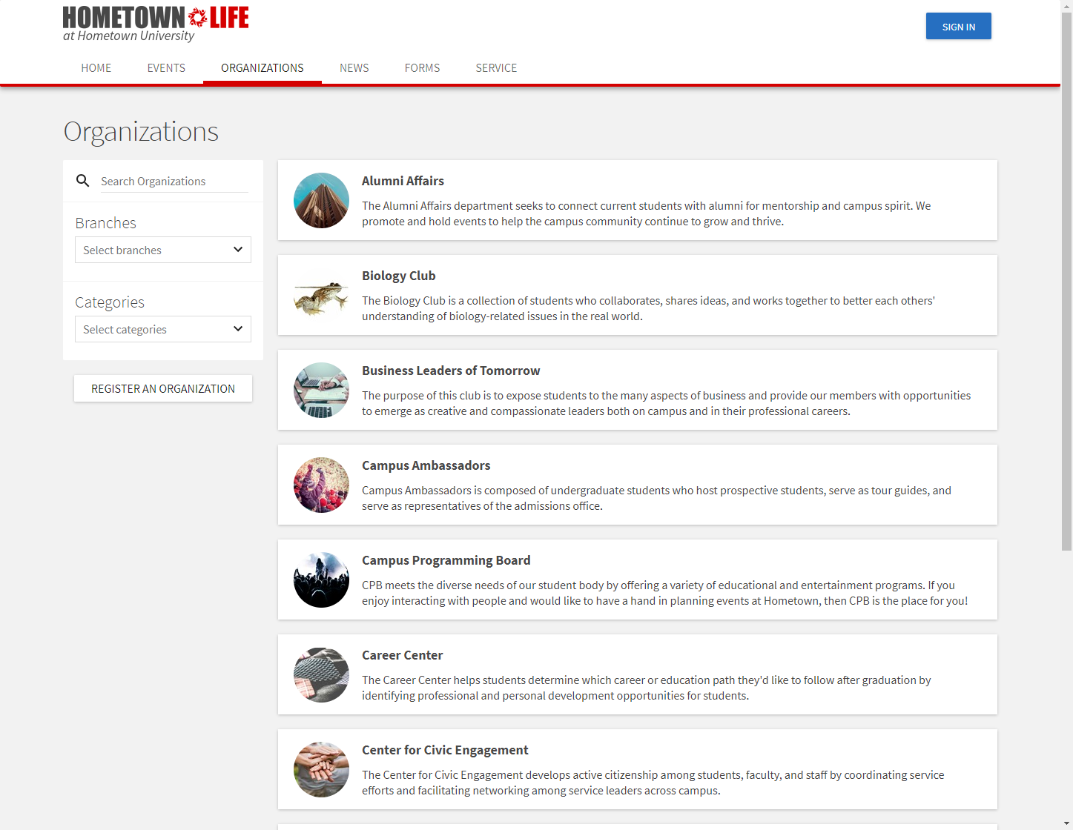
Organization Management
Used for Registered Student Organizations (RSOs),Fraternities and Sororities, Sports Clubs, and Departments
Financial Management Tools

Slide 40
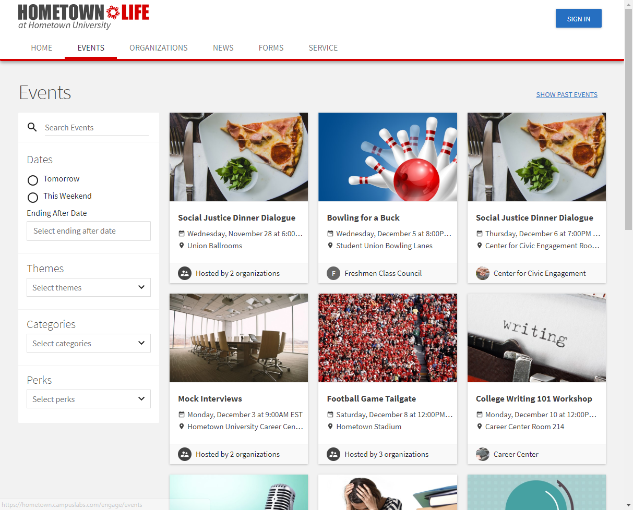
Event Management
Public, Private, Targeted
Set Maximum Seats
Approval Process
Attendance Tracking
Card Swipe
Boarding Pass
Custom Forms
Conditional Logic

Slide 41
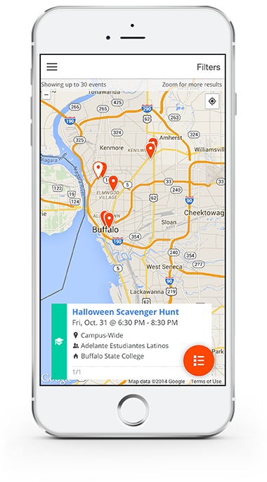
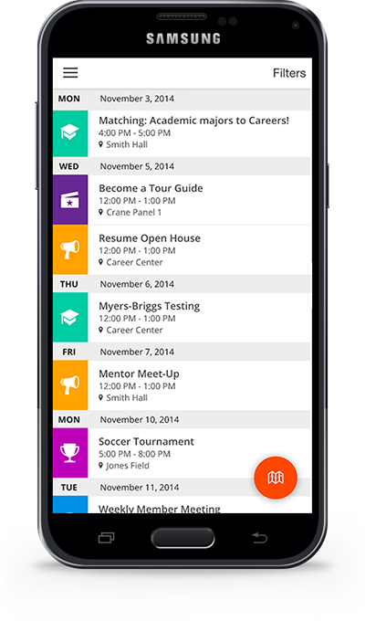
Mobile App
Find Events
RSVP / Sign Up
Find Groups
Check-in to Events

Slide 42
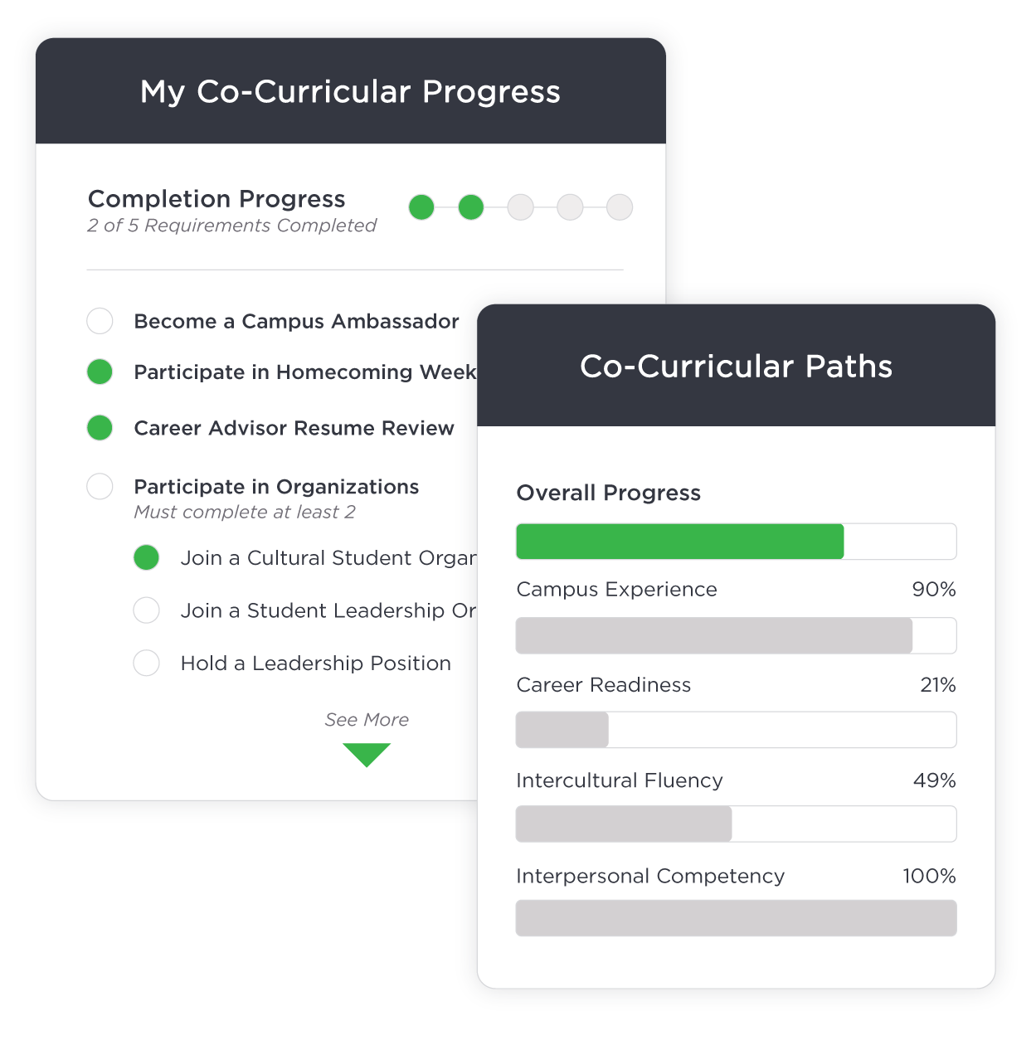
Guided Pathways
Directed Path
Used for development and training programs such as ISU Leads

Slide 43
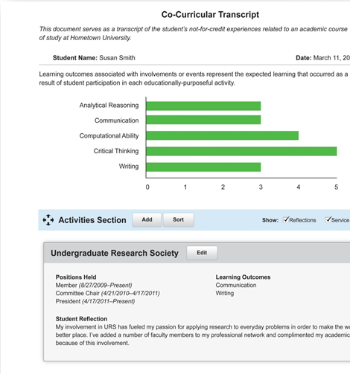
Student Involvement Tracking
Co-Curricular Activities
Page Two Transcripts
Attendance Tracking

Slide 44
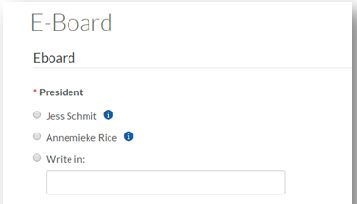
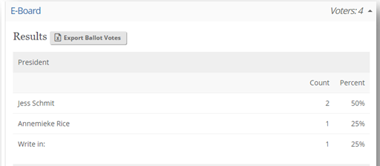
Secure Election Management
Organizational Elections
Campus-Wide Elections

Slide 45
Student Engagement Solution
Coming Summer 2019!

Slide 46
Learning Spaces & AV Technology
Doug Smith
Director
RoF Channels
#ISUCIT

Slide 47
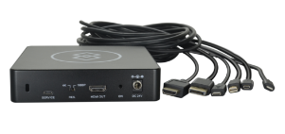
LS&AVT
Magical Video Connection Device
Mystical Learning Spaces Working Group
RoF Channels
#ISUCIT

Slide 48
Student Technology Support
David Greenfield
Director
RoF Channels
#ISUCIT

Slide 50
Adobe Software Updates
New products from October (Creative Cloud 2018)
Rush: Easy cross-device video editing
Photoshop CC for iPad
Project Gemini: Next gen drawing & painting app
Project Aero: Augmented reality authoring tool
PLUS updates of current titles

Slide 51
Adobe Software Updates
ISU User License: All Fac/Staff/GAs
Via app or package - upgrade any time
ISU Serial License: Labs/Classrooms/Open Areas
Now Shared Device License
DO NOT upgrade now
Feb ‘19 release, Directory sync, testing = Summer

Slide 52
Mass Purchase Information
Apple
Jan 28: quote submit
Feb 25: target for pricing and orders
Dell & Lenovo
Late Jan/Feb: Campus Roadmap Presentations
Mid Feb: Organizing meeting
Late March: Websites, pricing, ordering
Early May: Req Deadline

Slide 54
AT – ISO – Office of IAM
Dan Taube
Interim Assistant Director
RoF Channels
#ISUCIT

Slide 55
Office of IAM
A year in review…
IAM Strategy Development
Hired a Lead IAM Admin
Services & Support Transition
Problem Management
Data Consistency Across Systems
Affiliation Logic & Assignment
Identity Data Dictionary
Foundation for Automation
Reimplementation of 1-Year Standard
Second Phase of Manual Effort
32,000 ULIDs Deprovisioned for Past Students, Employees, and Guests
Duplicate Accounts
Grace Period Directory Data
Manager Values in AD
Deletion of User Objects in AD
Formation of the Office
AD/LDAP Sync Project
Account Deprovisioning
Problem Management

Slide 56
Office of IAM
The year ahead…
Identity Data Workshops
Communication with You
Campus Awareness
Published Documentation
Multi-Factor Authentication
Automated Deprovisioning
Central Account Creation
DLID Account Management
AT Office of IAM (Cherwell)
OIAM@ilstu.edu
309-438-4357 (TSC)
Dan Taube/Ben Rappleyea
… to the project managers, business and technical analysts, application and system admins, developers, subject matter experts, support specialists, and leadership that made the last year possible!
Growth of the Office
Projects in Planning
Contact Information
Special Thanks

Slide 57
CITx Fall 2018
CIT MVP Awards
Full-Time Award - $1,000, August CIT
Student Award - $500, April CITx
Put towards professional development
cit.illinoisstate.edu/awards
RoF Channels
#ISUCIT

Slide 58
CITx Fall 2018
CIT Awards – presented in August
Full-Time Award - $1,000, Student Award - $500
put towards professional development
link is live
Thanks to Charley, Mark, and Rob for the support
RoF Channels
#ISUCIT

Slide 59
CITx Fall 2018
Redbirds of a Feather Sessions
Everything Endpoint
Jeff Grabb in 131
Collaboration – Shared Goals and Shared Creation
Bill Hamann in 150
Take Charge of your IT Career at ISU
Andee Radliff and Dean Plumadore in 148
MS Teams – Anything Goes!
Paul Unsbee in 149
RoF Channels
#ISUCIT

Slide 60
CITx Fall 2018
Thank you to the
CIT Planning Group
Carla, Paul, Jeff, Liam, Tyler, Bill, and I
RoF Channels
#ISUCIT

Slide 61
CITx Fall 2018
Thank you for coming
Would you like to join the CIT Planning Group?
Go have a wing…….
Email: isucit@illinoisstate.edu
RoF Channels
#ISUCIT

Slide 62
Email: isucit@illinoisstate.edu
RoF Channels
#ISUCIT

