Slide 1
Email: isucit@illinoisstate.edu
RoF Channels
#ISUCIT

Slide 2
Welcome to CITx Spring 2018
Dean Plumadore as the Emcee
Sponsors: AT, OAT, SAIT, TechZone, and COB
Suggestion Box
After Event at the Pub II
CITnow series kicks off this summer with a Virtualization Summit (Craig)
RoF Channels
#ISUCIT

Slide 3
Welcome to CITx Spring 2018
Redbirds of a Feather Sessions (RoF)
Standard Operating Environment for Endpoints
Dan Taube in 131
Service/Infrastructure Monitoring
Tim Walsh in 150
Growing your IT Career
Dean Plumadore in 148
Useful Bots for MS Teams
Nathan Stien in 149
RoF Channels
#ISUCIT

Slide 4
Spring CITx - Keynote
Dr. Todd McLoda
Dean – CAST
Presentation
RoF Channels
#ISUCIT

Slide 5
AT – Client Services
Tyler Piper
Interim Assistant Director
in for Carla Birkelbaw
RoF Channels
#ISUCIT

Slide 6
ITSM Updates
Combined Change/Release record coming soon
SLA record live
Final results for the ITSM project
Minor upgrade to Cherwell 9.3.1
Notes:
Change/release record – last piece of new functionality from the implementation project, and actually is coming full circle as it replaces the original Change record, one of the first things to go into production. It’s in configuration now, and will be released in May/June.
SLA – record is live and may be used, but documentation will be available later this month and an official release announced
Final tally - Project ends with 11 major record types configured to ISU’s needs, covering 10 ITIL processes, and a WHOLE LOT of collaborative work to get there – thanks to all who participated!
Upgrade – minor upgrade, will require new client only, planned for late May. Now that we are (mostly) out of active development of new functionality, we will be able to follow Cherwell’s release schedule more closely.

Slide 7
ITSM Updates
IT Help 2.0
Working group developing recommendations focused on the IT Help user experience
Simplify and streamline
Integrations will be key
Tentative implementation Fall 2018
Notes:
Simplify and streamline
we’re looking at all service request forms in conjunction with the work of a Forms working group, evaluating for volume of usage, fields needed, whether a specifics form is needed at all
Incident submission can be streamlined to a single form
Redesign interface for easier navigation to the right request
Integrations
Plan to deliver as much content as possible to My
Investigating 3rd party knowledge solutions and chat bots to provide a better search experience
Single Sign-On

Slide 8
Web and Interactive Communications
Arturo Ramirez
Director
RoF Channels
#ISUCIT

Slide 9
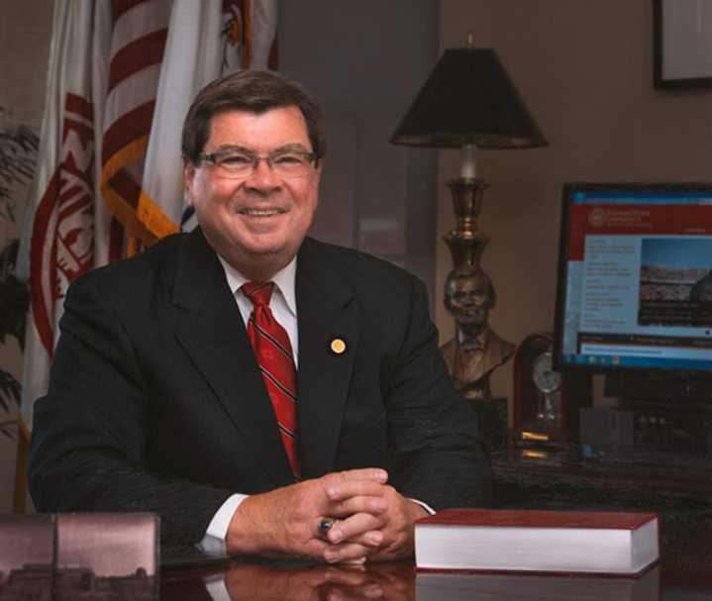
New University Homepage

Slide 10
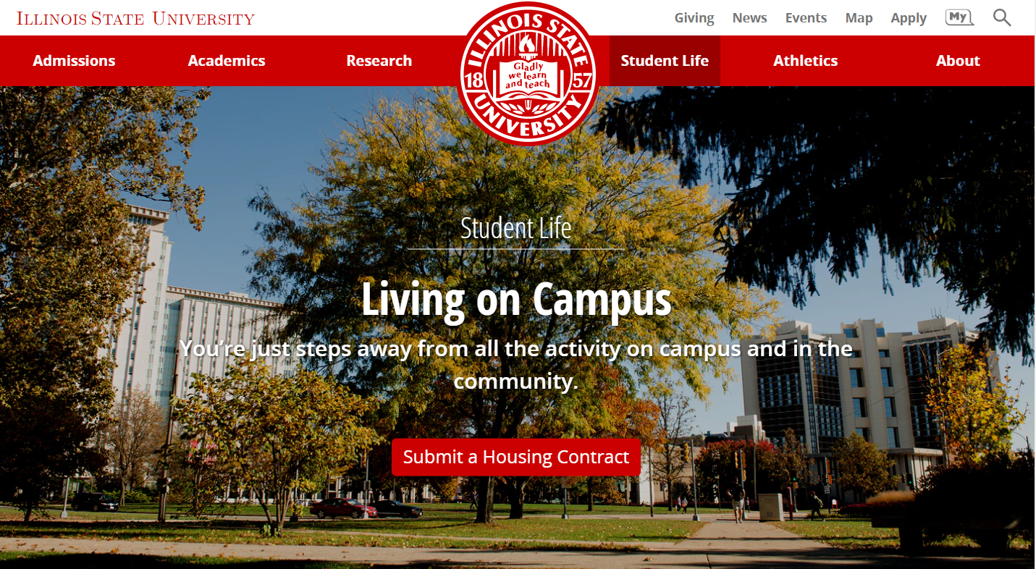

Slide 11
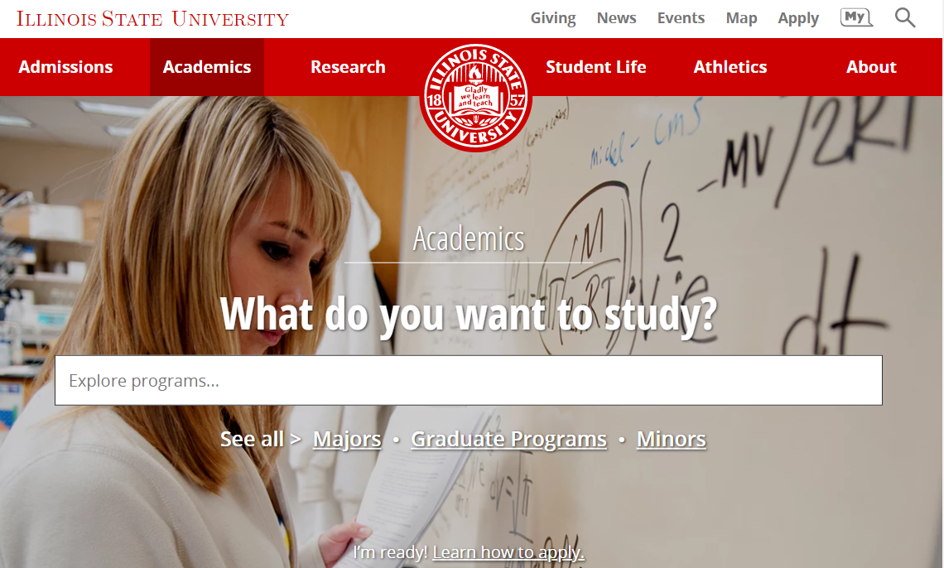

Slide 12
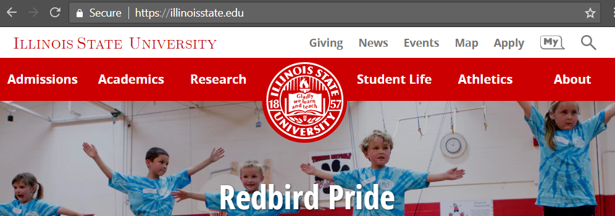
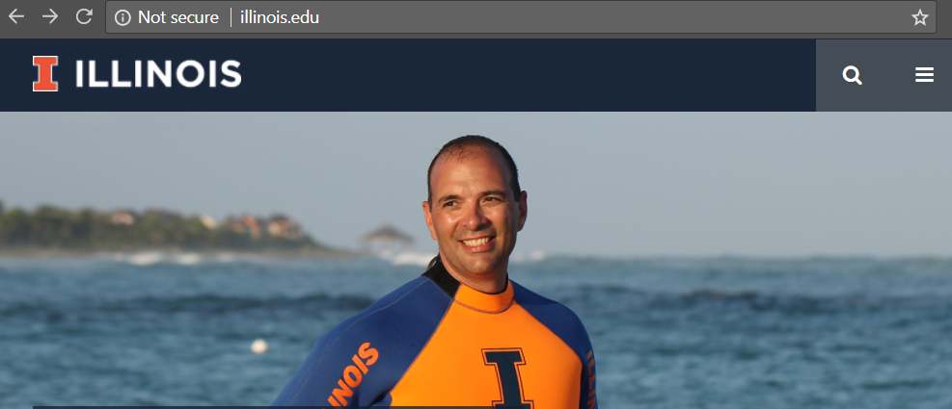
HTTPS? Yes!!!
Thank you AT + WEB
HTTPS? Nope…
¯\_(ツ)_/¯
Notes:
https://support.google.com/chrome/answer/95617?visit_id=0-636589043256055405-4123297306&p=ui_security_indicator&rd=1
The site isn't using a private connection. Someone might be able to see or change the information you send or get through this site.
On some sites, you can visit a more secure version of the page:
Select the address bar.
Delete http://, and enter https:// instead.
If that doesn't work, contact the site owner to ask that they secure the site and your data with HTTPS.

Slide 13
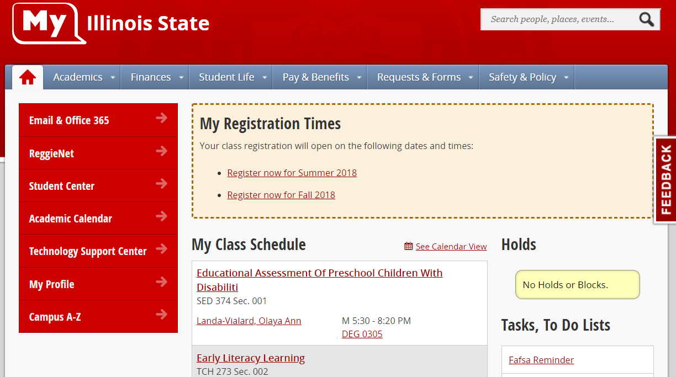

Slide 14
2.0

Slide 15
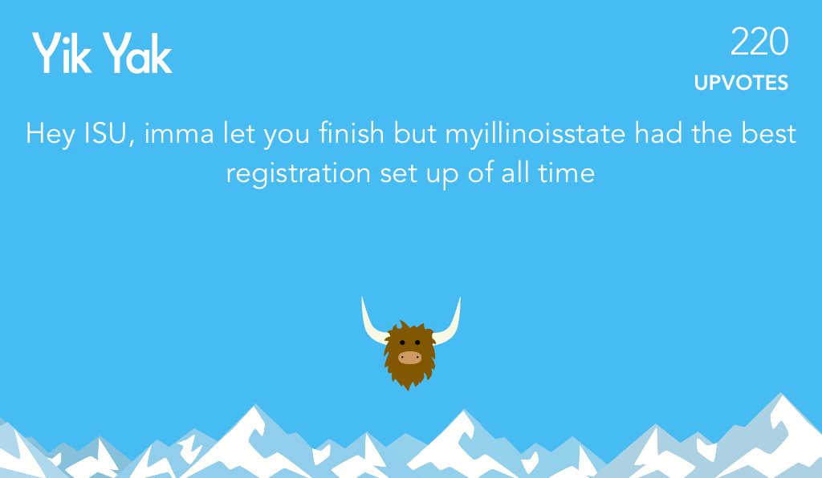
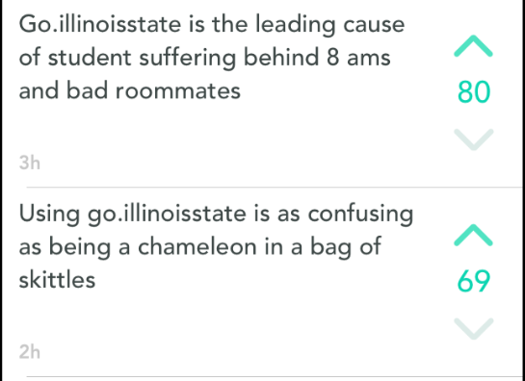
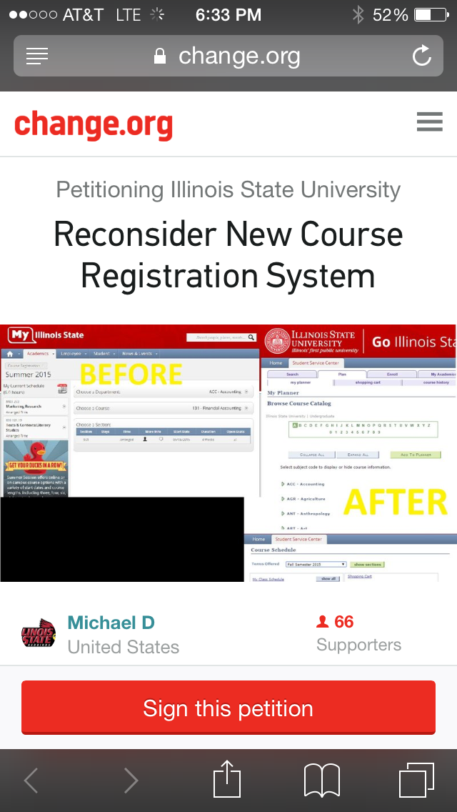
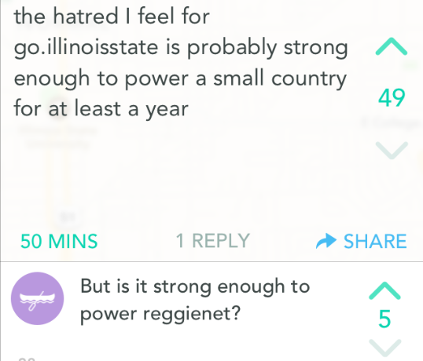
Enterprise Portal – We’ve come a long way!

Slide 16
AT - ION
Craig Jackson
Director
RoF Channels
#ISUCIT

Slide 17
ION – End User Experience
Wireless Enhancements
Quad, Tri-Towers, CFA, Redbird Activity Center
University Operator
(309) 438-2111 or “0”
Classroom Builds
Fell & DeGarmo
Virtual Desktops/Virtual Applications
CAST & COB

Slide 18
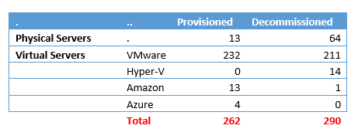
ION – Server & Storage Management
Notes:
THANK YOU!
From March 2017 to March 2018, the campus decommissioned a total of 290 servers and provisioned 262 new servers

Slide 19
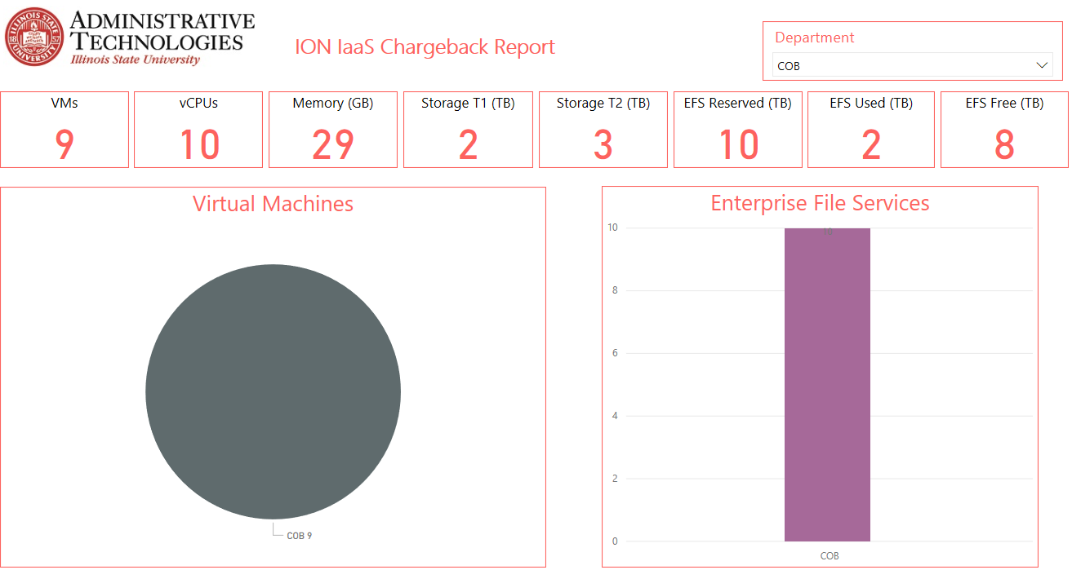
ION – Utilization Showback

Slide 20
ION – Utilization Showback

Slide 21
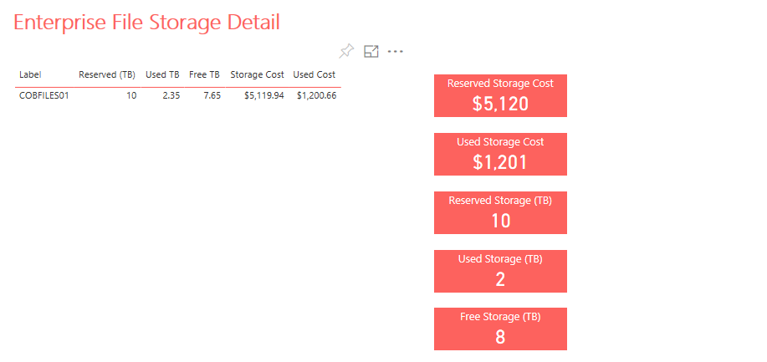
ION – Utilization Showback

Slide 22
ION – O365 Groups/Teams
186 - Team-enabled Groups
230,138 - Chat messages
19,218 - Teams Chat messages
Teams Device Usage
Client: Portal (40%), Windows (34%), Mac (6%)
Mobile: Android (10%), Apple iOS (10%)
Notes:
Total: Number of Groups that are Teams Enabled: 186
SharePoint 2010 Sites to Teams/SharePoint Online: 76
Storage Consumed: 10.5 TB
Number of Files: 3,167,490

Slide 23
CITx Spring 2018
CIT MVP Awards
Full-Time Award - $1,000, August CIT
Student Award - $500, April CITx
Put towards professional development
Link was live at Noon today
Thanks to Charley, Mark, and Rob for the support
RoF Channels
#ISUCIT

Slide 24
CITx Spring 2018
Full Time CIT MVP Award
Anyone can nominate a Tech staff member
3 statements of support
Been FT Tech for 1 year
Proven record of working in a team
Eligible to win once every 4 years
https://cit.illinoisstate.edu/awards/
RoF Channels
#ISUCIT

Slide 25
CITx Spring 2018
Student CIT MVP Award
Anyone can nominate a Student Tech
Been a Student Tech
Eligible to win once every 4 years
https://cit.illinoisstate.edu/awards/
RoF Channels
#ISUCIT

Slide 26
CITx Spring 2018
Redbirds of a Feather Sessions
Standard Operating Environment for Endpoints
Dan Taube in 131
Service/Infrastructure Monitoring
Tim Walsh in 150
Growing your IT Career
Dean Plumadore in 148
Useful Bots for MS Teams
Nathan Stien in 149
RoF Channels
#ISUCIT

Slide 27
Learning Spaces & AV Technology
Doug Smith
Director
RoF Channels
#ISUCIT

Slide 28
LSAVT
STV 101 upgrade to dual laser projectors and dual content display.
similar upgrades planned for Capen and FSA 133 this summer
Designed the AV for CVA 134 collaborative classroom
All classrooms managed by LSAVT will have the same level of digital technology and consistent user interfaces.
Beginning in the fall of 2018 LSAVT will offer Kramer VIA on a per request basis to be installed into classrooms.
RoF Channels
#ISUCIT

Slide 29
LSAVT
RoF Channels
#ISUCIT

Slide 30
Center for Teaching Learning and Technology
Charles Bristow
in for Claire Lamonica
RoF Channels
#ISUCIT

Slide 31
ReggieNet
New landing page
Automatic switch based on alerts about Central Login
Link to page with alternative login
Working on simplified course combination interface

Slide 32
ReggieNet
Planned upgrade to version 12
Tentative date – mid July
New features
Gradebook improvements
Release exceptions in Tests & Quizzes
New responsive design for mobile
Bullhorn notifications
Accessibility improvements

Slide 33
AT – Business Office
Kevin Hand
Director
RoF Channels
#ISUCIT

Slide 34
Gartner will be renewed!
Easy access to Gartner via My.IllinoisState (Research Tab)
If you find an article they consider “super-premium”, get a hold of Kev
Will track usage and access to determine if campus-wide access is still desirable

Slide 35
Student Technology Support
David Greenfield
Director
RoF Channels
#ISUCIT

Slide 36
Software Updates
Adobe
Zoom

Slide 37
Mass Purchase
Dell & Lenovo
Kaby Lake R – price bump
Kaby Lake – do the orders in April
Sky Lake – Dell by Oct
Apple

Slide 45
AT – Information Security Office
Kevin Crouse
Director
RoF Channels
#ISUCIT

Slide 46
Information Security Office
The Audit is Coming, The Audit is Coming!!!
Continued Processor Vulnerabilities
Thanks to everyone for continue to be vigilant in the face of unknown remedy timeframes
More of them to come

Slide 47
CITx Spring 2018
CIT MVP Awards
Full-Time Award - $1,000, August CIT
Student Award - $500, April CITx
Put towards professional development
cit.illinoisstate.edu/awards
RoF Channels
#ISUCIT

Slide 48
AT – Enterprise Data and Analytics
Rachel Hart
Interim Director
RoF Channels
#ISUCIT

Slide 49
Data & Analysis Collaboration
Enterprise Data & Analytics (EDA) is developing several areas of collaboration in order to increase awareness and use of the data warehouse
Academic Departments | Provide data and project ideas to be used for class work corresponding with real EDA analysis projects (with the proper security and resources provided)
Student Affairs IT | Decentralized development of Cognos Analytics
Stevenson Center for Community and Economic Development | Knowledge transfer and consult on analysis projects
Data-loving Faculty Touchpoints | Bi-Monthly information exchanges with faculty to discuss data concerns and trends within Higher Ed.

Slide 50
Academic Technology
Mark Walbert
Associate Vice President
RoF Channels
#ISUCIT

Slide 51
Adobe Creative Cloud campus license!
2018 TechQual+ Survey

Slide 52
AT – Application Services
Todd Smoak
Director
RoF Channels
#ISUCIT

Slide 53
AT Application Services
INTO
SLATE (CRM)
Reggienet Upgrade
Budget Wizard 2.0
Server Monitoring
Regroup, AD/LDAP
1 Card
PROJECTS
PROJECTS
IPEOPLE
OMCS -> ANYONE?

Slide 54
Milner Library
Paul Unsbee
Director - IT
RoF Channels
#ISUCIT

Slide 55
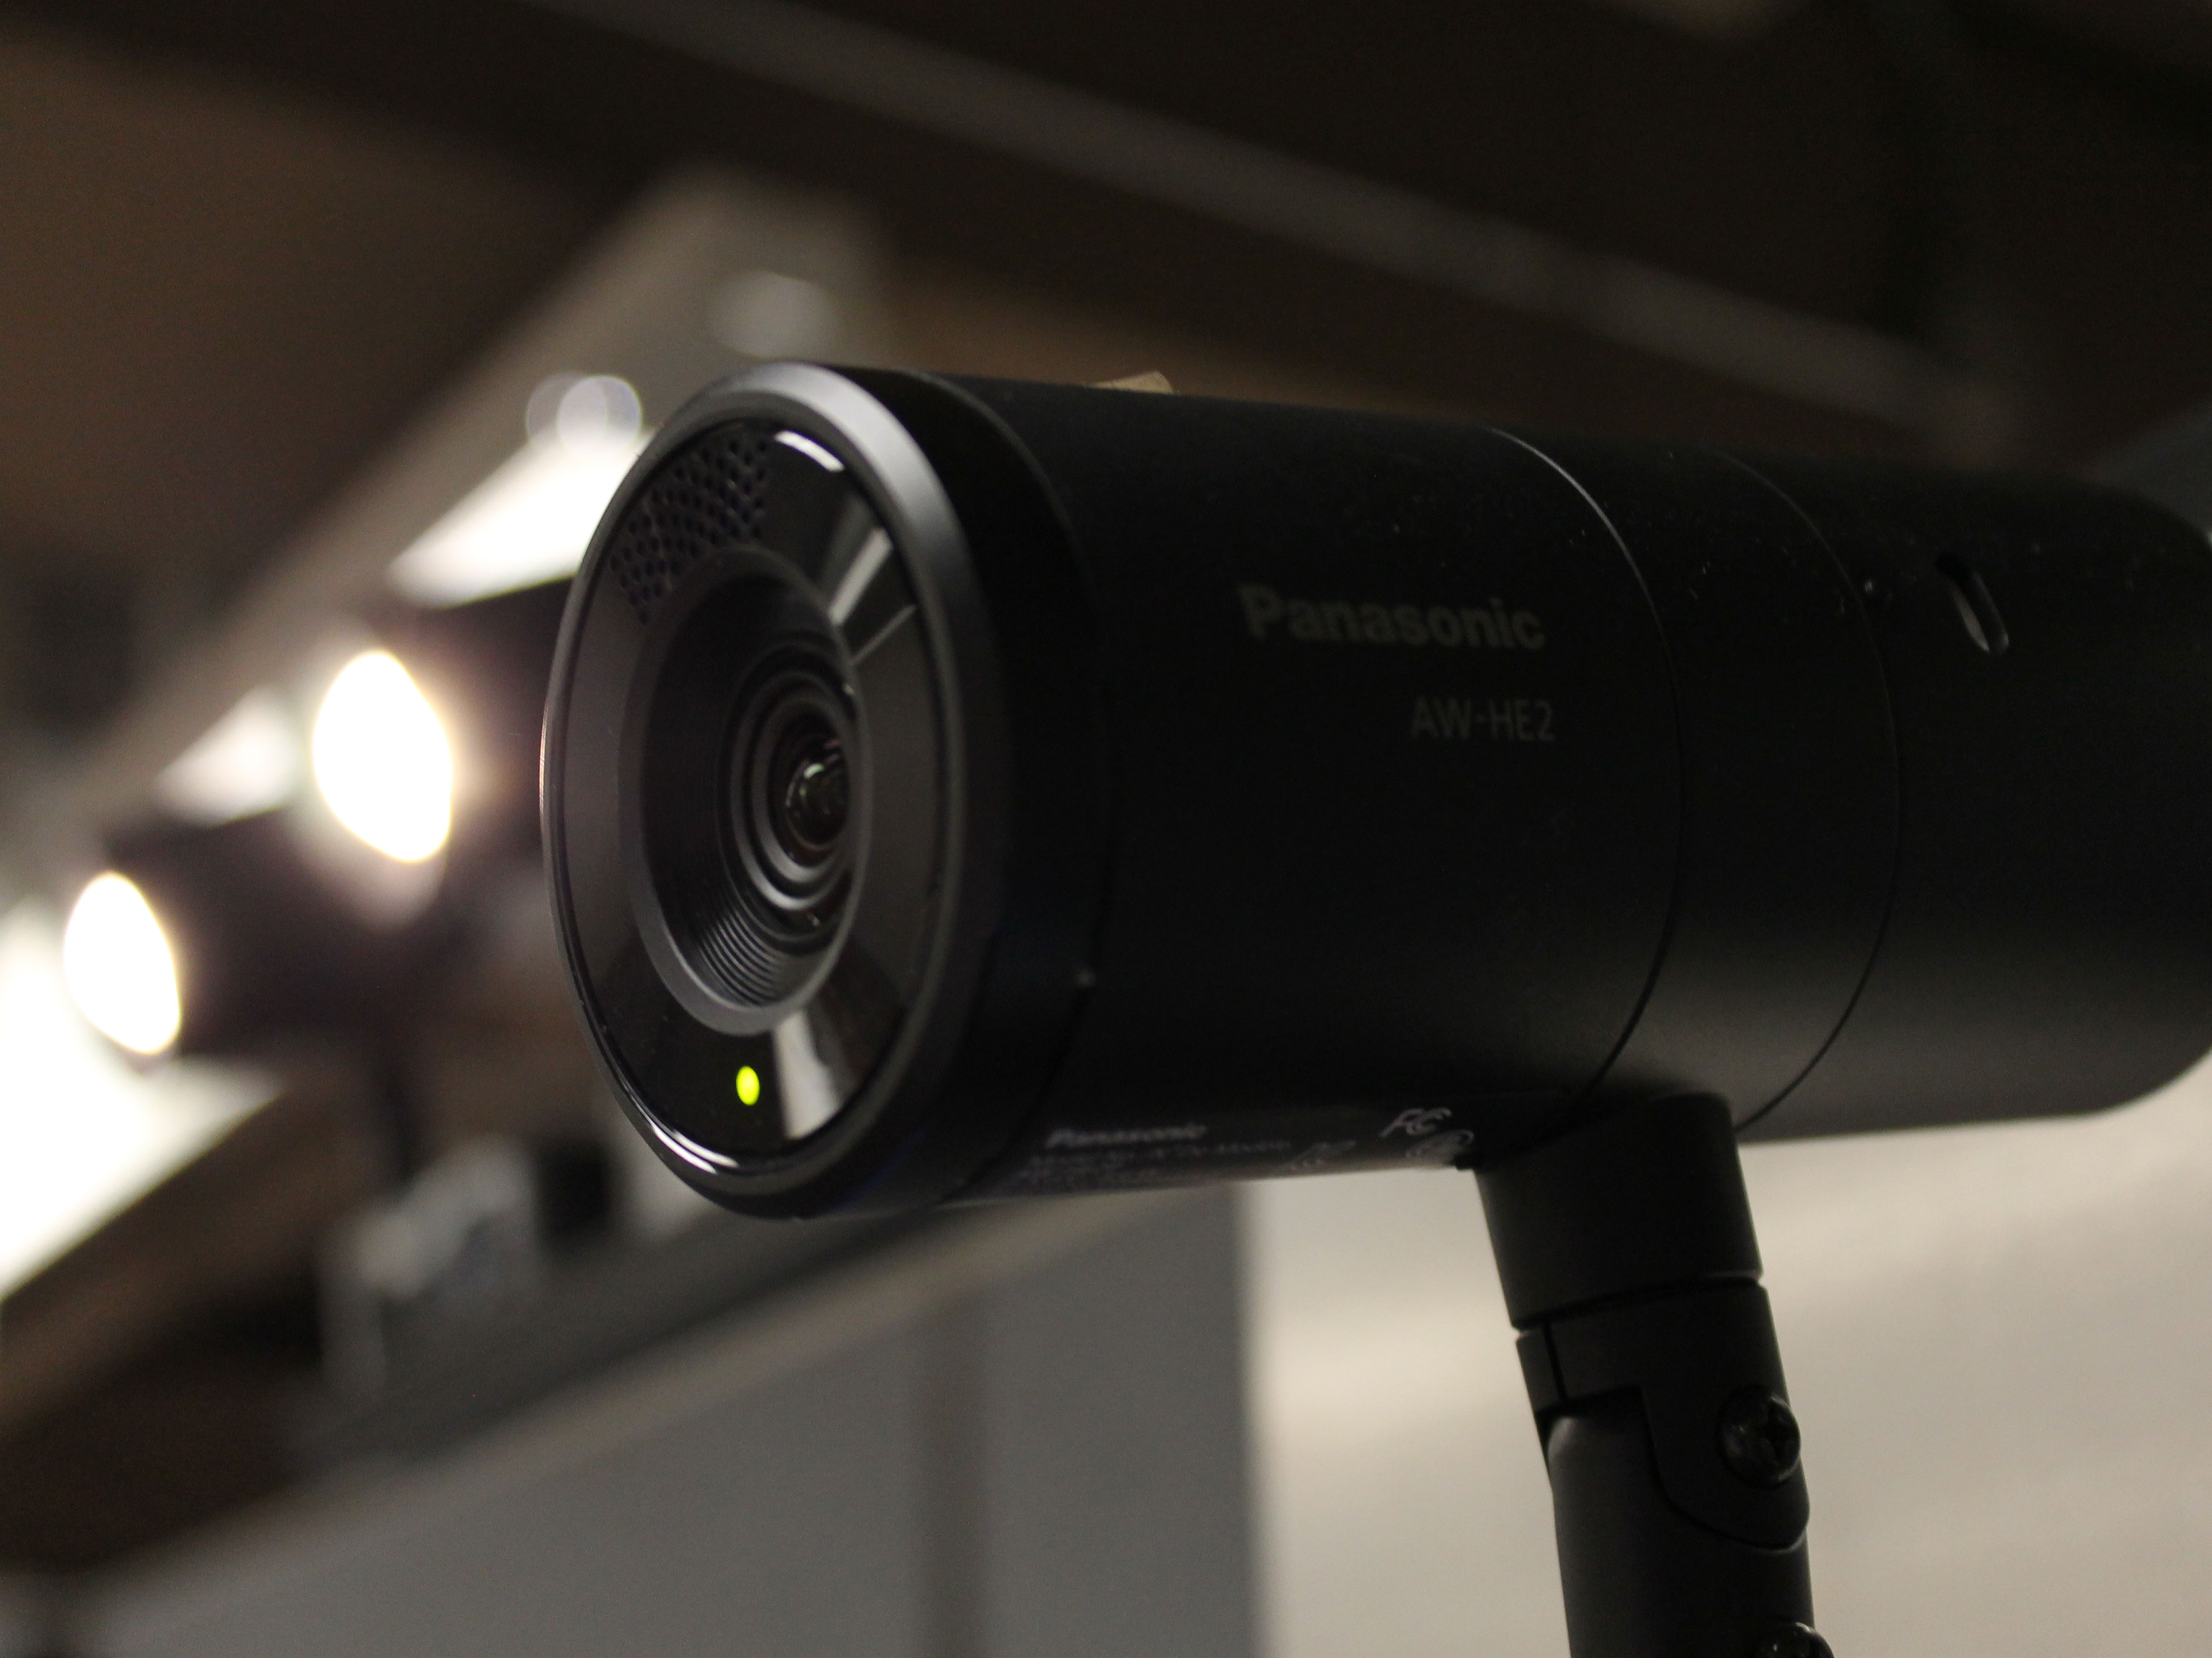
Ready Record Studio

Slide 56
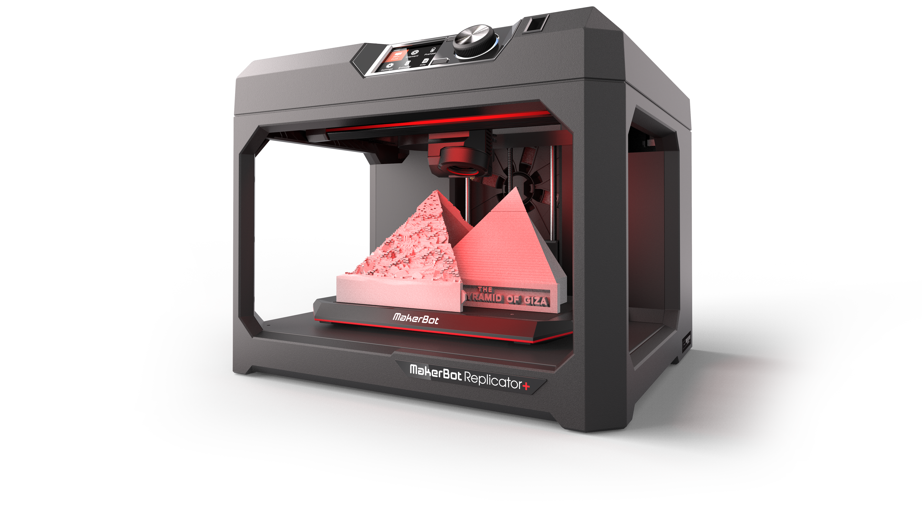
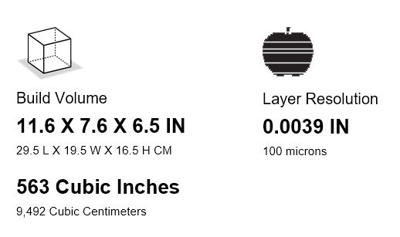
3D Printing - PaaS

Slide 57
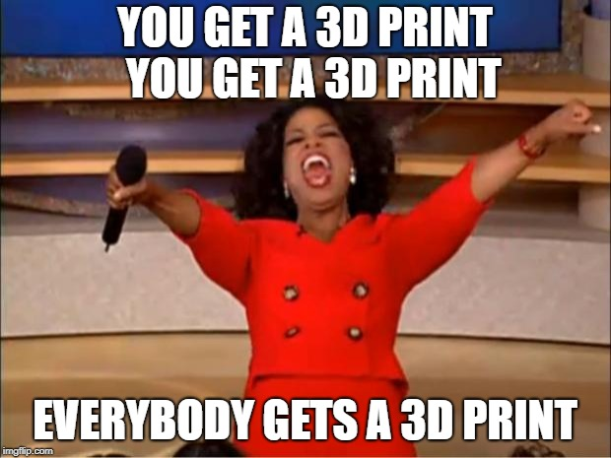
3D PaaS - Summer Pilot

Slide 58
Administrative Technology
Charley Edamala
Associate Vice President
RoF Channels
#ISUCIT

Slide 59
Four Perspectives on Innovation
IT’s Need for Operational Excellence
User Experience in the Post ERP world
Innovation
The personal connection

Slide 60
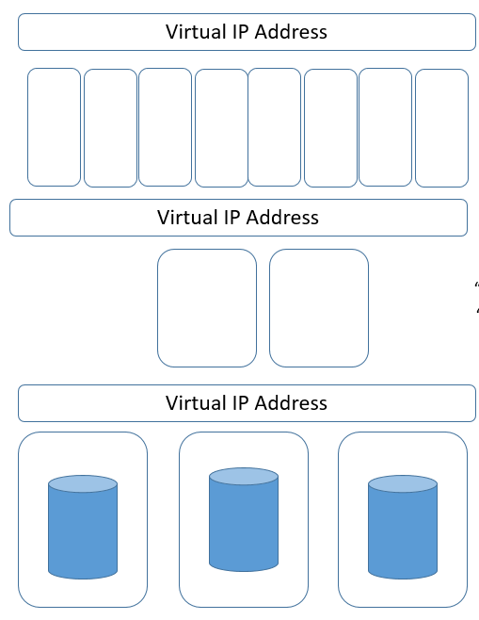
Operational Experience
MY.ilstu.edu
Central Login
ReggieNet
Campus Solutions
Human Resources
365
Azure
AWS
OMCS
Responsible for uptime
Establish processes
Governance, etc
Public Cloud
Private Cloud
Many vendor contracts.
Not sure which cloud.
Complex network.
Less control and flexibility

Slide 61
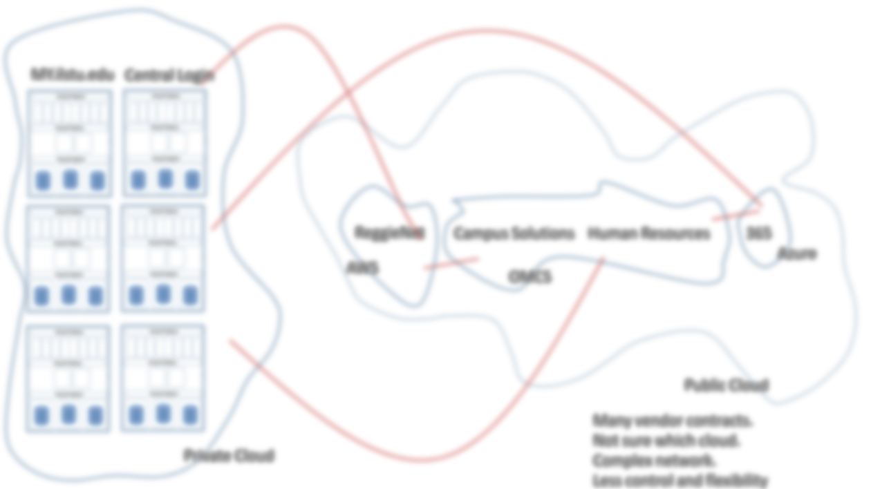
User Experience
Presentation Layer
USER EXPERIENCE:
I just want it to be easy. Modern. Fun.
Business Rules
Business Rules
Digital Asset

Slide 62
Innovation
“We need to do this”
“We need to aim for this possibility”
Operations
Predictable Innovation
Disruptive Innovation
Includes Process Definitions. Project Methodologies, ITIL, etc.
Excellence
Incremental
Innovation

Slide 63
Innovation Planning
and Operational Excellence
Capacity
2018
2019
2020
Financial Systems
Faculty/Research
Experience
Student
Enrollment
Operations

Slide 64
Innovation and Self Actualization
Self Actualization:
with focus on mission,
creatively achieving great goals
Disruptive
Innovation
Esteem needs:
trusted and credible
Continuous Value Driven
End User Relationship
Predictable
Innovation
Safety Needs:
protected by easy to understand processes, no gotcha game or confusion,
Process definition, Operational Excellence
Incremental
Innovation
Physiological Needs: empowered team member with a career path
Skilled, empowered
Employees
Chaos

Slide 65
CITx Spring 2018
CIT Awards – presented in August
Full-Time Award - $1,000, Student Award - $500
put towards professional development
link was live at Noon today
Thanks to Charley, Mark, and Rob for the support
RoF Channels
#ISUCIT

Slide 66
CITx Spring 2018
Redbirds of a Feather Sessions
Standard Operating Environment for Endpoints
Dan Taube in 131
Service/Infrastructure Monitoring
Time Walsh in 150
Growing your IT Career
Dean Plumadore in 148
Useful Bots for MS Teams
Nathan Stien in 149
RoF Channels
#ISUCIT

Slide 67
CITx Spring 2018
Thank you to the
CIT Planning Group
Carla, Paul, Jeff, Liam, Tyler, Bill, and I
RoF Channels
#ISUCIT

Slide 68
CITx Spring 2018
Thank you for coming
Would you like to join the CIT Planning Group?
Go have a cookie…….
Email: isucit@illinoisstate.edu
RoF Channels
#ISUCIT

Slide 69
Email: isucit@illinoisstate.edu
RoF Channels
#ISUCIT

