Slide 2
CITx 2017 IT News

Slide 3
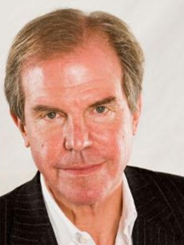
1995:
“A company's move into the digital future would be at a speed proportionate to the conversion of its atoms to bits - videocassette rental are an example, since these atoms could become bits very easily.”
“Wayne Huizenga, Blockbuster's former chairman, was the lunch speaker. He defended his stock by saying, "Professor Negroponte is wrong.“”
Nicholas Negroponte
Negroponte Blockbuster Bits Atoms

Slide 4
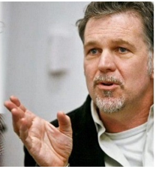
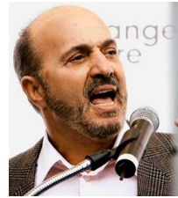
“In 2000, Reed Hastings, the founder of a fledgling company called Netflix, flew to Dallas to propose a partnership to Blockbuster CEO John Antioco and his team. The idea was that Netflix would run Blockbuster’s brand online and Antioco’s firm would promote Netflix in its stores. Hastings got laughed out of the room.”
Forbes.com Hastings Antioco
Reed Hastings (Netflix)
John Antioco (Blockbuster)

Slide 5
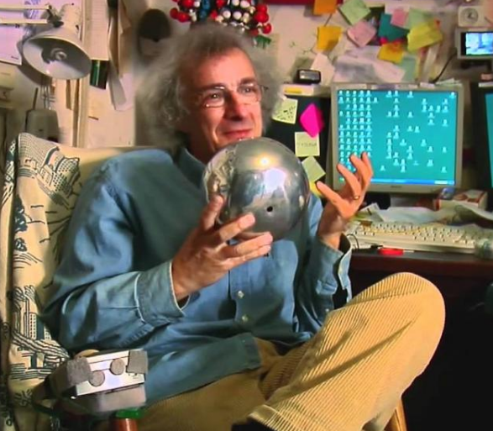
Do our computer pundits lack all common sense? The truth is no online database will replace your daily newspaper, no CD-ROM can take the place of a competent teacher and no computer network will change the way government works.
How about electronic publishing? Try reading a book on disc. At best, it's an unpleasant chore: the myopic glow of a clunky computer replaces the friendly pages of a book. And you can't tote that laptop to the beach. Yet Nicholas Negroponte, director of the MIT Media Lab, predicts that we'll soon buy books and newspapers straight over the Internet. Uh, sure.
Then there's cyberbusiness. We're promised instant catalog shopping—just point and click for great deals. We'll order airline tickets over the network, make restaurant reservations and negotiate sales contracts. Stores will become obsolete. So how come my local mall does more business in an afternoon than the entire Internet handles in a month? Even if there were a trustworthy way to send money over the Internet—which there isn't—the network is missing a most essential ingredient of capitalism: salespeople.
Clifford Stoll
Clifford Stoll Newsweek 1995

Slide 6
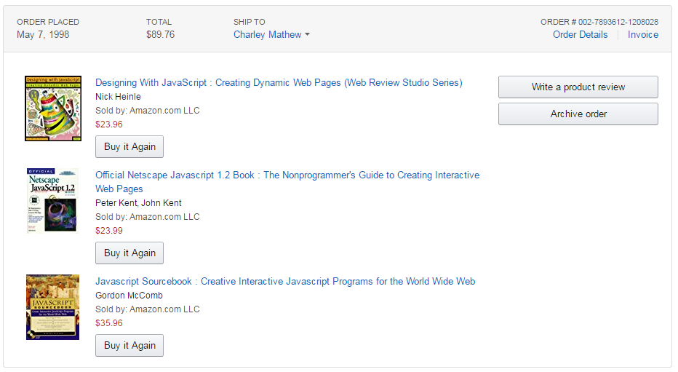

Slide 7
Predicting the Higher Ed Future
Will there still be brick and mortar places?
What will learning look like?
What about MOOCs?
Blockchain for credentials?

Slide 8
User Experience and Internet
What do Facebook, Amazon, Netflix, YouTube, Google, Uber have in common?

Slide 9
User Experience and Internet
What do Facebook, Amazon, Netflix, YouTube, Google, Uber have in common?
Excellent processes that meet “the need”
Great Digital Experience
Fun, easy, effective interfaces
Intuitive
Open data
Understand the Internet way: authentic, sharing, community

Slide 10
The Future of the ILSTU Portal
Native Internet Application, not just a rework of different business functions
Digital Experience needs to be effective
Meets “the need”
Fun and intuitive
Data mash ups

Slide 11
The Future of the ILSTU Portal
My.ilstu.edu (or My.illinoisstate.edu) will be the central enterprise portal
Platform:
Current application
Leverages data feeds from CS, iPeople, etc
Leverages central authentication
Requires tight cooperation between several IT areas

Slide 12
Progress on My.ilstu
Governance structure
Steering Committee
Working Group
Faculty, Advisor, Student Focus Groups
Projects completed:
Class rosters for faculty – January 12
Class schedules for students – January 12
Webgate – January 29

Slide 13
Future My.ilstu
Create GPA Calculator – March 15
Display Student Grades in My – April 12
Display Student Checklists in My – May 10
Provide Class Rosters in My Improvements
Add majors to Rosters – May 17
Past/future semesters – May 24
ICS – May 31
Make Campus Email Preferred Email Once Created – May 24
Remove Tools Webpage
Sync Appropriate Person Data to AD and LDAP – TBD

Slide 14
The Future
Change is constant!
Collaborate across IT lines to
Enhance Digital Experience, based on user feedback and analysis
Making it fun and intuitive
Adhering to the Internet Way

Slide 15
#ISUCIT
In use for over 10 years at ISU
Regularly does not meet research needs
Not responsive
FormStack has already replaced some of this functionality

Slide 16
#ISUCIT
Chosen as the replacement by a committee of Faculty and Staff
Cloud hosted
All ULIDs will have access
Survey design support provided by Qualtrics
Available this summer ‘17

Slide 17
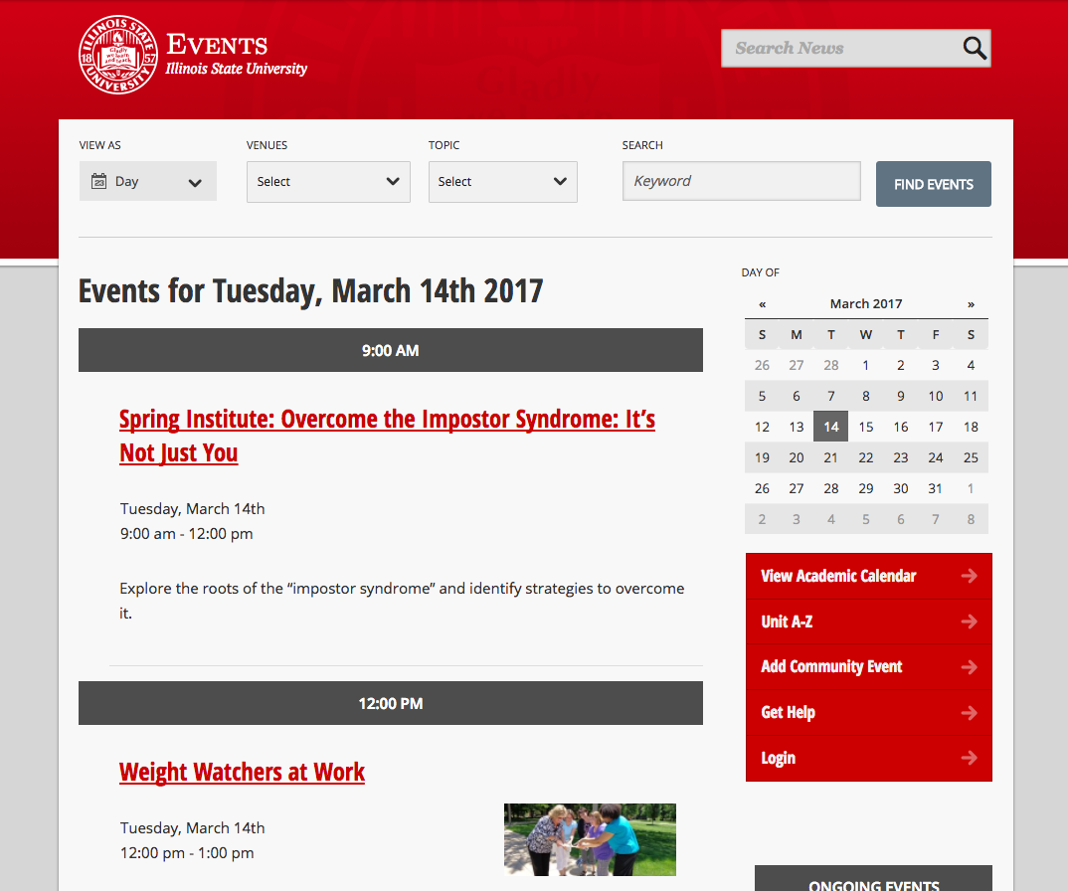
#ISUCIT
University Events Calendar

Slide 18
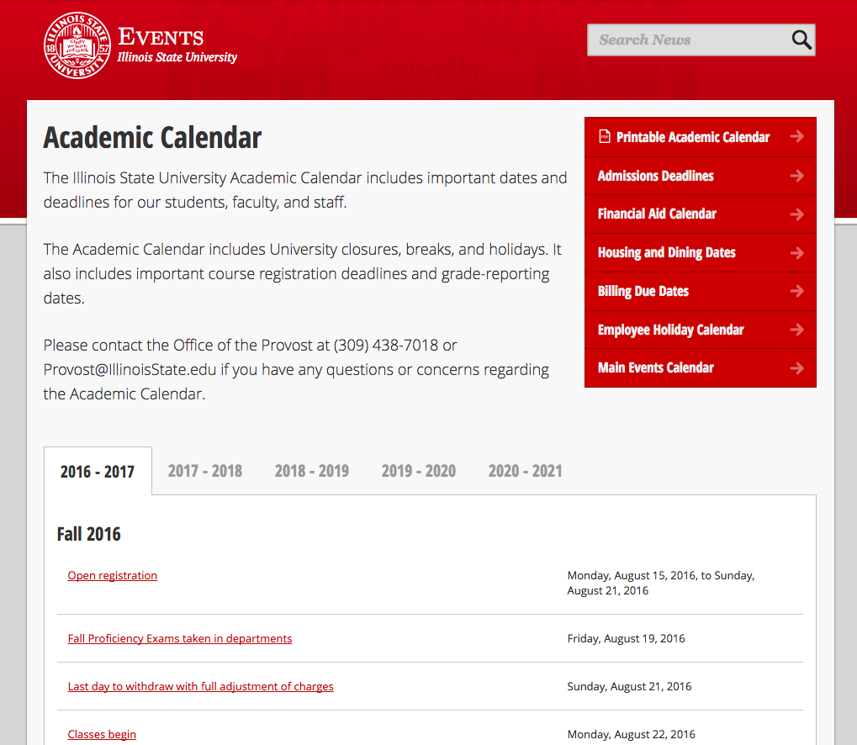
#ISUCIT
University Events Calendar

Slide 19
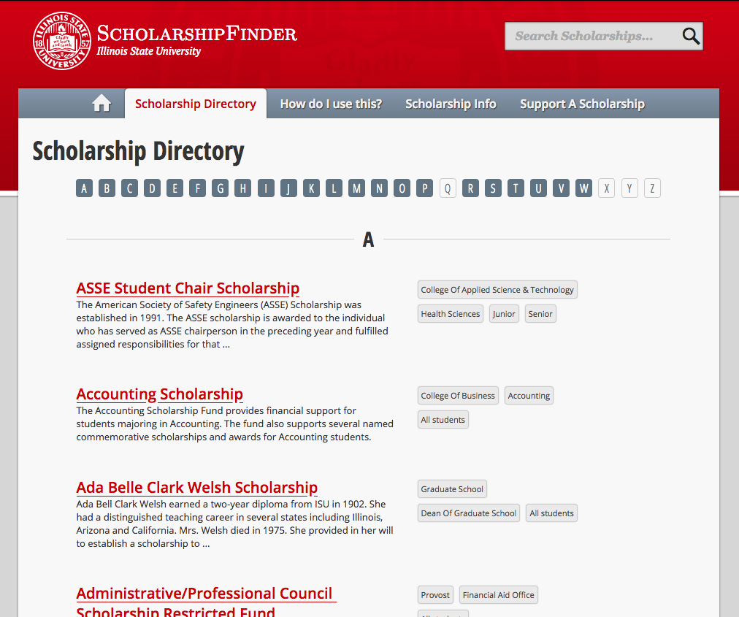
#ISUCIT
ScholarshipFinder

Slide 20
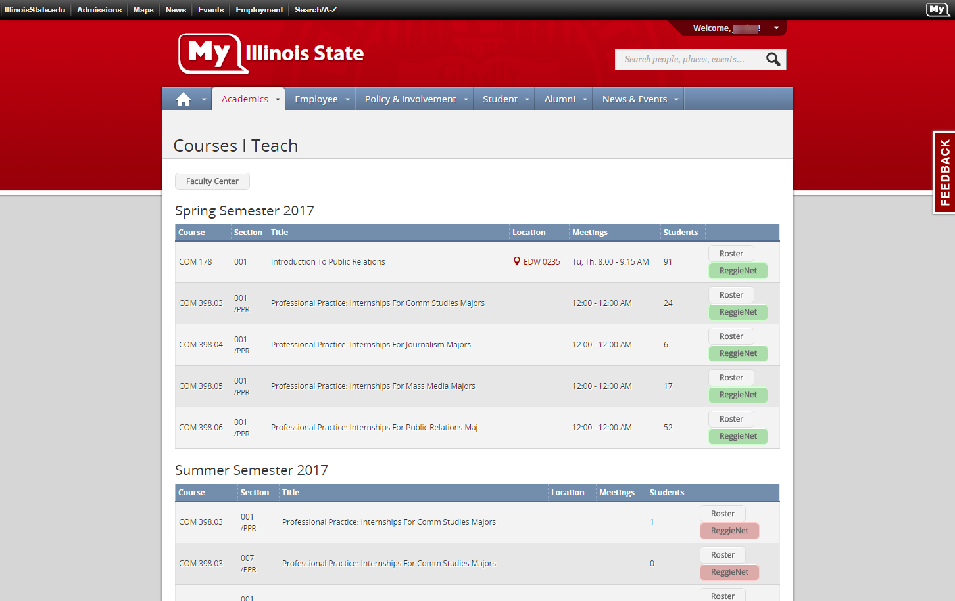
#ISUCIT
My.IllinoisState.edu

Slide 21
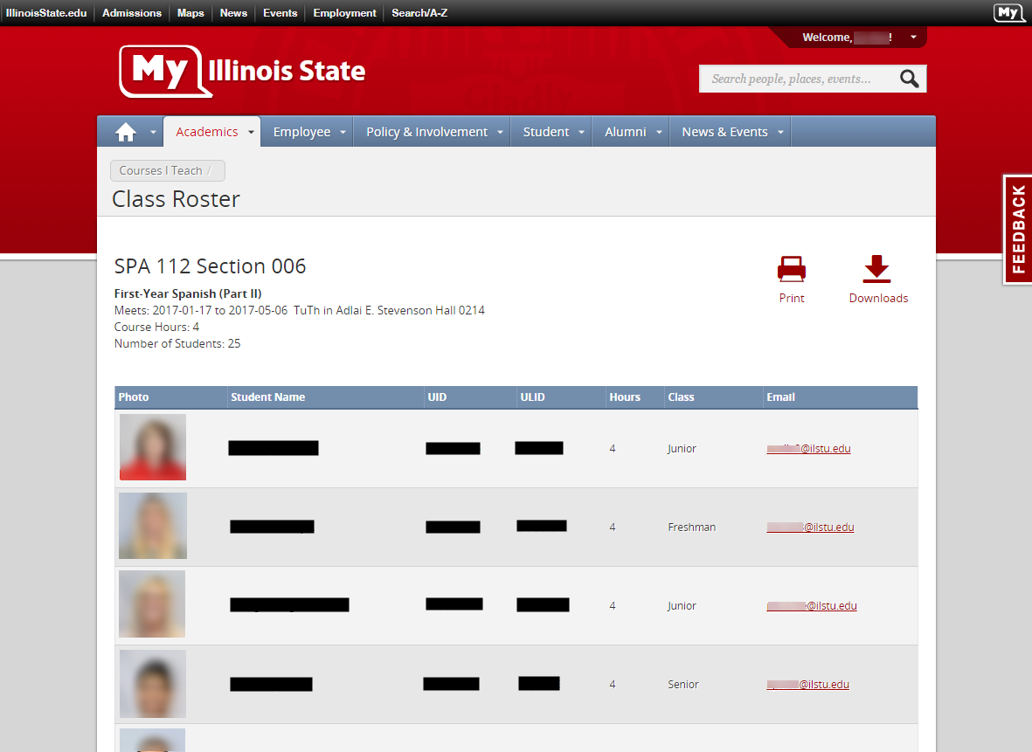
#ISUCIT
My.IllinoisState.edu

Slide 22
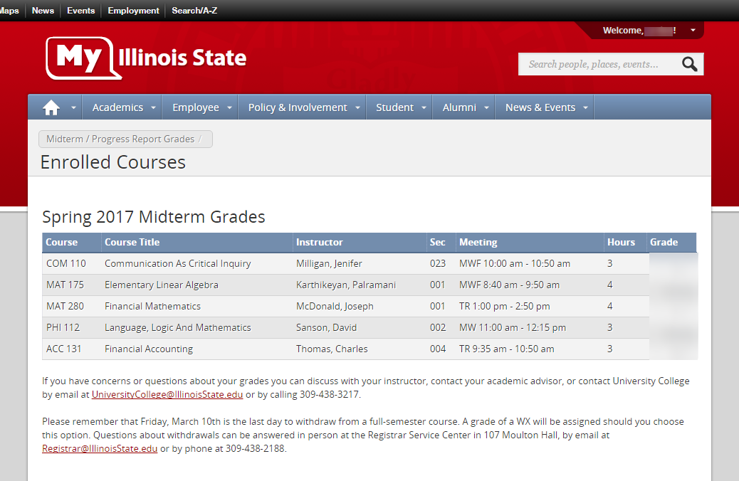
#ISUCIT
My.IllinoisState.edu

Slide 23
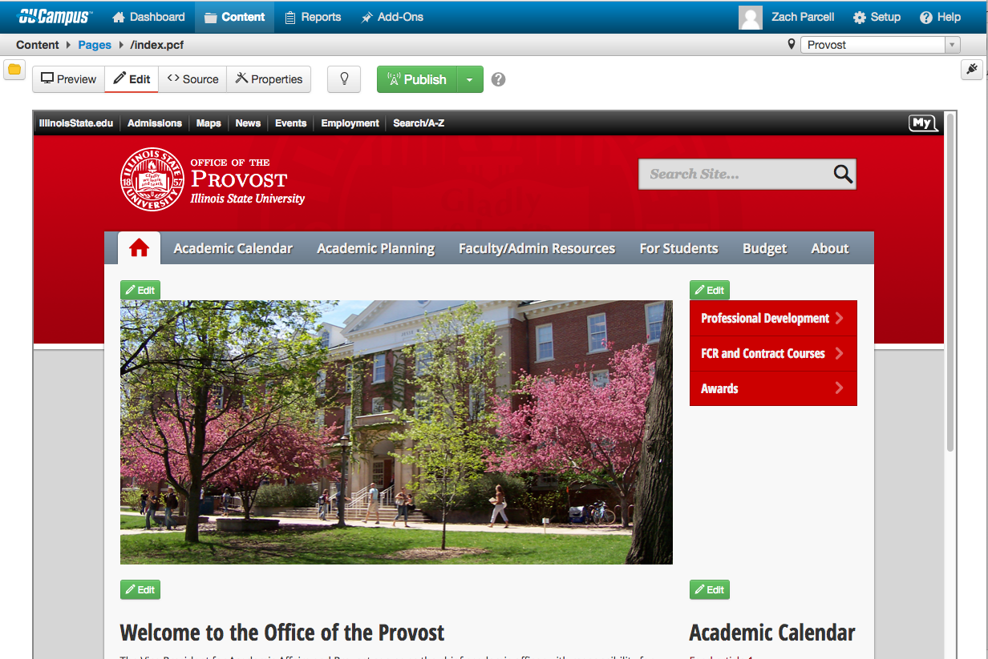
#ISUCIT
OUv9 to OUv10 Conversion

Slide 24
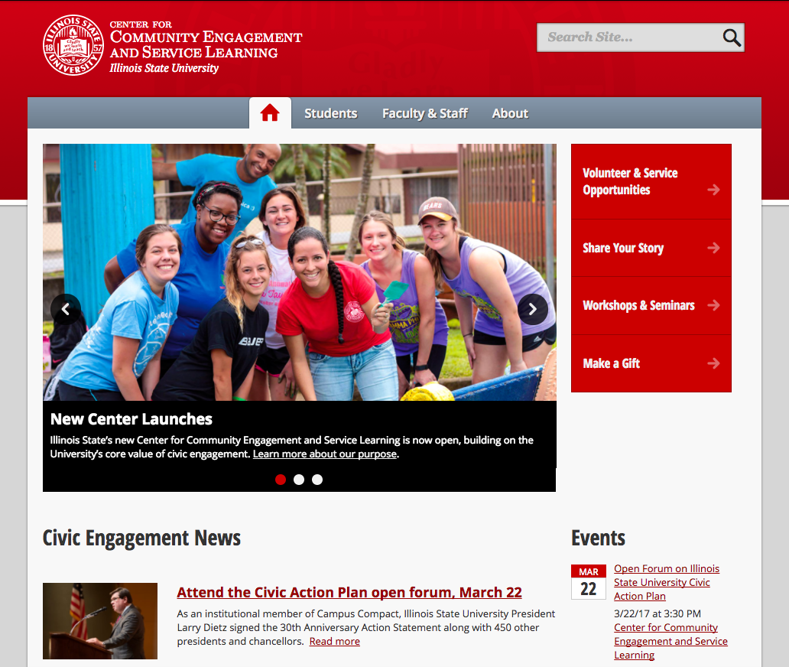
#ISUCIT
Center for Community Engagement and Service Learning

Slide 25
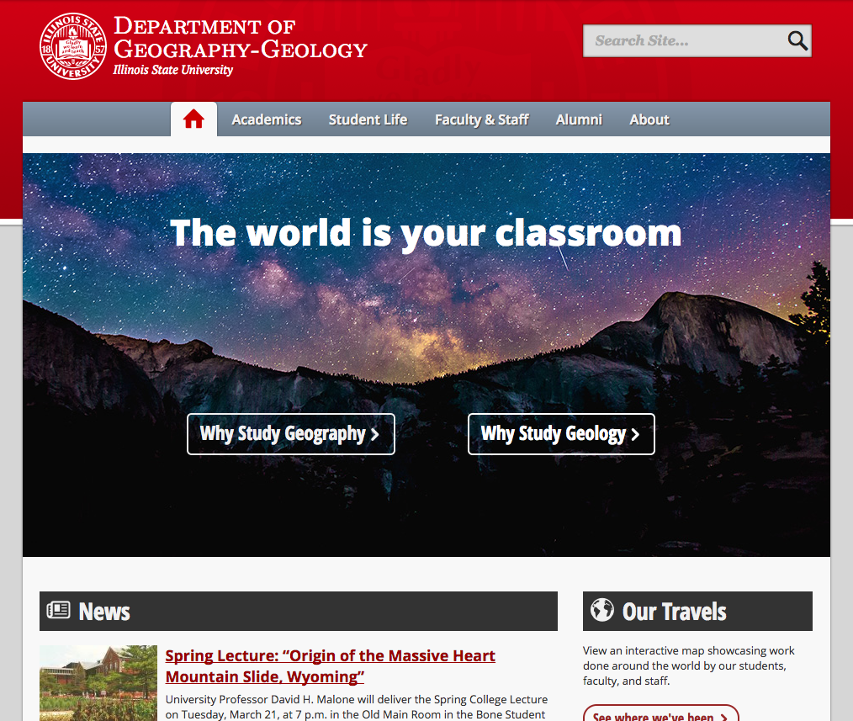
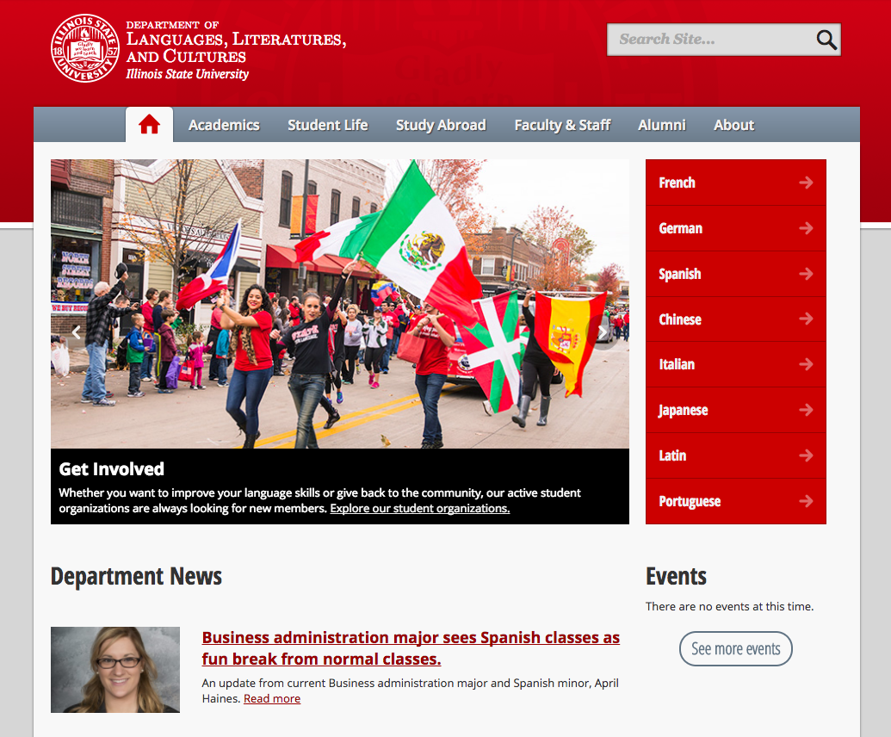
#ISUCIT
Academic Sites

Slide 26
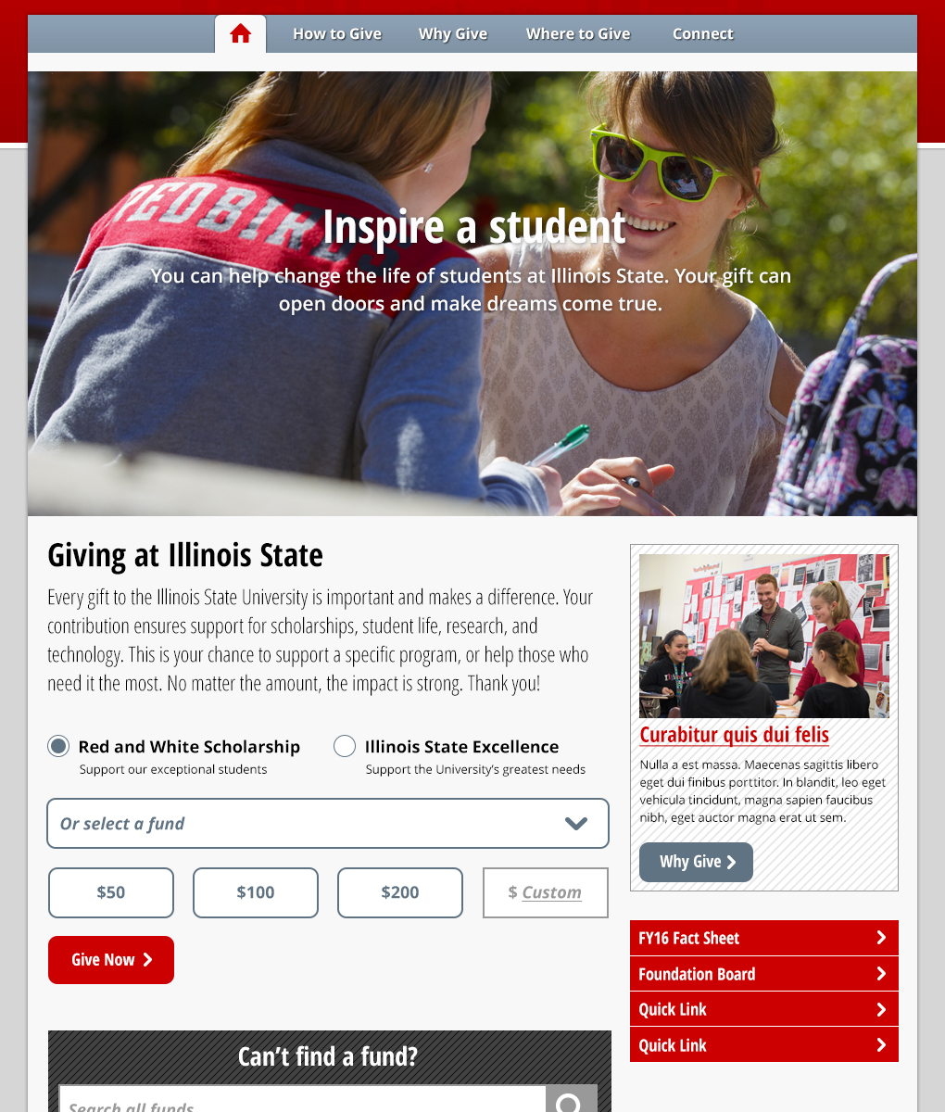
#ISUCIT
University Advancement

Slide 27
#ISUCIT
IllinoisState.edu

Slide 28
ITSM Metrics
#ISUCIT
84,897 incidents/service requests closed
35% incidents, 65% service requests
2,302 Knowledge Articles (786 published)
1,515 changes recorded
14,403 tasks completed
Notes:
Last year at this time… 13,537 incidents/service requests
1,620 KBs – 30% increase

Slide 29
ITSM Project Update
#ISUCIT
All new functionality in production by 6/30/17
Currently in configuration & testing:
Reservation Manager (equipment checkout)
Vendor and Contract forms
Mobile access for IT staff
Project Management
Release Management
Notes:
Last year at this time… 13,537 incidents/service requests
1,620 KBs – 30% increase

Slide 30
ITSM Project Update
#ISUCIT
Currently in the requirements phase:
Problem Management
Service Level/Catalog Management
CMDB
Infrastructure CI types available for population
Automation of Endpoint CIs from SCCM in progress
Future (later in 2017)
Upgrade to Cherwell 9.x and self-service portal redesign
Notes:
Last year at this time… 13,537 incidents/service requests
1,620 KBs – 30% increase

Slide 31
Operational Excellence
#ISUCIT
Continuous Improvement project in AT
Major focus on existing services after period of rapid change
Establish core set of attributes every service needs, fill in gaps and document everything

Slide 32
New IT Staff Communication List
#ISUCIT
Utilizing Office 365 Groups
Initially a distribution list, more collaboration options in future
Replaces ITANNOUNCE-L
Automatic subscription of IT staff

Slide 33
AirWatch Update
#ISUCIT

Slide 34
9 to 7 Dial Plan Change
#ISUCIT
All phones change over on March 22nd
Be mindful of analog lines that have preprogrammed speed dials (i.e. Fax Machines)
911 dialing remains the same

Slide 35
ReggieNet Upgrade
#ISUCIT
Upgraded to Sakai 11. 3
New interface
Responsive Design

Slide 36
New features
#ISUCIT
Enhancements to the Lessons tool (multiple columns, section breaks)
A new checklist feature in the Lessons tool
Individual student activity reports in the Tests & Quizzes tool
A new trash feature in the Resources tool now prevents accidental deletion
A new Gradebook

Slide 37
TechZone updates
#ISUCIT
Campus Mass Purchase update
Win10 purchasing implications
TechZone News

Slide 38
Account Refresh
Full Account Refresh
More than just changing a user’s password
Policy Compliance
Passwords (Policy 9.2.2)
Electronic Signature (Policy 9.8.8)
Timeline
March 20 – April 28

Slide 39
Media Streaming
Office 365 Video Tile
35 Channels
Working Group for Video Distribution
Eric Yeager
On-Demand Video
Streaming
Notes:
Thanks to all for setting up the video service
APPS, CTLT, IA
Working to have course-related materials off by ________________
Publicly available content
TV-10
Milner Library
Currently investigating other options and hope to have recommendations by May 1.

Slide 40
O365 Email & Portal Apps
THANK YOU
Email migration nearly complete
Governance Group
Support levels, sequence of new apps
Great functionality coming very soon
Roundtable after this session

Slide 41
O365 Email & Portal Apps Metrics
Email
19.8 TB of Email
12.3 million emails sent/received last 30 days
OneDrive
3.7 TB of Storage
1.4 million files
Clients Used past 30 days
3,022 Outlook on Windows
1,008 Outlook on Mac
21,593 Outlook on Web
11,296 Outlook Mobile
515 Mac/IOS Mail App
5,147 Other Mobile

Slide 42
Round Table Sessions, 10:30-11:30
#ISUCIT
Drive Encryption of university devices as a standard
(Jason Ross & Dan Taube - SFHB 131)
ReggieNet upgrade/Integration with Office 365
(Charles Bristow - SFHB 148)
Office 365 Innovations and Controls
(Craig Jackson, Dave Greenfield, & Mike Regilio - SFHB 149)
Campus Communications, Mediums and Platforms
(Ryan Christie & Ed Vize - SFHB 150)

